Slide 1
Tesseract OCR with Python

Slide 2
Python-tesseract is an optical character recognition (OCR) tool for python. That is, it will recognize and “read” the text embedded in images. Additionally, if used as a script, Python-tesseract will print the recognized text instead of writing it to a file.

Slide 3
Installing the Tesseract + Python “bindings”
// if you have virtual enviroment
$ pip install pillow
$ pip install pytesseract or
//on termianl $ sudo apt install tesseract-ocr

Slide 4
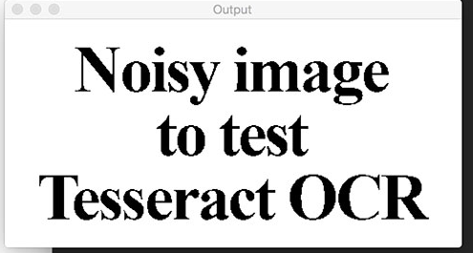
Noisy imageto testTesseract OCR
pic.png
Run - tesseract pic.png stdout output - Noisy image to test Tesseract OCR

Slide 5
from PIL import Image
import pytesseract
import argparse
import cv2
import os
ap = argparse.ArgumentParser()
ap.add_argument("-i", "--image", required=True,
help="path to input image to be OCR'd")
ap.add_argument("-p", "--preprocess", type=str, default="thresh",
help="type of preprocessing to be done")
args = vars(ap.parse_args())
image = cv2.imread(args["image"])
gray = cv2.cvtColor(image, cv2.COLOR_BGR2GRAY)
if args["preprocess"] == "thresh":
gray = cv2.threshold(gray, 0, 255,
cv2.THRESH_BINARY | cv2.THRESH_OTSU)[1]
#Python code

Slide 6
elif args["preprocess"] == "blur":
gray = cv2.medianBlur(gray, 3)
filename = "{}.png".format(os.getpid())
cv2.imwrite(filename, gray)
text = pytesseract.image_to_string(Image.open(filename))
os.remove(filename)
print(text)
cv2.imshow("Image", image)
cv2.imshow("Output", gray)
cv2.waitKey(0)

Slide 7
Run using python code $ python ocr.py --image pic.png
Noisy image to test Tesseract OCR

Slide 8
Point to remember
1. Tesseract take image as a input for processing if we want to extract the text (like time, subtitle etc...) data of any video stream/file we have to provide video frame to the tesseract.
2. In case of gstreamer we have to provide video frame to Tesseract.

Slide 9
Thank you

