Slide 1
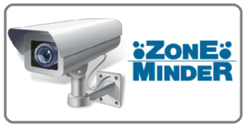
ZoneMinder
Video management System

Slide 2
Introduction
Zone Minder is a free, open-source software application for monitoring via closed-circuit television - developed to run under Linux and FreeBSD and released under the terms of the GNU General Public License (GPL).
A full-featured, open source, state-of-the-art video surveillance software system.
Monitor your home, office, or wherever you want. Using off the shelf hardware with any camera, you can design a system as large or as small as you need.

Slide 3




Supported OS
Ubuntu
Debian.
Fedora
Gentoo
RHEL, Red hat, CentOS

Slide 4
Offline/Online camera → No of camera support → Trail version- Open source →
ZoneMinder provides offline camera (video from disk space) & online camera as well.
ZoneMinder will support as many cameras as you have the hardware available for.
It is a full-featured, open source, state-of-the-art video surveillance software system.

Slide 5
Feature List
Monitor from anywhere:
Access ZoneMinder from any internet-accessible device. With a full featured web based interface, as well as Android and iOS apps, you can access ZoneMinder anywhere.
Use any camera:
Don't get locked into purchasing expensive, proprietary cameras. ZoneMinder allows you to use any analog or IP-enabled camera.
You are in control of your data:
In the age of the Cloud and the Internet of Things, few solutions allow you to both own your data, and control where it goes. Fully on premises, with upcoming optional secure, cloud-enhanced features.

Slide 6
Feature List
Run a really small, or super big, system:
Suitable for home use and small business use, as well as multi-server enterprise deployments. Compatible with everything from the Raspberry Pi, all the way to the latest server-class hardware. Leverage your GPU for optimized image processing
Advanced AI powered detection
Leverage 3rd party contributions like the EventServer and zmMagik to get real time Object, Person detection and Blended event summaries.
Actively maintained, built by those who care:
ZoneMinder is actively maintained by a team committed to open source. We have a vibrant community of contributors and participants.

Slide 7
Runs on CentOS 5 Linux distribution.
Supports video, USB and network cameras.
Support Pan/Tilt/Zoom cameras, extensible to add new control protocols.
Built on standard tools, C++, Perl and PHP.
Uses high performance MySQL database.
High performance independent video capture and analysis daemons allowing high failure redundancy.
Multiple Zones (Regions of Interest) can be defined per camera. Each can have a different sensitivity or be ignored altogether.
Feature List

Slide 8
Feature List
Large number of configuration options allowing maximum performance on any hardware.
User friendly web interface allowing full control of system or cameras as well as live views and event replays.
Supports live video in mpeg video, multi-part jpeg and stills formats.
Supports event replay in mpeg video, multi-part jpeg, stills formats, along with statistics detail.
User defined filters allowing selection of any number of events by combination of characteristics in any order.
Event notification by email or SMS including attached still images or video of specific events by filter.

Slide 9
Feature List
Automatic uploading of matching events to external FTP storage for archiving and data security.
Includes bi-directional X.10 (home automation protocol) integration allowing X.10 signals to control when video is captured and for motion detection to trigger X.10 devices.
Highly partitioned design allows other hardware interfacing protocols to be added easily for support of alarm panels etc.
Multiple users and user access levels.
Multi-language support with many languages already included.
Full control script support allowing most tasks to be automated or added to other applications.

Slide 10
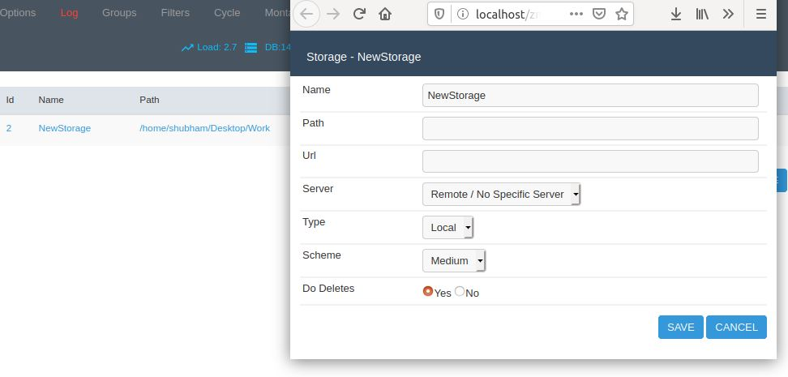
Storage
1. Go to ZoneMinder Console
2. Click on Add button
3. Navigate storage tab
4. Fill required details.
In ZoneMinder we have explicitly manage the storage that where we would like to store the streamed data.
Storage folder name
Storage location

Slide 11
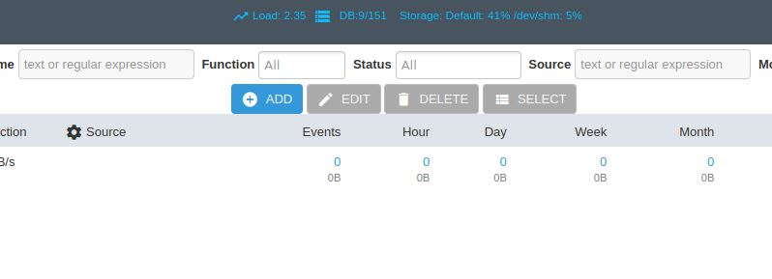
Add offline video
Click on Add button

Slide 12
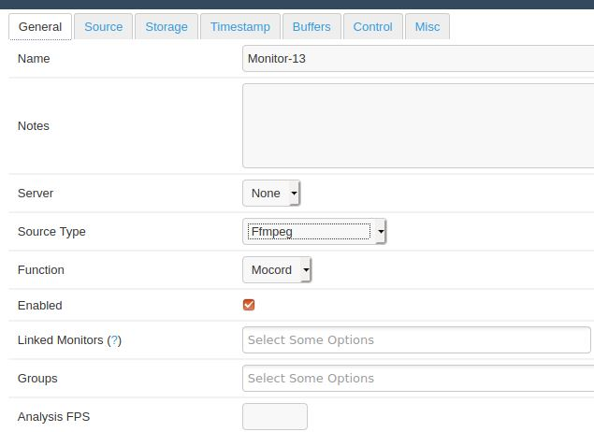
Fill required details Note – according the source type streaming method(protocol) will change under source tab.
Provide screen name
Select mode
Select source type

Slide 13
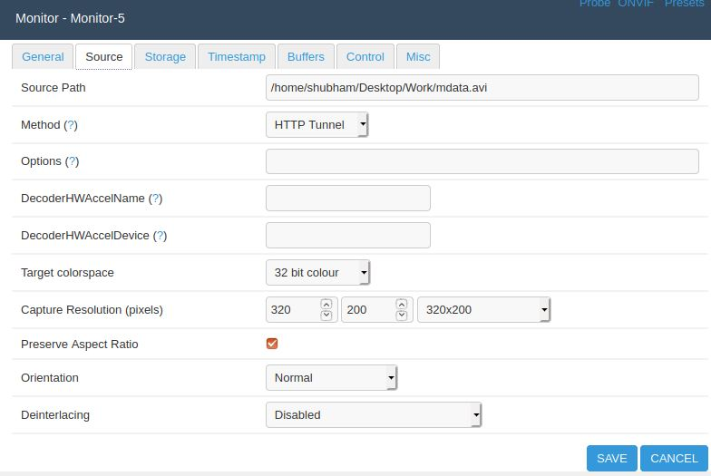
Navigate source tab and fill required entries
File location
Select method
Click on save

Slide 14
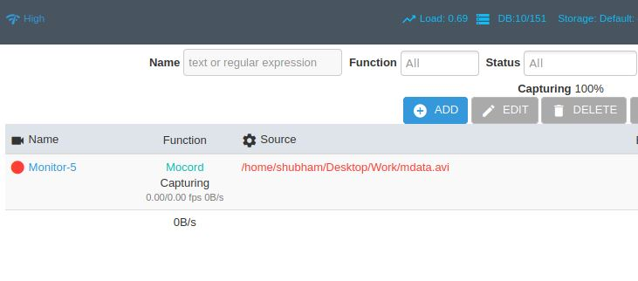
Click on monitor-5

Slide 15
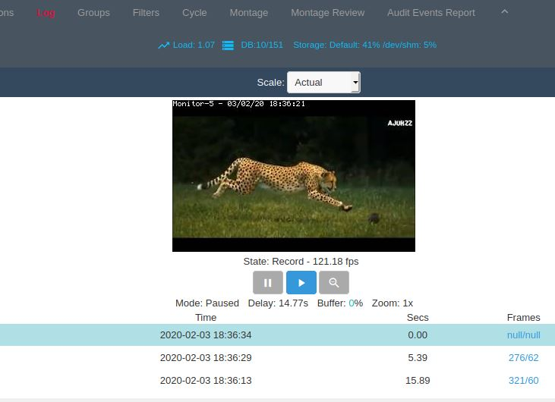
Streamed output

Slide 16
Thank you

