Slide 1
ShelfWise
A campus library's lending desk, carried from a laptop to a monitored Kubernetes cluster
Shubham Kumar · 24BCS10320 · DevOps Heros, Session 21 final capstone · October 2026
74 tests
10 CI jobs
Trivy-gated images
GitOps with Argo CD
AWS VPC + EKS
Notes:
ShelfWise is my own application domain: a lending desk for a campus library. This deck covers what it does, how it's built, and how it travels through CI/CD, Terraform, Kubernetes, GitOps and monitoring.

Slide 2


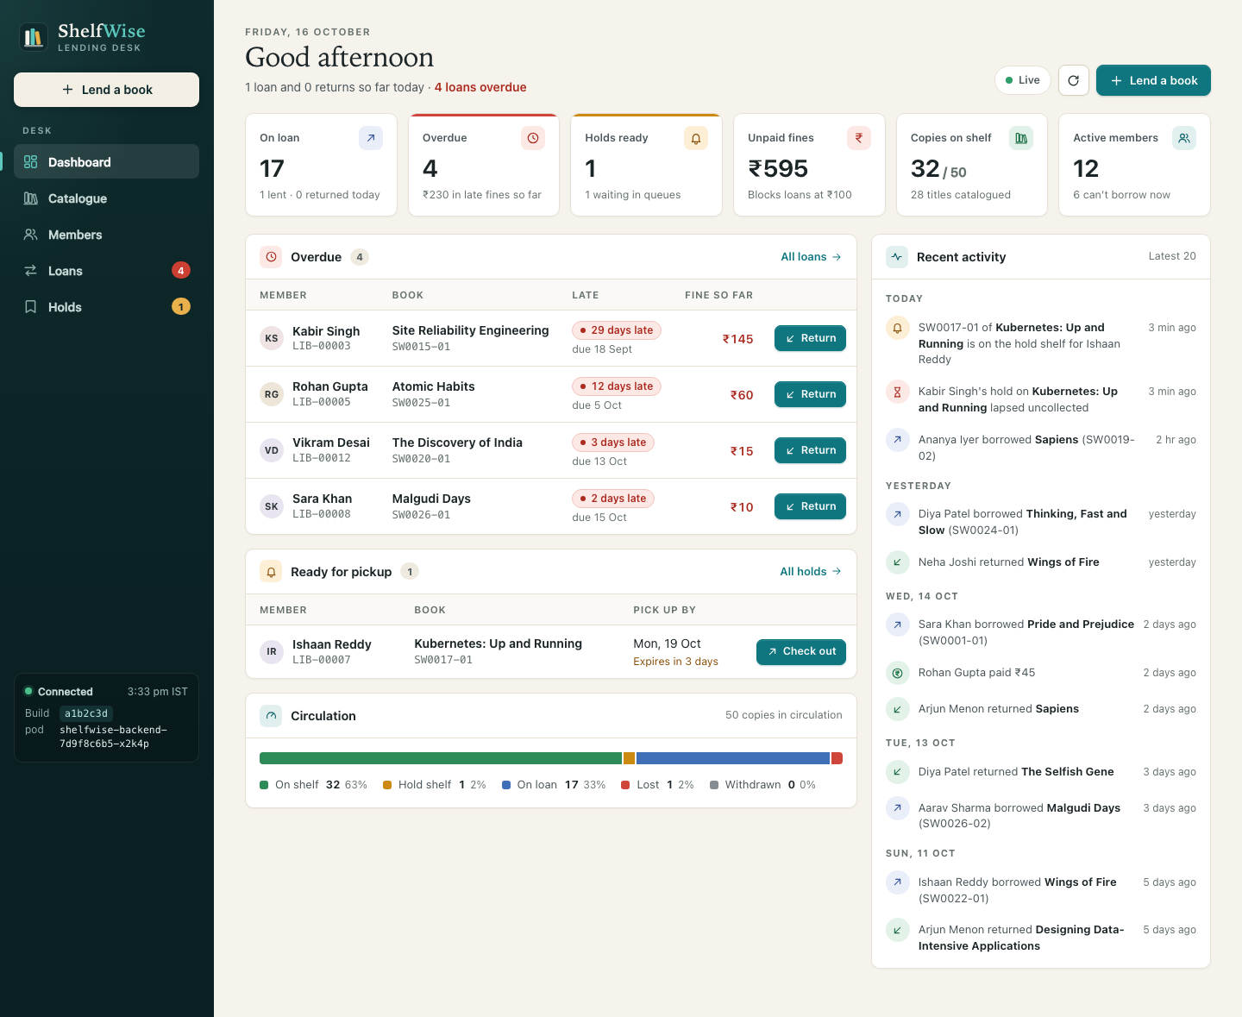


What ShelfWise does
Librarians catalogue books and their physical copies, register students and faculty, lend and take back copies, and run the holds queue for popular titles.
Every refusal is a rule, not a crash: the API answers 409 with a sentence the desk can read out, and the rules are published at /api/info so the UI never hardcodes them.
One copy, one borrower
Loan limits by member
Row locks plus a partial unique index: two API replicas can never lend the same copy.
Students 3 books for 14 days, faculty 6 for 28. Two renewals, never while someone is waiting.
Fines that matter
A fair holds queue
₹5 per day late, capped at ₹200. ₹100 unpaid (or any overdue book) blocks new loans.
A returned copy goes to the first member waiting; they have 3 days to collect it.

Slide 3
Tech stack
APPLICATION
DATA
QUALITY
React 19 + Vite 8 · FastAPI 0.143 · SQLAlchemy 2.1 · Alembic 1.20
PostgreSQL 17 · CHECK constraints · partial unique indexes
pytest 9 · ruff · 60-day simulation · multi-process races
CONTAINERS
CI/CD
SECURITY
Multi-stage Docker · nginx-unprivileged · compose
GitHub Actions (10 jobs) · GHCR · SHA-tagged images
Trivy 0.76 · Gitleaks 8.30 · Bandit · pip-audit · npm audit
INFRASTRUCTURE
KUBERNETES
GITOPS + OBSERVABILITY
Terraform 1.15 · AWS provider 6.69 · VPC + EKS 1.35
kind 1.37 · Helm 4 · Traefik 3.7 · HPA · PDB · NetworkPolicy
Argo CD 3.5 · Prometheus · Grafana · Alertmanager

Slide 4
Architecture: from git push to a monitored cluster
git push
main
GitHub Actions
10 jobs: test · scan · build
GHCR
backend + frontend :<sha>
Promote commit
gitops/values-gitops.yaml
Argo CD
syncs every change
kind cluster (Kubernetes 1.37) · namespace shelfwise · Pod Security restricted
Prometheus
scrapes /metrics · 5 alert rules
Browser
shelfwise.local
Traefik Ingress
/ → UI · /api → API
Frontend
React on nginx · 2 pods
Grafana
14-panel ShelfWise dashboard
Hold-expiry CronJob
→ PostgreSQL, every 30 min
Backend API
FastAPI · HPA 2–6 pods
PostgreSQL
StatefulSet + PVC
Terraform → AWS
VPC (2 AZ) + EKS + nodes
NetworkPolicy: only the API (and the CronJob) may reach PostgreSQL
PDBs keep one pod of each tier through node drains · probes: /health, /ready
Notes:
CI never touches the cluster. It pushes images and commits the new tag to Git; Argo CD notices and rolls it out. Terraform builds the AWS side separately.

Slide 5
Rules the database enforces too
Loan lifecycle
returned
fine if late
If a bug slipped past the API, PostgreSQL still says no
active
due in 14 / 28 days
lost
₹500 fee
Partial unique index
renew ×2 (not overdue, nobody waiting)
one active loan per copy; one open hold per member and book; one ready hold per copy
Any move out of returned or lost → 409 loan_closed
CHECK constraints
Hold lifecycle
fulfilled
borrowed
renewals 0–2, due after borrowed, fines ≥ 0, closed_at set exactly when closed, valid status values
waiting
queue position
ready
3 days to collect
Row locks, fixed order
expired
next in line
member → book → its loans/holds, so concurrent desks queue instead of deadlocking
copy returned → first waiting member · cancel at any open stage
Advisory lock on migrate
every replica runs alembic upgrade at start; one migrates, the rest wait

Slide 6
Testing: rules, migrations and real races
74
93%
1 / 10
3 / 6
tests pass on PostgreSQL in CI (72 + 2 skipped on SQLite locally)
line coverage of the backend
replicas racing for the last copy get it; 9 get a clear 409
loans for one student at six desks at once (limit 3)
How the tests stay honest
Mutation test: remove the row locks
Never the real database: a throwaway SQLite file, or a disposable PostgreSQL in CI
Schema built by running the real Alembic migrations (up, down, up)
A 60-day simulated library checks invariants afterwards
Races run as separate processes: threads were staggered by the GIL and proved nothing
One student, six desks: all 6 loans go through — the limit of 3 is broken.
Last copy, ten desks: the unique index still stops a double loan, but 9 members get a vague "retry" instead of "no copy on the shelf".
Both race tests fail, every time — so they really test the locks.

Slide 7
CI/CD: every push to main, gate by gate
Gates in parallel
pytest + ruff
PostgreSQL: migrations, lock, races
Build + Trivy
both images; fixable HIGH/CRITICAL fail
Push to GHCR
:<commit sha>, the scanned tarball
Deploy in kind
helm upgrade --install + smoke test
Promote
commit tag to values-gitops.yaml
Frontend build + npm audit
Gitleaks · Bandit · pip-audit
Helm lint + kubeconform
3m 35s
SHA
0
Terraform validate + Trivy IaC
for a full green run (run #10, the live demo push)
image tags are full commit SHAs; nothing is ever tagged latest
deploy credentials in CI: Argo CD pulls from Git
Notes:
If any gate fails, nothing is built or pushed. The pushed image is the exact tarball Trivy scanned, never a rebuild.

Slide 8







DevSecOps: seven automated checks
Gitleaks
secrets in the whole git history
What the Trivy gate lets through, and why
Bandit
Python SAST, medium+
The gate fails a build on any HIGH or CRITICAL CVE that has a fixed version, and on any HIGH or CRITICAL secret finding in an image layer. Both images pass: nothing fixable, no secrets at those levels.
Scanned without --ignore-unfixed, the backend's Debian 13 base still shows 8 HIGH CVEs (0 CRITICAL) with no fix released. Example: CVE-2025-69720, a stack overflow in ncurses' infocmp (CVSS 7.8, local). Fixed upstream in 6.5-20251213; Debian's 6.5+20250216-2 is still marked affected.
They sit in OS packages the Python API doesn't call (ncurses, util-linux, systemd libraries), in a container that runs non-root with a read-only root filesystem. Blocking on them would stop every release with nothing to upgrade to; the digest-pinned base image is bumped when Debian ships fixes, and CI rescans every build.
pip-audit + npm audit
known-vulnerable dependencies
Trivy image ×2
OS + library CVEs, secrets in layers
Trivy config
Terraform misconfigurations
Pod Security restricted
non-root, no caps, seccomp, RO root
Pinned supply chain
actions by commit SHA, images by digest

Slide 9
AWS with Terraform: VPC and EKS in ap-south-1
VPC 10.20.0.0/16
Internet gateway
28
ap-south-1a
ap-south-1b
resources in one plan, all plain HCL
Public subnet
NAT gateway · load balancers
Public subnet
load balancers
12m 23s
Private subnet
EKS worker node (t3.medium)
Private subnet
EKS worker node (t3.medium)
terraform apply, end to end
< $1
EKS control plane 1.35
AWS-managed · API mode · audit logs
for the whole apply → screenshots → destroy cycle
Managed node group in the private subnets · EBS CSI driver via EKS Pod Identity

Slide 10
Kubernetes with Helm, deployed by Argo CD
Deployments
backend (HPA 2–6), frontend (2)
The GitOps loop
Services
1 · commit + push
code change
ClusterIP for API, UI; headless for DB
Ingress
Traefik: / → UI, /api → API
StatefulSet + PVC
4 · rollout
maxUnavailable 0
2 · CI promotes
new SHA into Git
PostgreSQL 17
HPA · PDB · NetworkPolicy
scale, survive drains, isolate DB
CronJob
3 · Argo CD syncs
≤ 60 s poll
lapse uncollected holds
ServiceMonitor · PrometheusRule
scrape + alert
Live demo: commit to Synced in 4 min 25 s (CI 3 min 35 s, then Argo CD picked up the promotion 48 s later)

Slide 11
Autoscaling under load
6
pods at peak (max 6)
45 s
until the first scale-out decision (all 6 pods by 75 s)
2m 20s
after load stopped, back to 2

Slide 12
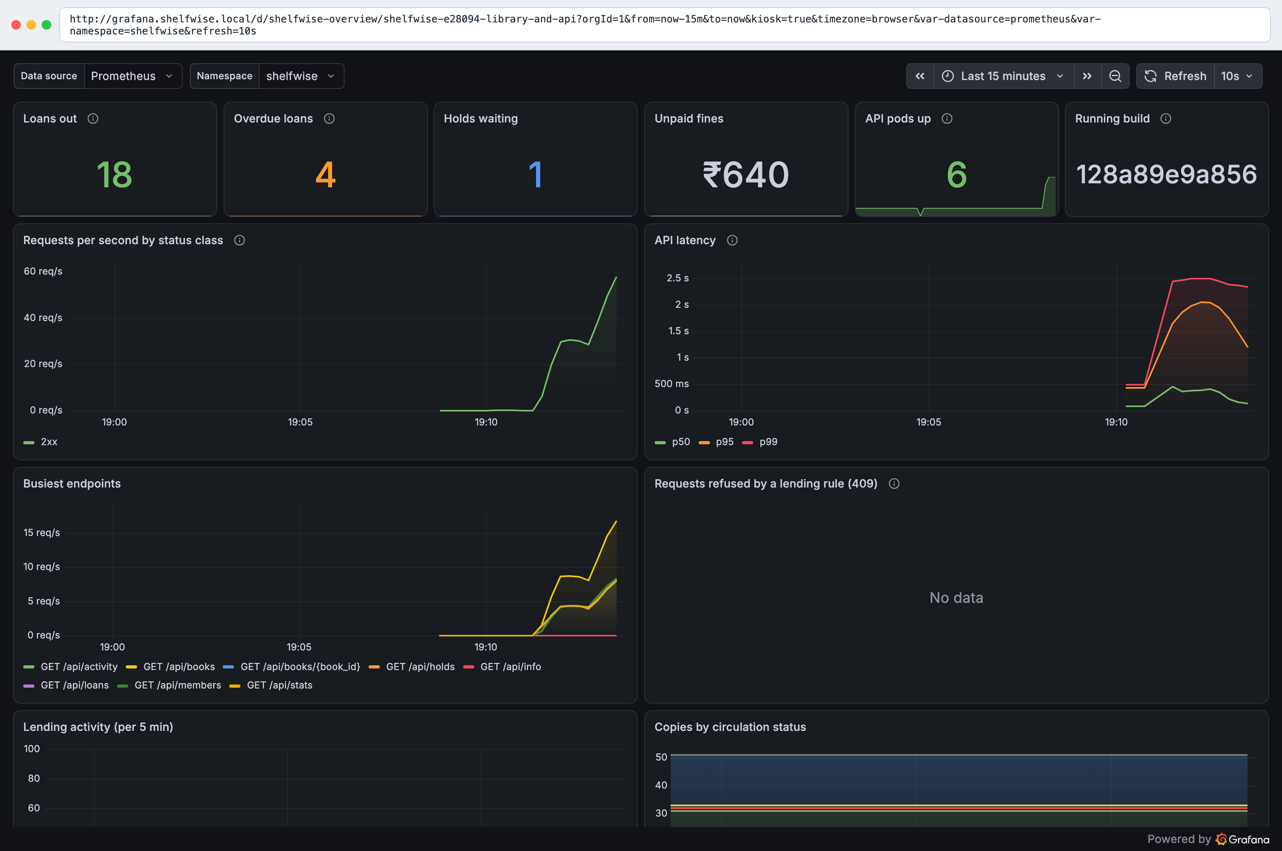
Observability: Prometheus, Grafana and alerts
What the API exposes at /metrics
HTTP rate, latency and status per route (buckets from 5 ms)
Loans out, overdue, holds, unpaid fines, copies by status — read from the DB at scrape time
Refusals per rule (409s) and the running build SHA
Alerts
API down · 5xx > 5% · p95 > 500 ms
Database unreadable
Business: too many overdue loans
6 / 6 API pods scraped and UP at peak load

Slide 13





Key learnings
Correctness lives in the database
Ship exactly what you scanned
Row locks in a fixed order, backed by constraints. Thread-based race tests lied; process-based ones proved it.
CI saves the scanned image as a tarball and pushes that, never a rebuild.
Git is the deploy button
Defaults hide problems
CI has no cluster credentials. A promotion commit is the release, and Argo CD does the rest.
Prometheus ignores other releases' ServiceMonitors; latency buckets start at 100 ms; Trivy ignores misplaced options.
Pin everything
Retired tools are a security risk
Actions by commit SHA after the 2026 Trivy-action tag hijack; base images by digest; charts by version.
ingress-nginx was archived in March 2026, so this cluster uses Traefik with standard Ingress objects.

Slide 14
Limitations and what I would do next
PostgreSQL runs in the cluster
Amazon RDS with backups
One NAT gateway
One per AZ
No login on the API
OIDC
Secrets via kubectl
External Secrets
Local TLS off
cert-manager
GitOps on kind
Argo CD on EKS

Slide 15
Thank you
Questions, and the live walkthrough in the demo video
github.com/shubhamkumar9199/devops-heros/tree/main/session21-python
Green run: github.com/shubhamkumar9199/devops-heros/actions/runs/38908055488

