Slide 1
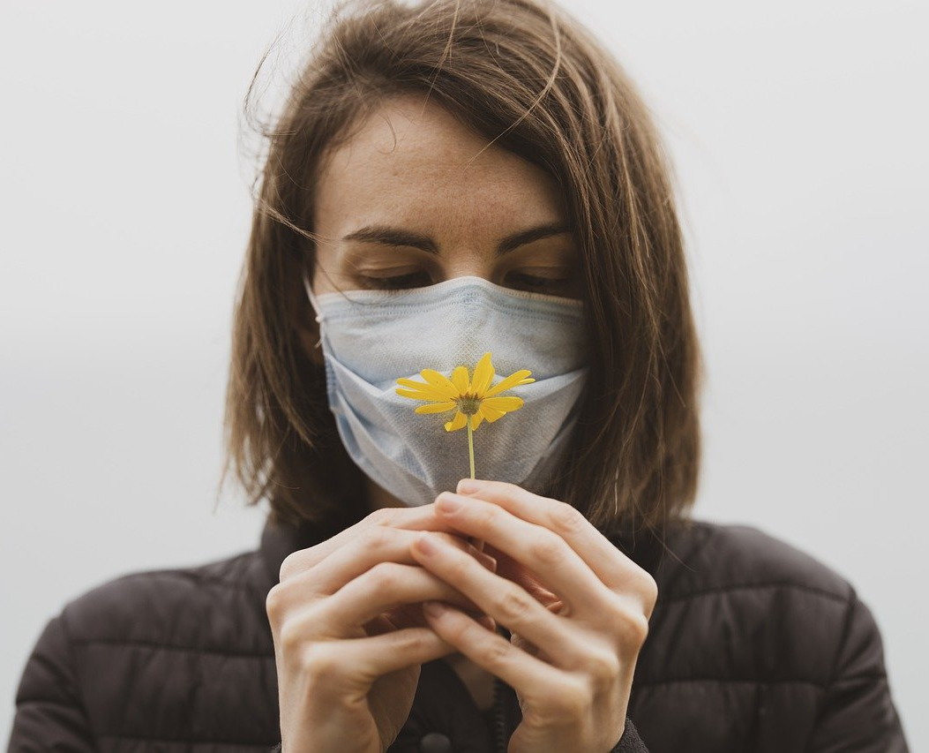
SAFEX
Your Safety Our Priority

Slide 2
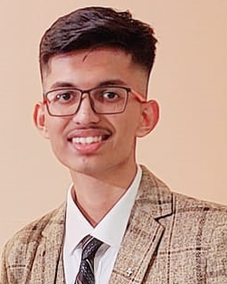
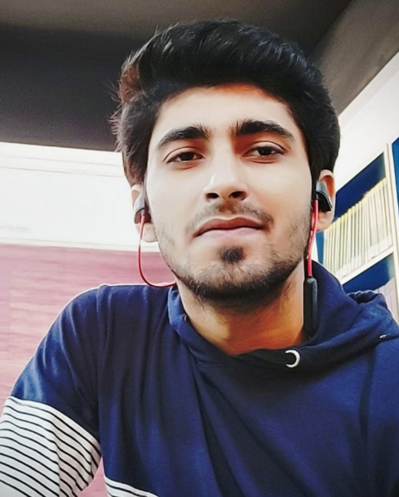
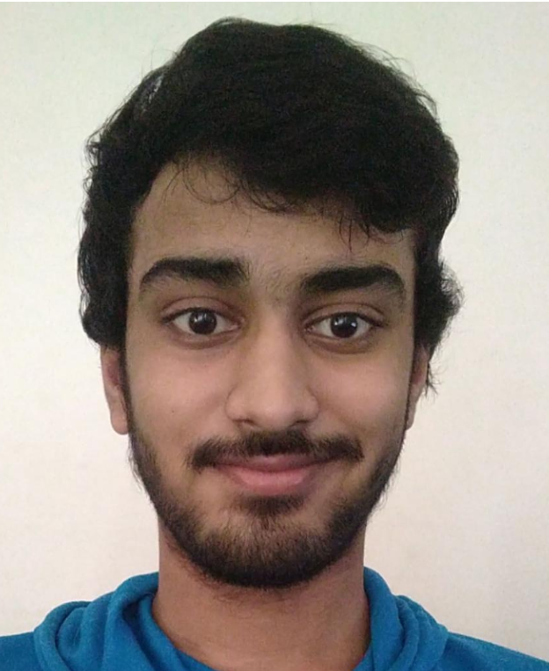

OUR
TEAM
Harsh
Jha
Shubham
Jha
Harshal
Sanghvi
High School
3rd Year Btech CSE
Manav Rachna University
High School

Slide 3
SafeX App helps you check how Covid safe a public place is before you visit that place
Using AI, scores generated based on collected data
Hotels, Malls, Restaurants, Gyms, Public transport, Salons, Grocery Stores, Banks/ATM, Gas station, Pharmacy, Parks and outdoor spaces
Personal Software
Recognize Staff wearing mask
Public Wearing mask
Social distancing Check
Facial Recognition to allow authorized people
Public Places
Data of public places with reviews and stars based on:
Regular Sanitization
Hygiene
Practicing Social distancing
SOP Followed by employees
Good ventilation
Digital menu? Disposable(For hotels)
Size of gathering
USER
SAFEX
App
Access to
collected data
Generated score
and review data

