Slide 1
NSAP Eligibility Prediction using IBM Watsonx.ai
CAPSTONE PROJECT
Presented By:
Shubham Kumar Sharma-Engineering College, Ajmer
Computer Science Department

Slide 2
OUTLINE
Problem Statement (Should not include solution)
Proposed System/Solution
System Development Approach (Technology Used)
Algorithm & Deployment
Result (Output Image)
Conclusion
Future Scope
References

Slide 3
Problem Statement
The National Social Assistance Program (NSAP) is a flagship social security and welfare program by the Government of India. It aims to provide financial assistance to the elderly, widows, and persons with disabilities belonging to below-poverty-line (BPL) households. The program consists of several sub-schemes, each with specific eligibility criteria.
Manually verifying applications and assigning the correct scheme can be a time-consuming and error-prone process. Delays or incorrect allocation can prevent deserving individuals from receiving timely financial aid.
Your task is to design, build, and evaluate a multi-class classification model that can accurately predict the most appropriate NSAP scheme for an applicant based on their demographic and socio-economic data. The goal is to create a reliable tool that could assist government agencies in quickly and accurately categorizing applicants, ensuring that benefits are delivered to the right people efficiently.

Slide 4
Proposed Solution
To automate the classification of applicants into the correct NSAP sub-scheme using a machine learning model trained on demographic and socio-economic data, thereby reducing manual errors and accelerating benefit delivery
Data Collection:
Gathered synthetic or real applicant data with features such as:
Age , Gender, Maritial State, Disability Status etc.
Data Preprocessing:
Clean and preprocess the collected data to handle missing values, outliers, and inconsistencies.
Feature engineering to extract relevant features from the data that might impact relevant schems.
Machine Learning Algorithm:
Explored multiple machine learning algorithm :
Snap Random Forest Classifier
Random Forest Classifier

Slide 5
Proposed Solution
Deployment:
Algorithm Chosen:
Decision Tree Classifier (with HPO and FE)
Achieved highest accuracy of 0.967
Snap Decision Tree Classifier also performed well
Model deployed in Watsonx.ai
Input interface supports table & JSON
Predictions exported in table and JSON format
Training Process:
Used supervised learning on labeled scheme data
Hyperparameter optimization (HPO-1 & HPO-2) and Feature Engineering (FE) applied

Slide 6
System Approach
System Requirements:
IBM Cloud (Lite – Mandatory)
IBM Watsonx.ai Studio
IBM Cloud Object Storage
Steps Followed:
Data preprocessing and labeling
AutoAI experiment to train multiple pipelines
Model selection based on cross-validated accuracy
Real-time prediction using Watson UI

Slide 7
Algorithm & Deployment
Algorithm Selection:
Decision Tree Classifier (with HPO and FE)
Achieved highest accuracy of 0.967
Snap Decision Tree Classifier also performed well
Data Input:
Age , Gender, Marital status, Aadhar number (optional), Mobile number , Category (obc, gen , sc and at).
These features were selected because they directly correlate with eligibility conditions across various NSAP sub-schemes like:
IGNOAPS (Old Age Pension)
IGNWPS (Widow Pension)
IGNDPS (Disability Pension)

Slide 8
Algorithm & Deployment
Training Process :
Platform Used: IBM Watsonx.ai AutoAI
Dataset Split: AutoAI handled training/validation split internally (typically 80:20 or with K-fold cross-validation)
Preprocessing:
Categorical encoding (e.g., gender, pension type)
Handling of missing values
Automatic feature transformation by AutoAI
Model Selection: The pipeline with highest accuracy (96.7%) using Decision Tree Classifier was selected

Slide 9
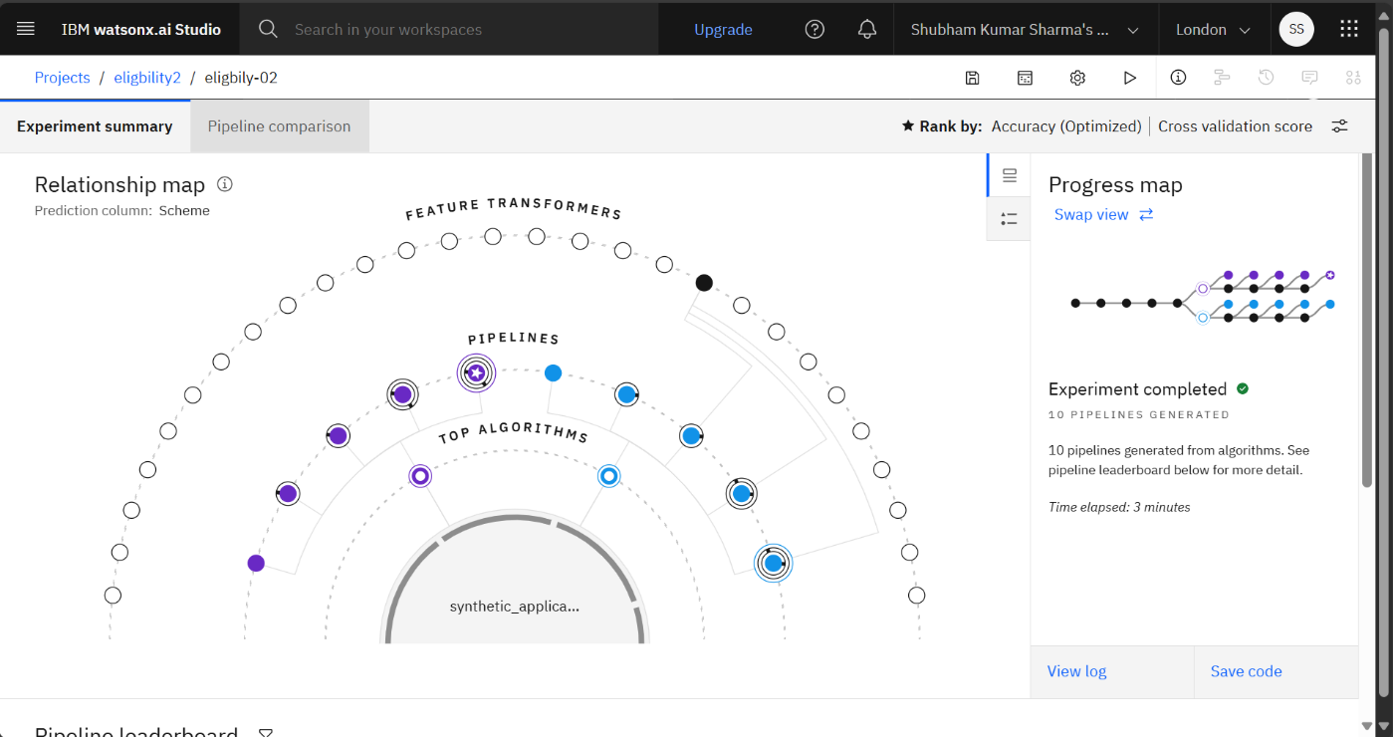
Result
8 ML Pipelines trained using AutoAI in 3 minutes.
Best Model: Batched Tree Ensemble Classifier (Snap Random Forest Classifier)
Example Prediction: IGNDPS with probability [1.0, 0.0, 0.0]

Slide 10
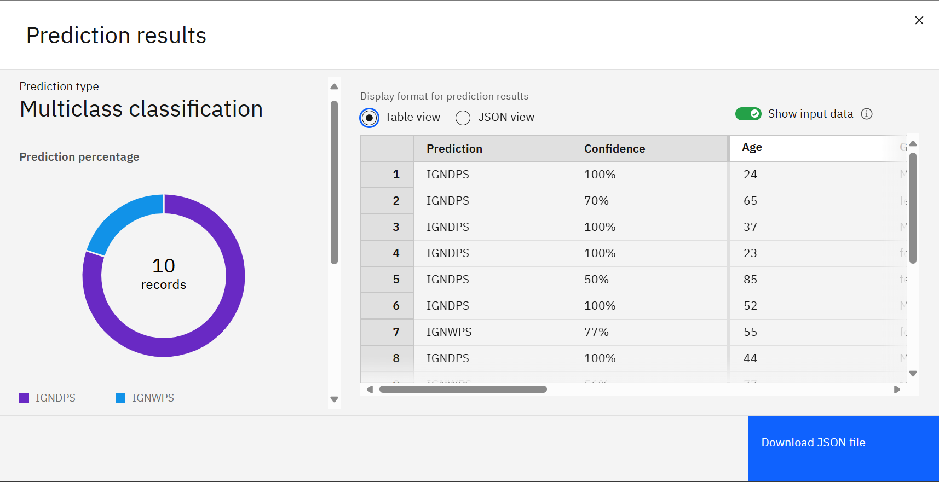
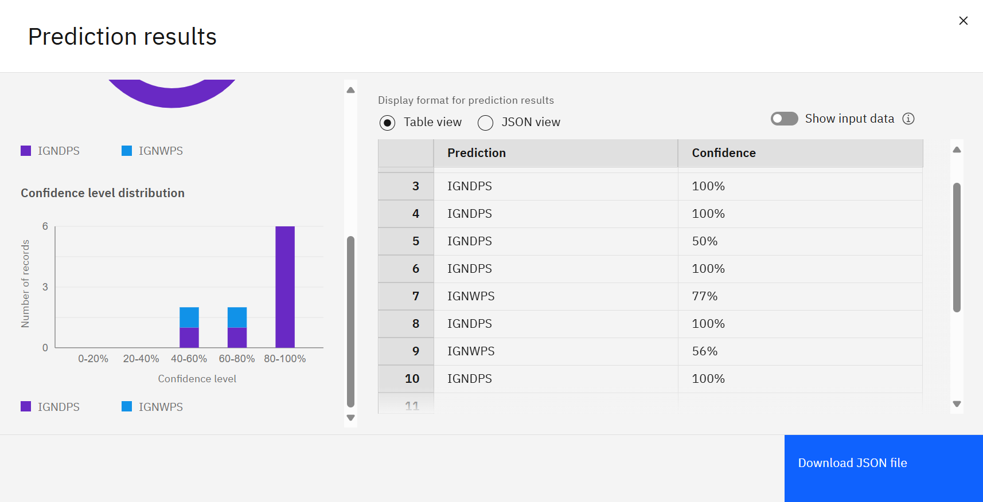
Result

Slide 11
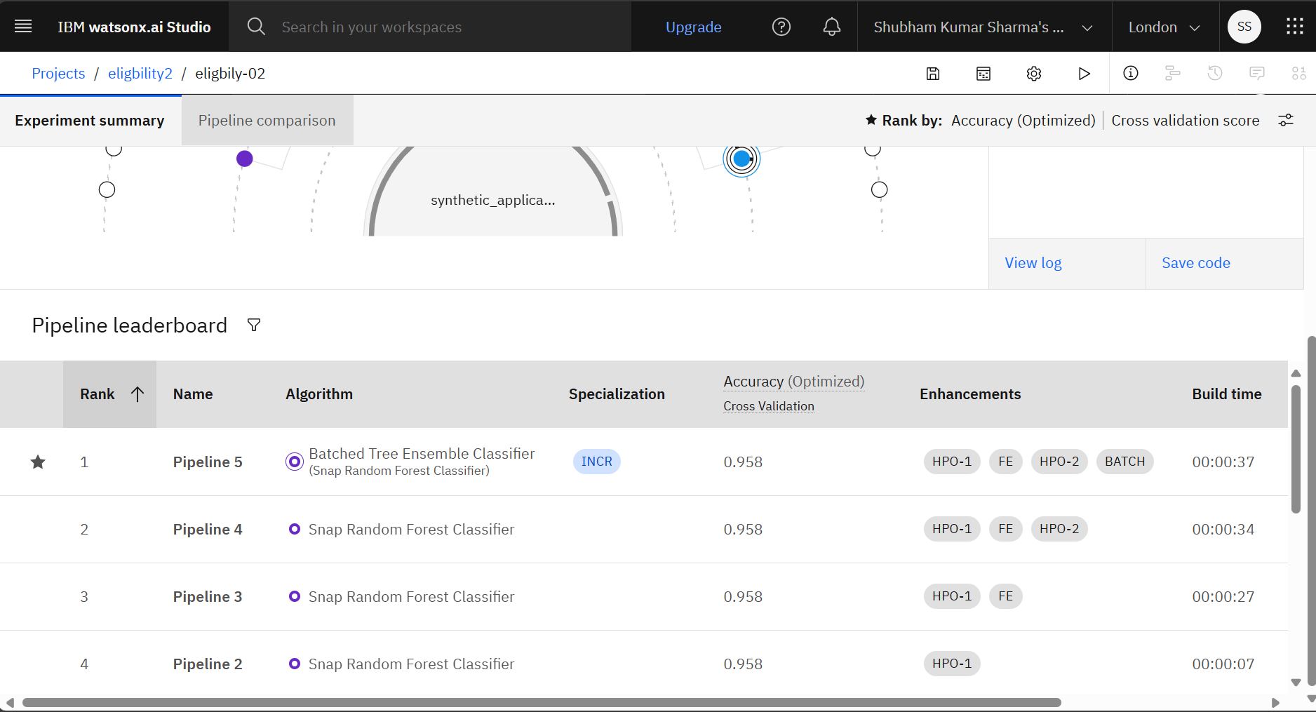
Result

Slide 12
Conclusion
Automated prediction improves efficiency and reduces manual errors.
Watsonx.ai supports scalable deployment and real-time predictions.
Model helps ensure timely scheme allocation to eligible citizens.

Slide 13
Future scope
Expand to cover more NSAP schemes and complex eligibility rules.
Hybrid ML + Rule-based logic integration.
Aadhaar and real-time ID verification integration.
API-based bulk processing and feedback loop for retraining.

Slide 14
References
AI Kosh Dataset: https://aikosh.indiaai.gov.in
IBM Watson Studio & Cloud Documentation
NSAP Guidelines – Ministry of Rural Development
IBM AutoAI Technical Docs

Slide 15
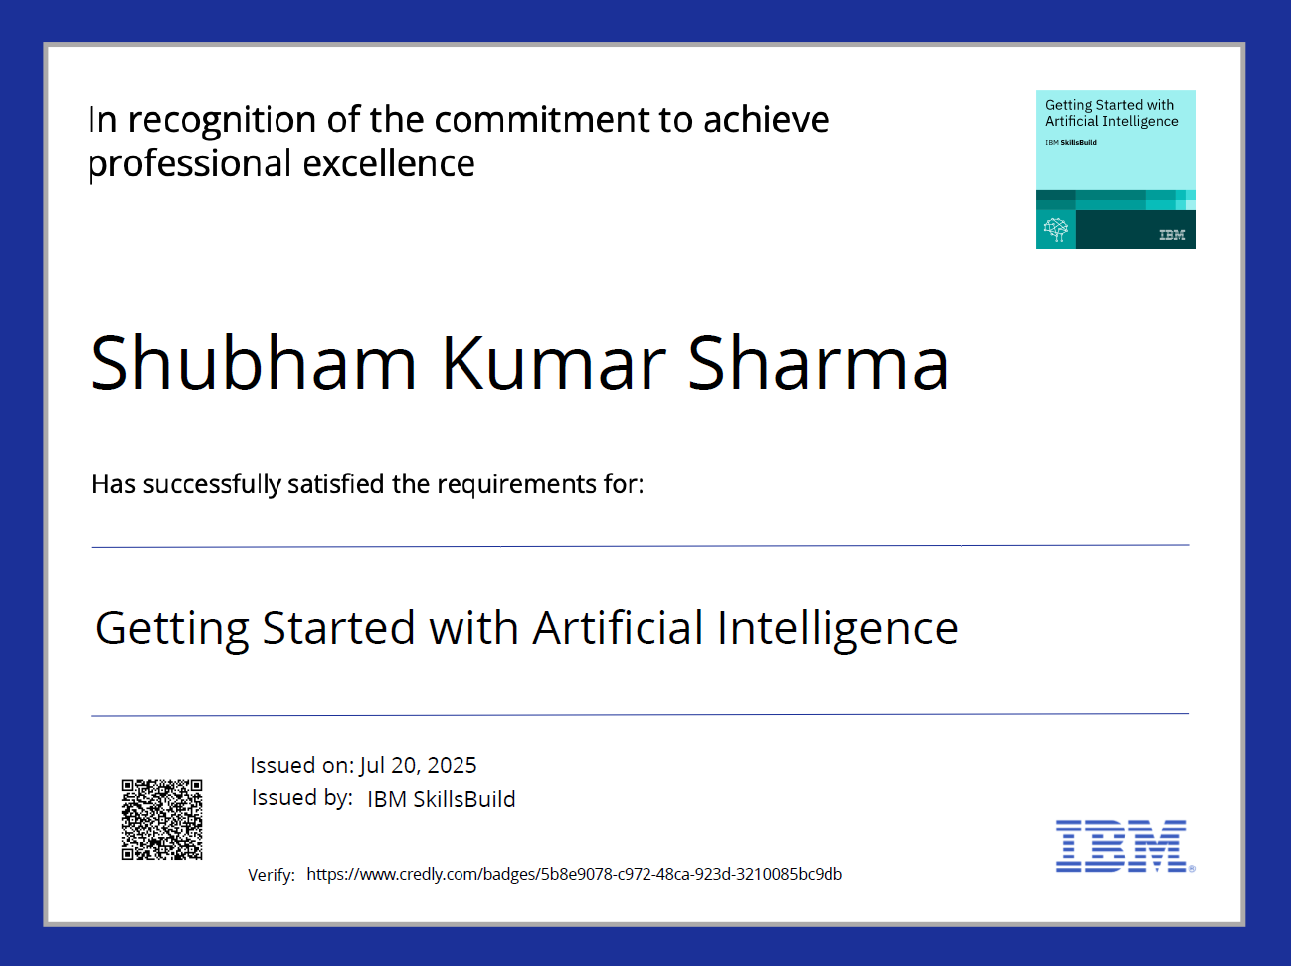
IBM Certifications

Slide 16
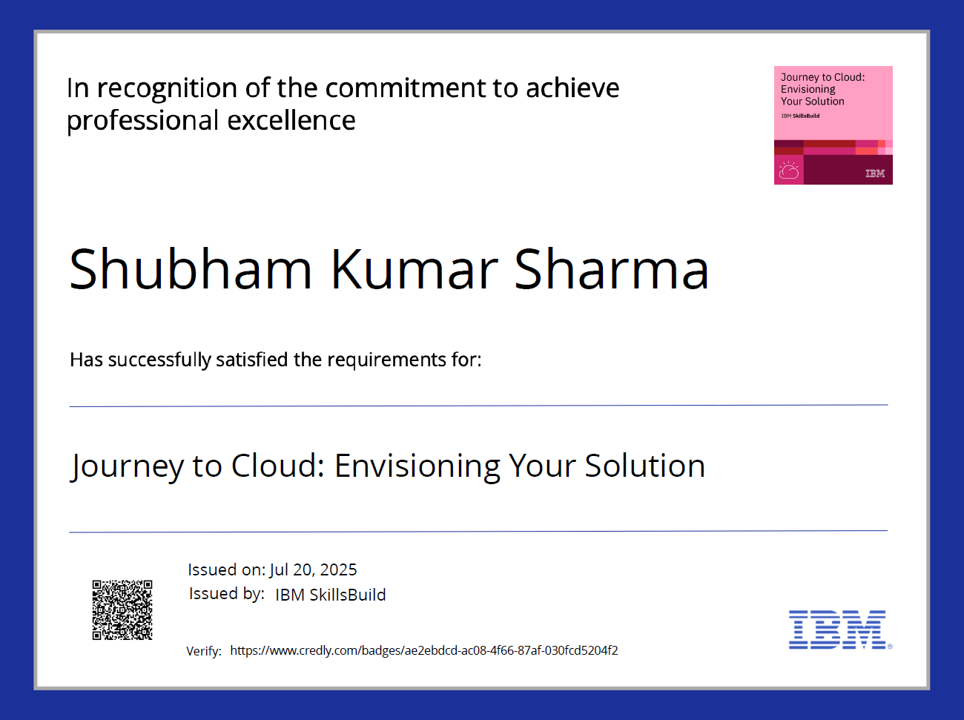
IBM Certifications

Slide 17
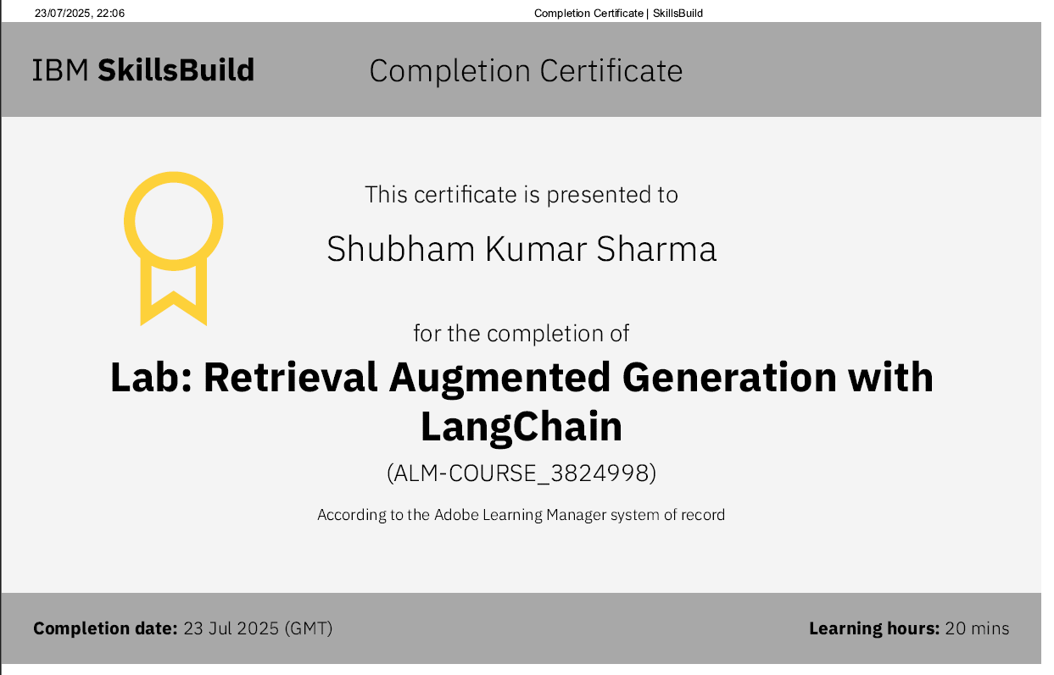
IBM Certifications
Screenshot/ credly certificate( RAG Lab)

Slide 18
THANK YOU

