Slide 1
AI-Powered Data Analyst Assistant
Final Year Project Synopsis
Presented By: it-01 (Group-a2)
Project Mentor: MR. Bharat chaudhari sir
B.Tech Information Technology
MGM University, Chhatrapati Sambhajinagar

Slide 2
Existing Problems:
Businesses collect huge volumes of data every day, but:
Manual data cleaning is time-consuming
Data analysis requires technical knowledge
Reports are generated manually
Decision-making becomes slow
Non-technical users struggle with analytics
Proposed Solution:
Develop an AI-powered web application that automates:
Data Cleaning
Data Profiling
Data Visualization
AI-generated Insights
Machine Learning
Report Generation

Slide 3
Objectives:
Upload CSV & Excel datasets
Automatically clean raw data
Analyze data using statistical methods
Generate interactive charts
Provide AI-powered insights
Build ML models
Export professional reports
Help users make data-driven decisions

Slide 4
System Architecture:
Streamlit Web Interface
Data Upload Module
User
Data Analytics Module
Data Profiling Module
Data Cleaning Module
Visualization Module
AI Insights Module
Machine Learning Module
Generator PDF / Excel Report

Slide 5
Technology Stack:
Category | Technology
Programming Language | Python
Frontend | Streamlit
Data Processing | Pandas, NumPy
Data Visualization | Plotly
Machine Learning | Scikit-learn
Statistics | SciPy
Report Generation | ReportLab, OpenPyXL, XlsxWriter
Version Control | Git & GitHub
Integrated Development Environment | Visual Studio Code

Slide 6
Project Workflow:
Start
Upload Dataset
Validate File
Clean Dataset
AI Insights
Visualizations
EDA
Data Profiling
Machine Learning
Download PDF/Excel
Generate Reports
End

Slide 7
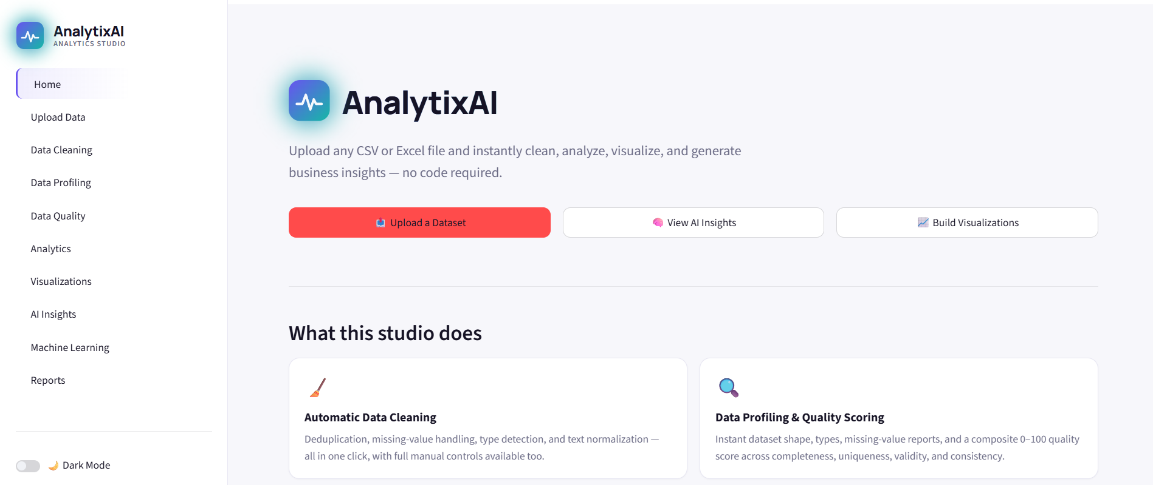
User Interface Design:

Slide 8
Current Progress:
✅ Requirement Analysis
✅ Technology Selection
✅ Environment Setup
✅ GitHub Repository
✅ Project Structure
✅ Frontend Framework
✅ Theme Design
✅ Navigation System

Slide 9
Features:
CSV Upload
Excel Upload
Missing Value Handling
Duplicate Removal
Data Type Detection
Correlation Analysis
Trend Analysis
Outlier Detection
Feature Engineering
Machine Learning
Automatic Reports

Slide 10
Advantages:
No Coding Required
User Friendly
Fast Processing
Automated Analysis
AI-based Recommendations
Professional Reports
Time Saving
Expected Outcome:
After completion, users will be able to
Upload any dataset
Automatically clean data
Analyze data
Generate AI insights
Build ML models
Export reports
All without writing code.

Slide 11
Thank You!

