Slide 1
PREDICTING BACK ORDERS TO OPTIMIZE INVENTORY MANAGEMENT Using MATLAB/OCTAVE
Shubham Aggarwal Mr. Hemant Tulsani
0201480284 (Project Guide)

Slide 2
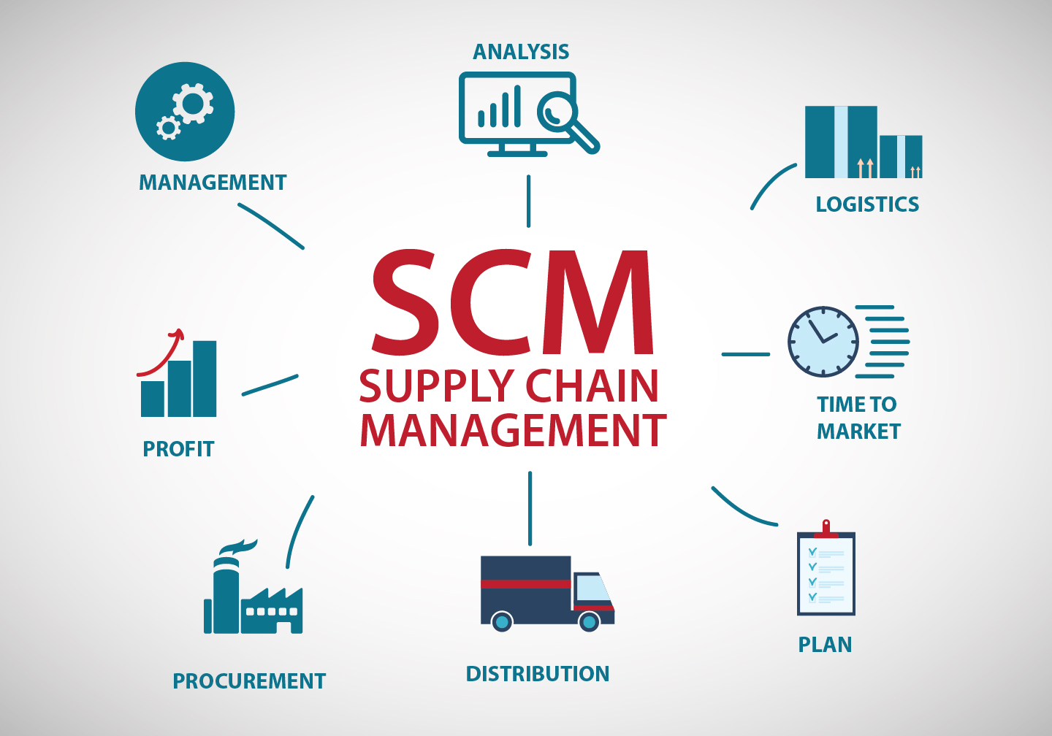
Supply Chain Management

Slide 3
Supply Chain Management Metrics
A supply chain is only as strong as its weakest link. The solution is to measure all key areas which include:
Back order
Customized order promise cycle time.
Customized order actual cycle time
Inventory turnover

Slide 4
Back Order Management
A Backorder is an unfilled customer order or commitment.
It is an immediate (or past due) demand against an item whose inventory is insufficient to satisfy the demand.
Product is ordered but out-of-stock and promised to ship when the product becomes available.

Slide 5
The problem is when a product is not immediately available, customers may not have the luxury or patience to wait. This translates into lost sales and low customer satisfaction.

Slide 6
But, with the help of MATLAB, Machine Learning and basic Data Science ethics we can predict back orders effectively and improve inventory planning.

Slide 7
OBJECTIVE :
Using machine learning techniques, train on historical data.
Predict orders in early stages of supply chain.
Making a model which can be feed in machines that can directly propose the future orders that are going to be made

Slide 8
TECHNIQUES INVOLVED IN MODELLING:
End to End Pipeline process
Data Normalization
Model Evaluation
f1score
precision
Recall
Imbalance classifcation
Accuracy Prediction

Slide 9
DATASET INFORMATION
The dataset used in this project comes from website Kaggle, provided by an anonymous company.
The data was taken as weekly snapshots at the start of each week.
In total, it consists 23 attributes with 1,915,211 entries and, 6 of which are binary,1 notation and the other 16 are numeric.

Slide 10
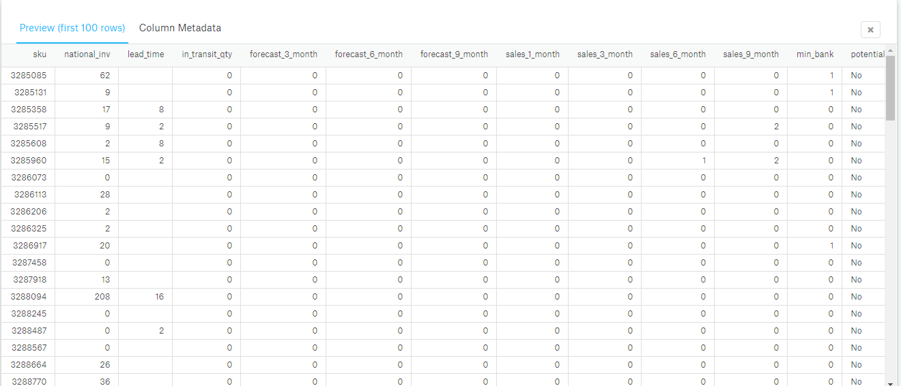
TEST DATASET PREVIEW (first 20 rows)

Slide 11
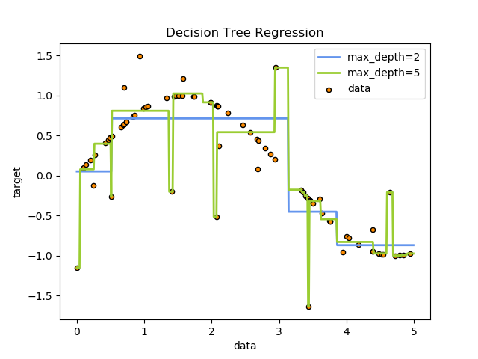
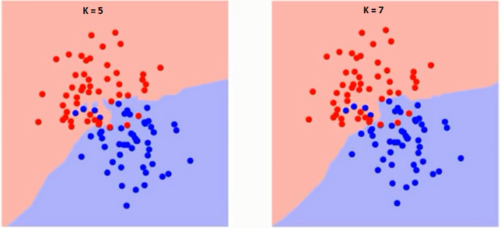
Algorithms used :
DECISION TREE K-Nearest Neighbur

Slide 12
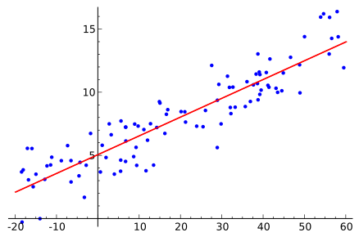
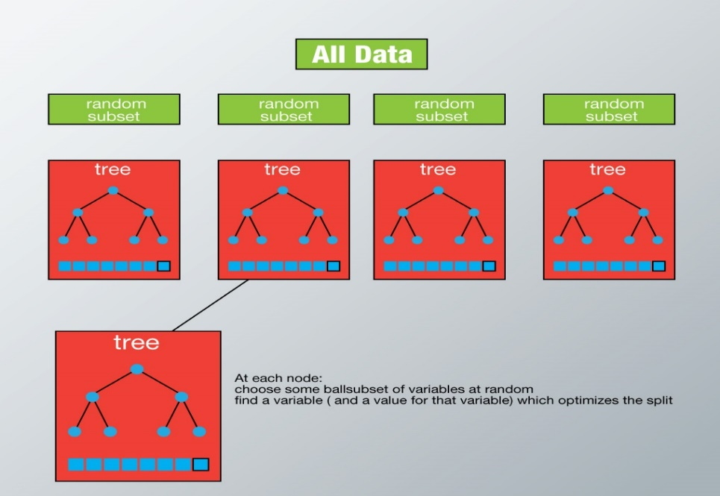
Algorithms used :
Logistic Regression Random Forrest

Slide 13
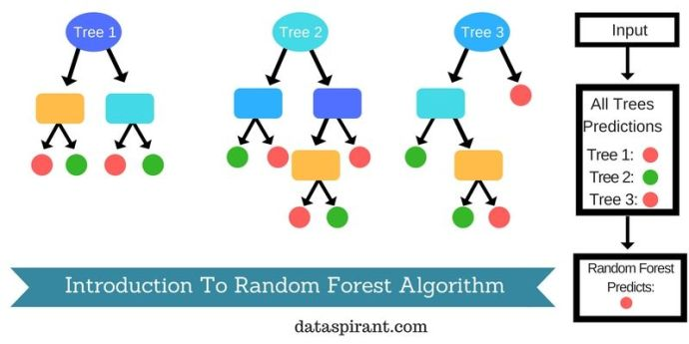
Algorithms used :
Random forest

Slide 14
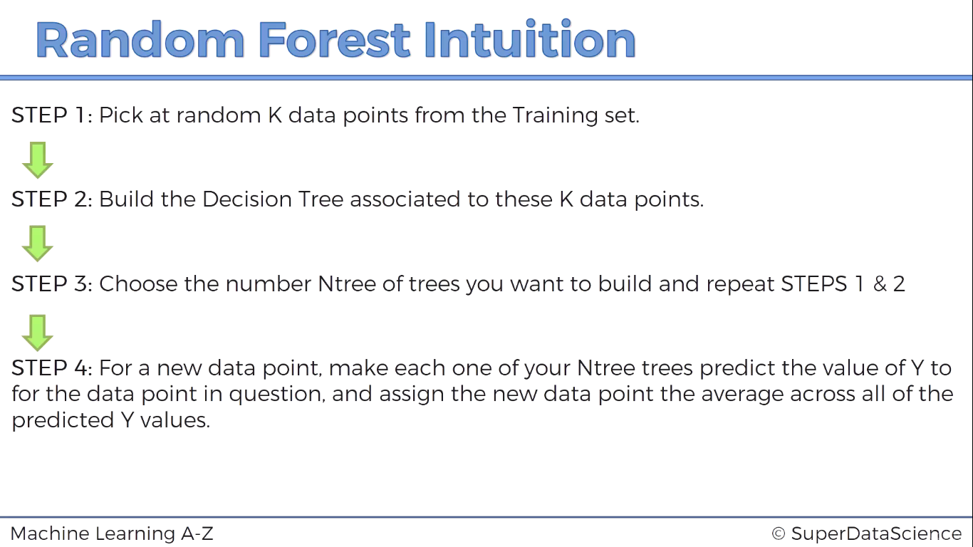

Slide 15
K-Nearest Neighbors
Non-parametric method used for classification and regression
An object is classified by a majority vote of its neighbors, with the object being assigned to the class most common among its k nearest neighbors (k is a positive integer, typically small)
In k-NN regression, the output is the property value for the object. This value is the average of the values of its k nearest neighbors.

Slide 16

Each tree is grown to the largest extent possible and there is no pruning.
Predict new data by aggregating the predictions of the ntree trees (i.e., majority votes for classification, average for regression).

Slide 17
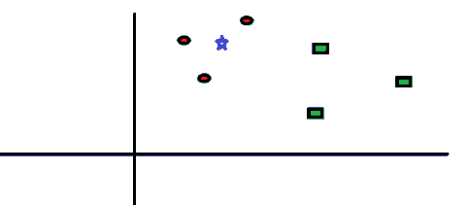
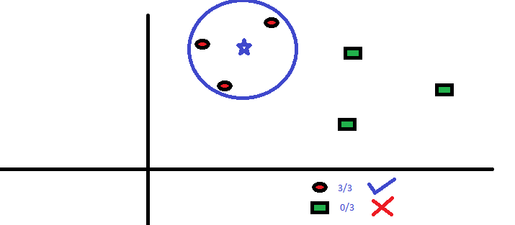

Slide 18
RESULTS
1. Logistic Regression
2. Random Forest
Training set score
0.922302124946
Test set score
0.903371253507
Training set score
0.952938296527
Test set score
0.928783927244

Slide 19
RESULTS
3. KNN
4. Decision Tree
Training set score
0.9457555663220
Test set score
0882435242088
Training set score
0.946260516081
Test set score
0.912461476039

Slide 20
Random Forest is the most desirable model.

Slide 21
REFERENCES
[1] Bryggeriforeningen. The danish beer revolution. The Danish Breweries Association,
October 2015.
[2] Mikkel N. Schmidt Tue Herlau and Morten Mørup. Introduction to Machine Learning
and Data Mining. Technical University of Denmark, 2016.
[3] Christopher M Bishop. Pattern recognition and machine learning. Springer, 2013.
ISBN 0-387-31073-8.
Relevant papers
[Santis, Rodrigo & P. de Aguiar, Eduardo & Fonseca, Leonardo. (2017). Predicting Material Backorders in Inventory Management using Machine Learning.]

Slide 22
THANK YOU !!!!!

