Slide 1
AI Video Concept Search
Ask a question in plain English, get the exact video and timestamp where it is taught: Retrieval-Augmented Generation over 10 lecture videos
Vednarayan Hiralkar | Aryan Shastri
github.com/Ved3205/ai-video-concept-search
Notes:
One-line pitch: we turn hours of lecture video into something you can ask questions to, and the answer points to the exact timestamp.

Slide 2
The problem: finding one concept in hours of video
“Where was Java inheritance discussed?”
Without this system
With this system
Watch the recordings or scrub through them manually, or search a raw transcript for exact keywords. A question phrased differently from what was spoken finds nothing.
Type a natural-language question. The system retrieves the matching transcript segments by meaning and answers with the video, the timestamps and what is taught there.
Notes:
Set up the pain point. Example question comes straight from our README.

Slide 3
Dataset: 10 Java course videos
# | Video | Chunks | Min
1 | Introduction to Java | 251 | 18.7
2 | Variables, Input & Output | 618 | 42.5
3 | Conditional Statements | 576 | 25.1
4 | Loops in Java | 487 | 29.5
5 | Best Pattern Questions | 1013 | 58.4
6 | Advanced Pattern Questions | 633 | 39.1
7 | Functions / Methods | 475 | 26.8
8 | Functions Practice Questions | 23 | 1.5
9 | Time & Space Complexity | 319 | 21.9
10 | Arrays Introduction | 435 | 25.7
4,830
transcript chunks
4.8 hours
of lecture audio
1,024
dimensions per BGE-M3 embedding
Notes:
All numbers computed from the JSON files in the repo. Video 8 is a short clip.

Slide 4
End-to-end pipeline
Offline indexing (run once)
Videos
>
FFmpeg
>
Whisper
>
JSON
>
BGE-M3
10 lecture recordings
Extract mp3 audio
Speech to English text
Timed chunks per video
Embed every chunk
Online querying (every question)
Question
>
Embed
>
Search
>
Prompt
>
Llama 3.2
Natural language
Same BGE-M3 model
Cosine similarity, top 5
Question + chunks
Grounded answer
Notes:
Indexing runs once per video set. Querying runs for every question.

Slide 5
Step 1: audio and transcription
Audio extraction
One chunk in jsons/
process_video.py runs FFmpeg on every video and saves numbered mp3 files, e.g. 10_Arrays_Introduction_Java_.mp3.
{
"number": "10",
"title": "10_Arrays_Introduction_Java_",
"start": 0.0,
"end": 4.0,
"text": " Hi everyone and welcome to
the Java placement course."
}
Whisper (medium model)
create_chunks.py transcribes each mp3 (Hindi audio, task = translate to English) and writes one JSON file per recording, one chunk per Whisper segment.
Notes:
Hindi-language lectures are translated to English by Whisper's translate task, so retrieval and answers are in English. Each segment keeps its timestamps.

Slide 6
Step 2: embeddings and storage
BGE-M3 via Ollama
JSON per recording
One joblib index
read_chunks.py sends each chunk's text to the local Ollama embed API. Every chunk becomes a 1,024-dimension vector that captures meaning, so different wording still matches.
Transcript chunks stay in one JSON file per video, with title, video number, start, end and text. This is the human-readable source of truth.
All 4,830 chunks and their embeddings are combined into a pandas DataFrame and saved as embeddings.joblib (about 45 MB), loaded once at query time.
Notes:
No vector database on purpose: at 4,830 vectors brute-force cosine similarity is instant, and the whole index is a single portable file.

Slide 7
Step 3: retrieval and grounded answers
Embed query
>
Cosine similarity
>
Top 5 chunks
>
Llama 3.2
Same model as indexing
Against all 4,830 chunks
Title, number, start, end, text
Local via Ollama
What the RAG prompt enforces
Answer only from the provided chunks, never from general knowledge
Say which video contains the answer and the relevant timestamps
Explain what is taught in those timestamps and guide the user to that section
If the question is unrelated, state that it only covers the provided videos
Notes:
The prompt forces the model to answer only from retrieved chunks and to cite video and timestamps.

Slide 8
Technology stack
Python
FFmpeg
OpenAI Whisper (medium)
Pipeline scripts, pandas DataFrame, scikit-learn cosine similarity, joblib persistence.
Extracts audio from the video files.
Speech-to-text with segment timestamps; Hindi audio translated to English.
BGE-M3
Llama 3.2 (Ollama)
JSON + joblib
Multilingual embedding model, served by Ollama.
Local LLM that writes the grounded answer.
Transcript chunks per video and a single embeddings index.
Notes:
Everything runs locally, so there are no API costs and no data leaves the machine.

Slide 9
Limitations and future scope
Current limitations
Future scope
Tested on 10 videos only
Transcript-based retrieval only; no speaker diarization
Quality depends on transcript accuracy and chunking
Command-line prototype, no web interface
Better chunking and reranking
Timestamp citations with source text
Vector database such as Qdrant
Web interface and multi-meeting search
Summaries, action items, decisions
Notes:
Be upfront about limitations; it shows you understand the system. Future items are possible extensions, not claims about the current build.

Slide 10
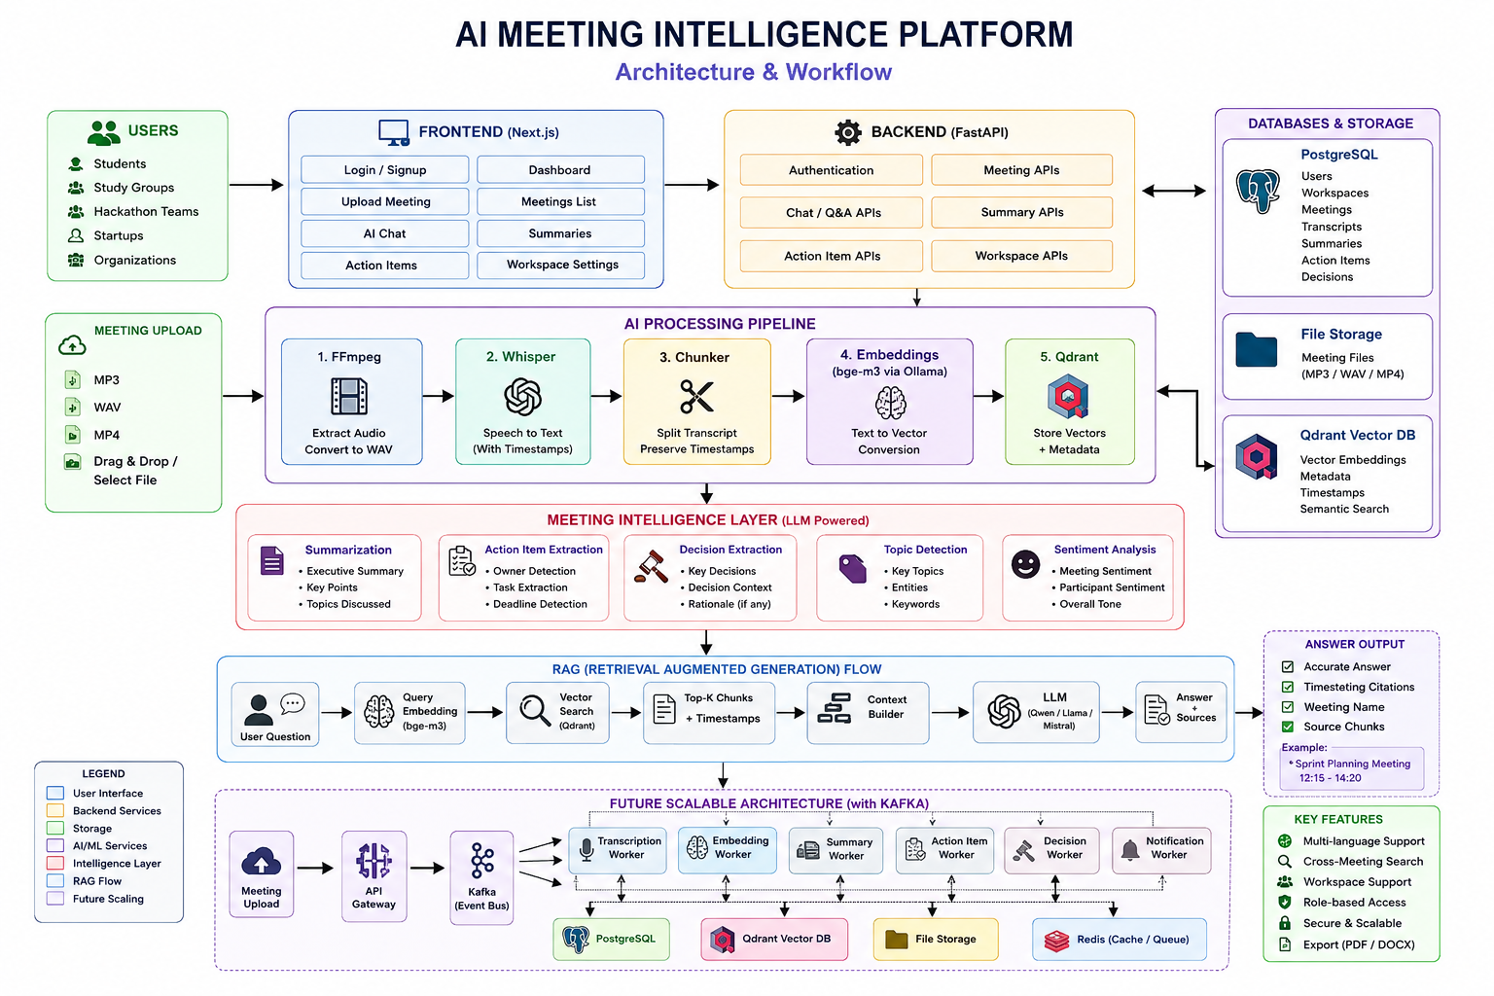
Where it is heading: the full platform
Planned vision (not yet built)
Working today: the RAG core in this deck
Planned: FastAPI backend, Next.js frontend, Qdrant, PostgreSQL
Planned: summaries, action items, Kafka workers
github.com/Ved3205/ai-video-concept-search
Notes:
This diagram is the planned architecture in the repo docs. It extends the working RAG core with a web app, database, summaries and scalable workers. It is not implemented yet.

