Slide 1
VIDEO GAME SALES AND RATINGS

Slide 2
Content
01
INTRODUCTION
02
What IS DATA MANGEMENT?
03
What Is ETL PROCESS?
INTRODUCTION
04
ANALYSIS

Slide 3
1.
INTRODUCTION

Slide 4

WHAT IS
?

Slide 5

WHY THIS TOPIC ?

Slide 6
WHAT IS DATA MANAGEMENT?

Slide 7

Data management is the process of storing, organizing and maintaining the data created and collected by an organization. Effective data management is a crucial piece of deploying the IT systems that run business applications and provide analytical information to help drive operational decision-making and strategic planning by corporate executives, business managers and other end users.

Slide 8
3.
WHAT IS ETL PROCESS ?

Slide 9
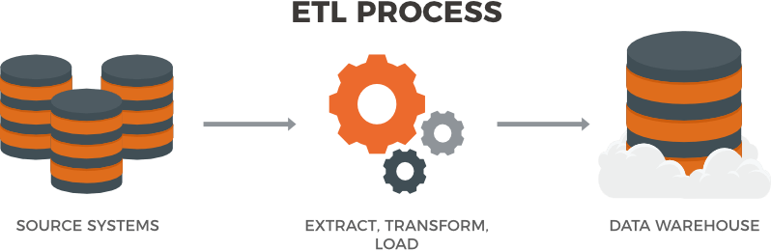
ETL stands for Extract, Transform and Load. It’s a generic process in which data is firstly acquired, then changed or processed and is finally loaded into data warehouse or databases or other files such as PDF, Excel.
You can extract data from any data sources such as Files, any RDBMS, MYSql Database, Websites or real-time user activity, transform the acquired data and then load the transformed data into a data warehouse for business uses such as reporting or analytics.

Slide 10
4.
ANALYSIS

Slide 11
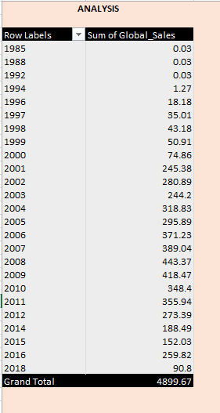
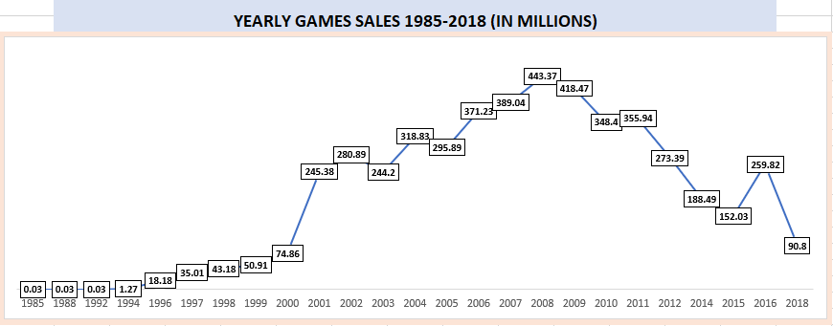
1. YEARLY GAMES SALES

Slide 12
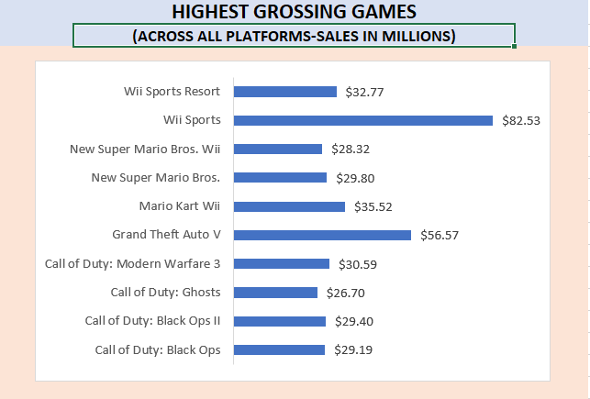
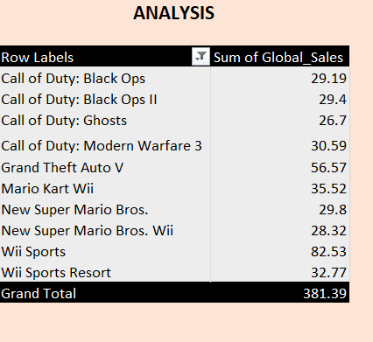
2. HIGHEST GROSSING GAMES

Slide 13
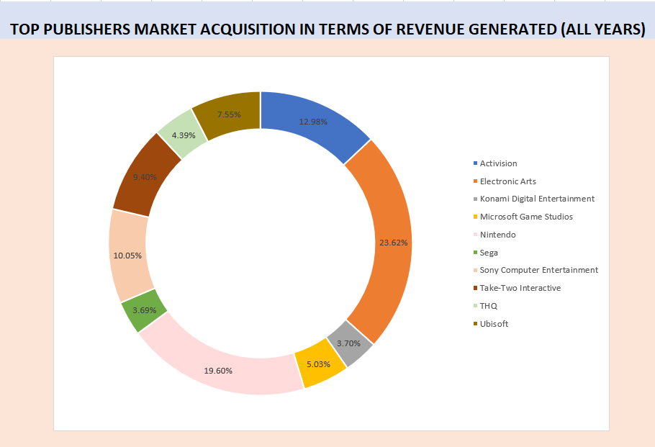
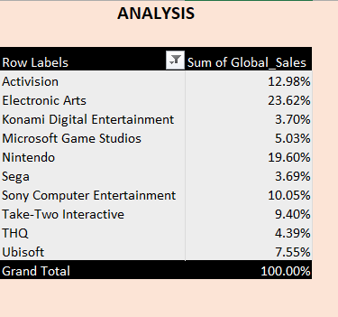
3.PUBLISHER MARKET ACQUISITION

Slide 14
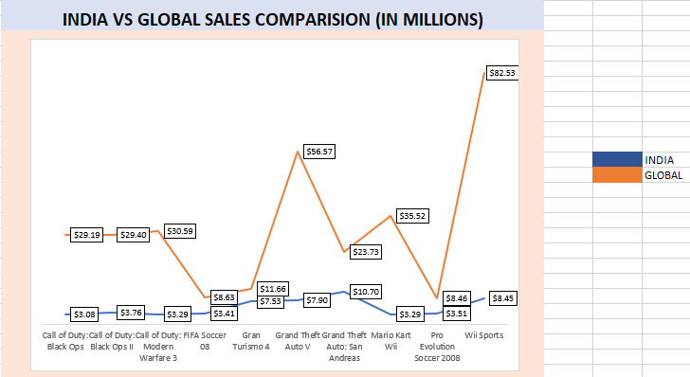
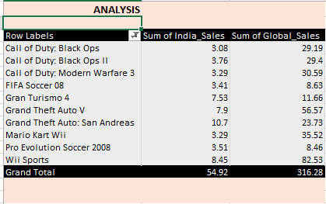
4. INDIA VS GLOBAL SALES COMPARISION

Slide 15
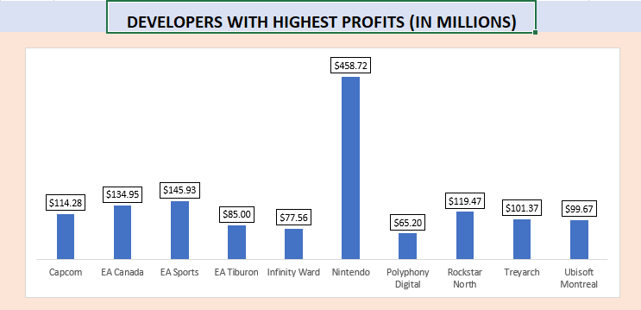
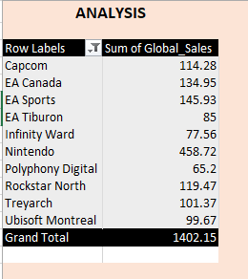
5. DEVELOPERS WITH HIGHEST PROFITS

Slide 16
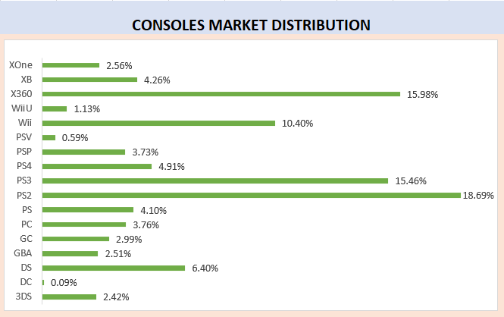
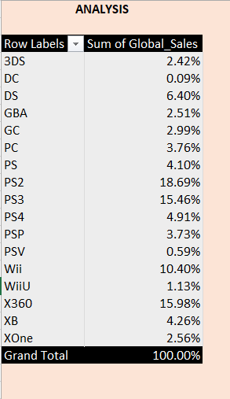
6. CONSOLES MARKET DISTRIBUTION

Slide 17
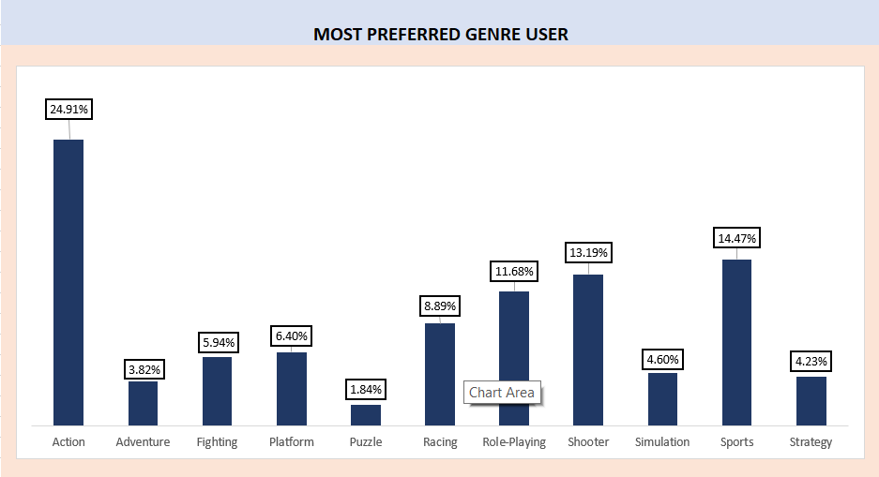
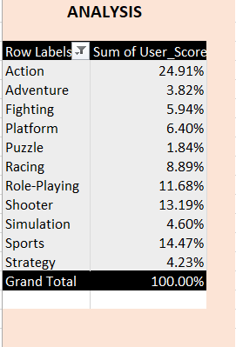
7. MOST PREFERRED GENRE USER

Slide 18
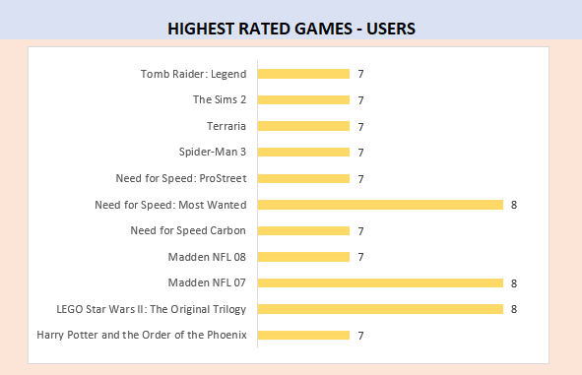
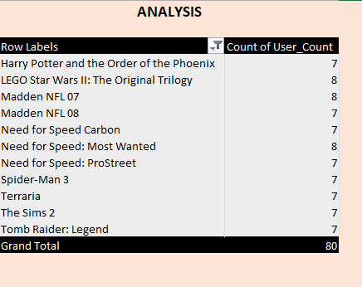
8. HIGHEST RATED GAMES- USERS

Slide 19
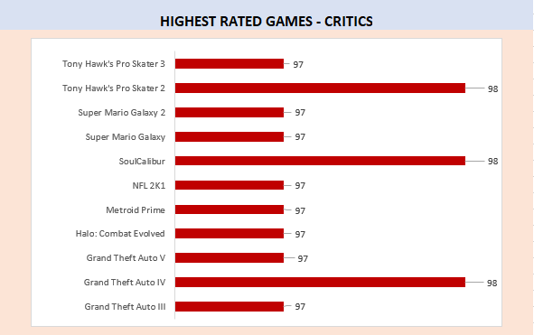
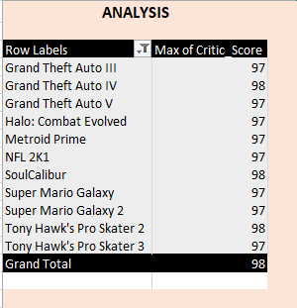
9. HIGHEST RATED GAMES- CRITICS

Slide 20
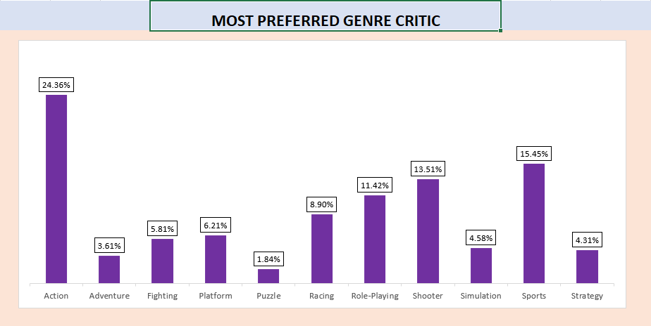
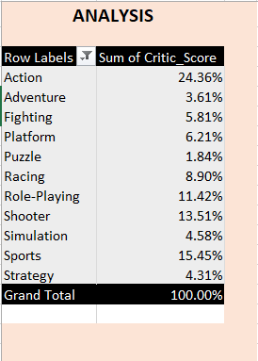
10. MOST PREFERRED GENRE CRITIC

Slide 21
THANKS!
Any questions?

