Slide 1

University registrar
By: Shubham Metha
NUID: 001444464

Slide 2

PROBLEM STATEMENT:
A University is a huge ground of students, staffs, courses, and projects. All of these are connected to each other and need to work hand in hand.
There comes a huge amount of data. Most of the universities and colleges save the data in excel sheets or just a book registry.
The issue here is, less availability of information than its overabundance, and access to quality information for diverse users and uses.
The challenge is to refine what is useful out of the huge quantity of information available: to retrieve, store, calculate, alter, explain, and present information in all its forms like text, and numeric data.

Slide 3
SOLUTION STATEMENT:
The goal is to not provide simply data but, information that enhances understanding. The database will provide us with information about students, staff, courses and projects.
It will let the university know about the staff members available, courses that each staff member is teaching and the timings.
The database will help university to sort and categorize data as per courses, students and project interest.
The database will have the data of all the students and staff. The university can use the data to determine information like: student biographic information, students allocated to particular course, staff availability, course timings, staff information, and projects of research.
The database will provide a framework to the user through describing the high level components and architecture, sub systems, interfaces, database design.

Slide 4
ENTITIES:
The entities used for the University Registrar database are following:
UNIVERSITY AND DEPARTMENT: These entities will have the university name and department name.
STUDENT: The student entity will cover all the student details such as name, address, biographic and personal information.
STAFF: The staff will have primarily staff_id, and then the basic biographic information. The staff will have a relationship with courses and projects.
COURSE OFFERED: The course offered is the table which will have course name, and will also populate course schedule.
AREA OF INTEREST: The area of research table will collect the information about the area in which a staff member is interested and details about it.
RESEARCH PROJECT: The Research project will have project_id, name and details about the project.

Slide 5
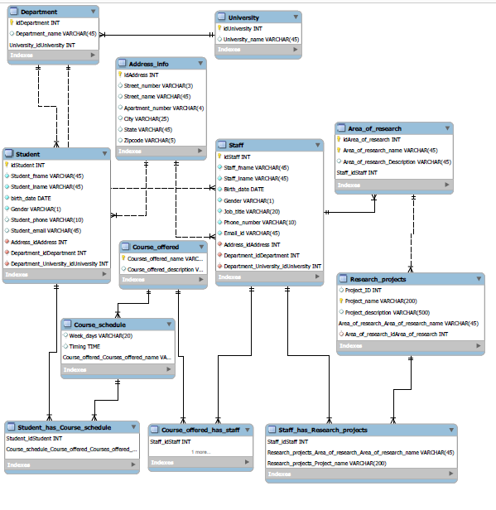
ER
DIAGRAM:

Slide 6
features used
Multiple User Login
Security
Goal-targeted content
Personalized experiences
Ease to access useful Data
Normalization
Groups Data Logically
Reduces Data Duplication
Less update, delete and insert anomalies
Triggers
Integrity of data
Data validation
Logging of event
Stored Procedure
Scalability
Fast and robust
Productivity and Ease of Use
Views
Built-in security
Stabilization of information
Simplicity for queries
Backup
Better when data loss
High rate of reliability
Greater Security

Slide 7
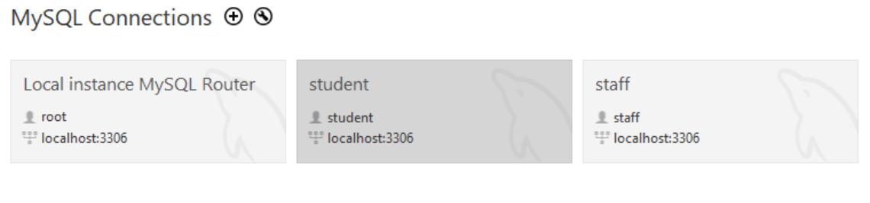
DIFFERENT USER CONNECTION
Student Connection for Student login
Staff Connection for Staff login
Root Connection for Admin login

Slide 8
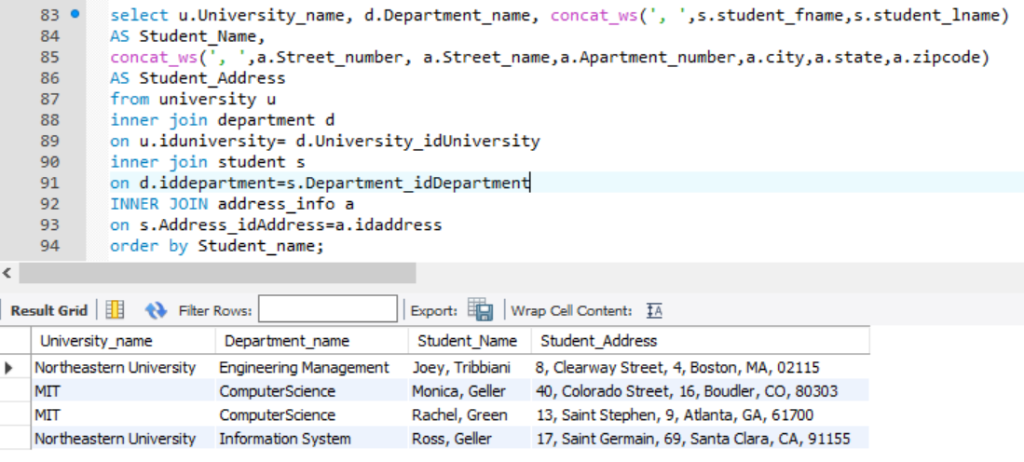
Student information

Slide 9
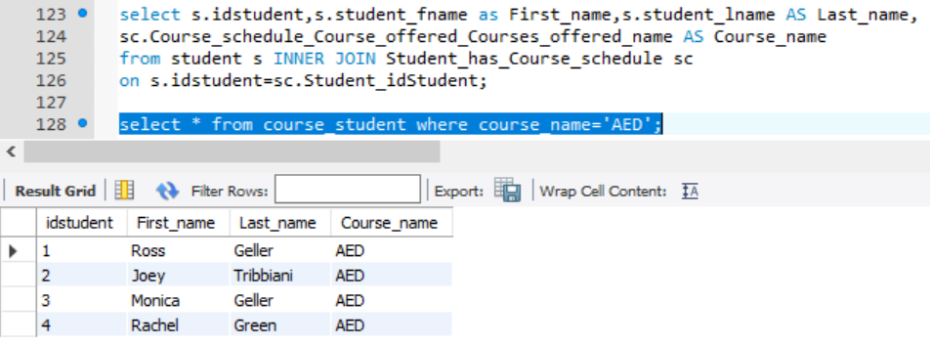
VIEW FOR COURSE & STUDENT

Slide 10
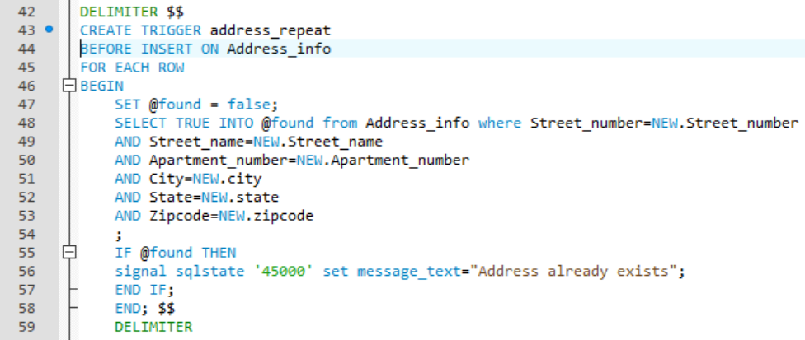
TRIGGER FOR ADDRESS VALIDATION

Slide 11
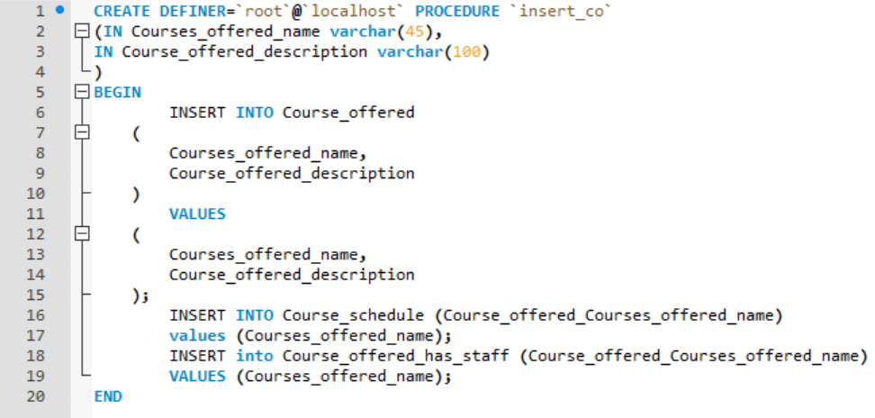
STORED PROCEDURE TO INSERT DATA IN COURSE OFFERD & SCHEDULE TABLES

Slide 12
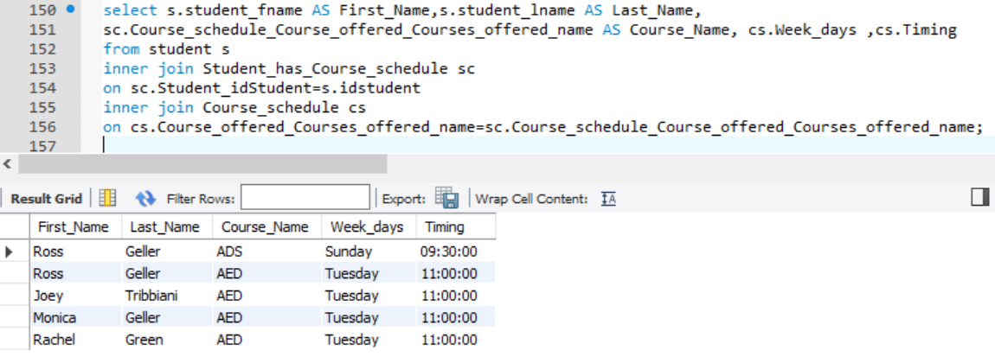
QUERY TO GET STUDENT SCHEDULE

Slide 13
ANY QUESTION?

