Slide 1

Medictiv: Advanced Analytics Use Cases for Fraud Waste And Abuse (FWA)
February 2017
This document is confidential and contains proprietary information, including trade secrets of CitiusTech. Neither the document nor any of the information contained in it may be reproduced or disclosed to any unauthorized person under any circumstances without the express written permission of CitiusTech.

Slide 2
Healthcare Fraud- Problem Definition
CitiusTech: Healthcare Fraud – Our Understanding
Fraud costs payers close to $1 billion annually in UAE as compared to US which is up to $175 billion
Only 2% are detected despite Technological Advancement in Fraud Detection Solutions
Fraud costs the average UAE family between $400 and $600 per year in the form of increased premiums
Fraud Investigations can also impact Customer Satisfaction and Payer-Provider Relationship
Its becoming Increasingly Difficult for payers to detect Well organized Frauds
There is an industrywide need for advanced technologies which can:
Analyze huge financial and clinical data beyond age old techniques to not only detect fraudulent activity, but to prevent it
Detect and adapt to continuously evolving fraud and abuse patterns
Offer detection of suspicious claims with high certainty before payments
Identify outliers from high claims volumes which can potentially be suspicious in nature
Automate the detection of multi-entity fraud and abuse schemes
Low
Impact
Waste
Abuse
Fraud
High
Impact
Fraud, waste and abuse exist on a continuum from low to high impact, and fall into following categories:
Medical identity theft; Billing for unnecessary, not rendered or non-covered services & items; upcoding; unbundling; duplicate billing; over-utilization; phantom billing; beneficiary fraud.

Slide 3

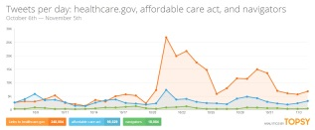
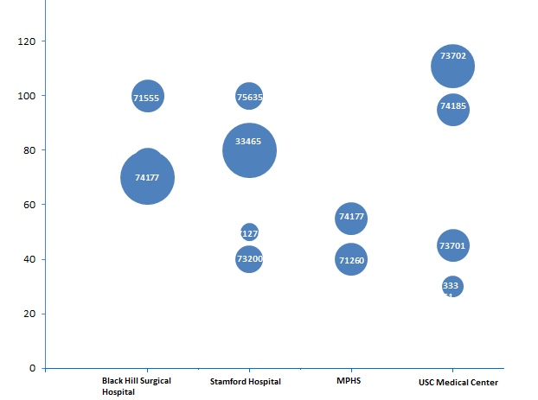
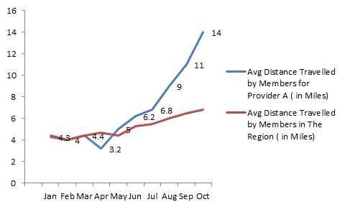

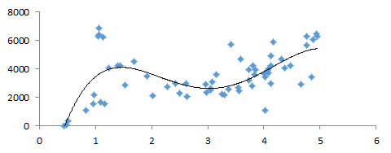


CitiusTech: Healthcare Fraud – Business Cases
Pattern Analytics | Geo-Mapping Analytics | Social Media Analytics | Risk Score Analytics
Use Intelligence to identify Patterns Clinical Procedures Abuse Trends Mismatch between diagnosis and medications/procedures Recurrent high value claims by provider Member Visit Patterns Drug prescription refills before time Multiple prescriptions for similar condition from geographically distant location | Track Member movement to Provider Locations Track member movements for a Provider Multiple member visits to various provider or a single provider Noticeably high distance traversed by a member for an office visit | Validate claims data with Social Media analytics Member information mismatch with Social Media Abnormalities in member’s demo data vs actuals from Social Media Deviations in claims data vs unstructured data (Audio and Text messages) Member data validation: Check for historical, hospitalization and medication data | Member Risk Score vs. Claim Costs Cluster cases of high claim amount and corresponding Low Risk Scores Claim Amount Mismatch– Actual vs. Expected claim amount based on the Risk score Enable stratification of providers based on their potential fraud appetite, tempered by overhead of possible appeals
$ Value

Slide 4
CitiusTech: Evidence Based Reimbursements Approach (1/2)
Objective:
Evaluate claim payments to identify opportunities for cost control and improving care quality; build intelligence for decision support around provider contract negotiation or value-based payment (e.g., payment bundling)
Methodology:
Exploratory Analytics
Identify outliers in payments by diseases, procedures, drugs, etc.
Determine if outliers are justifiable – by health plan or contract
Determine spend distribution by disease to determine member population by chronic diseases, etc.
Opportunity Identification
Determine variance in spend on procedures
Compare spend with benchmarks adjusted for geography (e.g., Truven or median spend) to determine contract renegotiation opportunity
Determine highest spend members using Pareto analysis to determine up/cross sell opportunity
Payment Bundling
For disease care episode, e.g., hip or knee replacement, perform pre- and post-event analysis
Determine comorbid conditions and procedures in pre- and post-event periods (determine risk adjustment for payment if applicable)
Mine data to determine optimal combination of procedures and determine total spend for the bundle

Slide 5
CitiusTech: Evidence Based Reimbursements Approach (2/2)
Step 1: Exploratory Analysis
Step 2: Opportunity Identification
Settled Claims – Inpatient, Outpatient, Pharmacy, Home Health, etc.
DATA SOURCE
SPEND VARIANCE
BENCHMARKING
PARETO ANALYSIS
Determine variance in spend per procedure and drug
Compare spend with benchmarks for CONTRACT NEGOTIATION opportunity
Determine high spend members for plan CROSS / UPSELL opportunity
Justifiable outliers
Cleansing
Outlier detection
Univariate analysis
Health plan based benchmarking
EXPLORATORY ANALYSIS
Step 3: Bundled Payments
Create segments / groups of procedures based on frequency and spend
PRE/POST EVENT ANALYSIS
DATA MINING
CREATE COHORT
Determine volume, spend of procedures before and after the event of interest
Create member cohort, e.g. members who have had hip replacement

Slide 6
CitiusTech: Healthcare Fraud Analytics Approach (1/2)
Objective:
Identify outlier claims in settled claims to determine fraud and abuse patterns, and leverage patterns to predict if submitted claims are fraudulent.
Methodology:
Exploratory Analytics
Identify outliers in payments by diseases, procedures, drugs, etc.
Identify outliers unexplained by health plan policies as potential frauds
Retrospective Analytics
Mine potential fraud claims by following dimensions – Payer, health plan, providers, location, specialty, diagnosis/disease, services/procedures
Data mining provides patterns in data based on these dimensions
For each pattern, determine incidence of fraud (proportion of all claims)
For each pattern, determine reimbursements made for fraudulent claims
Perform drill down / drill through to determine critical causes of fraud
Present focused list of high value claims to maximize recovery
Predictive Analytics
Based predictive model based on patterns revealed in the retrospective
Model will be able to predict
If a claim is fraudulent, or
Risk of claim being fraudulent

Slide 7
CitiusTech: Healthcare Fraud Analytics Approach (2/2)
Step 1: Exploratory Analysis
PAYMENT INTEGRITY (FRAUD DETECTION AND PREVENTION)
Step 2: Retrospective Analysis – “post-pay”
DATA SOURCE
Settled Claims – Inpatient, Outpatient, Pharmacy, Home Health, etc.
Mine claims for patterns based on provider, disease, procedure, etc.
DATA MINING
Pattern wise fraud incidence and remittances to determine collections opportunity
REPORT PATTERNS
REVIEW & COLLECTIONS
\
Review results and initiate collections
Suspect outliers
EXPLORATORY ANALYSIS
Cleansing
Outlier detection
Univariate analysis
Health plan based benchmarking
Step 3: Predictive Analysis “pre-pay”
MODELLING
Create model based on patterns to predict risk of fraud
Predict risk of fraud for submitted claims and delay / prevent reimbursement
REAL TIME SCORING
REVIEW & REJECT
Review prediction and finalize decision; notify provider with reason
DATA SOURCE
Submitted Claims – Inpatient, Outpatient, Pharmacy, Home Health, etc.
For predictive analytics only

