Slide 1
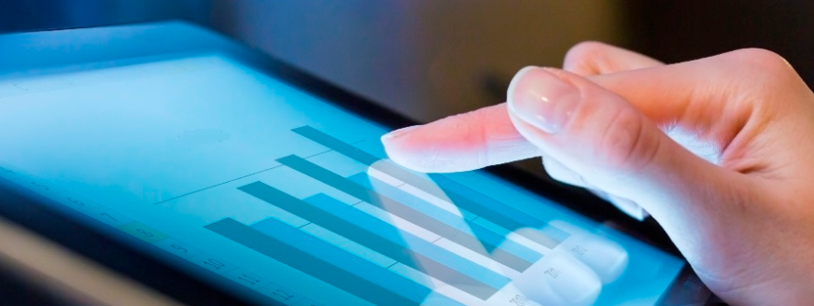
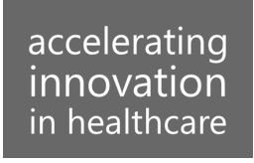
Medictiv: Advanced Analytics Use Cases for Medical Devices
February 2017
This document is confidential and contains proprietary information, including trade secrets of CitiusTech. Neither the document nor any of the information contained in it may be reproduced or disclosed to any unauthorized person under any circumstances without the express written permission of CitiusTech.

Slide 2
Medtronic: Advanced Analytics Focus Areas (1/3)
Treatment Planning
Identify Targeted Treatments
Predict Treatment Efficacy
Medication Management / Device Management
Risk Assessment
Service Use (Pharmacy, Inpatient, ER, etc.)
Readmission, Length of stay
Behavioral risk
Process Improvement
Personnel Utilization
Equipment Utilization
Data Management
Analytics Focus
Wellness Management
Predict disease progression
Episode Prediction
Smart connected devices
Clinical Trials Analytics
Site Selector
Patent Network Analysis
Clinical Trials Meta Analysis
Operational Analytics
Product supply optimization
Product Pricing
Product Innovation

Slide 3
Advanced Analytics Focus Areas (2/3)
Focus Area | Product Category | Key Use Cases
Risk Assessment | Cardiac Rhythm (SEEQ MCT, Reveal LINQ, Micra Pacemaker, Visia ICDs, Viva CRT-P) Diabetes (MiniMed, iPro2 Professional CGM) Symplicity RDN System | Predictive alerts for high / low sugar levels using data from CareLink and CGM Readmission risk or LOS prediction for patients using cardiovascular or diabetes products Predict high risk CKD patients progressing rapidly towards ESRD using data from Symplicity RDN Identify risk of sudden cardiac death associated with obstructive sleep apnea by collating data from multiple smart connected devices Patient risk categorization based on care setting – inpatient, ER, Device use and other services
Wellness Management | Diabetes (MiniMed) Cardiac Rhythm (Reveal LINQ, Micra Pacemaker) | Predict disease progression based on data from EHR, Medtronic devices and behavioral data (e.g. physical activity, diet, etc.) Predict risk of adverse clinical events – e.g. risk for Arrhythmia, Tachy, Brady episodes. Adjust device (Reveal LINQ / Micra pacemaker) configuration

Slide 4
Advanced Analytics Focus Areas (3/3)
Focus Area | Product Category | Key Use Cases
Treatment Planning | Diabetes (MiniMed, iPro2 Professional CGM) | Identify most suitable treatment plan by comparing patient EHR / device data with other patients within a similar population cohort Forecast efficiency of treatment by monitoring device data (e.g. data from MiniMed for Diabetes)
Process Improvement | Neurological (O-arm Surgical Imaging System) | Forecast personnel and equipment utilization e.g. utilization for O-arm surgical imaging equipment
Operational Analytics | Cardiovascular (Coronary Balloons, Catheters) | Forecast surgical equipment demand for products such as balloons, catheters and ventilator filters Identify cross-sell / up-sell opportunities by analyzing ordered (sales data) vs utilized (claims data) surgical equipment quantity Reliability prediction for CRHF and RCS products
Clinical Trials Analytics | Symplicity RDN System CareLink Monitors | Statistical analysis of clinical trials data from Symplicity RDN System Identify most suitable clinical trial site and patients for recruitment

