Slide 1



Medictiv: Advanced Analytics Use Cases for Provider ISV
February 2017
This document is confidential and contains proprietary information, including trade secrets of CitiusTech. Neither the document nor any of the information contained in it may be reproduced or disclosed to any unauthorized person under any circumstances without the express written permission of CitiusTech.

Slide 2
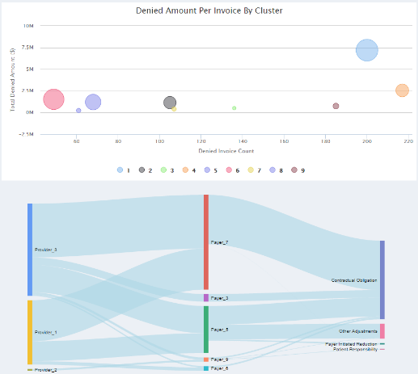
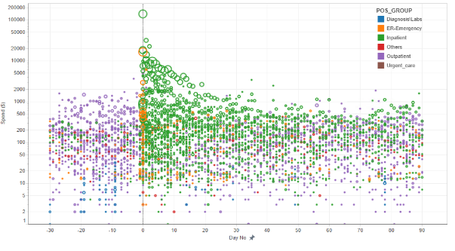
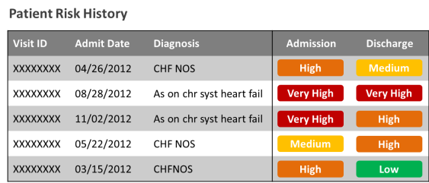
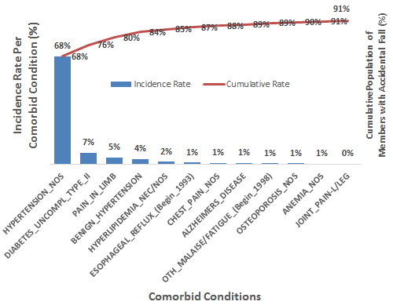
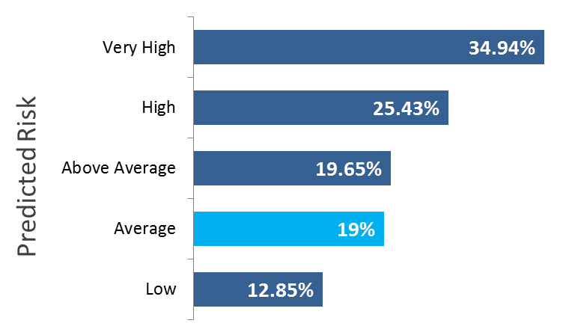
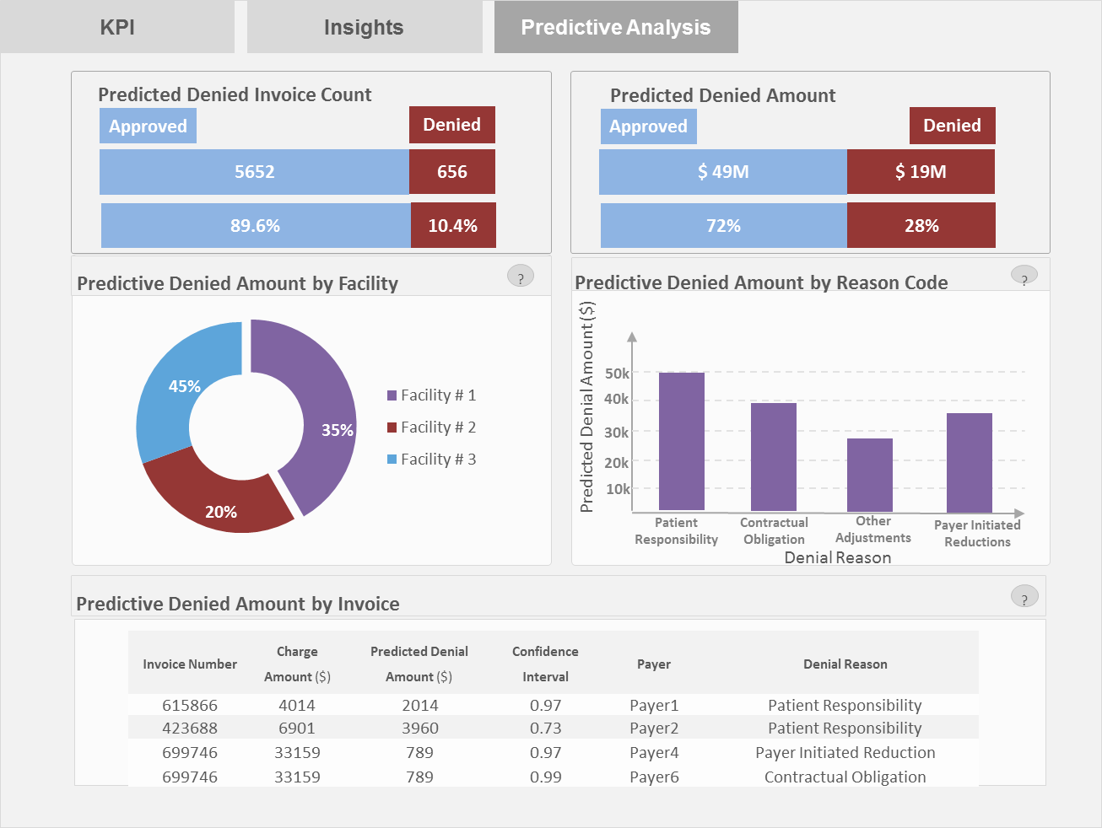
Approach Framework: Sample Outcomes
Readmissions Management | Revenue Cycle Management | Cost Containment
Predict risk of a patients being readmitted to the hospital within 30 / 60 / 90 days of discharge Adjust treatment and post-discharge care to ensure readmission is prevented | Determine patterns of denials by treatments, physicians, payers and health plans Predict is newly submitted claims will be denied and likely reason for denial | Contain costs borne by payers to treat chronic conditions by bundling payments Predict risk of a fall in senior citizens to enable preventative measures and rapid response

Slide 3
Approach Framework: Sample Use Case Approach
Step 1: Exploratory Analysis
SAMPLE USE CASE FRAMEWORK
Step 2: Retrospective Analysis
DATA SOURCE
Claims Data, Clinical Data, Radiology Data, Patient/Member generated Data, etc.
Mine claims for patterns based on provider, disease, procedure, etc.
DATA MINING
Report outcomes and other dimensions of interest for each generated pattern
REPORT PATTERNS
REVIEW
\
Review results, identify additional outcomes of interest, determine future actions
EXPLORATORY ANALYSIS
Cleansing
Defining outcomes
Outlier detection
Univariate / bivariate analysis
Step 3: Predictive Analysis
MODELLING
Create model based on patterns to predict risks / probabilities of outcomes of interest
Predict risk / probability of outcome either in real time or batch processing
SCORING
REVIEW & REJECT
Review predictions and finalize decision; notify stakeholders to determine action
DATA SOURCE
Incomplete / New: Claims Data, Clinical Data, Radiology Data, Patient/Member generated Data, etc.
For predictive analytics only

