Slide 1
Analysis of Global CO₂ Production
Presented by: Shubham Mittal
Last Updated: 27-May-2021

Slide 2
Table of contents
Problem
Data Analysis
Key Insights
Recommendations

Slide 3
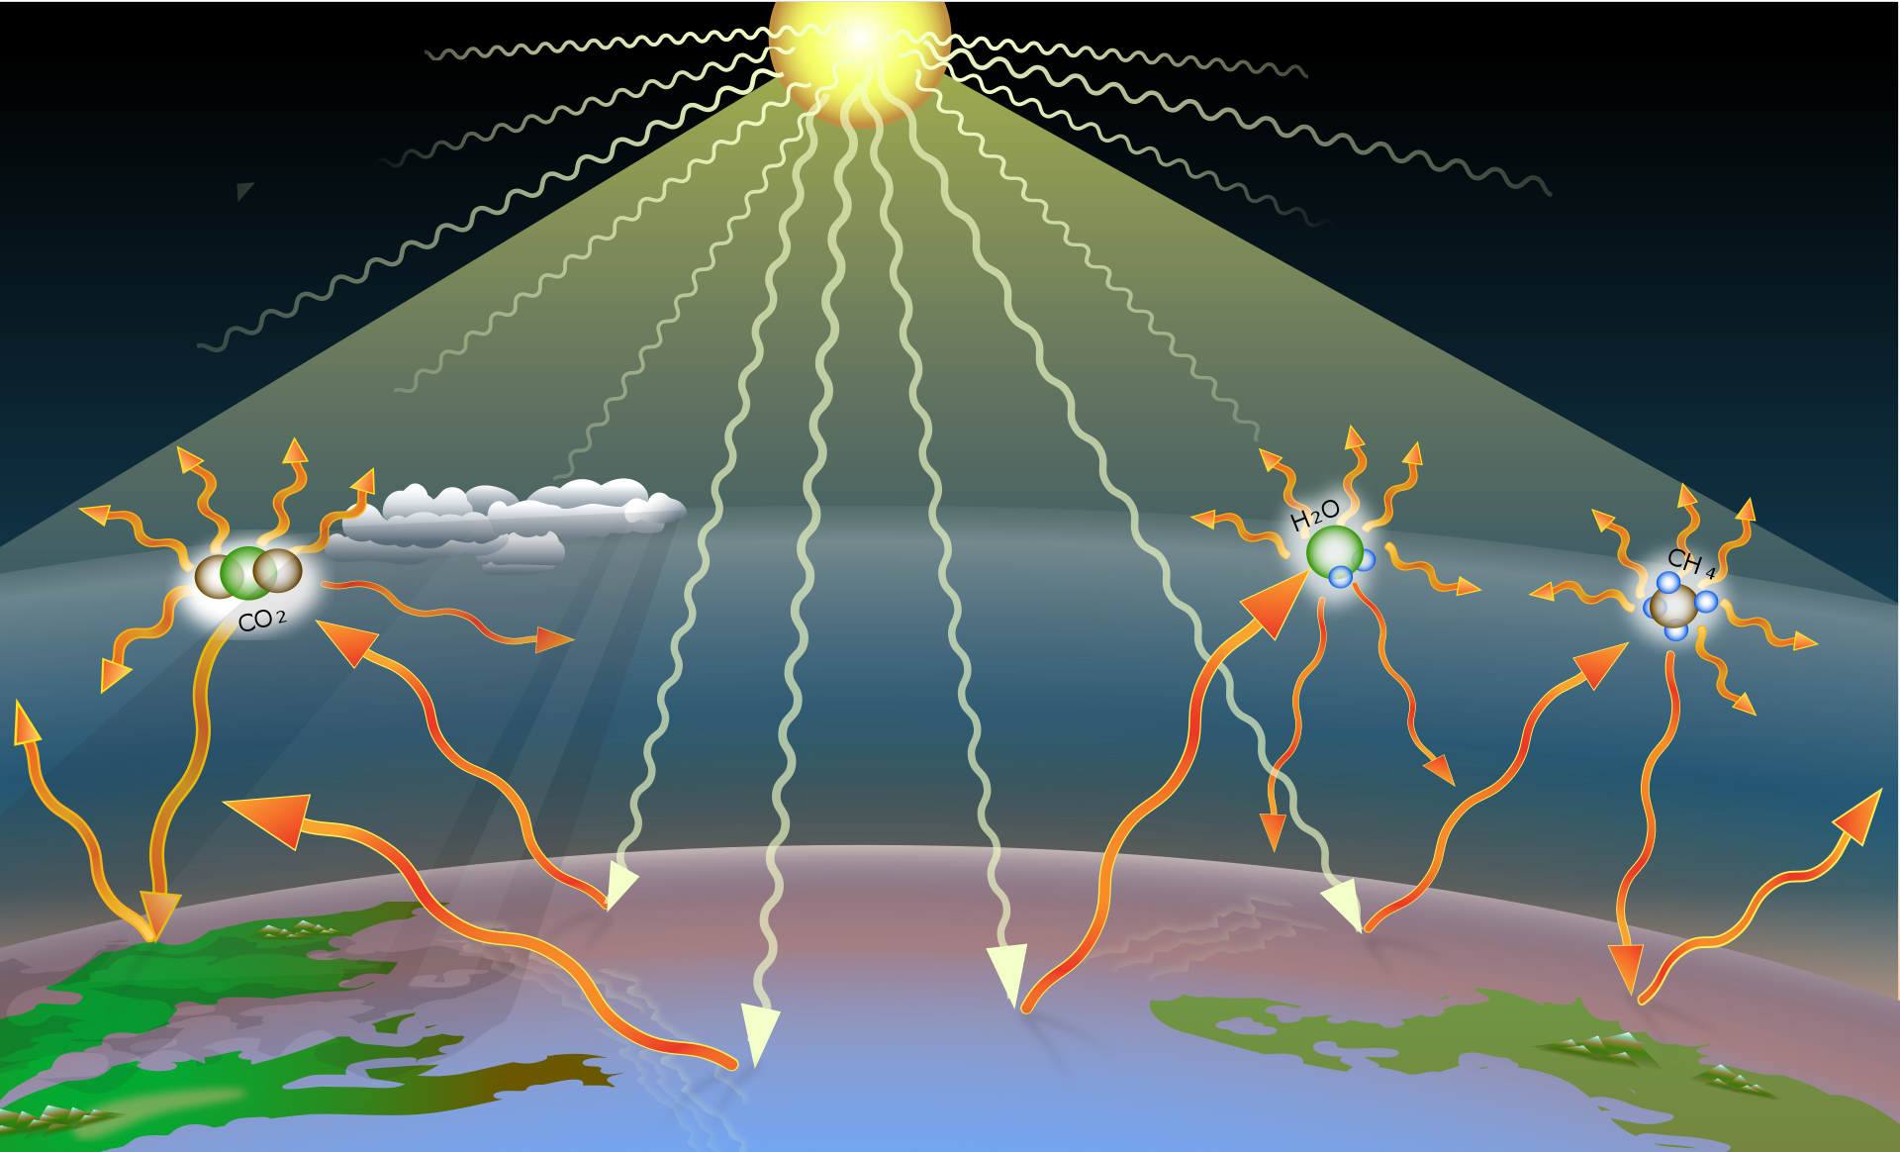
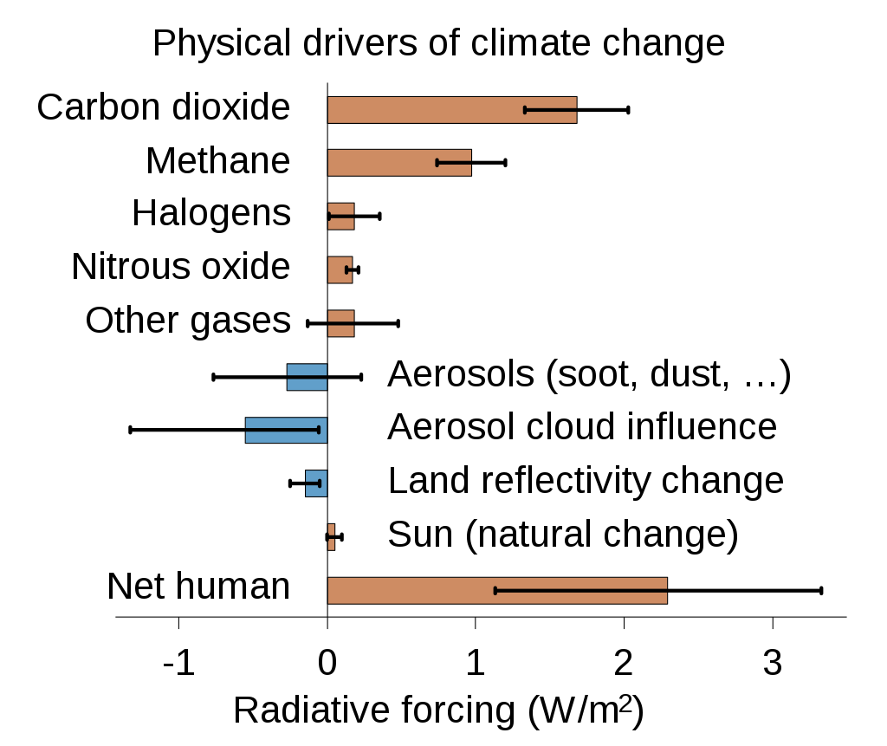
Problem
Greenhouse Effect
Earth is hotter now
Seal-level increasing
Uncertainty in weather
Ozone layer depleting
It’s GLOBAL WARMING

Slide 4
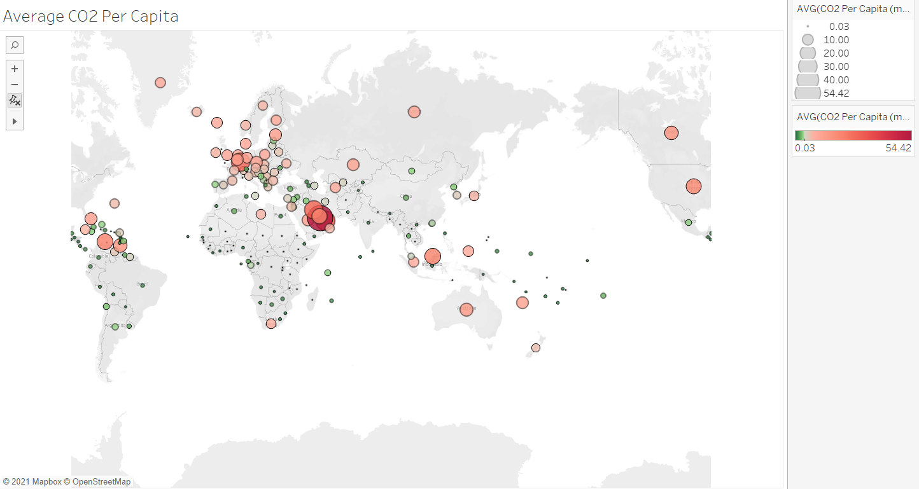
Average Carbon-Dioxide emission per person
247 countries
Averaged over 1960-2011
International variability

Slide 5
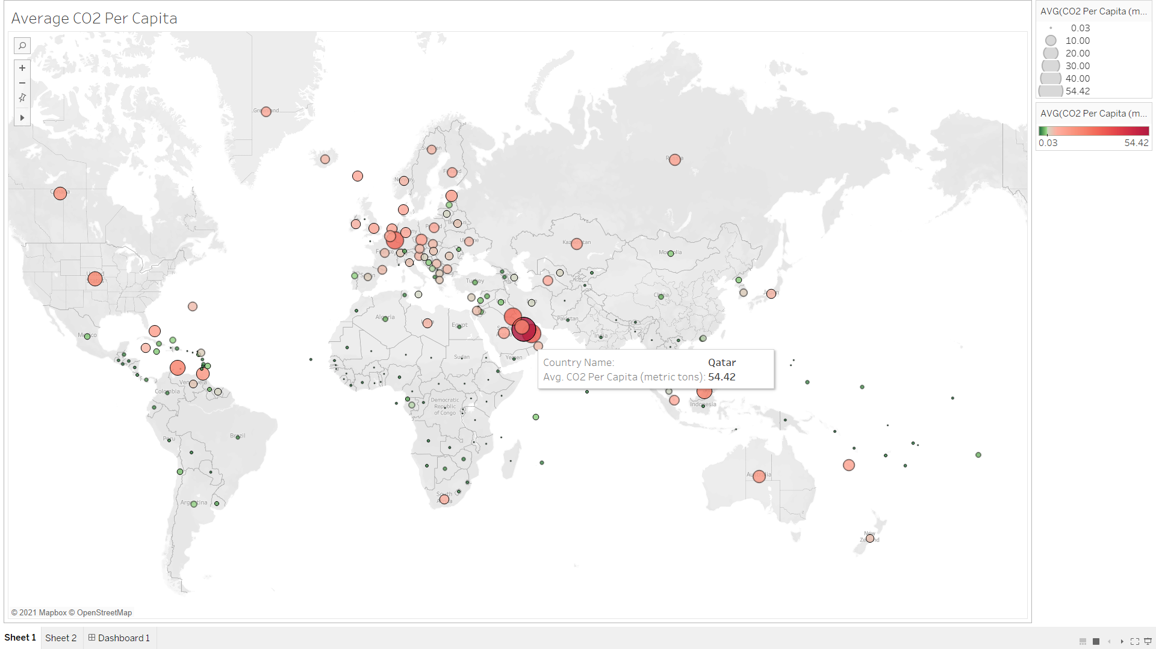
Most emitting country

Slide 6
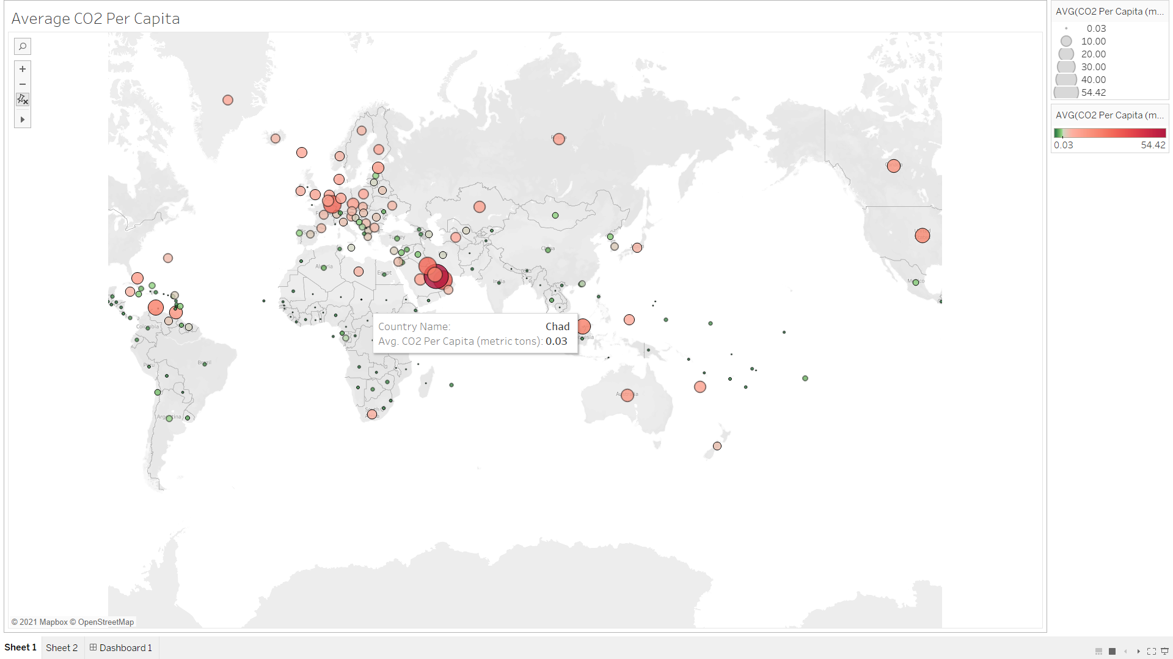
Least emitting country

Slide 7
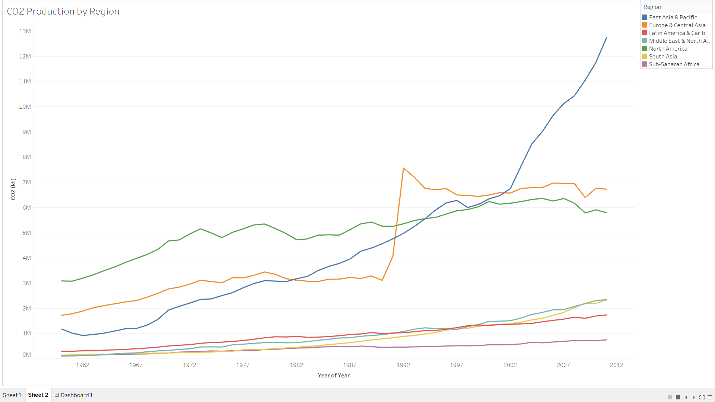
Yearly trend of CO2 production
Biggest Contributor
Smallest Contributor

Slide 8
Key insights
Recommendation(s)
Vast international heterogeneity in emissions
Biggest contributors = East Asia & Pacific + Europe & Central Asia
East Asia & Pacific has exponential rise since 2002
North America has gradual reduce after 2005
Nations in East Asia & Pacific should adopt to cleaner energy alternatives
Note: The analysis is based only upon the global data recorded till 2011. The updated trends may vary

Slide 9
Thanks

