Slide 1
Data Science Project
Analyzed By: Shubham Modi
Project Owner: Shubham Modi

Slide 2
Introduction
In this experiment, I performed an Exploratory Data Analysis of the dataset for a selected group of customers in the initial days of post-sale.

Slide 3
Objectives
Here are the questions I would like to answer:
Is there a correlation between the Score and repayment performance?
Is there a correlation between the Score and delinquency status?
Are there other interesting insights you can glean from the dataset provided?

Slide 4
Technologies
Language - Python
Framework - Jupyter Notebook
Python Libs –
pandas
numpy
scikit-learn
seaborn
matplotlib

Slide 5
Analysis Steps
Finding missing values
Explore numerical and categorical variables
Standardization of Variables
Finding and removing outliers (if needed)
Finding relationships between different variables
Experiments with model training

Slide 6
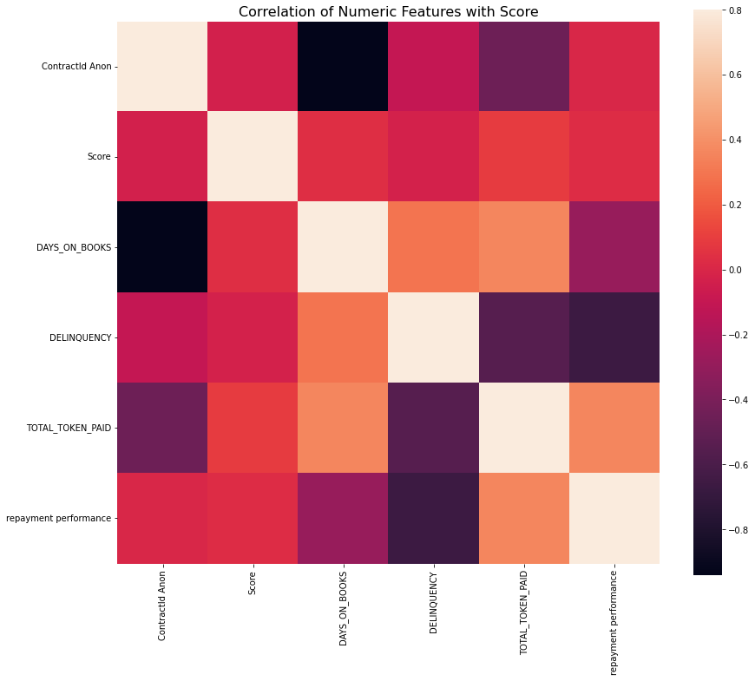
Observations
Correlation values of ‘Score’ with the other features

Slide 7
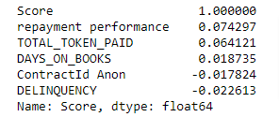
Observations
Correlation values of ‘Score’ with the other features

Slide 8
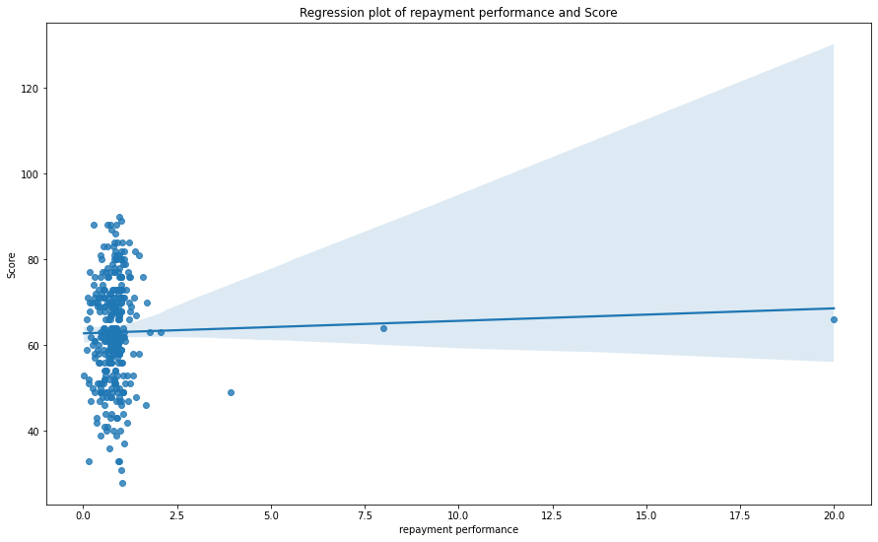
Observations: score vs repayment performance

Slide 9
Observations: score vs repayment performance
From the aforementioned visualizations, It seems “repayment performance" and “score" has a positive correlation.
Although the correlation value is very small, 0.074

Slide 10
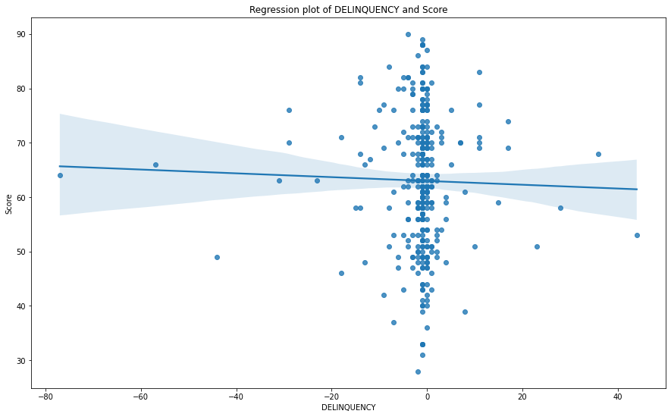
Observations: score vs delinquency

Slide 11
Observations: score vs delinquency
From the aforementioned visualizations, It seems “delinquency" and “score" has a negative correlation.
Pearson Correlation value is, -0.022

Slide 12
Observations: other insights
Most contracts are using 'Product 1(large SHS)’
There is a class of customers for which scores is varying plus they are using Product 1(large SHS). So, in my opinion, targeting this class would be apt for Sales purposes.

Slide 13
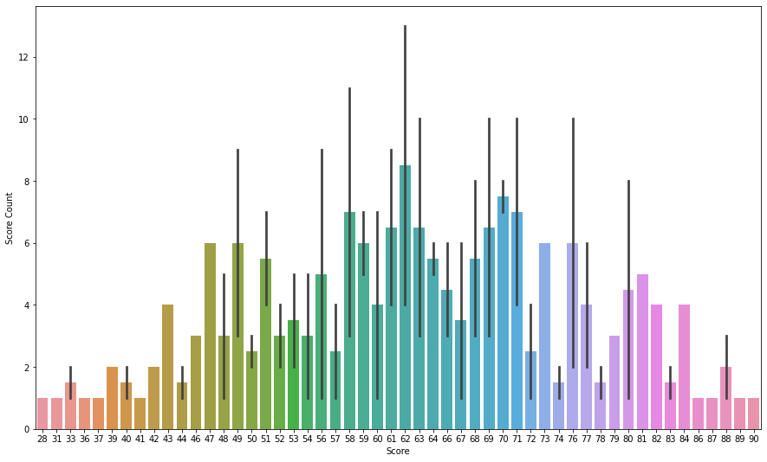
Observations: other insights
Most of the contract id (whether the UPSELL is True or False) lies between the 1st std deviation of the distribution. That means Businesses need to focus on the contract ids' whose score lies between 43 to 76.
grey bars have Upsell Value – True
Colored bars have Upsell Value – False

Slide 14
Future Work
We can also perform regression modeling on ‘score’ using given features.
For example, I did the same experiment using two features ‘repayment performance’, and ‘delinquency’ (without removing outliers) to predict the scores. For which I got the MAE score of 9.822
This can be further improved if provided with enough samples in the future. Outliers can be removed after the discussion with the SMEs. We have seen outliers in the regplots for different features in the previous slides.

