Slide 1
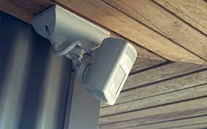
MOTION DETECTION AND SURVEILLANCE SYSTEM

Slide 2
CONTENT Abstract Introduction Problem Statement Methodology Use Case Diagram Progress References

Slide 3
ABSTRACT In today's competitive environment, the security concerns have grown tremendously. In the modern world, possession is known to be 9/10'ths of the law. Hence, it is imperative for one to be able to safeguard one's property from worldly harms such as thefts, destruction of property, people with malicious intent etc. Due to the advent of technology in the modern world, the methodologies used by thieves and robbers for stealing has been improving exponentially. Therefore, it is necessary for the s the improvement in mass media and various forms of communication, it is now possible to monitor and control the environment to the advantage of the owners of the property. surveillance techniques to also improve with the changing world.

Slide 4
the improvement in mass media and various forms of communication, it is now possible to monitor and control the environment to the advantage of the owners of the property. The latest technologies used in the fight against thefts and destruction are the video surveillance and monitoring. By using the technologies, it is possible to monitor and capture every inch and second of the area in interest. However, so far the technologies used are passive in nature in the monitoring systems only help in detecting the crime participate in stopping or curbing the crime while it takes place. Therefore, we have developed a methodology to detect the motion in a video stream environment and this is an idea to ensure that the monitoring systems not only actively participate in stopping the crime.

Slide 5
Introduction In recent years, motion detection has attracted a great interest from computer vision researchers due to its promising applications in many areas, such as video surveillance, traffic monitoring or sign language recognition. However, it is still in its early developmental stage and needs to improve its robustness when applied in a complex environment: Several techniques for moving object detection have been proposed among them the three representative approaches are temporal differencing, background subtraction and optical flow.

Slide 6
Temporal differencing based on frame difference, attempts to detect moving regions by making use of the difference of consecutive frames (two or three) in a video sequence. This method is highly adaptive to dynamic environments, but generally does a poor job of extracting the complete shapes of certain types of moving objects. Background subtraction is the most commonly used approach in presence of still cameras. The principle of this method is to use a model of the background and compare the current image with a reference. In this way the foreground objects present in the scene are detected.

Slide 7

Problem Statement Developing a solution for the identification and rendering of human faces in videos on real time basis By using this technique we can identify the miscellaneous activity in such areas where we can personally go. In this we use real time videos that help to recognize threats and miscellaneous activity.

Slide 8
Methodology The objective of this experiment is to compare the performance of 2 emotion-recognition implementations. The first one (Experiment A) is a Python-based application which makes use of the OpenCV machine learning algorithms for facial and emotion detection. The second one (Experiment B) is a C# software application which makes requests to a Cognitive Services API for emotion detection. In both cases, the Extended CohnKanade dataset of images was used as input for the analysis. Both applications were developed by the authors for this experiment.

Slide 9
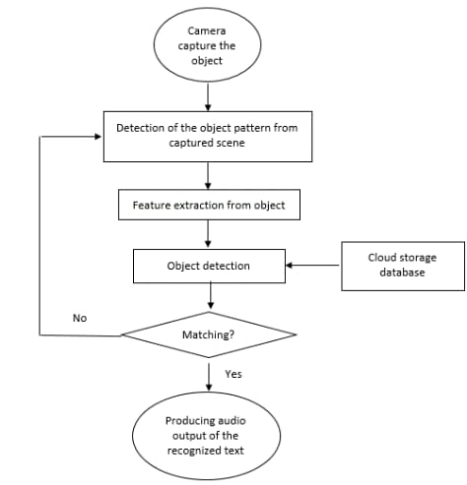
Use Case Diagram

Slide 10
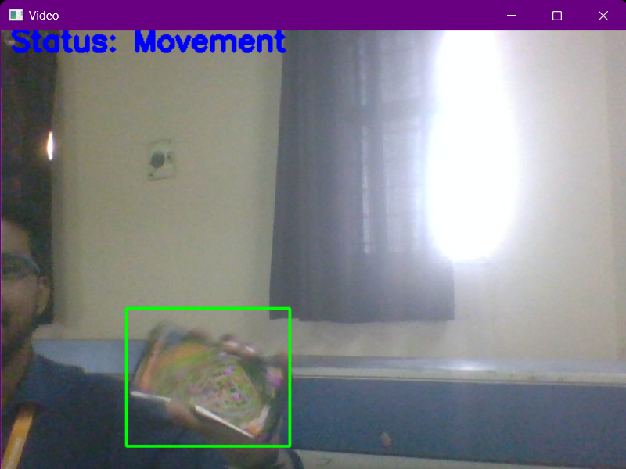
Progress

Slide 11
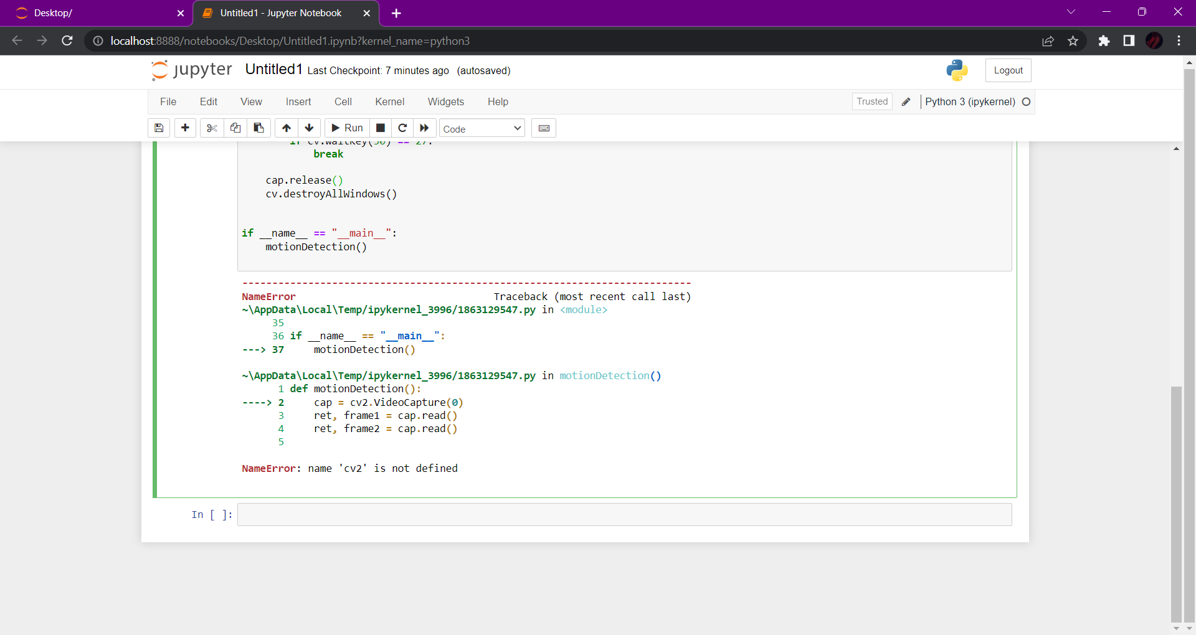
Progress(error)

Slide 12
References
A motion detection system in python and Opencv IEEE Paper (Suraiya Parveen &Javeria Shah) Jamia Hamdard University, New Delhi.
Emotion Detection using image processing in python( raghav Puri,archit Gupta, manas sikri, Mohit Tiwari, Nitish Pathak, Shivendra goeal) Bharti Vidyapeeth’s College of Engineering , New Delhi , India.
MATEC web of Conference 2017.
Phillipp Wagner July 2012(Face recognition with Python.
An Intelligent motion detection using Opencv , International journal of scientific research in science , engineering and technology.
A survey on object detection and tracking algorithm by Rupesh Kumar Rout , CSE Department NITRourkela.
Real time abnormal function detection in surveillance video by Massachusetts Institiute of technology Cambridge University.

Slide 13
Thank you Group Members Anurag Selote Pranita Ambulkar Sakshi Dhage Shreyash Bagde Shubham Mowade Tushar Nandurkar

