Slide 1
Book1
File created on: 23/12/20 4:55:28 PM GMT+05:30

Slide 2
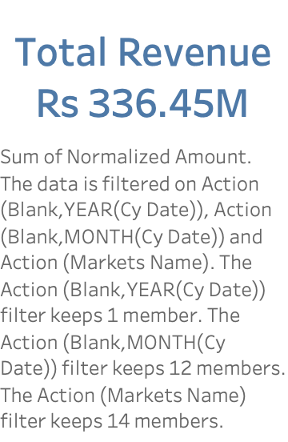

Slide 3
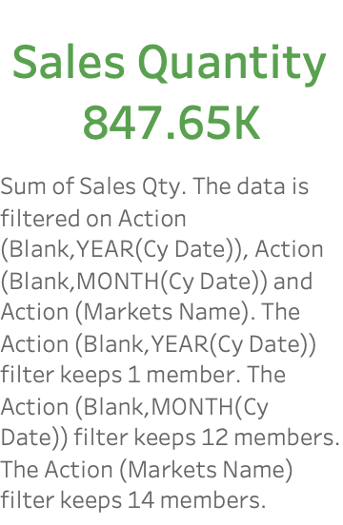

Slide 4
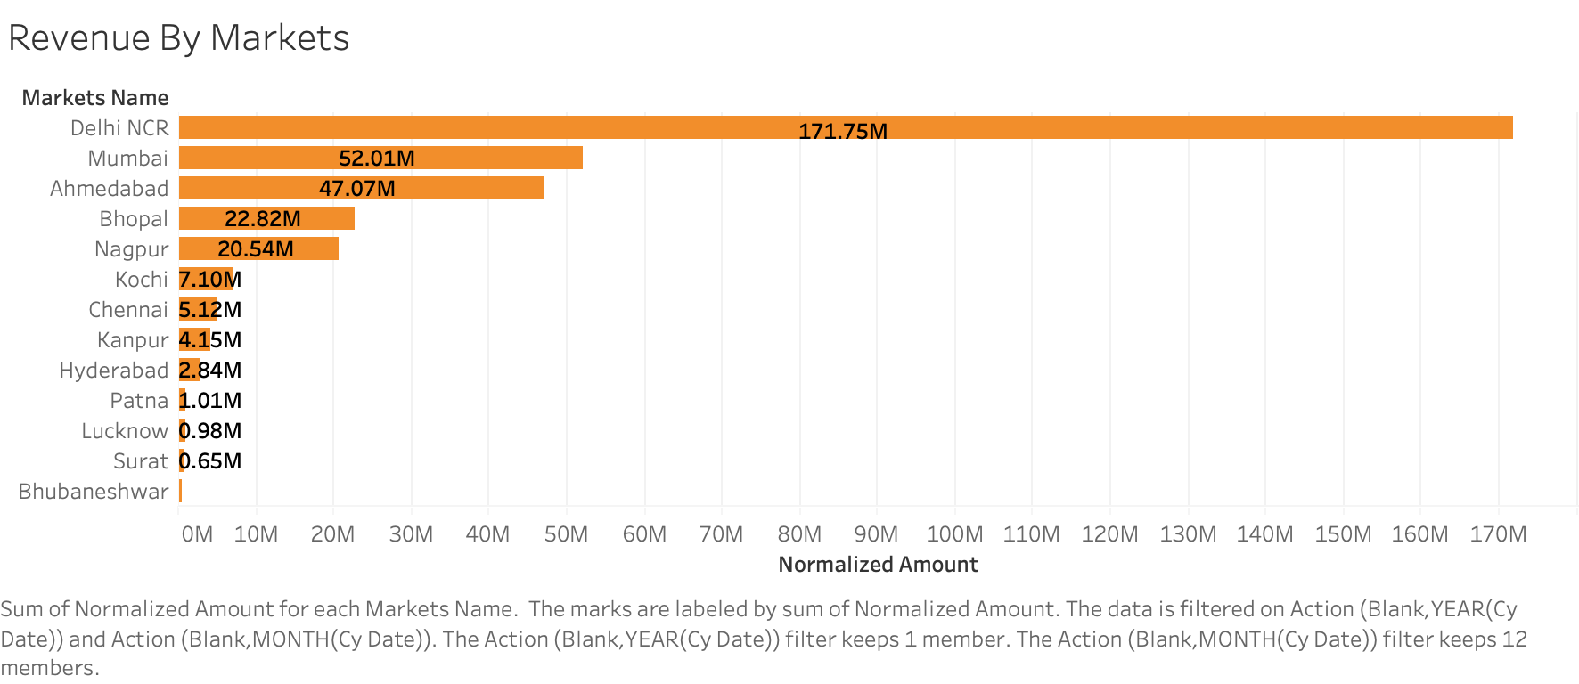

Slide 5
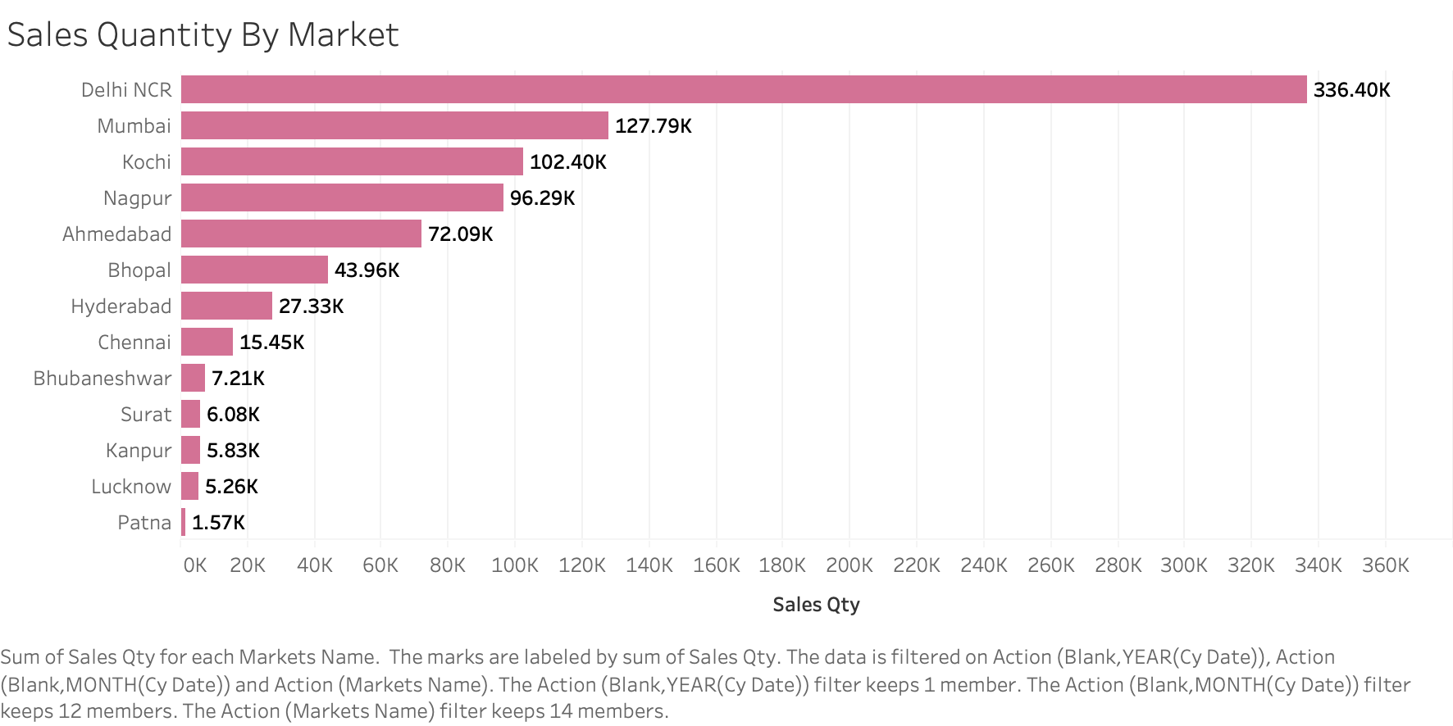

Slide 6


Slide 7


Slide 8
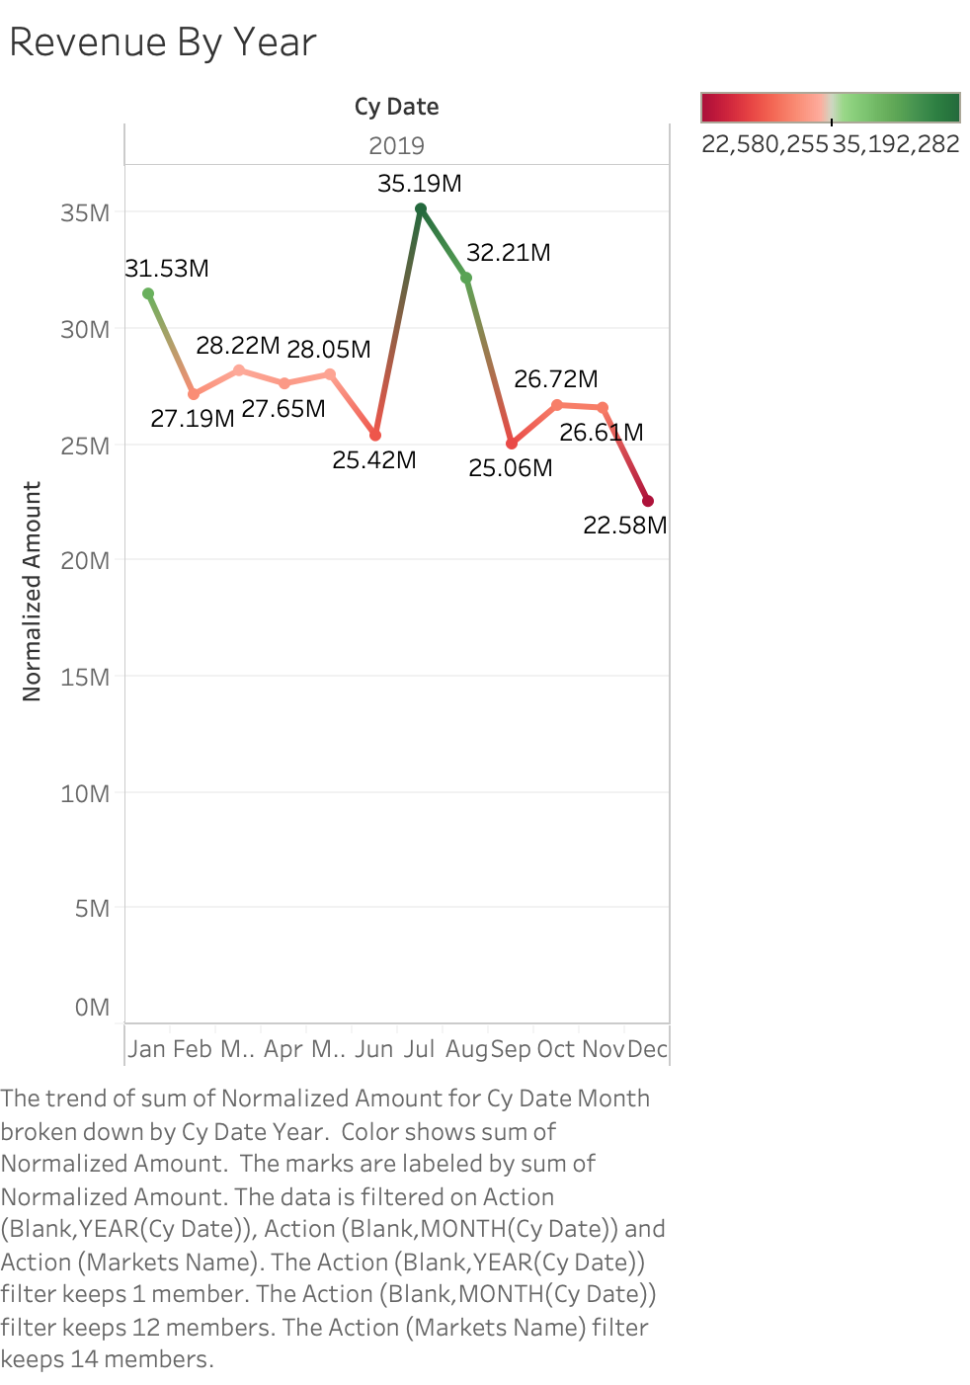

Slide 9
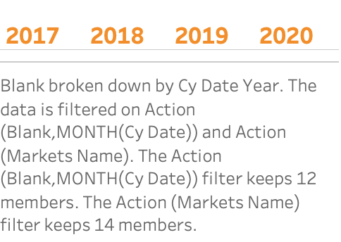

Slide 10


Slide 11
