Slide 1
Guided Capstone Project
Big Mountain Resort Ticket Prices

Slide 2
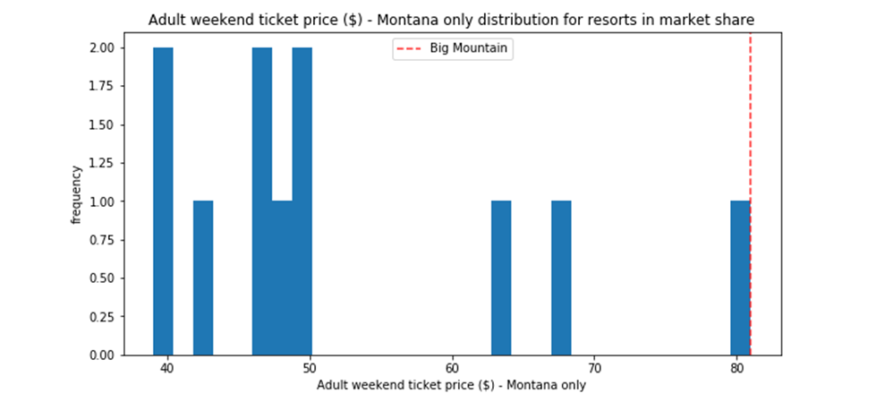
Big Mountain resort ticket price comparison in state Montana

Slide 3
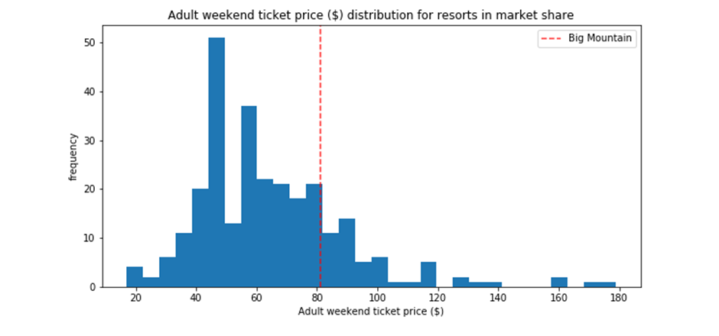
Big Mountain Resort ticket price comparison in overall resorts in country USA

Slide 4
Price Prediction
Current ticket price of Big mountain resort is $81
Predicted ticket price for Big mountain resort is $94
Suggested ticket price for Big mountain resort is $89

