Slide 1
Guided Capstone Project
Big Mountain Resort Ticket Prices

Slide 2
Problem Identification
The target is to increase the overall revenue of the Big Mountain Resort.
Revenue can be increased by increasing the ticket prices.
Revenue can be increased by decreasing the operational cost.

Slide 3
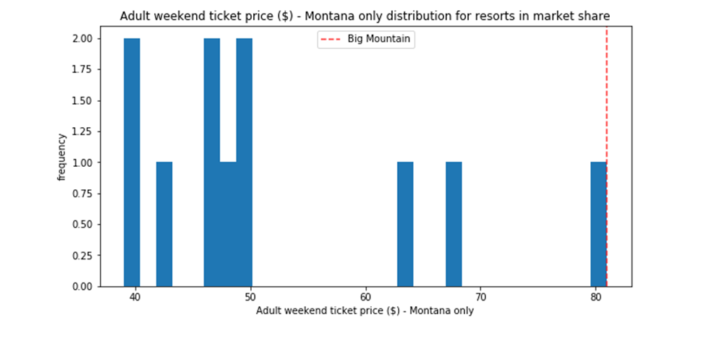
Big Mountain resort ticket price comparison in state Montana
It has the highest ticket price among its competitors in the state.

Slide 4
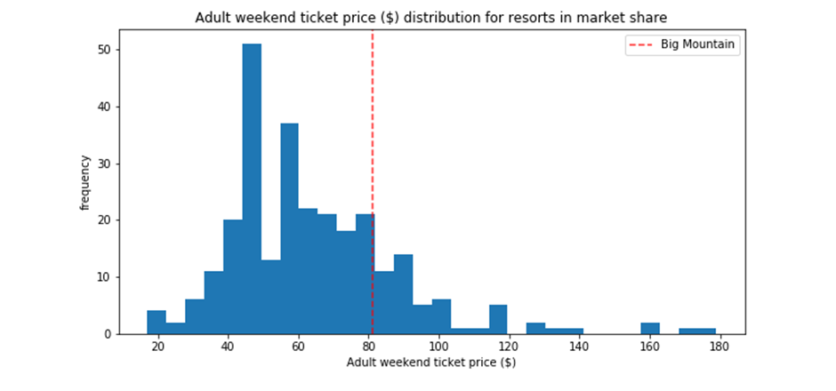
Big Mountain Resort ticket price comparison in overall resorts in country USA

Slide 5
Modelling Output
As per current facilities the model is predicting the ticket price to almost $94, which is an almost 16% increase as per the current ticket price.
The model lies in the assumption that other resorts have accurately set their prices based on what the market supports.

Slide 6
Other Modelling Outputs
People are willing to pay more for certain facilities and less for others.
Closing down one runs in the resort will not have any effect on ticket price and revenue.
Increasing the vertical drop, chair lift, snow making area and runs in conjunction shows a significant increase in the ticket price and revenue for the resort.

Slide 7
Conclusion
As per current facilities there is an almost 16% room (~$94) for an increase in the ticket prices.
But the resort is also the most expensive among the state.
Considering the at par facilities provided by the resort but also considering the state in which it lies, the resort could thus charge a ticket price of $89 which is a 10% increase in its current price.

