Slide 1
NYC AIRBNB DATA STORY TELLING

Slide 2
NYC AIRBNB LISTINGS DATA
Since 2008, guests and hosts have used Airbnb to expand on travelling possibilities and present more unique personalized way of experiencing the world. The dataset describes the listing activity and metrics in NYC, NY in 2019.
The dataset is taken from kaggle website and it consists of 48895 unique records and 16 columns which are in a mix of categorical and numerical values.

Slide 3
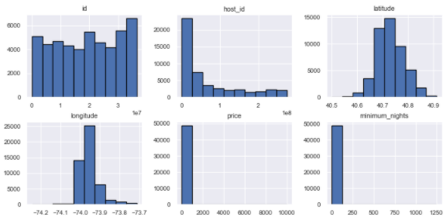
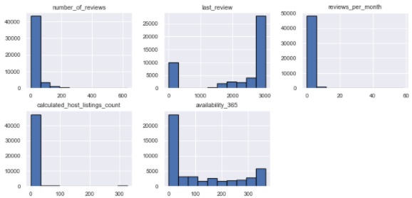
HISTOGRAM OF NUMERICAL COLUMNS

Slide 4
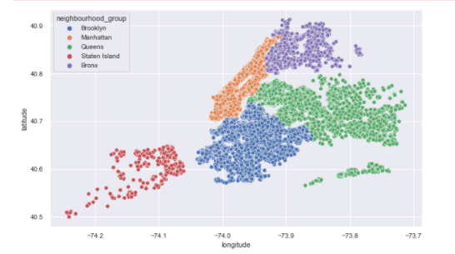
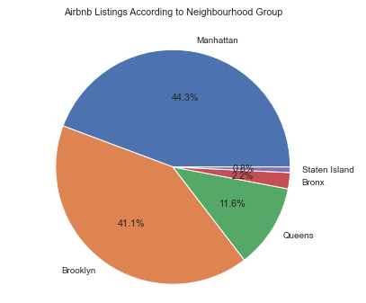
MAP AND PIE CHART OF NEIGHBOURHOOD GROUP

Slide 5
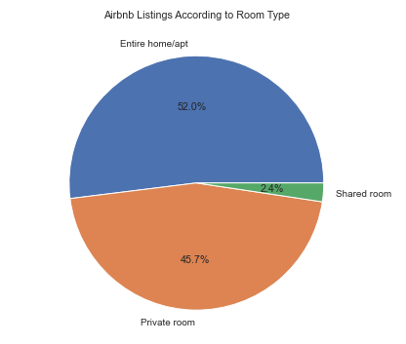
PIE CHART OF ROOM TYPE

Slide 6
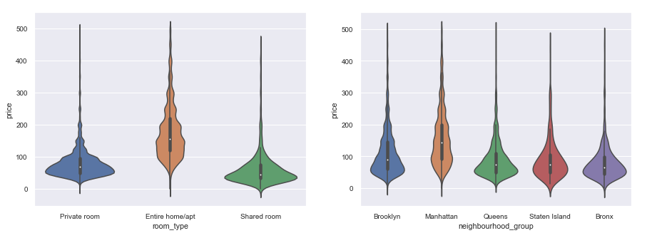
VIOLIN PLOT TO SHOWCASE DENSITY AND DISTRIBUTION OF PRICE

Slide 7
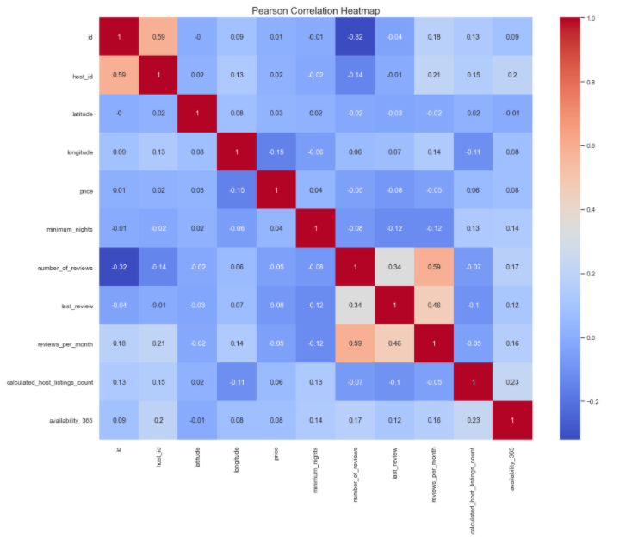
PEARSON CORRELATION HEATMAP

