Slide 1
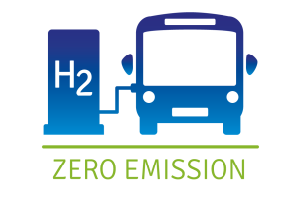

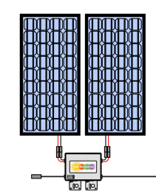

Grid
Nuclear Energy
Wind Farm
Solar Farm
Hydrogen Production (Thermal Process)
Thermal Energy
Hydrogen Market

Slide 2
Grid
Nuclear Energy
Wind Farm
Solar Farm
Hydrogen Production (Thermal Process)
Thermal Energy
Hydrogen Market

Slide 3
Grid
Nuclear Energy
Wind Farm
Solar Farm
Hydrogen Production (Thermal Process)
Thermal Energy
Hydrogen Market

