Slide 1

AI-Based Digital Twin Prototype for Two-Hour Glucose Forecasting
HAPPIEST HEALTH DIGITAL TWIN CHALLENGE 2026
An experimental glucose forecasting proof of concept
TEAM
Transcendental-Coders
TEAM LEADER
Madhav Kumar
MEMBERS
Madhav Kumar, Sunny Kumar, Shubham Panchal
Experimental prototype - not clinically validated. Based on historical datasets.
COLLEGE
Kamla Nehru Institute of Technology
INCUBATOR
N/A
Notes:
Introduce the team and the project. Emphasise that this is an experimental proof of concept built on historical datasets.

Slide 2



The challenge: making sense of historical health data
Health records arrive as many files
Broader Digital Twin vision (not claimed here)
EHR data comes as CSV files that must be inspected for missing values and duplicates.
A personalized model that combines health records and wearable data for an individual. This prototype does not establish patient-level integration, clinical validation, real-time monitoring or clinical decision support.
Wearable glucose is a time series
Readings every 5 minutes need preprocessing and feature engineering before any forecasting.
What this prototype actually implements
EHR data quality pipeline
Wearable glucose preprocessing and features
The two datasets are not linked
Experimental two-hour glucose forecast
Individual-level mapping between EHR and wearable data has not been established.
Flask API serving readings and predictions
Web dashboard for history and forecast
Notes:
Distinguish the broader Digital Twin vision from what is actually implemented in this prototype.

Slide 3






Project objectives
01
02
03
EHR data quality assessment
Wearable glucose preprocessing
Time-series feature engineering
Inspect EHR CSV files and report missing values, duplicates and column-level quality.
Inspect and prepare historical glucose time-series data.
Build lag, rolling, recent-change and activity features.
04
05
06
Experimental 2-hour forecasting
API-based prediction service
Dashboard visualization
Predict glucose about 120 minutes ahead with a machine-learning model.
Serve participants, historical readings and forecasts through Flask.
Let a user pick a participant and view history and forecast.
Notes:
Six objectives of the prototype, from data quality through to dashboard visualization.

Slide 4

Two separate datasets
EHR dataset
Wearable glucose dataset
18
0
5 min
Steps, calories
EHR CSV files processed
processing failures (recorded run)
sampling interval
activity features, where available
processed
separately
Raw source data was preserved
Historical glucose time series
Checked for missing values, duplicates and column-level quality
Participants identified by IDs such as HUPA0001P
Individual-level mapping between the two datasets has not been established. No dataset statistics beyond those shown here are claimed.
Notes:
18 EHR CSV files were processed with zero processing failures in the recorded run. The two datasets are separate; no individual-level mapping exists.

Slide 5





EHR preprocessing pipeline
EHR CSV files
Inspection
Preprocessing
Quality reports
Missing-value analysis
Duplicate identification
Column-level checks
Find gaps in each column of every EHR file.
Identify duplicate records and remove them during preprocessing.
Run data quality checks column by column and write the results to reports.
Output: cleaned EHR data and data quality reports. Raw source data is preserved.
Notes:
EHR CSV files go through inspection and preprocessing and end as quality reports. This pipeline is independent of the wearable forecasting pipeline.

Slide 6
Wearable data preprocessing
Glucose time series
Data cleaning
Feature engineering
Forecasting features
Sampling interval: one reading every 5 minutes
Each step is one reading; 12 readings cover one hour.
0
5
10
15
20
25
30
35
40
45
50
55
60
minutes
Preprocessing is applied to wearable glucose data only. EHR data is handled in a separate pipeline.
Notes:
Wearable glucose data is inspected, cleaned and turned into forecasting features. The sampling interval is five minutes.

Slide 7




Feature engineering and the two-hour target
Target construction
24 steps x 5 min = 120 min
Historical lags
Rolling statistics
Earlier glucose readings give the model recent history.
Summary statistics over recent windows of readings.
Now (t)
t + 24 steps
Recent changes
Activity features
Target = glucose about 120 minutes ahead (5-minute sampling)
How glucose has moved between recent readings.
Steps and calories, where available.
Features: lags, rolling statistics, recent changes, activity
The future target is the prediction label only. It is never used as an input feature.
Notes:
A 24-step shift at five-minute sampling corresponds to a 120-minute prediction horizon. The target is the label and is excluded from the inputs.

Slide 8
System architecture: two separate pipelines
EHR PIPELINE
EHR CSV Files
EHR Data Inspection
EHR Preprocessing
Data Quality Reports
No data path between the two pipelines
WEARABLE FORECASTING PIPELINE
1
Wearable Glucose Data
2
Inspection and Preprocessing
3
Feature Engineering
4
Forecasting Model
5
Flask API
6
Web Dashboard
Legend
GET /api/participants
Data flow
GET /api/cgm/<participant_id>
Model inference flow
API communication
GET /api/predict/<participant_id>
EHR and wearable datasets are processed separately. Individual-level mapping has not been established.
Notes:
Rebuilt from the System Architecture document. The EHR pipeline does not feed the forecasting model. The wearable chain runs from data through features and the model to the Flask API and the dashboard.

Slide 9


Forecasting model and baseline
Engineered wearable features
HistGradientBoostingRegressor
Glucose at t + 120 min
lags, rolling stats, changes, activity
scikit-learn, persisted with Joblib
experimental forecast
HistGradientBoostingRegressor
Persistence baseline
A scikit-learn model that builds many small decision trees one after another. Each new tree corrects the errors of the earlier ones. Here it learns from the engineered features to predict glucose 120 minutes ahead.
The simplest forecast: carry the current glucose value forward as the prediction. It gives a reference that the machine-learning model has to beat.
Experimental model. No clinical validation is claimed.
Notes:
Explain the model in simple terms and why a persistence baseline is a fair reference.

Slide 10
Recorded model evaluation
Metric | Persistence baseline | HistGradient-BoostingRegressor
MAE | 33.474 | 30.234
RMSE | 46.229 | 39.879
R² | 0.1376 | 0.3583
approx. 9.7%
lower MAE than the persistence baseline in the recorded evaluation
Recorded experimental evaluation results. Measurement units are not documented and are not stated. These results do not establish clinical usefulness or guaranteed generalization.
Notes:
Exact recorded values: baseline MAE 33.474, RMSE 46.229, R2 0.1376; model MAE 30.234, RMSE 39.879, R2 0.3583. The MAE is approximately 9.7% lower.

Slide 11
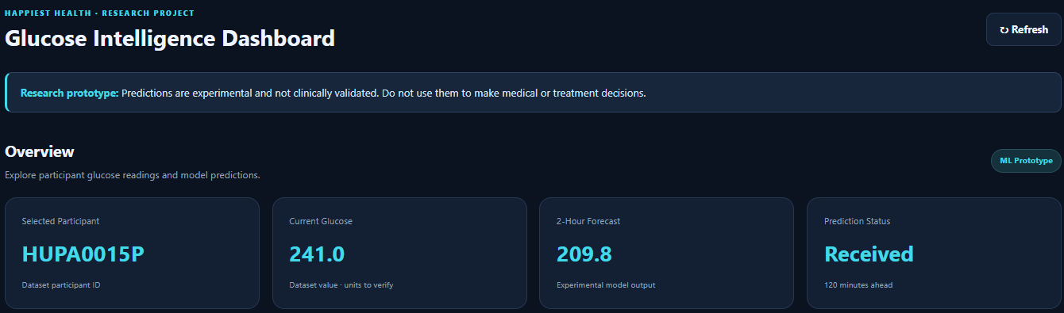
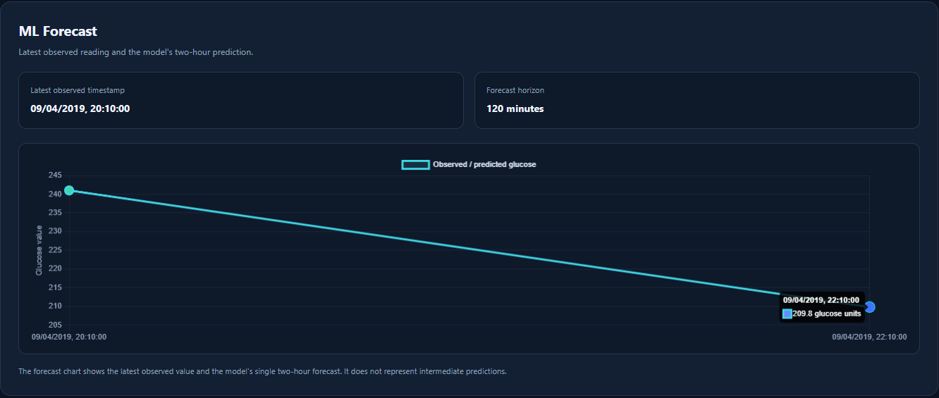
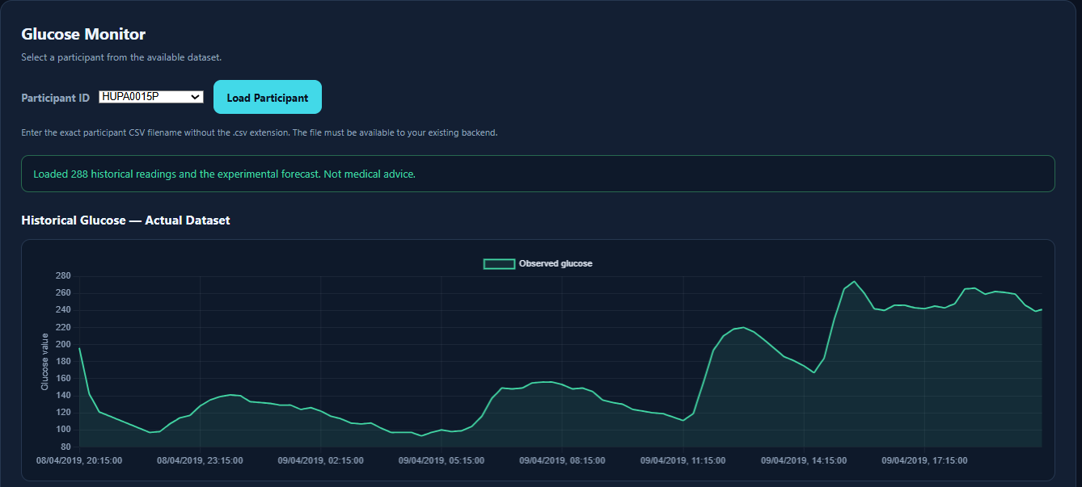
Working prototype: the web dashboard
Overview, participant HUPA0015P: current glucose 241.0, 2-hour forecast 209.8 (as displayed).
ML Forecast panel: latest observed reading and the model's single two-hour forecast.
1
Participant selection: Pick a participant ID from the dropdown and press Load Participant.
2
Historical glucose: A line chart shows the observed readings for that participant.
3
Forecast: Shows the latest observed value and one two-hour forecast, with no intermediate predictions.
Participant selector and historical glucose chart (288 readings loaded).
Notes:
All screenshots are from the actual dashboard and show participant HUPA0015P. This example is separate from the HUPA0001P API example on the next slide.

Slide 12
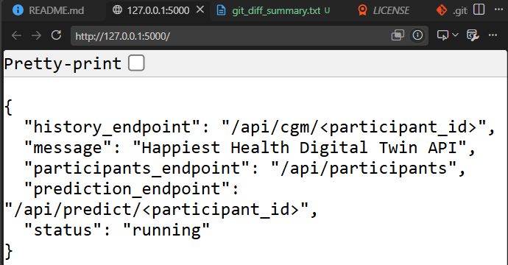
Flask API and a recorded prediction example
Recorded example: HUPA0001P
Historical-dataset example, not a real-time clinical prediction
Current glucose
326.0
Predicted glucose after two hours
294.2235
Forecast horizon
120 minutes
Latest source timestamp
2018-06-27T23:55:00
Screenshot of the running API root page (127.0.0.1:5000): service name, status "running" and the endpoint listing.
Dataset status
historical_dataset
Model status
experimental_prototype
This HUPA0001P example comes from the architecture document and is separate from the HUPA0015P dashboard screenshots. It does not imply a medically meaningful result.
Notes:
The API root page lists the history, participants and prediction endpoints and reports status running. The recorded response for HUPA0001P is a historical-dataset example only.

Slide 13

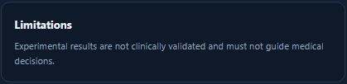
Limitations and future work
Not clinically validated.
Future work
Further validation
Data is historical; this is not real-time monitoring.
Data reconciliation, if valid patient-level linkage becomes available
Individual-level mapping between EHR and wearable datasets has not been established.
Additional participant-level evaluation
The current glucose model does not use EHR variables.
Recorded performance does not establish clinical usefulness or guaranteed generalization.
The dashboard shows the same caveat in its About This Project section.
Notes:
Be explicit about the limits of the prototype and what further work would be needed.

Slide 14
Conclusion
EHR quality pipeline
Experimental forecast
Flask API
Web dashboard
Inspection, preprocessing and quality reports
Wearable features and HistGradientBoostingRegressor, 120 minutes ahead
Three GET routes for participants, history and prediction
Participant selection, historical readings and forecast view
A proof-of-concept workflow from data preparation to forecast visualization, built on historical datasets.
Repository:
https://github.com/shubhampanchal6376/digital-twin
Team Transcendental-Coders | Team leader: Madhav Kumar | Kamla Nehru Institute of Technology
Disclaimer: experimental prototype, not clinically validated, historical data, no clinical decision support.
Notes:
Summarise the four implemented components and repeat the disclaimer. Share the repository link.

