Slide 1

💰 ExpenseManager
Smart Expense Tracking System

Slide 2

Project Overview
A modern expense tracking platform built with FastAPI, MySQL, and Streamlit.
Includes authentication, CRUD, analytics, and visualization features.

Slide 3

Tech Stack
⚙️ Backend: FastAPI
💾 Database: MySQL + SQLAlchemy
🎨 Frontend: Streamlit
🔐 Auth: JWT & OAuth2
🧩 Tools: Docker, Git, pytest, Alembic

Slide 4
Key Features
🔐 JWT Authentication & secure endpoints.
💸 CRUD Operations on expenses.
📊 Interactive analytics dashboard.
📁 Modular code architecture.
⚙️ Environment-driven configuration.

Slide 5
Deployment & Testing
🐳 Docker Compose setup for FastAPI + MySQL + Streamlit.
🧪 pytest for API validation.
✅ Black, flake8, and pre-commit hooks.

Slide 6
Future Enhancements
📈 AI-driven spending predictions.
📤 PDF/Excel report exports.
📱 Mobile-friendly dashboard.

Slide 7
Author
👨‍💻 Shubham pandey
Data Science Enthusiast | Full Stack Developer
📧 shubh@example.com

Slide 8
📡 System Architecture
Frontend
(Streamlit)
Backend
(FastAPI)
Database
(MySQL)
Analytics
Engine

Slide 9
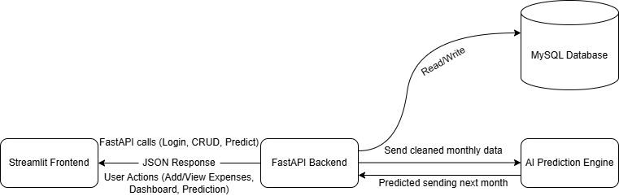
System Flow ER diagram

Slide 10
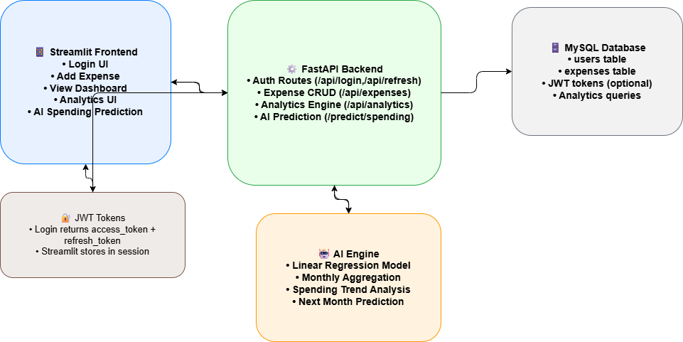
Expense Manager Architecture

