Slide 1

Project Title:– Superstore Data Analysis
Name: Shubham S Pandharpatte
AICTE-ID:STU65d77210b8b181708618256
Email:shubhampandharpatte30@gmail.com
Github:https://github.com/shubhampandharpatte/VOIS_PROJECT_PROJECT

Slide 2

PROBLEM STATEMENTS:
1. Visualizing total profit by region to identify the highest contributing regions for a store’s profitability.
2. Analyzing regional sales distribution to identify key contributors to overall sales performance within a store’s operational regions.
3. Examining the distribution of total sales across different product categories to gain insights into the revenue contribution of each category within a store.

Slide 3
PROBLEM STATEMENTS:
4. Analyzing total profit by product category to pinpoint the most profitable segments within a store’s product lineup.
5. Visualizing total sales across different customer segments to identify sales performance variations among segments within a store’s customer base.
6. Analyzing total profit across different customer segments to discern profitability disparities among segments within a store’s customer base.

Slide 4
PROBLEM STATEMENTS:
7. Exploring sales distribution across different states to discern geographical variations in sales performance within a store’s operational regions.
8. Investigating profit distribution across different states to identify geographical variations in profitability within a store’s operational regions.

Slide 5
About Project:
The objective of this project is to conduct a comprehensive analysis of the sales transactions dataset to derive actionable insights for the business. By leveraging statistical analysis and data visualization techniques,
we aim to:
Identify key sales trends and patterns across different dimensions such as geographical regions, customer segments, and product categories.
Assess the effectiveness of various marketing strategies, including discounting practices, in driving sales and profitability.
Understand the factors influencing profitability and identify opportunities for cost optimization.
Provide actionable recommendations to enhance overall sales performance, streamline operations, and maximize profitability.

Slide 6

WHO ARE THE END USERS?
Business analysts, sales managers, marketing teams, and executives within retail or e-commerce companies.
Supply chain managers responsible for optimizing logistics and inventory planning.
Financial analysts assessing the company's financial health and identifying opportunities for cost reduction or revenue enhancement.
Customer service teams utilizing insights to tailor services and support based on customer needs.
Data analytics professionals extracting insights and building predictive models for data-driven decision-making.
External stakeholders such as investors, suppliers, and regulatory bodies, depending on the organization's structure and partnerships.

Slide 7
Technology Used
Programming Language: Python
Libraries:
NumPy: For numerical computing, particularly for arrays, matrices, and mathematical operations.
Matplotlib: For creating static, animated, and interactive visualizations in Python.
Seaborn: Functionalities for statistical analysis, such as grouping data, fitting regression models, and adding emphasis on distributions.

Slide 8
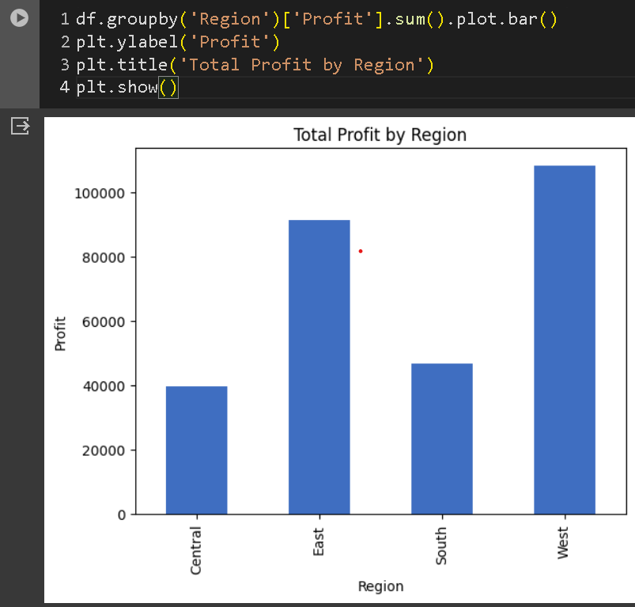
RESULTS:
1.

Slide 9
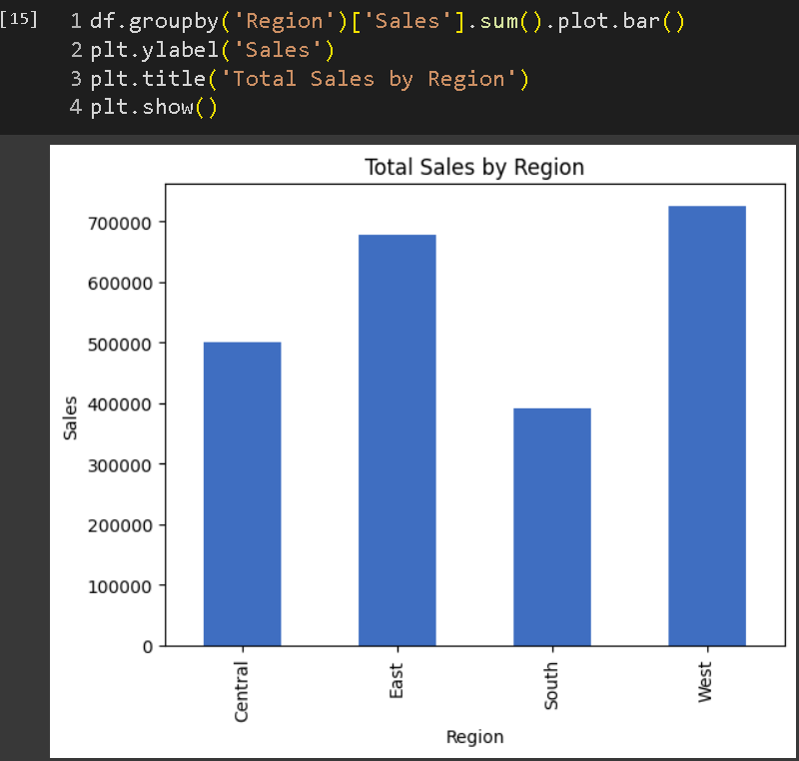
2.

Slide 10
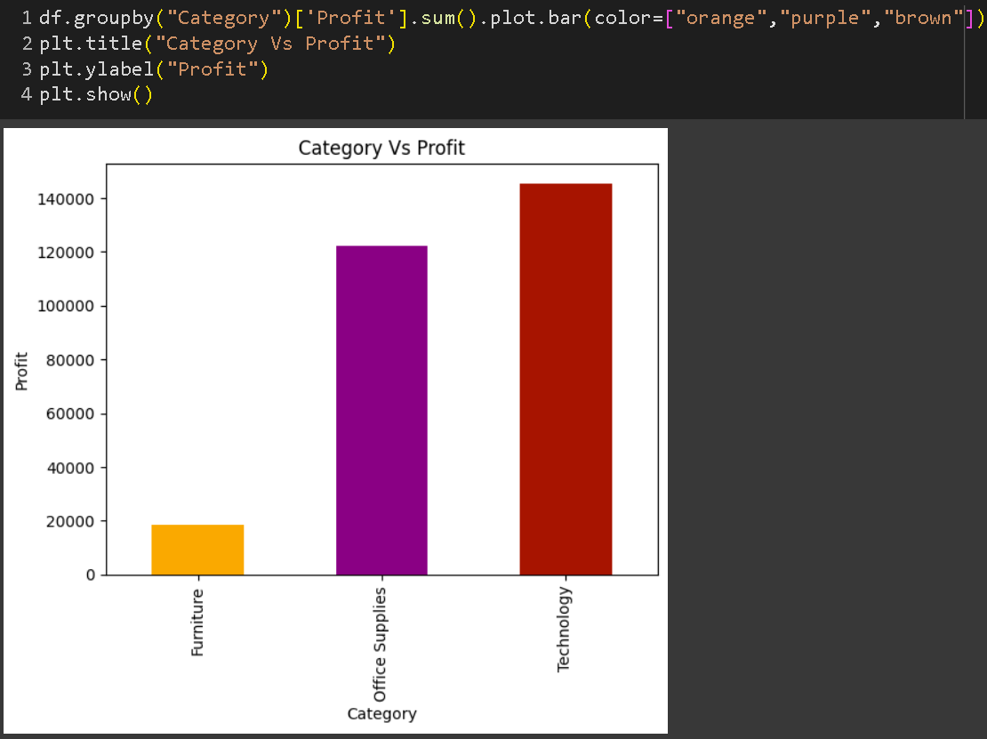
3.

Slide 11
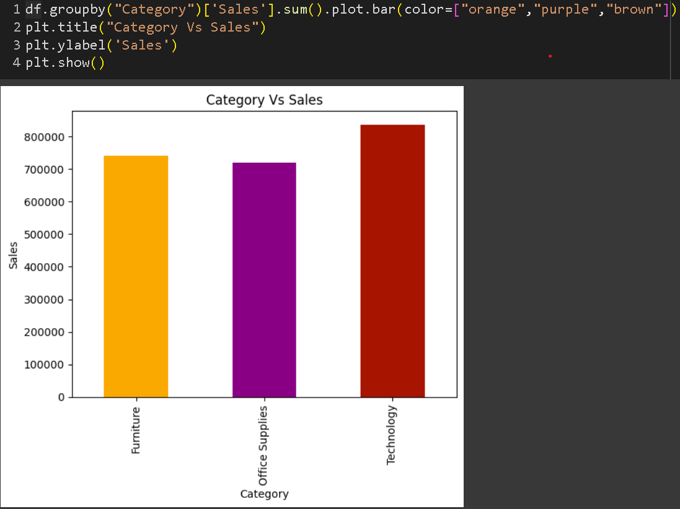
4.

Slide 12
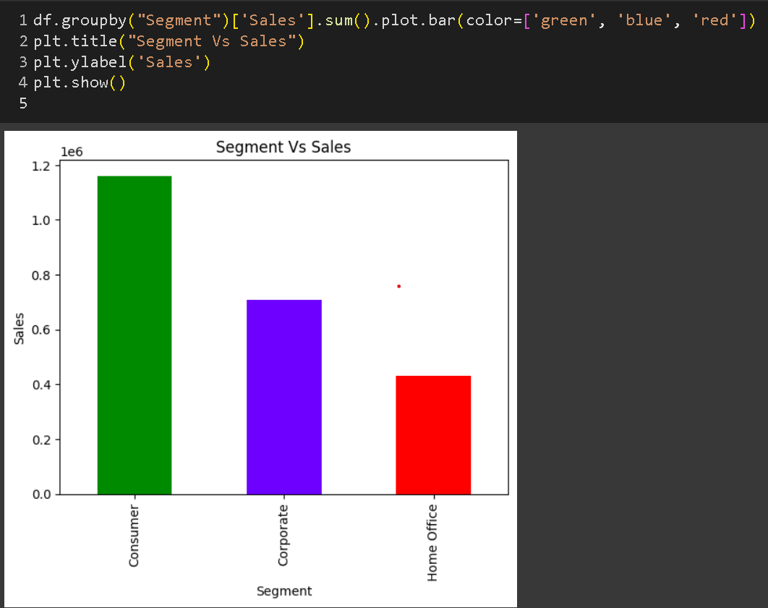
5.

Slide 13
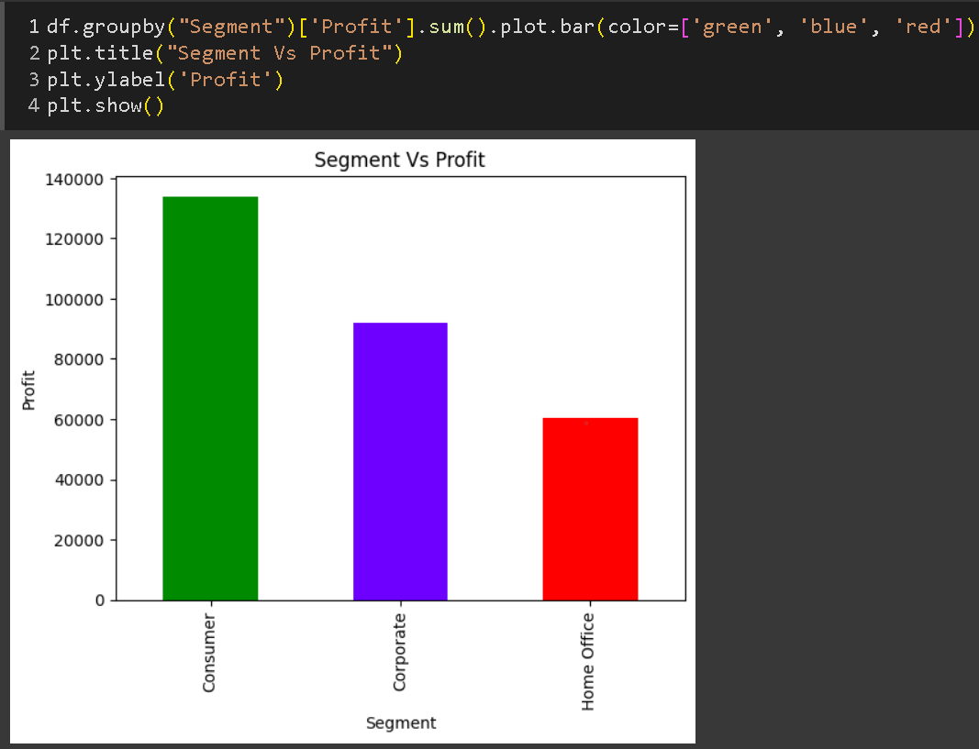
6.

Slide 14
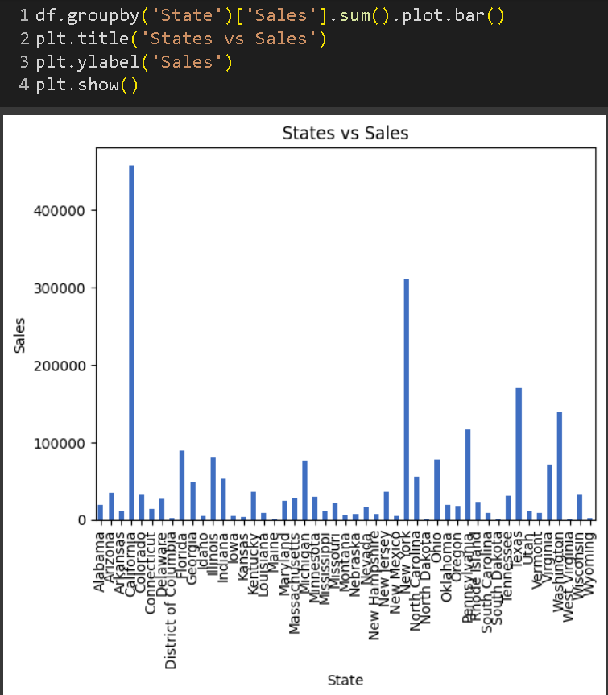
7.

Slide 15
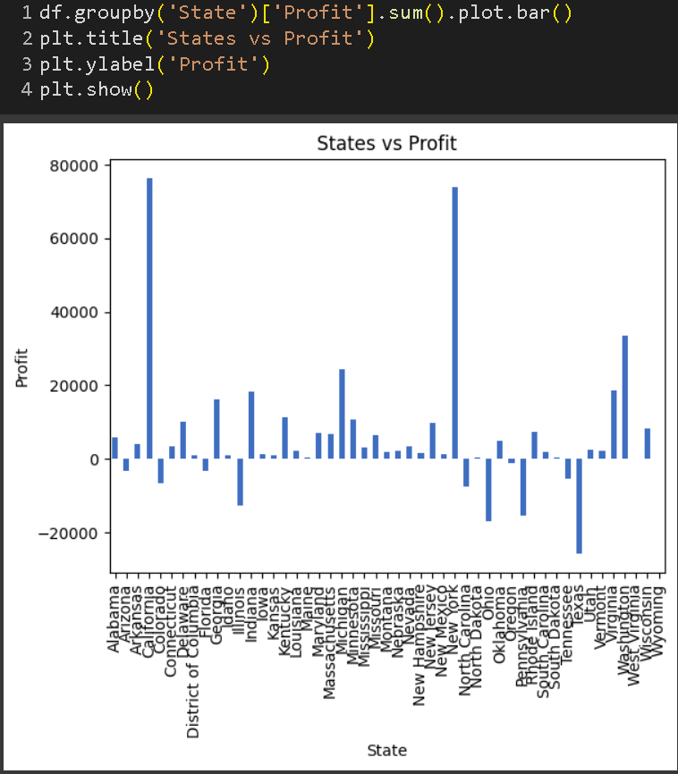
8.

Slide 16
Conclusion:
The company exhibits strong overall performance, with notable sales and profits concentrated in specific regions and product categories.
Regional variations significantly impact sales and profitability, highlighting the importance of region-specific strategies.
Strategic discounting is essential, as higher discounts are linked to decreased profits.
The Consumer segment plays a pivotal role, suggesting potential for targeted marketing efforts.
Opportunities for improvement include addressing profitability challenges in certain regions, optimizing discount strategies, and exploring avenues for cost reduction.

Slide 17
Thank you!!
.
.

