Slide 1
VP
CLINICAL NATURAL LANGUAGE TECHNOLOGY
VisitPrep — A Clinical Natural Language Technology Proof of Concept
Past, Present & Future · NLP · OCR · Computer Vision · LLM · LMM
Shubham Pareek — Columbia University
Intern Assessment · Topic 1
A local, source-grounded, provenance-first application · deterministic on-device processing · synthetic data only
Notes:
Introduce myself and the project. This is my individual proof of concept, VisitPrep, built for Topic 1 on clinical natural language technology. It runs entirely locally with deterministic, source-grounded processing.

Slide 2
WHAT CLINICAL NLP IS
Five capability layers, turning text into computable data
~80% of clinical data is unstructured text — notes, patient narratives, discharge summaries, scanned documents. Clinical NLP makes it computable.
1
2
3
4
5
NLP
OCR
Computer Vision
LLM
LMM
Parse free text into concepts, assertions (present / absent / uncertain) and relations. The foundation.
Convert scanned faxes, PDFs and handwritten or printed documents into machine-readable text.
Extract signal from medical images and document layout — tables, fields, stamps, signatures.
Transformer models (BERT → GPT-4 class) that summarize and reason with less task engineering.
Large multimodal models reasoning jointly over text + images + structured data — the frontier.
VisitPrep operates in the NLP layer, with typed interfaces designed so the others can be layered in.
VisitPrep · A clinical NLP proof of concept
2
Notes:
Clinical NLP spans five layers: NLP, OCR, computer vision, large language models, and large multimodal models. My project works in the first layer but is built so the others can be added.

Slide 3
THE ARC
Past → Present → Future
PAST · ~2000–2015
PRESENT · ~2018–now
FUTURE
Rule-based & statistical
Transformer era
Multimodal, agentic, governed
UMLS dictionary / ontology lookup — MetaMap, cTAKES
Hand-built rules, regex, negation (NegEx), assertions
Shared tasks: i2b2 / n2c2 challenges
BERT → BioBERT, ClinicalBERT (on MIMIC-III)
Generative LLMs; Med-PaLM passes medical QA
Vision: CheXNet; document AI fuses OCR + layout
LMMs over notes + images + labs
Retrieval-grounded / agentic pipelines that cite spans
Hybrid deterministic + neural, governance-first
→
→
Transparent, auditable, cheap — but brittle to phrasing.
State-of-the-art — but hallucination, opacity, PHI risk.
Neural recall with deterministic guardrails — the pattern this project follows.
VisitPrep · A clinical NLP proof of concept
3
Notes:
The field moved from transparent but brittle rule-based systems, to accurate but opaque transformer models, toward a governed, hybrid future. VisitPrep is a small instance of that hybrid, provenance-first pattern.

Slide 4
TRENDS
Where clinical NLP is heading
1
From extraction to generation
2
Multimodal + document AI converge
Value shifts from tagging concepts to summarizing and drafting — ambient scribes and narratives.
OCR + CV + NLP merge into one document-understanding stack for the fax / PDF reality of healthcare.
3
Grounding & provenance are required
4
Hybrid architectures win in regulated settings
Clinicians and auditors demand source-linked evidence; ungrounded generation is a liability.
Deterministic guardrails wrap neural models to keep outputs auditable and safe.
5
Privacy-preserving / on-device deployment
De-identification and local models become table stakes wherever PHI is involved.
VisitPrep · A clinical NLP proof of concept
4
Notes:
Five trends: generation over extraction, multimodal convergence, provenance as a requirement, hybrid architectures in regulated settings, and privacy-preserving deployment.

Slide 5
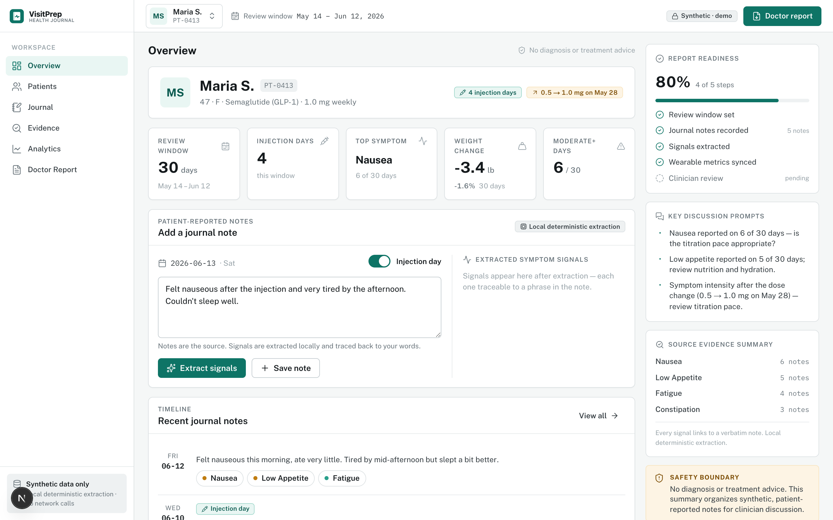
THE PROJECT · VISITPREP
The clinical-NLP value chain, end to end
A local Next.js / TypeScript app. A patient on GLP-1 injections logs daily notes and wearable metrics; VisitPrep prepares a source-grounded pre-visit summary.
1
Unstructured note
↓
2
Structured signals
↓
3
Trend analytics
↓
4
Doctor-ready summary
Overview — journal capture with local signal extraction, KPIs, and a persistent safety boundary.
VisitPrep · A clinical NLP proof of concept
5
Notes:
This is the running app. The pipeline goes from an unstructured note to structured signals to analytics to a doctor-ready summary. Everything runs locally and is traceable to the source text.

Slide 6
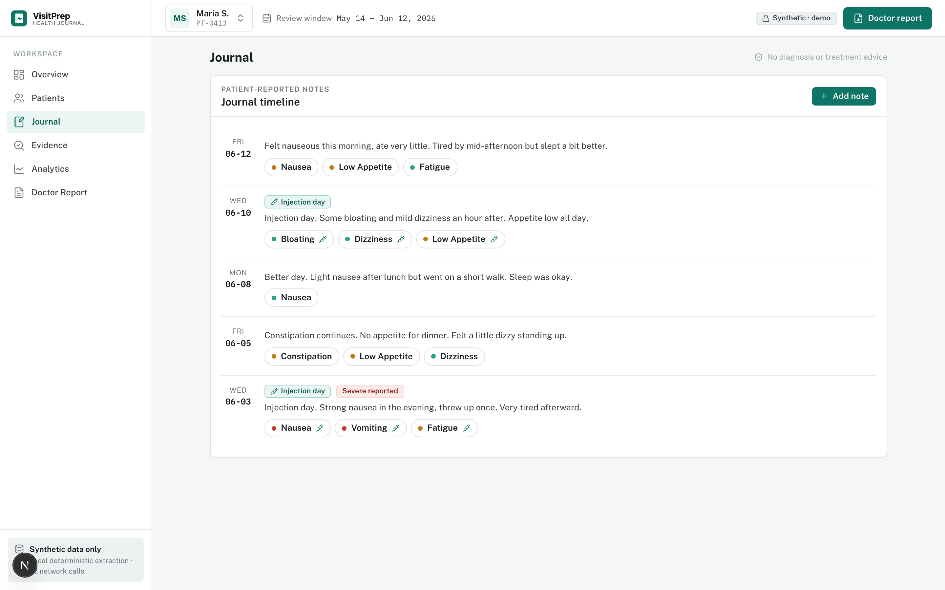
CAPTURING EVIDENCE
Every note, its extracted signals
Each patient note is shown with the symptom signals extracted from it.
Signals are color-coded by severity (mild → severe).
Injection days and “severe reported” days are flagged inline.
Every chip traces back to a phrase in the note — nothing is inferred without a source.
Journal — a per-note timeline of extracted symptom signals.
VisitPrep · A clinical NLP proof of concept
6
Notes:
The journal view makes the raw evidence browsable: each note with its extracted, severity-coded symptom chips and injection markers.

Slide 7
ARCHITECTURE
Four layers — auditable NLP separated from presentation
1
Data layer
Typed JournalEntry + WearableMetrics; synthetic JSON (no PHI). Wearable data kept separate from journal text.
typed · synthetic · no PHI
2
NLP extraction layer · src/lib/nlp/
Deterministic, rule-based, auditable: 14 symptoms / 7 categories; assertion (present · absent · uncertain · resolved); severity; temporal + injection context; evidence span + confidence on every signal.
extractionMethod: "rule-based" — interface allows semantic-local / hybrid later
3
Analytics layer · src/lib/analytics/
Symptom frequency, top symptoms, category mix, severity distribution, injection-adjacent analysis, wearable trends (weight, sleep, steps, RHR, activity).
deterministic analytics
4
Report layer · src/lib/report/
Template summary: snapshot, medication context, symptom & wearable highlights, evidence notes with source text, discussion prompts, safety disclaimer.
built from computed data, never live UI state
Hybrid-ready, provenance-first. Neural methods can be layered in behind the same typed interfaces without losing the audit trail.
VisitPrep · A clinical NLP proof of concept
7
Notes:
Four layers, with the auditable extraction kept fully separate from the UI. The report is built from computed data, never from live UI state, so an export is reproducible.

Slide 8
INSIDE THE NLP PIPELINE
Seven deterministic steps, each traceable to source
1
Sentence spanning
5
Temporal + injection context
Split the note into spans that keep absolute character offsets.
Time-of-day tags; symptom within ~48h of an injection.
2
Dictionary matching
6
Evidence span + confidence
14 symptoms / 7 categories, weighted aliases, word-boundary aware.
Exact source span, matched text, and a score on every signal.
3
Assertion detection
7
Deduplicate & rank
present / absent / uncertain / resolved — clause-aware negation.
Best candidate per symptom; a present mention beats a negated one.
4
Severity detection
Hardening: word-boundary negation, contraction handling, clause-aware scope, assertion-aware ranking.
mild / moderate / severe from phrases; self-rating fallback.
VisitPrep · A clinical NLP proof of concept
8
Notes:
Extraction is seven deterministic steps. The hard part is assertion detection — negation is clause-aware, so 'No vomiting since breakfast, but I vomited after lunch' is correctly read as present.

Slide 9
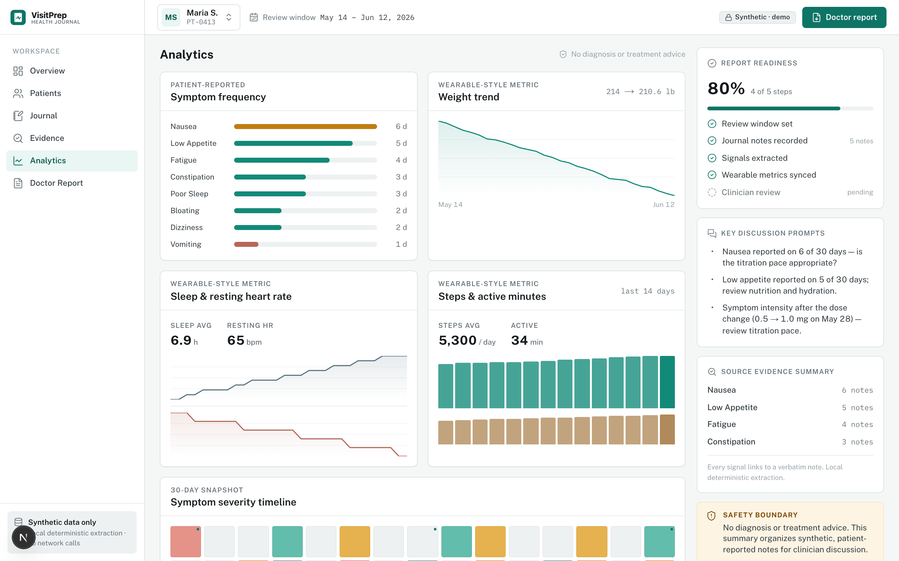
ANALYTICS
Deterministic trends from the extracted signals
Symptom frequency and category mix across the review window.
Weight, sleep, resting heart rate, steps and active minutes.
Week-1 vs week-4 averages for each wearable metric.
A symptom-severity timeline; injection-adjacent symptom breakdown.
Charts mapped to the clinical design tokens — restrained, not decorative.
Analytics — frequency, wearable trends, and a severity timeline.
VisitPrep · A clinical NLP proof of concept
9
Notes:
Analytics aggregates the extracted signals into frequencies, distributions, and wearable trends — all computed deterministically, then charted with the clinical palette.

Slide 10
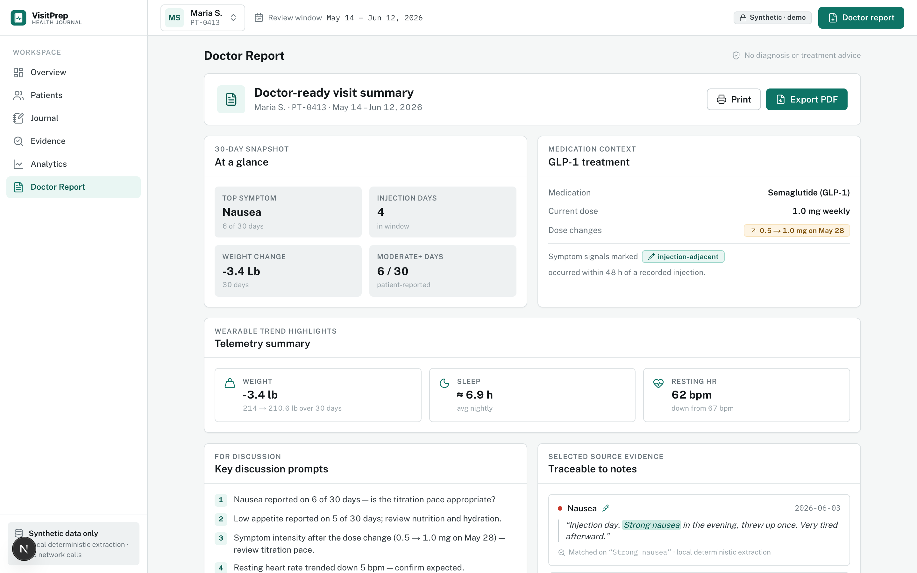
DOCTOR-READY OUTPUT
A source-grounded summary — every claim traces to a note
Snapshot, GLP-1 medication context, and injection-adjacency.
Wearable telemetry summary and discussion prompts.
Evidence notes selected by a transparent scoring algorithm.
Each note shown verbatim with the matched phrase highlighted.
A safety disclaimer is always included; language stays hedged.
Doctor Report — traceable evidence with the matched phrase highlighted.
VisitPrep · A clinical NLP proof of concept
10
Notes:
The doctor report is assembled deterministically. Evidence notes are chosen by a scoring algorithm that favors signal-rich, injection-adjacent days and diverse symptoms, and each is shown verbatim with the matched phrase highlighted.

Slide 11
RESULTS & ENGINEERING
Evaluation metrics & NLP hardening
1.00
1.00
1.00
0.94
1.00
0
Precision
Recall
F1
Severity acc.
Evidence span
Negation FP
npm run nlp:evaluate · 150 synthetic entries / 156 signals · injection-context accuracy 1.00
NLP ROBUSTNESS HARDENING
HONESTY CAVEAT
Fixed substring-negation bug — “no”/“not” no longer fire inside words like “normal”/“nothing”.
Added negation contractions (“don’t have”, “isn’t”) that were previously missed.
Made negation lookback clause-aware (stops at but / however / , / ;).
Made candidate ranking assertion-aware so a present mention beats an earlier negated one.
Tightened over-broad dictionary aliases that caused false positives.
These metrics are on a curated synthetic dataset the rules were tuned against. They demonstrate correctness of the pipeline — not real-world generalization.
VisitPrep · A clinical NLP proof of concept
11
Notes:
On the synthetic evaluation set the pipeline scores perfectly on precision, recall, and F1, with strong severity accuracy and full evidence-span coverage. I want to be honest: this is a curated synthetic set the rules were tuned against, so it shows correctness, not generalization.

Slide 12
REFLECTION & FUTURE WORK
A deterministic, provenance-first system can deliver the whole value chain
What it demonstrates
The trade-off
Future work
Capture → extraction → analytics → summary, auditable end to end, with a source span on every signal.
Rule-based methods are transparent and cheap but bounded in coverage; neural methods add recall at the cost of auditability.
Local sentence embeddings + MMR for semantic evidence; hybrid neural recall behind the same interfaces; OCR intake.
SAFETY BOUNDARIES
No diagnosis · no treatment or medication advice · no emergency triage. Hedged language (“reported”, “overlapped with”, “may be useful to discuss”). Synthetic data only. No external model or API calls.
Shubham Pareek — Columbia University · Intern Assessment · Topic 1
Notes:
To close: the project shows that a deterministic, provenance-first system can deliver the full clinical-NLP value chain, auditable end to end. The roadmap adds neural recall behind the same interfaces without giving up the audit trail — and it stays inside clear safety boundaries.

