Slide 1
Credit Card Fraud Detection
Group 3
Shivangi Nagpal
Mohdi Habibi
Rakesh Amireddy
Saumil Shah
Mahesh Reddy

Slide 2
Introduction
Financial fraud is an ever growing problem in day-to-day life
Credit card fraud rate increased to a great extent due to the volume of credit card transactions performed both online and offline
Data mining techniques analyze the credit card usage patterns to identify fraudulent transaction
Credit card fraud detection classifies data into legitimate (genuine) and fraudulent transactions
Applied both Supervised and Unsupervised learning techniques to evaluate and compare the results
The aim is to detect fraud accurately and before fraud is committed
Challenges include behaviour of genuine and fraudulent transactions, Class Imbalance and Feature selection

Slide 3

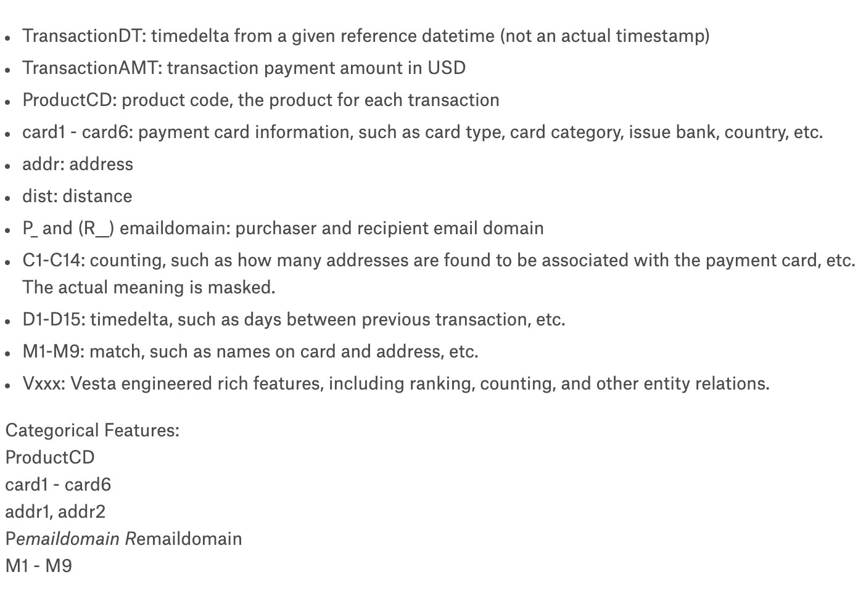

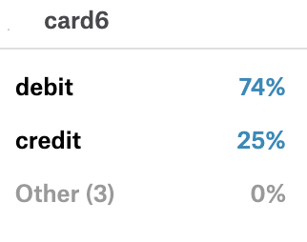
Understanding Data
1. Transaction data

Slide 4
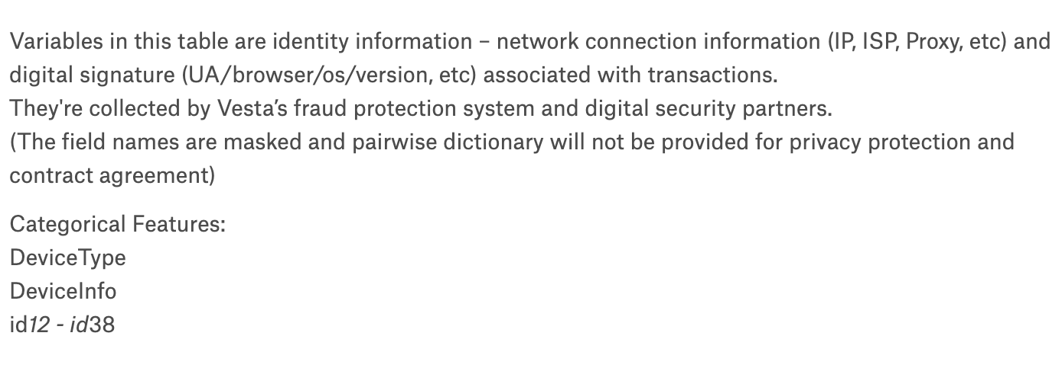
2.Identity data

Slide 5
Exploratory Data Analysis
Our dataset contains masked real life data for anonymity.
Data Analysis was a major step for the project, to clearly understanding of the data.
This helped to simplify large, complex data.
Exploring the data further helped us for data preprocessing and feature selection.

Slide 6
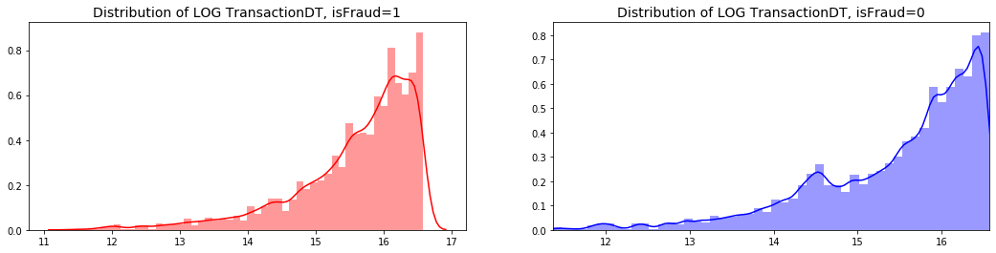
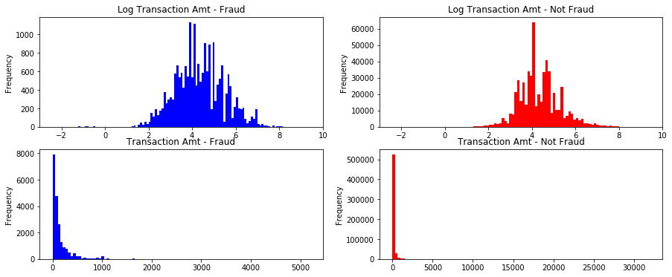

Slide 7
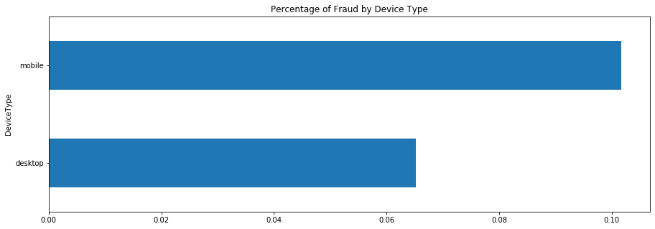
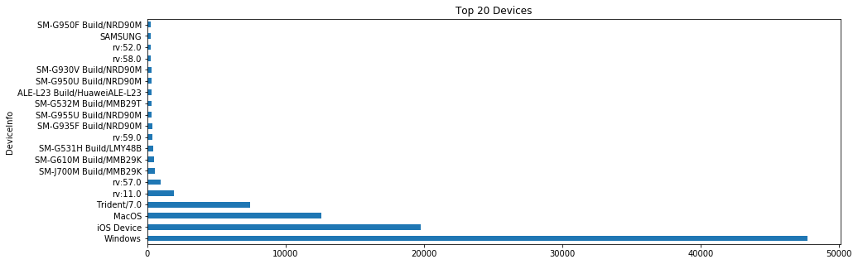

Slide 8
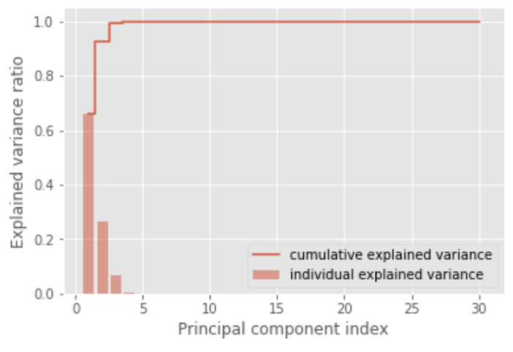
Data Preprocessing
First 2 PCAs covering 90% variance
Memory reduction (1.9GB -> 650MB)
Replace 414 cells containing NaN with 0
Better approach to change with mean but computation extensive
Transform categorical features to numerical
Apply one-hot encoding and label encoding
Apply standard scaler to Amount and Date
Original dataset contain 433 features
Apply PCA to overcome curse of dimensionality
After applying PCA, top 2 principal component represent 99% of data
PCA reduce our accuracy in this case

Slide 9
Methodology
Merge and clean data
Apply memory reduction techniques
Exploring the data
Apply supervised learning techniques: Naive Bayes, Logistic Regression, Support vector Machine, Random Forest
Apply unsupervised learning techniques: K means
Evaluate Metrics from different algorithms
Goal: Improving accuracy

Slide 10
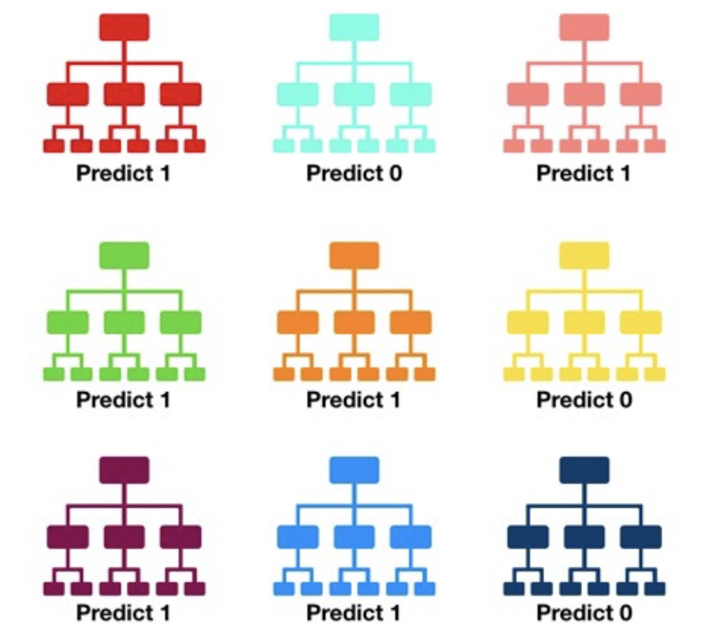
Random Forest
Consists of a large number of individual decision trees that operate as an ensemble. Each individual tree in the random forest gives a class prediction and the class with the most votes becomes the model’s prediction
Using wisdom of crowds
A large number of relatively uncorrelated trees operating together will outperform any of the individual constituent model(tree)
Trees protect each other from their individual errors

Slide 11

Matthews correlation coefficient (MCC)
Treat the true class and the predicted class as two (binary) variables, and compute their correlation coefficient (in a similar way to computing correlation coefficient between any two variables). The higher the correlation between true and predicted values, the better the prediction.
when the classifier is perfect (FP = FN = 0 ) the value of MCC is 1, indicating perfect positive correlation
Conversely, when the classifier always misclassifies (TP = TN = 0), we get a value of -1

Slide 12
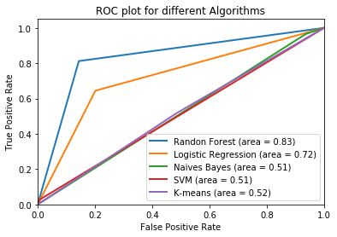
Results
Metrics | Classifiers
 | NB | LR | KM | RF | SVM
Accuracy | 0.0953 | 0.7932 | 0.5148 | 0.8548 | 0.9584
Sensitivity | 0.9654 | 0.6442 | 0.5172 | 0.8120 | 0.0280
Precision | 0.0360 | 0.1039 | 0.0372 | 0.1702 | 0.1157
Mathews correlation coefficient | 0.0221 | 0.1974 | 0.0117 | 0.3294 | 0.0406
SVM has highest Accuracy score ( 95%) but MCC score is very less when compared with other models.
Random Forest performs better in all the evaluation metrics with Accuracy value of 0.85, Area under ROC curve as 0.83 and MCC value of 0.33

Slide 13
Difficulties Encountered
Understanding of the features as most features have masked meanings.
The dataset is highly skewed with very large number of transactions in genuine class.
Understanding why model are giving less accuracy with PCA
Computational complexity of working with upsampled data was high
Replacing null values with mean in the dataset and applying polynomial features in the regularization process crashed Python Notebook

Slide 14
Key Learnings
Work with masked data
Downsampling and Upsampling of data
PCA analysis - when to use and when not
Importance of data preprocessing- one hot encoding (without that Accuracy and Area_Roc is less)
Importance of laplacian correction in naive bayes model if the data set has null values replaced by zero which will make the conditional probability zero as result predicted probability will be zero.
Random Forest Algorithm
ROC & Matthews correlation coefficient V/s Accuracy and F1-score

Slide 15
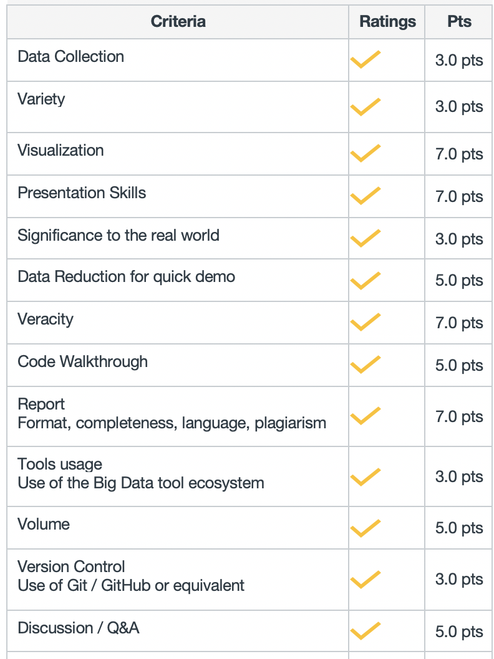
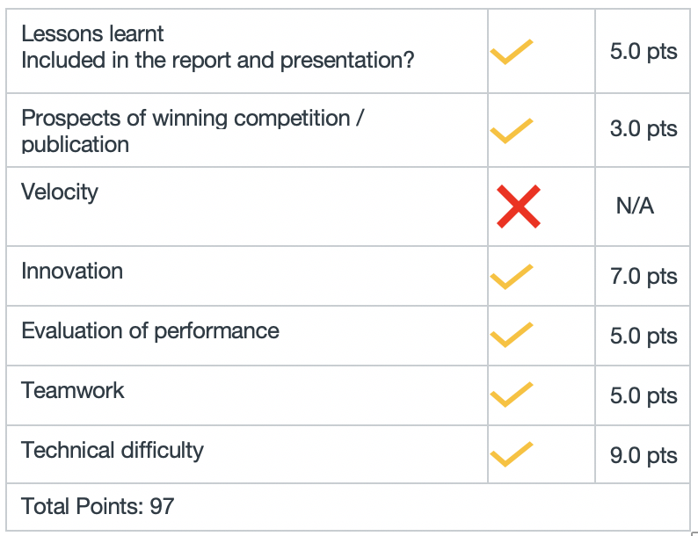
CMPE 255 Project Rubric

Slide 16
References
https://towardsdatascience.com/understanding-random-forest-58381e0602d2
https://towardsdatascience.com/the-best-classification-metric-youve-never-heard-of-the-matthews-correlation-coefficient-3bf50a2f3e9a
https://en.wikipedia.org/wiki/Matthews_correlation_coefficient#Advantages_of_MCC_over_accuracy_and_F1_score
https://www.kaggle.com/c/ieee-fraud-detection/discussion/101203
https://www.kaggle.com/c/ieee-fraud-detection/data

