Slide 1
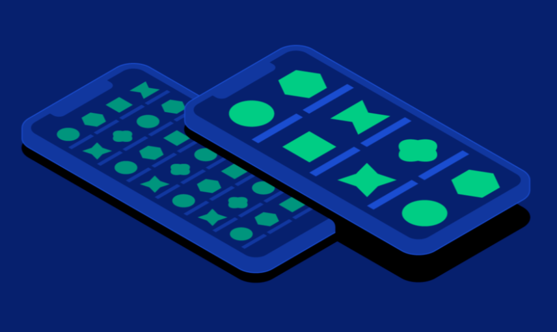
IE403: Human-computer interaction
Group
11
Study Mobile phone interaction patterns among elderly and propose prototypes for easier screen-based interaction
Tasks:
Research about how elder people interact with smart phones. (survey)
Define which problems they face.(from survey and other research papers)
Provide solutions for problems to make easy interactive interface.
Give examples of interfaces made for elder people

