Slide 1
Assessing social anxiety through digital biomarkers embedded in a gaming task
Group 11:
201901011 - Himanshu Dudhatra
201901100 - Shubham Patel
201901145 - Gargey Patel
201901150 - Mihir Patel

Slide 2
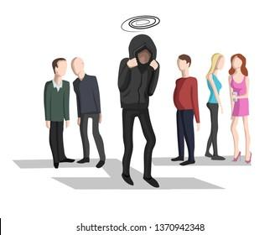
Introduction
What is social anxiety
How it affects people
Assessment techniques
Digital biomarkers and its use
Embedding digital biomarkers in digital games

Slide 3
Related Work
The Characteristics of Social Anxiety
The Assessment of Social Anxiety via Digital Biomarkers
Social Presence in Virtual Environments

Slide 4
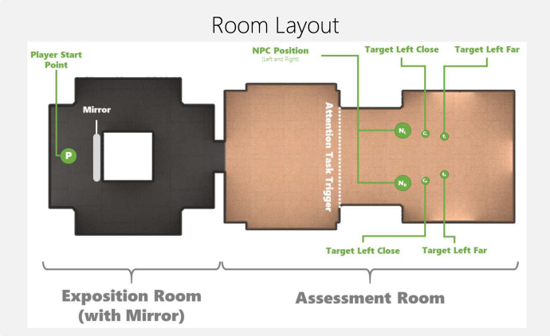
Method
Task
2 target
distances
2 Npc positions
3 types of
Npc presence
x
x
Total 12 configurations
NPC = Non Player Character

Slide 5
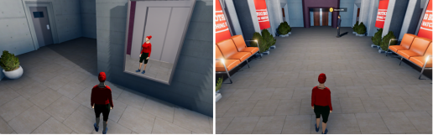
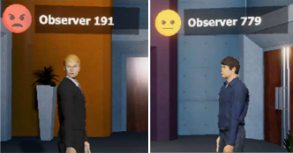
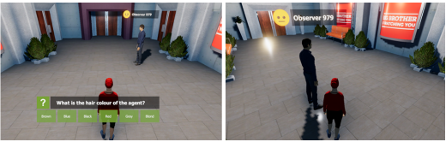
Npc emotions
Mirror Room
Assessment Room
Angry
Neutral
Attention test
Target position

Slide 6
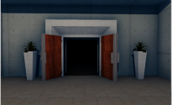
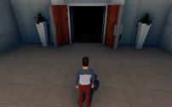
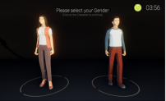
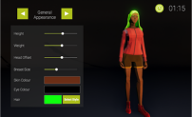
Experiment Conditions
Camera Perspective
116 participants
23 FPP-predefined
30 FPP-customized
First-Person Perspective
Third-person Perspective
28 TPP-predefined
Player’s Avatar Type
35 TPP-customized
Predefined Avatar
Customized Avatar

Slide 7


Slide 8
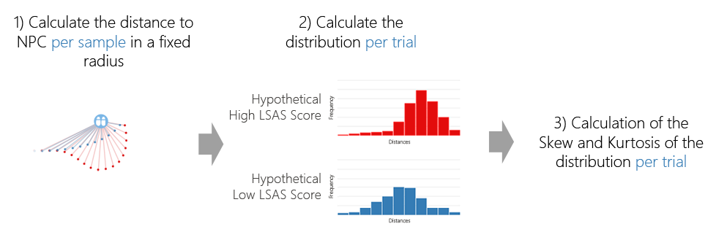
In game digital biomarkers
Calculations
Speed, accuracy and movement features
Expectations based on literature

Slide 9
Result
Expected relationship of features with increasing social anxiety | Third person perspective(TPP) |  | First person perspective(FPP)
 | Customized | Predefined | Customized | Predefined
Higher target error
Less time in room
Higher kurtosis
Higher final distance to Npc
Higher minimum distance to Npc
Higher mean distance to Npc
Higher skew
No relationship with path length

Slide 10
Discussion
Implication of Design
Ethical Concerns
Limitations

Slide 11
Conclusion
Social anxiety, a severe mental burden
Digital biomarkers with digital games
According to study result; social anxiety also manifests in game similarly as in physical world
Patient’s Accuracy and Movement path
The influence of customized avatars as well as camera perspective

Slide 12
Thank You!

