Slide 1

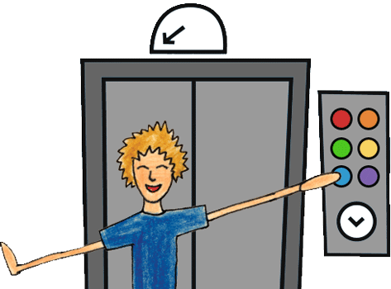
EL467 - Digital Programming
-Prof. Yash Agarwal
Implementation of Elevator Control System using Verilog HDL
By,
201901078 - Jaydip Mokariya
201901100 - Shubham Patel

Slide 2
Abstract
Introduction
Where it is used?
How it works?

Slide 3
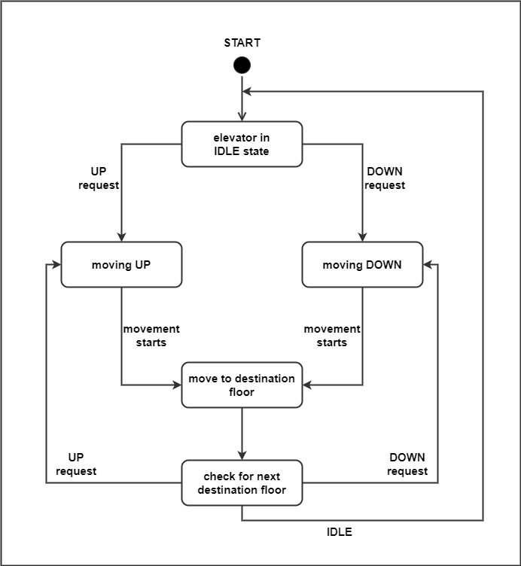
Working flow chart

Slide 4
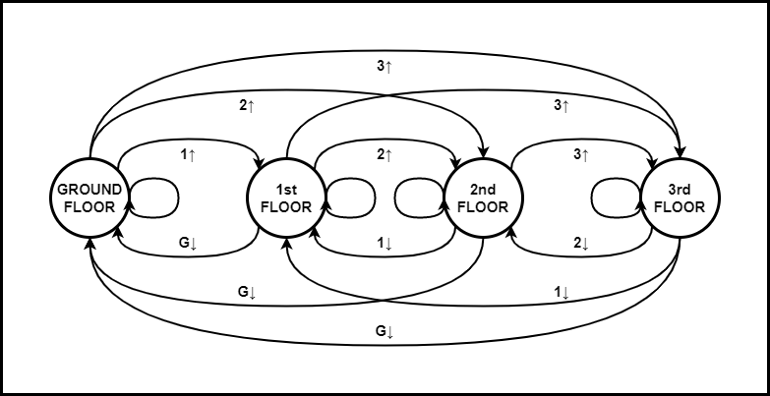
State machine

Slide 5
Implementation code:
Elevator.v
ElevatorTestbench.v

Slide 6
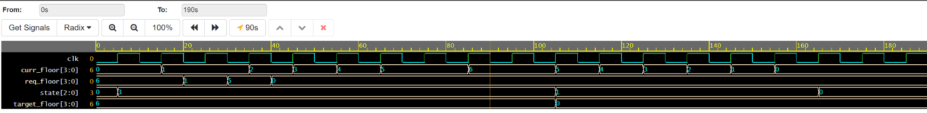
Output waveform:

