Slide 1

SC402: INTRODUCTION TO
CRYPTOGRAPHY
-Prof. Manish Gupta
VISUAL CRYPTOGRAPHY AND IMPLEMENTATION
Group 10:
201901011 - Himanshu Dudhatra
201901024 - Dhavalsinh Raj
201901100 - Shubham Patel
201901143 - Akshat Patel

Slide 2

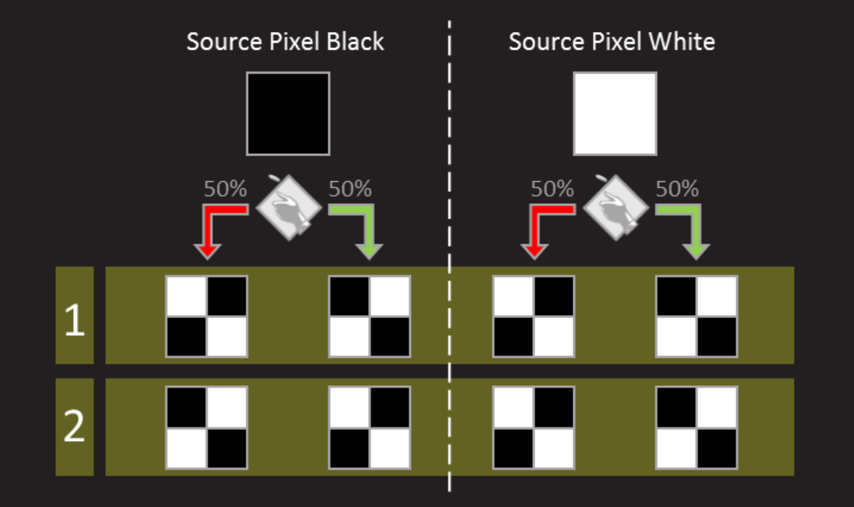
Visual Cryptography
Overview of Visual Cryptography
How Visual Cryptography works
1)
2)

Slide 3
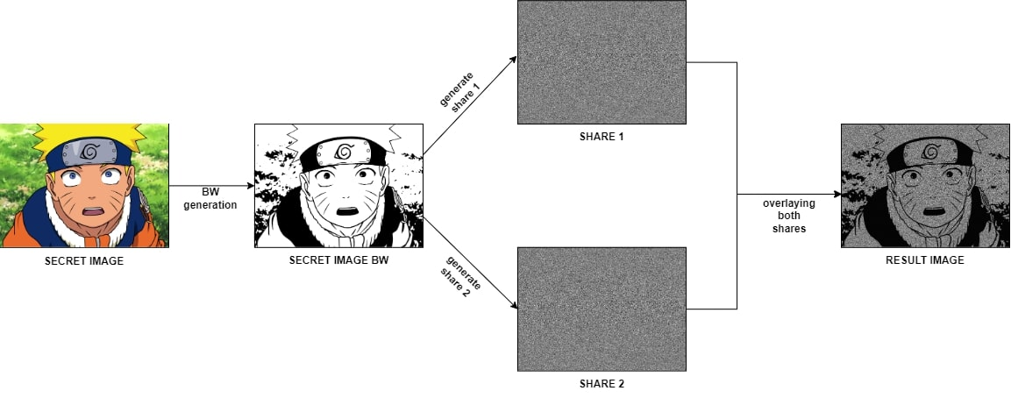
Visual Cryptography implementation
GitHub Code

Slide 4
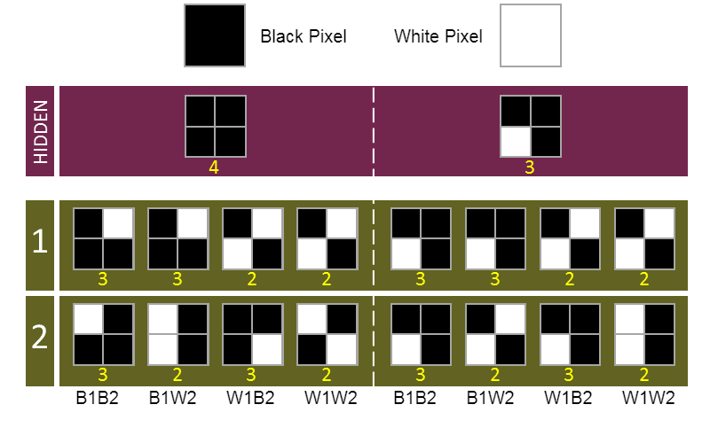
Visual Steganography
Overview of Visual Steganography
How Visual Steganography works
1)
2)

Slide 5
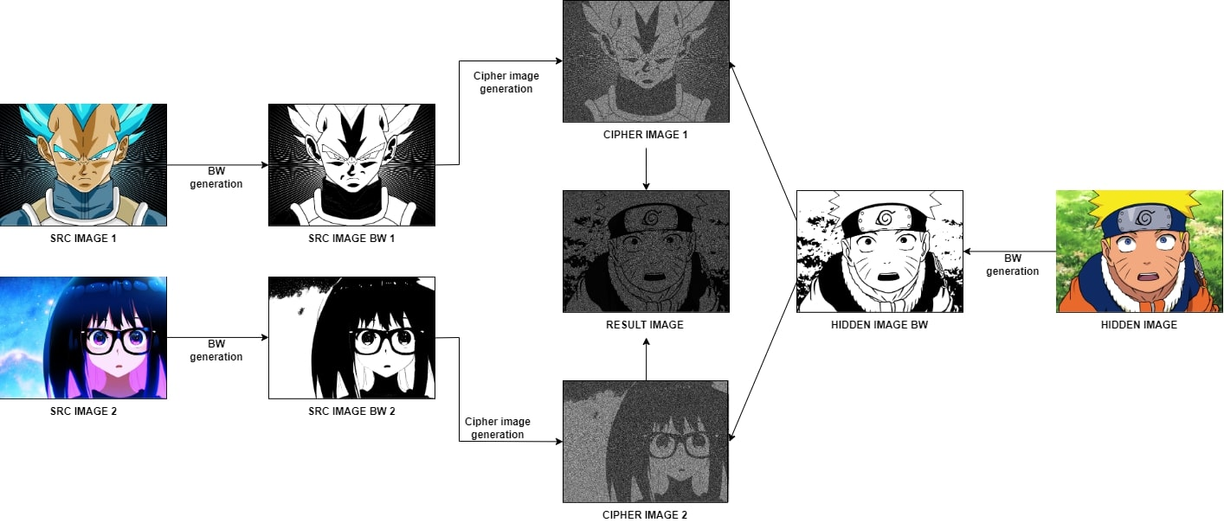
Visual Steganography implementation
GitHub Code

Slide 6
Thank You

