Slide 1

DTDC Courier Insights:
A Comprehensive SQL-Based Logistics Analysis
Shubham Patil

Slide 2
Project Introduction
Analysis is based on 60-day operational data from DTDC courier services
Total consignments analyzed: 49,629
Tools used: MySQL for data extraction & analysis
Focused on 7 key logistics KPIs:
1. Operational Efficiency
2. Consignment Cost Structure
3. Financial Metrics
4. Geo-Logistics Optimization
5. Exception & Risk Management
6. Client Behavior

Slide 3
Project Objective
Leveraging MySQL to diagnose inefficiencies in DTDC’s consignment operations.

Slide 4
Logistics performance indicators
Operational efficiency:
What is the average turnaround time and standard deviation per mode of transport?
How many consignments were handled per day?
Max and min number of consignments handled per day.
Number of days where number of consignments are above average.
Which top 5 booking codes experience higher delivery times across cities?
Identify count of shipments where the delivery gap is unusually high compared to similar routes.

Slide 5
2. Geo-Logistics Optimization:
Segment by mode of transport and routes, which route suffers most delays in terms of delivery gap and volume of consignments.
Which top 5 routes operate with the lowest cost-per-kg (high efficiency)?
Which top 5 routes operate with the highest cost-per-kg (Low efficiency)?
Which routes have the highest consignment volume and weight?
3. Consignment Cost Structure:
What is the average cost per kg by mode?
Which cities consistently incur higher VAS charges?
Find % of total revenue spent on VAS.

Slide 6
4. Financial Metrics:
What is the total % revenue generated from each sender state and mode combination?
Total revenue, VAS charge margin and profitability index of each mode of transport and correlation with volume of consignments.
Identify top 5 senders state contributing highest total revenue across all consignments, their vas charge margin and profitability index.
5. Exception & Risk Management:
Count Consignments where chargeable_wt deviates significantly > 2kg from actual_wt.
Which routes and mode combinations generate high revenue but have low consignment volume?
6. Client Behavior:
Top 10 clients by revenue or volume.

Slide 7
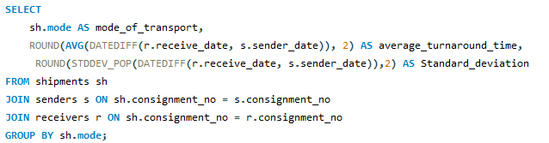

Important SQL Snippets
1. Average Turnaround Time and standard deviation per Mode of Transport
Output:
Analysis: All modes deliver in ~3 days with minimal variation (SD: 1.4–1.42), showing consistent turnaround performance across Air, Express, and Surface.

Slide 8
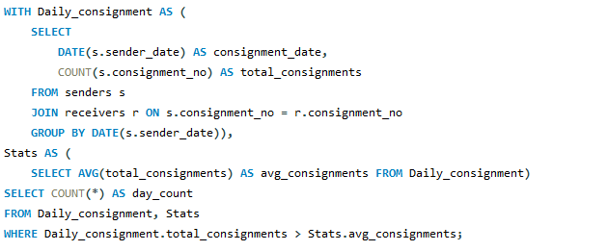

2. How many days had above-average consignment volume?
Output:
Analysis: Average consignment volume is only exceeded on 23% of the days. This suggests that consignment load is concentrated on a few high-volume days, while the rest of the period sees relatively lower or below-average activity.

Slide 9
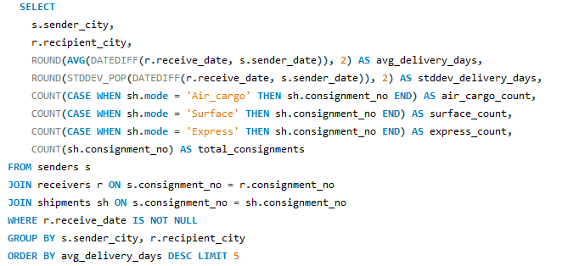
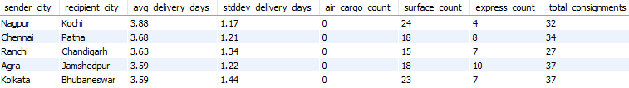
3. Segmented by mode of transport and route, which routes experience the most delays in terms of delivery gap and consignment volume?
Analysis: 80% of high delivery gaps occur in Surface mode, 20% in Express—primarily on routes like Nagpur–Kochi, Chennai–Patna, etc., with 25–40 consignment volume each.
Output:

Slide 10
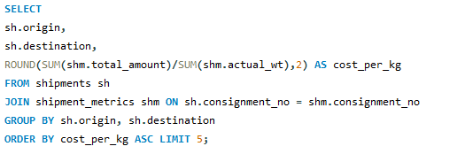
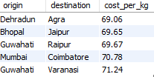
4. Top 5 routes operate with the lowest cost-per-kg (high efficiency)
Output:
Analysis: High-efficiency lanes like Dehradun - Agra, Bhopal - Jaipur, Guwahati – Raipur, Mumbai – Coimbatore and Guwahati - Varanasi worth expanding.

Slide 11
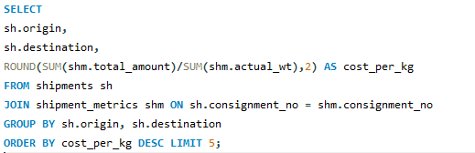
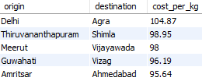
5. Top 5 routes operate with the highest cost-per-kg (low efficiency)
Output:
Analysis: Flag routes such as Delhi–Agra, Thiruvananthapuram–Shimla, Meerut–Vijayawada, Guwahati–Vizag, and Amritsar–Ahmedabad for price revision.

Slide 12
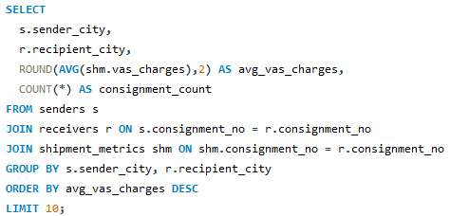
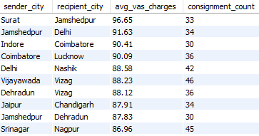
6. Which cities consistently incur higher VAS charges?
Output:
Analysis: Routes involving Tier 2 and 3 cities (e.g., Jamshedpur, Indore, Coimbatore, Dehradun) are frequently on this list. Possible reasons: Infrastructure gaps requiring extra services.

Slide 13
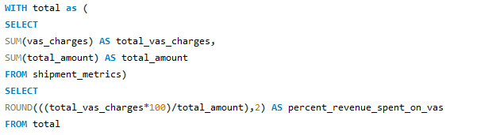

7. Find % of total revenue spent on VAS.
Output:
Analysis: 13.23% of the total revenue is allocated to VAS charges, representing premium add-ons or upgrades to the core logistics services offered.

Slide 14
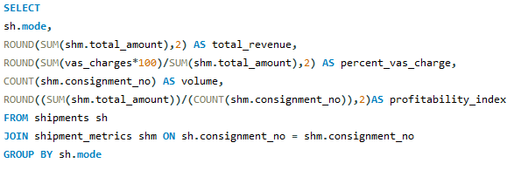

8. Total revenue, VAS charge margin and profitability index of each mode of transport and correlation with volume of consignments.
.
Output:
Analysis: Major contribution to revenue is done by surface mode of transport with highest observed volume of shipments. Vas charge margin from revenue is highest in Surface. Profitability index is highest in express mode of transport 727 per consignment.

Slide 15
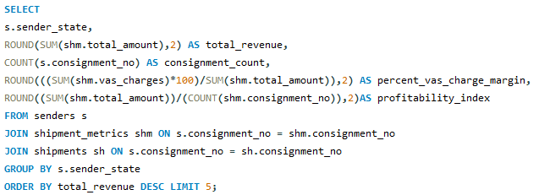
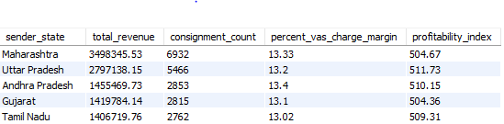
9. Identify top 5 senders state contributing highest total revenue across all consignments, their vas charge margin and profitability index.
.
.
Output:
Analysis: Major volumes of high revenue orders are received from Maharashtra and Uttar Pradesh. Profitability index is consistent through all top 5 states in range 500-510 per consignment.

Slide 16
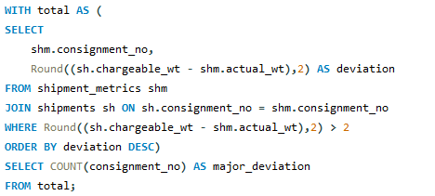

9. Count Consignments where chargeable_wt deviates significantly > 2kg from actual_wt.
.
.
Output:
Analysis: 34.28% of consignments have a significant weight deviation. Data inconsistencies observed in data in form of incorrect weight capture during booking.

Slide 17
Key Insights and Findings:
1. Operational Efficiency
Average turnaround time is ~3 days across all transport modes with low variance (SD: 1.4–1.6), reflecting strong process stability.
Daily shipments fluctuate between 1,600–1,700 and only 23% of days exceed the average, revealing inconsistent peak demand.
High-delay booking codes (e.g., BR926) suggest the need for service package audits.
2. Consignment Cost Structure
Express mode has the highest cost-per-kg due to speed; Surface has the lowest, reflecting bulk, non-urgent shipments.
Efficient routes: Dehradun–Agra, Mumbai–Coimbatore.
Inefficient routes (e.g., Delhi–Agra) need optimization.
VAS charges consume 13.23% of revenue — an opportunity for cost control.

Slide 18
3. Delivery Performance
Surface mode accounts for 80% of delays, especially in routes to Kochi, Chandigarh, Bhubaneswar.
3,799 consignments show major delays — route-level root cause analysis needed.
4. Financial Metrics
Surface mode drives ~50% of ₹1.2 Cr revenue via volume (30K+ consignments).
Express mode leads in profitability (₹727 per consignment).
Top states (e.g., Maharashtra, UP) show steady revenue and margin (~₹500–510 per consignment).
5. Geo-Logistics Optimization
Low-volume, high-revenue routes (e.g., Vijayawada–Delhi) identified for revenue scaling.
Tier-2/3 cities like Dehradun, Jamshedpur show high VAS cost — hinting at infrastructure limitations.

Slide 19
6. Exception & Risk Management:
34.28% of consignments show >2kg variance in chargeable vs. actual weight — indicating packaging or data errors.
3,799 shipments flagged for excessive delivery delays — potential revenue and reputation risks.
7. Client Behavior:
Clients like Keer PLC and Kala Group maintain regular volume but require loyalty strategies (discounts, bundles) to boost retention.

Slide 20
Conclusion
Operational workflows are stable, to add more efficiency in operations route-level optimization, booking code auditing, and volume balancing should be done.
In mode of transportations surface dominates in volume and revenue. But express mode yields superior per-unit profitability. This creates an opportunity to up sell value-driven consignments.
Cost and delay hotspots in Tier-2 routes show underlying infrastructure issues.
A significant portion of revenue is driven by a limited number of high-performing origin-destination routes and key clients. Need to focus on improving routes and customers with average performance to make the business more stable and grow faster
Exception handling needs a stronger data governance framework, especially around weight misreporting and unusual delivery gaps.

Slide 21
THANK YOU !
Shubham Patil
Github link: shubhampatil-source (SHUBHAM PATIL)
Linkedin Link: www.linkedin.com/in/shubham-patil-331386191
Email-ID : shubhamjgd022@gmail.com

