Slide 1
PL/SQL Instructions

Slide 2
Demo1:
Goal:
Insert a record into table of students.
Run demo program:
Before running this program, you should create a table named students first
This table will be used in the rest of programs
Please refer to demo1.sql for details
Run java program
-bash-4.2$ javac -cp /usr/lib/oracle/18.3/client64/lib/ojdbc8.jar mydemo1.java
-bash-4.2$ java -cp /usr/lib/oracle/18.3/client64/lib/ojdbc8.jar mydemo1.java
mydemo1 is a very simple program just for demo, so all the values(except sid) of student are hard coded.
You need to change the usr_id and password in all of demo programs to your own Oracle id and password

Slide 3
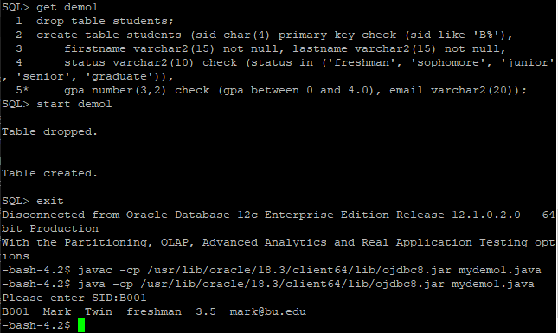
Demo1 output:

Slide 4
Demo2:
Goal:
Run a sql procedure from Java:
Get the status of students according to sid
Run demo program:
Before running this program, you should create a procedure named show_status
Please refer to demo2.sql for details
Run java program
-bash-4.2$ javac -cp /usr/lib/oracle/18.3/client64/lib/ojdbc8.jar mydemo2.java
-bash-4.2$ java -cp /usr/lib/oracle/18.3/client64/lib/ojdbc8.jar mydemo2.java

Slide 5
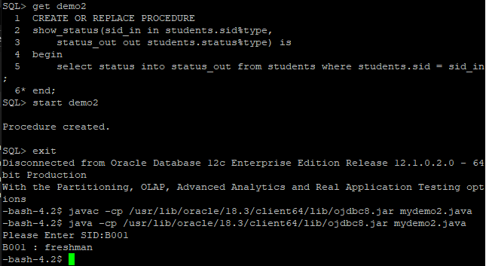
Demo2 output:

Slide 6
Demo3:
Goal:
Run a SQL function from Java
Get all of records in the tables of students.
Run demo program:
Before running this program, you should create a package named refcursor_jdbc1, and a function getstudents in the package
Please refer to demo3.sql for details
Run java program
-bash-4.2$ javac -cp /usr/lib/oracle/18.3/client64/lib/ojdbc8.jar mydemo3.java
-bash-4.2$ java -cp /usr/lib/oracle/18.3/client64/lib/ojdbc8.jar mydemo3.java

Slide 7
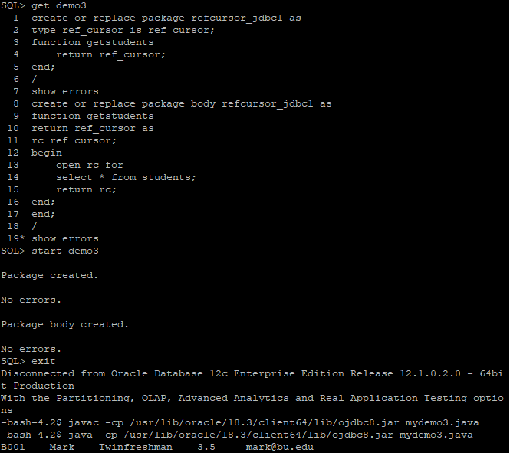
Demo3 output:

Slide 8
Demo4:
Goal:
Run a SQL function from Java
Get records of students whose gpa are larger than 3.0
Run demo program:
Before running this program, replace function of getstudents with a new one
Please refer to demo4.sql for details
Run java program
-bash-4.2$ javac -cp /usr/lib/oracle/18.3/client64/lib/ojdbc8.jar mydemo4.java
-bash-4.2$ java -cp /usr/lib/oracle/18.3/client64/lib/ojdbc8.jar mydemo4.java

Slide 9
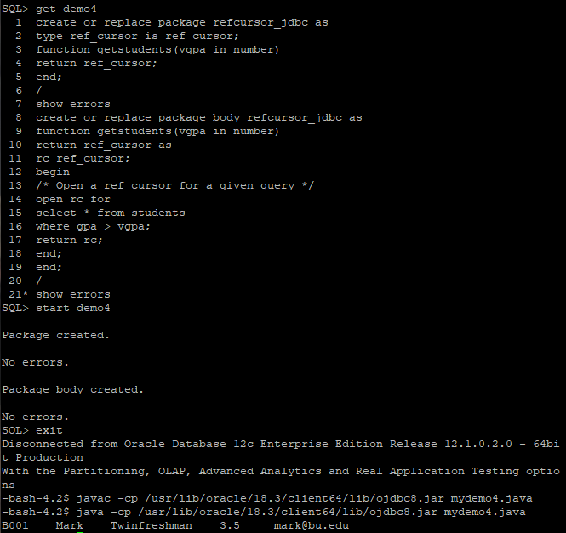
Demo4 output:

Slide 10
Thank you!

