Slide 1
RECHARGE APPLICATION
Represented By Shubham Pawar
Kshitij Shelke Sangharsh Narwade
Prathmesh Margaje Rohan Kunkekar

Slide 2
INTRODUCTION
In the history of communication technology, Wireless network is the fastest growing one. Multimodal communication which affects everyday life at home, at work, at school and raises broader concerns about politics and culture both global and local is possible because of mobile communication. In recent decade mobile phone is the easiest and suitable for voice communication. Integration of mobile phones with the Wireless Application Protocol (WAP) [1] and Internet enables consumers to enjoy various facilities.
For mobile phone users, generally two types of services prepaid and postpaid are offered by the mobile phone operators. Prepaid service is much popular than postpaid service among mass people. In our application we used only prepaid service. In case of prepaid service mobile phone users have to have a certain balance of money to use the service. Here comes the concept of mobile phone recharge.
People often find it difficult to recharge because of lack of recharge centers, long distances etc. Nowadays, in modern internet age, with the development of web services people gets a varieties of services sitting home. Mobile recharge is one of frequent demand for the most of the people, hence this service also should be provided by the web-service provider. Although in case of immigrant, this can be the only way to recharge mobile for their relatives. In the existing system, people can send a request to the recharge service provider using webpage by providing card name, mobile no and amount of money.
But recharge service providers recharge the mobile manually. They have to wait for a fixed time, which is sometimes not tolerable. Our aim is to overcome the limitations with possible outcomes and to reduce the waiting time and make it comfortable for both the customer and mobile recharge service providers.

Slide 3
FEATURES AVAILABLE
-Admin
-User
*Login
*Register & Sign up
*Add Top Up Details
* Remove Top Up Details
*Login
*Explore Top up
*Enter Mobile Number
*Enter Card Name
*Select Plan

Slide 4



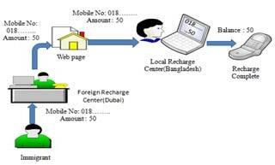











BACKGROUND
Account recharging is an obvious necessity for those who use prepaid phones. For this regarding, a prepaid phone user may do some certain tasks, like – he/she must visit a local recharge center, inform the recharger about the phone number to be recharged and amount to be recharged, and then pay the said amount of money. This is really time killing if the distances of these recharge centers are long or there are long queues of customers at those recharge centers. Some special cases may occur like a travelling person may wish to have an emergency recharge. Moreover, a person living somewhere in a rural area using a prepaid phone may face difficulty to recharge account because of lack of recharge centers, inability to communicate.
MobileNo:
018……..
page
Web
Local Recharge
Username & Password
MobileNo:
018……..
Balance :
Figure 1: Existing system Figure 2: Proposed system
Besides, if we take a look at the recharger, that person has to make a lot of entries about customer information in the log book and then do all the recharges. On this perspective view, the person working as a recharger also has to do a lot, manually, which is shown in Fig. 1. But anyone living in the recent time of science and technology may want a better, flexible and time saving way to recharge his/her prepay phone. To do a favor to these person there are some existing systems for

Slide 5
online prepaid recharging which is somehow still manual, although it is capable to remove the log book for customer record, still the recharger has to recharge manually by viewing from computer system.
The existing system also fails to support immigrant simultaneously, for those who want to recharge to their relative prepaid mobile .
Our main goal is to overcome those problems and make it comfortable and quicker for user satisfaction [3] [4]. There are three possible outcomes of this proposed system model. First one is to remove the local recharge center. Second one is making recharge comfortable of the immigrant by completing their recharge with their own username and password.. A proposed scenario is shown is Fig. 2.

Slide 6
ARCHITECTURE OF THE PROPOSED SYSTEM MODEL
In proposed architecture, an automated system is implemented to recharge prepaid mobile in online. A recharge center shopkeeper as well as a normal customer can upload customer mobile number, recharge amount in web page by using his own valid username and password. Database server stored the uploaded information. A file watcher always checks for a new request at the server. As soon as a new request is available for recharge, parser will parse the information to retrieve the desired customer number and valid amount.
All of the information of the customer including his/her cell number, recharge amount, date of recharge are then stored in a separate database table for further processing to generate additional reports. Finally, the customer will be notified about successful recharge completion through SMS. An online acknowledgement containing the transaction number of the successful recharge will also send to the requestor.
In recharge period message server is run on the PC. Two programs are simultaneously run also. A file watcher and another is parser. File watcher always watch the message inbox of the server for notifying if any new message come.
When it got a message then sends it to the parser for parsing. After parsing there found a mobile number, recharge amount and customer name from the message which correspond to the customer. Then a query will generate to retrieve the whole information of the customer correspond to report from the customer database. Then he/she will get a SMS which belongs to an acknowledgement of receiving his/her request. The information of the customers who are able to recharge then stored in a table including the cell number, name and date of recharge.

Slide 7
Start
Yes
Is Register
No
1.Enter Username
Enter Username
Enter Email
Enter Password
Enter password
Enter Mobile no
Admin
Role
User
5.Enter Address
6. Enter Role
Card Name
False
Mobile number
Amount
True
False
Card name
Validity
True
Recharge Successful
Package name
Plan added Successful
End

Slide 8
Register
User
Login
- username
- Id
+ Login
- email
- username
- username
- address
- email
- password
- mobile number
- address
- password
- mobile number
password
RechargeInfo
  Enter Mobile No
  TopUp
  Data Pack
-Unlimited Pack
  Sms Pack
Airtel
Bsnl
Jio
Vodafone-Idea
- Amount
- Amount
- Amount
- Amount
- Data
- Data
- Data
- Data
-Talk Time
-Talk Time
-Talk Time
-Talk Time
- Sms
- Sms
- Sms
- Sms
- Validity
- Validity
- Validity
- Validity

Slide 9
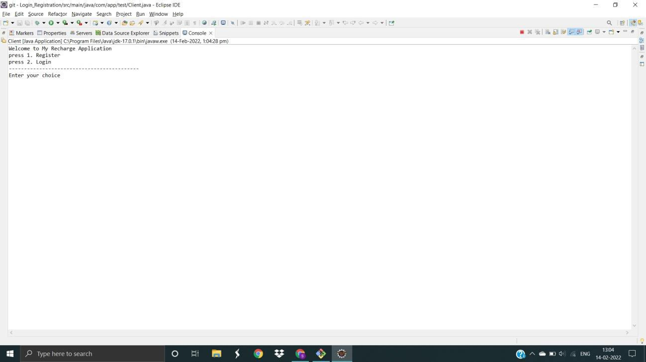
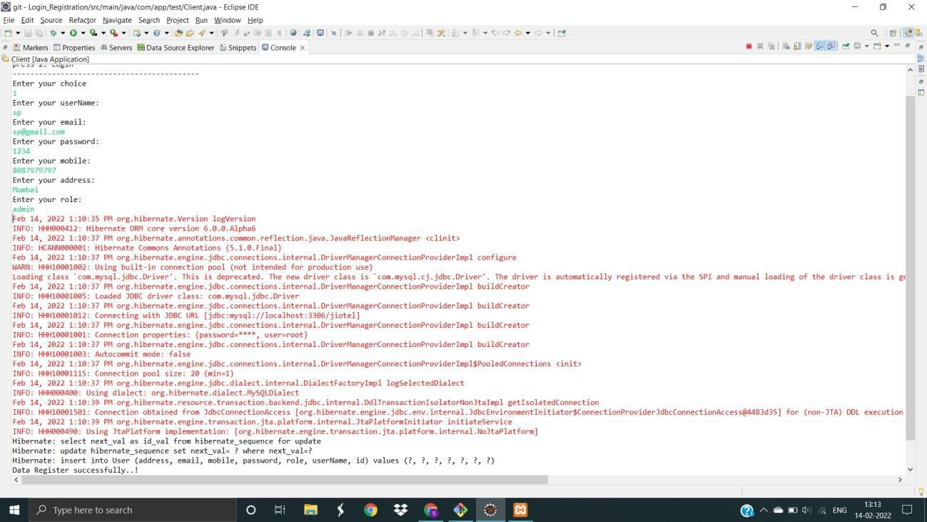
Screenshots
1. Login Register Page
2. Admin Register

Slide 10
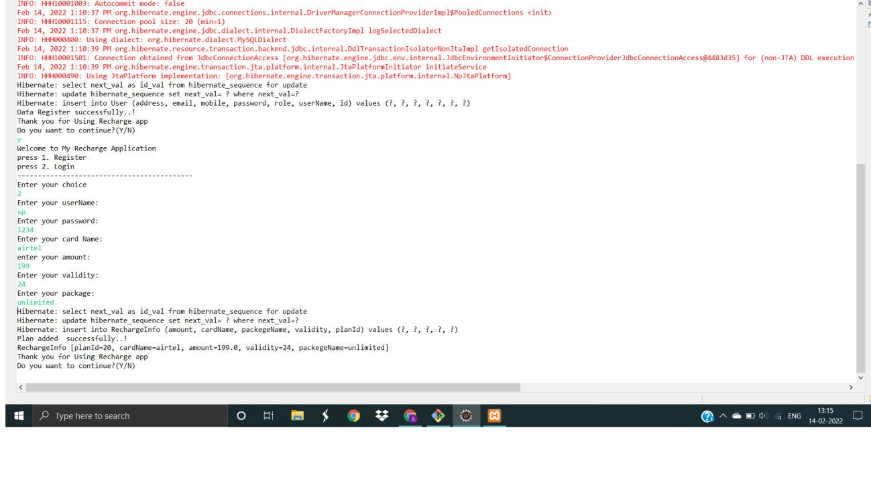
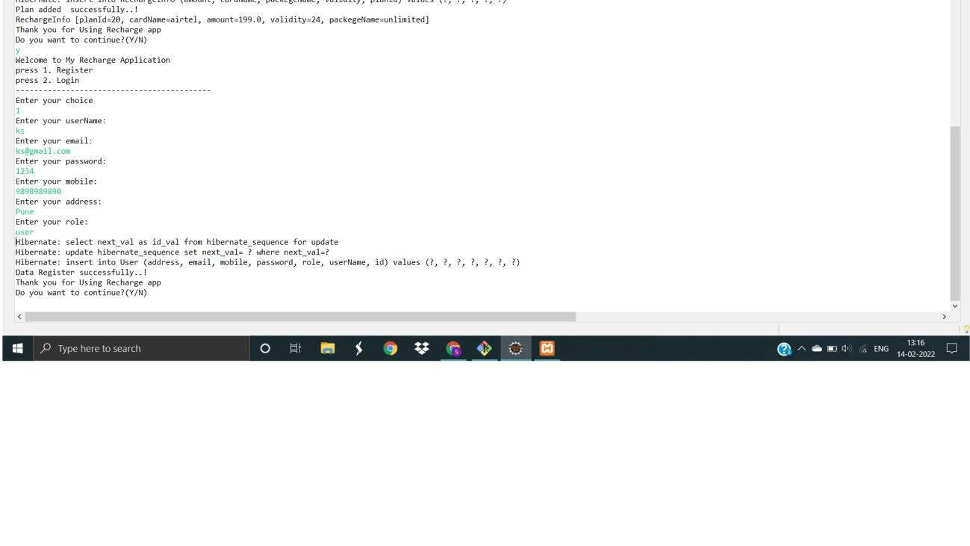
3. Login Admin
4. User Register

Slide 11
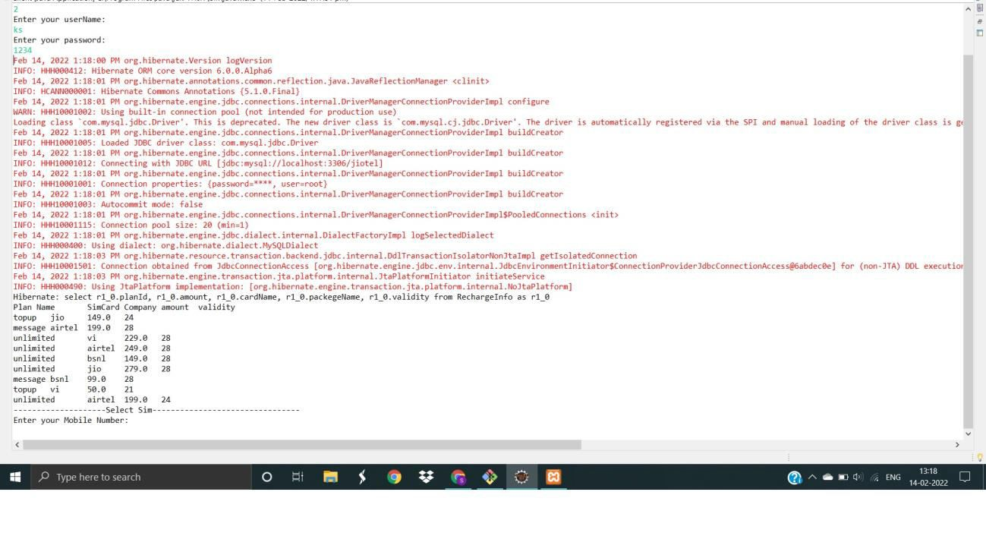
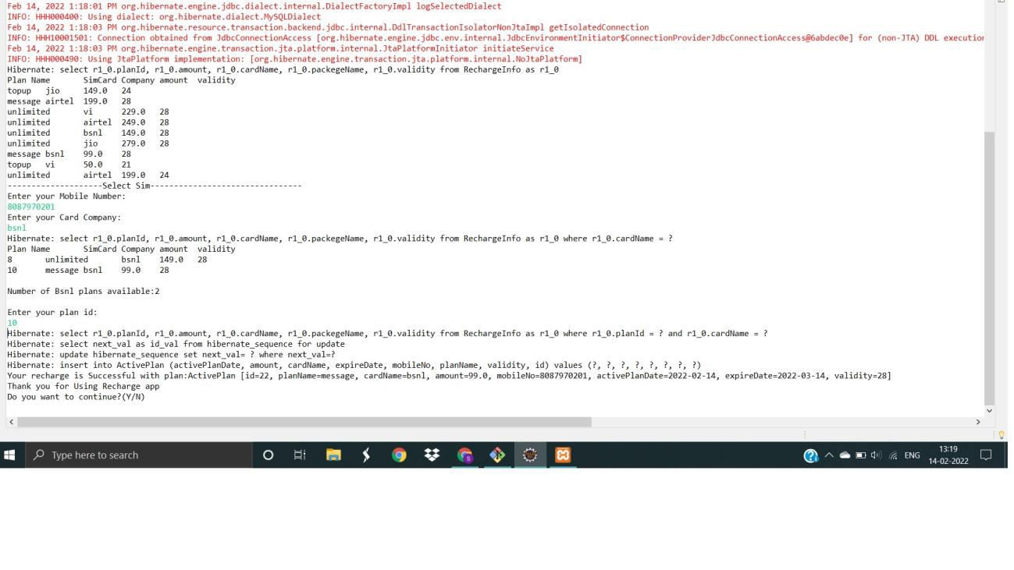
5. User Login
6. Recharge

