Slide 1



Marathwada Mitra Mandal’s
COLLEGE OF ENGINEERING,
KARVENAGAR, PUNE-52
(An Autonomous Institute Affiliated to SPPU, Pune)
Department of Mechanical Engineering
Accredited with 'A++' Grade by NAAC | Recipients of “Best College Award 2019” by SPPU |
NBA Accredited
A Capstone Project as a Part of F.Y. B. Tech Mechanical
Engineering Exploration lab (EEL) Course
Project Presentation
(Sem-I, F.Y. 2025-26)
on
Waste segregation project using Arduino
Presented By
1. (B25ME1112) Rohit Yadav
2. (B25ME1104) Jayraj Nikam
3. (B25ME1110) Aditya Raje
. 4. (B24ME1105) Atharva pardeshi
. 5.(B25ME1098) Nikhil Kulkarni
Dr. Swapnil Lahane

Slide 2
Contents
Introduction
Literature Review (Background of or Brief History)
Working Principle
Case Study
General arragement
Components of device
Similar project
Application
Benefits/Merits & Risks/Demerits
Conclusion & Future Scope
References

Slide 3
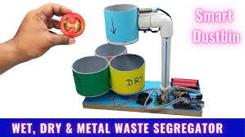
1. Introduction
Need for Waste Segregation:
Improper waste disposal leads to
environmental pollution and health hazards.
Limitations of Manual Methods:
Manual segregation is time-consuming,
unhygienic, and often inaccurate..
Role of Automation and Technology:
Automation using microcontrollers like
Arduino improves accuracy and speed in
waste sorting. Sensors can detect waste type
instantly, ensuring proper classification.
Purpose of the Project:
This project aims to build a smart dustbin that
automatically separates wet, dry, and metal
waste. It promotes clean and sustainable
waste disposal in daily life.

Slide 4
2. Literature Review (Background of or Brief History)
Waste Management Practices:
Historically, waste was collected without segregation,
leading to increased landfill use. This caused
environmental degradation and health issues.
Introduction of Waste Segregation:
Governments and NGOs began promoting segregation
into wet and dry waste to aid recycling. However,
manual methods remained inefficient and
labor-intensive.
´

Slide 5
3. WORKING PRINCIPLE
The system uses sensors like a moisture sensorand metal detector to identify the type of waste.
Each sensor sends signals to the Arduino based
on the waste's properties.
The Arduino microcontroller processes the input
from sensors. It then decides whether the waste is wet, dry, or metallic.

Slide 6
4. Case Study
>Waste management has become one of the most pressing issues in modern society due to rapid urbanization and industrial growth.
>The main objective of this project is to design and implement an automatic system that can identify and separate different types of waste without human intervention.
>The system is built around an Arduino Uno microcontroller, which acts as the brain of the setup. Several sensors are used to identify the type of waste placed in the system.

Slide 7

5. General Arrangement of Device
.
Three separate bins are for collecting metallic, wet, and dry waste automatically.
The Arduino control unit processes sensor data and servo motors forsegregation.
The device consists of an input section where waste is placed and detected by sensors.

Slide 8
6. Components of Device
1x Arduino uno smd
1x Servo 9g motor
1 x stepper motor
1 x stepper motor driver
1 x shaft adaptor
1x Rain drop moisture sensor
1x IR sensor
1 x Proximity sensor
1x usb cable
4x 3x20mm nut and bolt
6x 3x12mm nut and bolt
10 x F-F jumpers
3 x M-F jumpers
2 x 1200Mah 18650 Li-ion battery
1 x 2s 18650 battry holder
12v male jack
1x Big buzzer

Slide 9
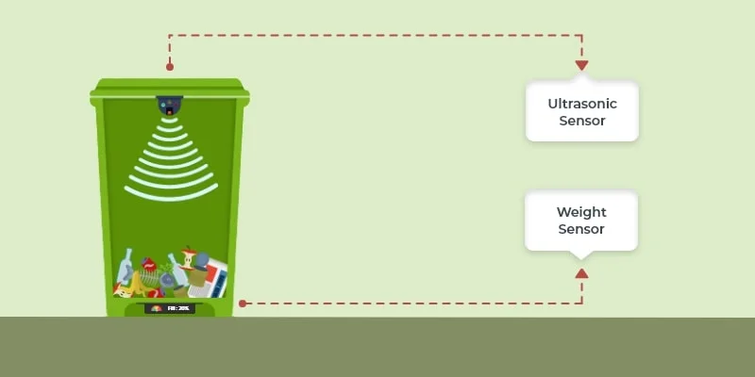
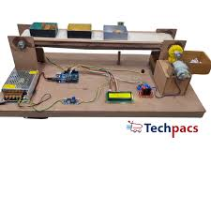
7. Similar Projects
IoT-Based Smart Waste Management System – Uses Arduino and a Wi-Fi module (like ESP8266) to send bin status data (e.g., full or empty) to an online platform for efficient waste collection scheduling.
Automatic Waste Segregator using Arduino and Conveyor Belt – Employs a conveyor belt mechanism with metal, moisture, and IR sensors to automatically sort metallic, wet, and dry waste as it moves along the belt.

Slide 10
8. Applications
Used in households for automatic separation of domestic waste.
Installed in schools and colleges to promote smart waste management awareness.
Applied in public places and offices to maintain cleanliness efficiently.
Utilized in municipal waste systems for faster and organized recycling processes.

Slide 11
9. Benefits
Reduces human effort by automating the waste segregation process.
Promotes recycling through proper separation of waste types.
Improves hygiene and cleanliness by minimizing manual waste handling.
Cost-effective and energy-efficient solution for smart waste management.

Slide 12
Risks/Demerits
Sensor malfunction may lead to incorrect waste classification.
Moisture or dust can affect sensor accuracy and system performance.
Electrical short circuits may occur if wiring is not properly insulated.
Limited capacity makes it unsuitable for large-scale or industrial waste.
Mixed or composite waste may not be correctly identified by basic sensors.

Slide 13
10. Conclusion
The Arduino-based Waste Segregation System provides a practical and efficient solution for automated waste management.

Slide 14
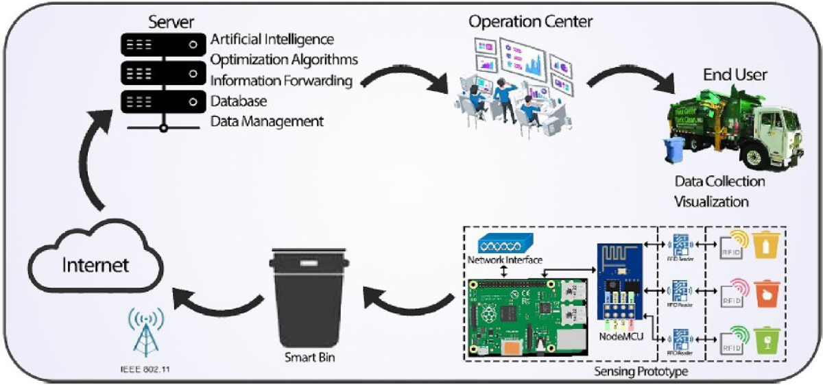
Future Scope
Integration with IoT: Real-time monitoring of bin status and automated notifications to waste management authorities.
Advanced Waste Detection: Use of image processing and machine learning to identify complex or composite waste materials.
Solar-Powered Operation: Making the system energy-efficient and suitable for off-grid locations.

Slide 15
11. References Follow the APA (American Psychological Association) Formatting for Reference (Source: Google Scholar)
Banerjee, S., Ghosh, S., Bera, A., Das, R., & Pal, S. (2025). Design and
Implementation of Smart Dustbin for Automated Wet and Dry Waste
Segregation. International Journal of Innovative Science and Research
Technology.
Dr. Sudha L K, Mohammed Tahir, Ruchitha E, Varshini R, Syed Saif Ali.
(2023). Smart Dustbin Monitoring System using Arduino UNO. IJERT,
Volume 12, Issue 02 (February 2023).
https://youtu.be/4XedfXtPxLQ?si=4ZNG5_9tUCA-JKbO

Slide 16

THANK YOU

