Slide 1
Digital Electronics Project
On
Smart Home Quarantine System
Presented By:
Shimaila Khan
Shubham Prakash

Slide 2
Overview
This project is a combination of Combinational & Sequential Circuits what we have learnt so far.
The circuit consists of logic gates ICs, Counter IC and some sensor which are configured in such a way that it resembles an Automatic Home Quarantine System which allows either only family members to enter into the house or any outsider whose body temperature is normal, not too HIGH & that too after sanitizing himself properly for 10sec.

Slide 3

Our Journey With the Project :
Searched on Google

Slide 4
Our Journey With the Project :
Searched on Google
Found A Relevant Project
But it had Microcontrollers
Sounds GOOD 😄
So Assumptions were taken to make it easy..

Slide 5
Assumptions :
Implemented Camera using IR sensor Module.
To be recognised by camera,we assume
All Family members are TALLER in height.
Outsiders are SHORTER in height
Temperature sensor...
Ultrasonic sensor was implemented using IR Proximity sensor Module.

Slide 6
What this project does:
1
Buzz Alarm
0
Ts
0
Cs
0
Note:
Cs=1 : Family Member
Cs=0 : Outsider
Ts=0 : Temperature OK
Ts=1 : Temperature HIGH
Ps=0 : No Object
Ps=1 : Object Found
1
Ps
1
Sanitizer ON for 30 sec.

Slide 7

How Camera Sensor is Working ?
Family Member
Outsider

Slide 8
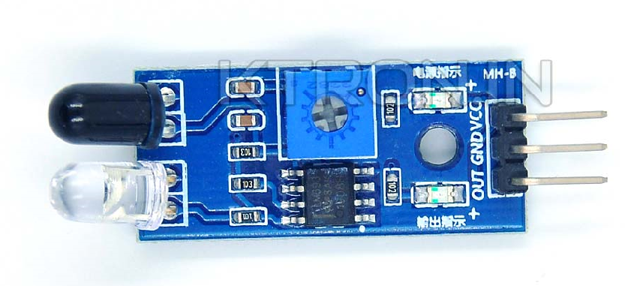

How Temperature Sensor is Working ?
HIGH
NO FLAME
LOW

Slide 9
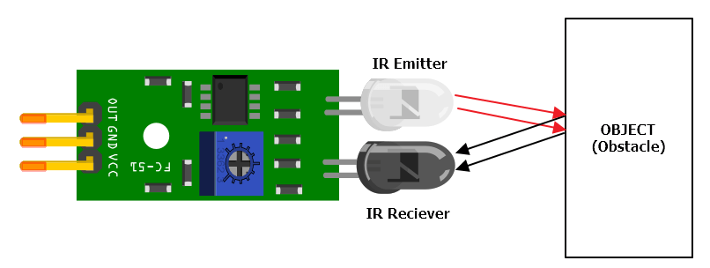
How Proximity sensor is working ?

Slide 10
Our Journey With the Project :
NOW it’s time for the implementation
So obtained LOGICAL EXPRESSIONS are...

Slide 11
Logical Expressions:
INPUT |  | OUTPUT
Cs | Ts | Psen | Bzz
0 | 0 | 1 | 0
0 | 1 | 0 | 1
1 | X | 1 | 0
Note:
cs = Camera Sensor
Ts= Temperature sensor
Psen= Proximity Sensor Enabler
Bzz= Buzzer
Bzz= cs’ . Ts
Psen= Cs + Ts’

Slide 12
Present State |  |  | Next State
Ps | Cs | Cen | Cen
0 | 0 | 0 | 0
0 | 0 | 1 | 1
0 | 1 | 0 | X
0 | 1 | 1 | 0
1 | 0 | 0 | 1
1 | 0 | 1 | 1
1 | 1 | 0 | 0
1 | 1 | 1 | 0
Note:
Ps= Proximity Sensor
Cs= Counter State
Cen= Counter Enabler
Note:
cs=0 Counting
cs=1 Not counting b/c max. Count occurred
Cen= (Ps.Cs’) + (Cs.Cen)

Slide 13
INPUT |  |  | OUTPUT
C1en | C1cs | C2cs | C2en
0 | 0 | 0 | 0
0 | 0 | 1 | 0
0 | 1 | 0 | 1
0 | 1 | 1 | 0
1 | 0 | 0 | 0
1 | 0 | 1 | 0
1 | 1 | 0 | 0
1 | 1 | 1 | 0
Note:
C1en= Counter 1 Enabler
C1s= Counter 1 State
C2s= Counter 2 State
C2en= Counter2 Enabler
Note:
cs=0 Counting
cs=1 Not counting b/c max. Count occurred
C2en= (C1en)’ . C1cs. C2cs

Slide 14
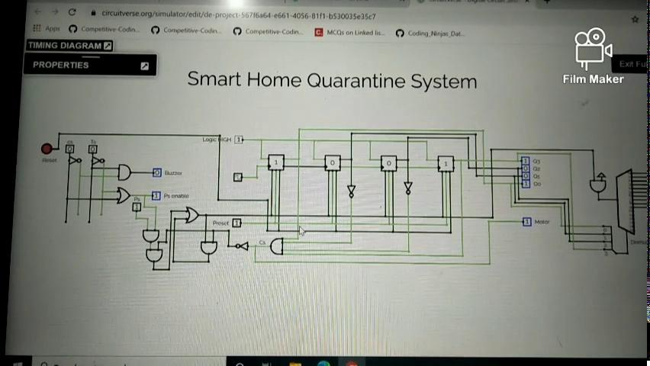
Circuitverse Simulation
Link:-
https://circuitverse.org/users/51123/projects/de-project-567f6a64-e661-4056-81f1-b530035e35c7

Slide 15
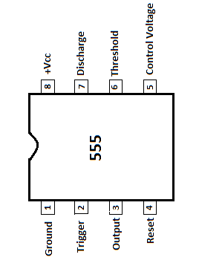
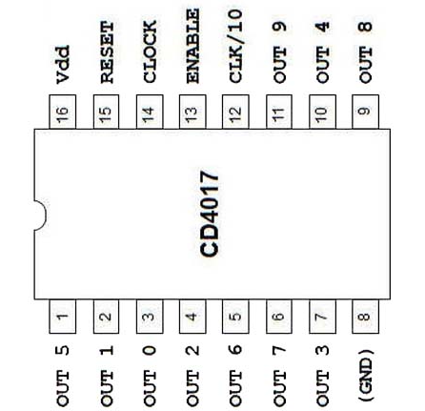
Components Used :
CD4017 Decade counter IC
NE555 Timer IC

Slide 16
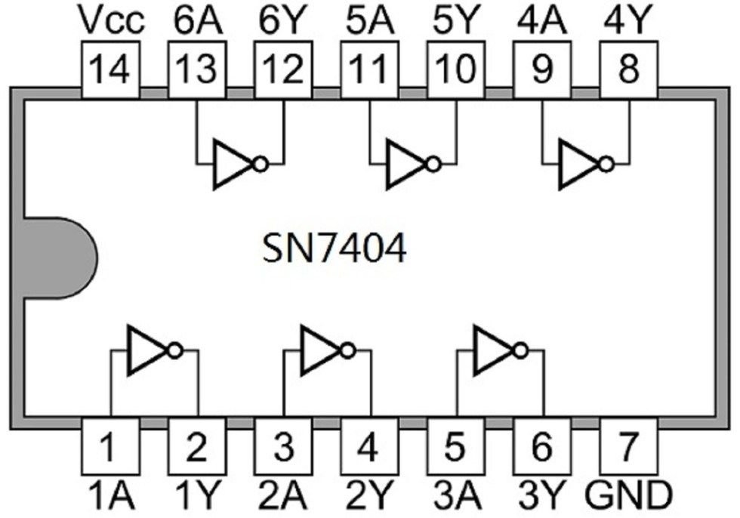
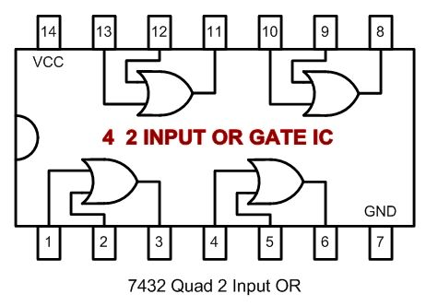
Components Used :
IC 7404 Logic Inverter
(NOT gate)
IC 7432 Logic OR

Slide 17
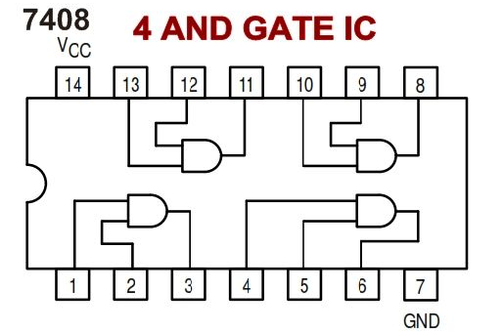
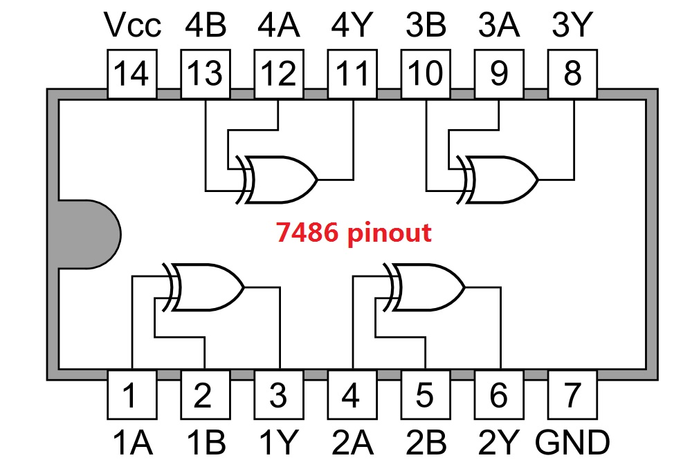
Components Used :
IC 7408 Logic AND
IC 7486 Logic XOR

Slide 18
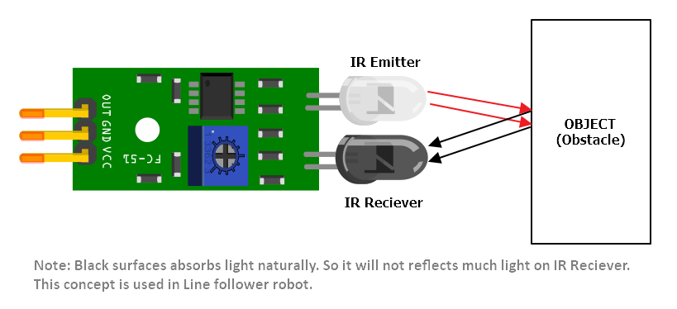
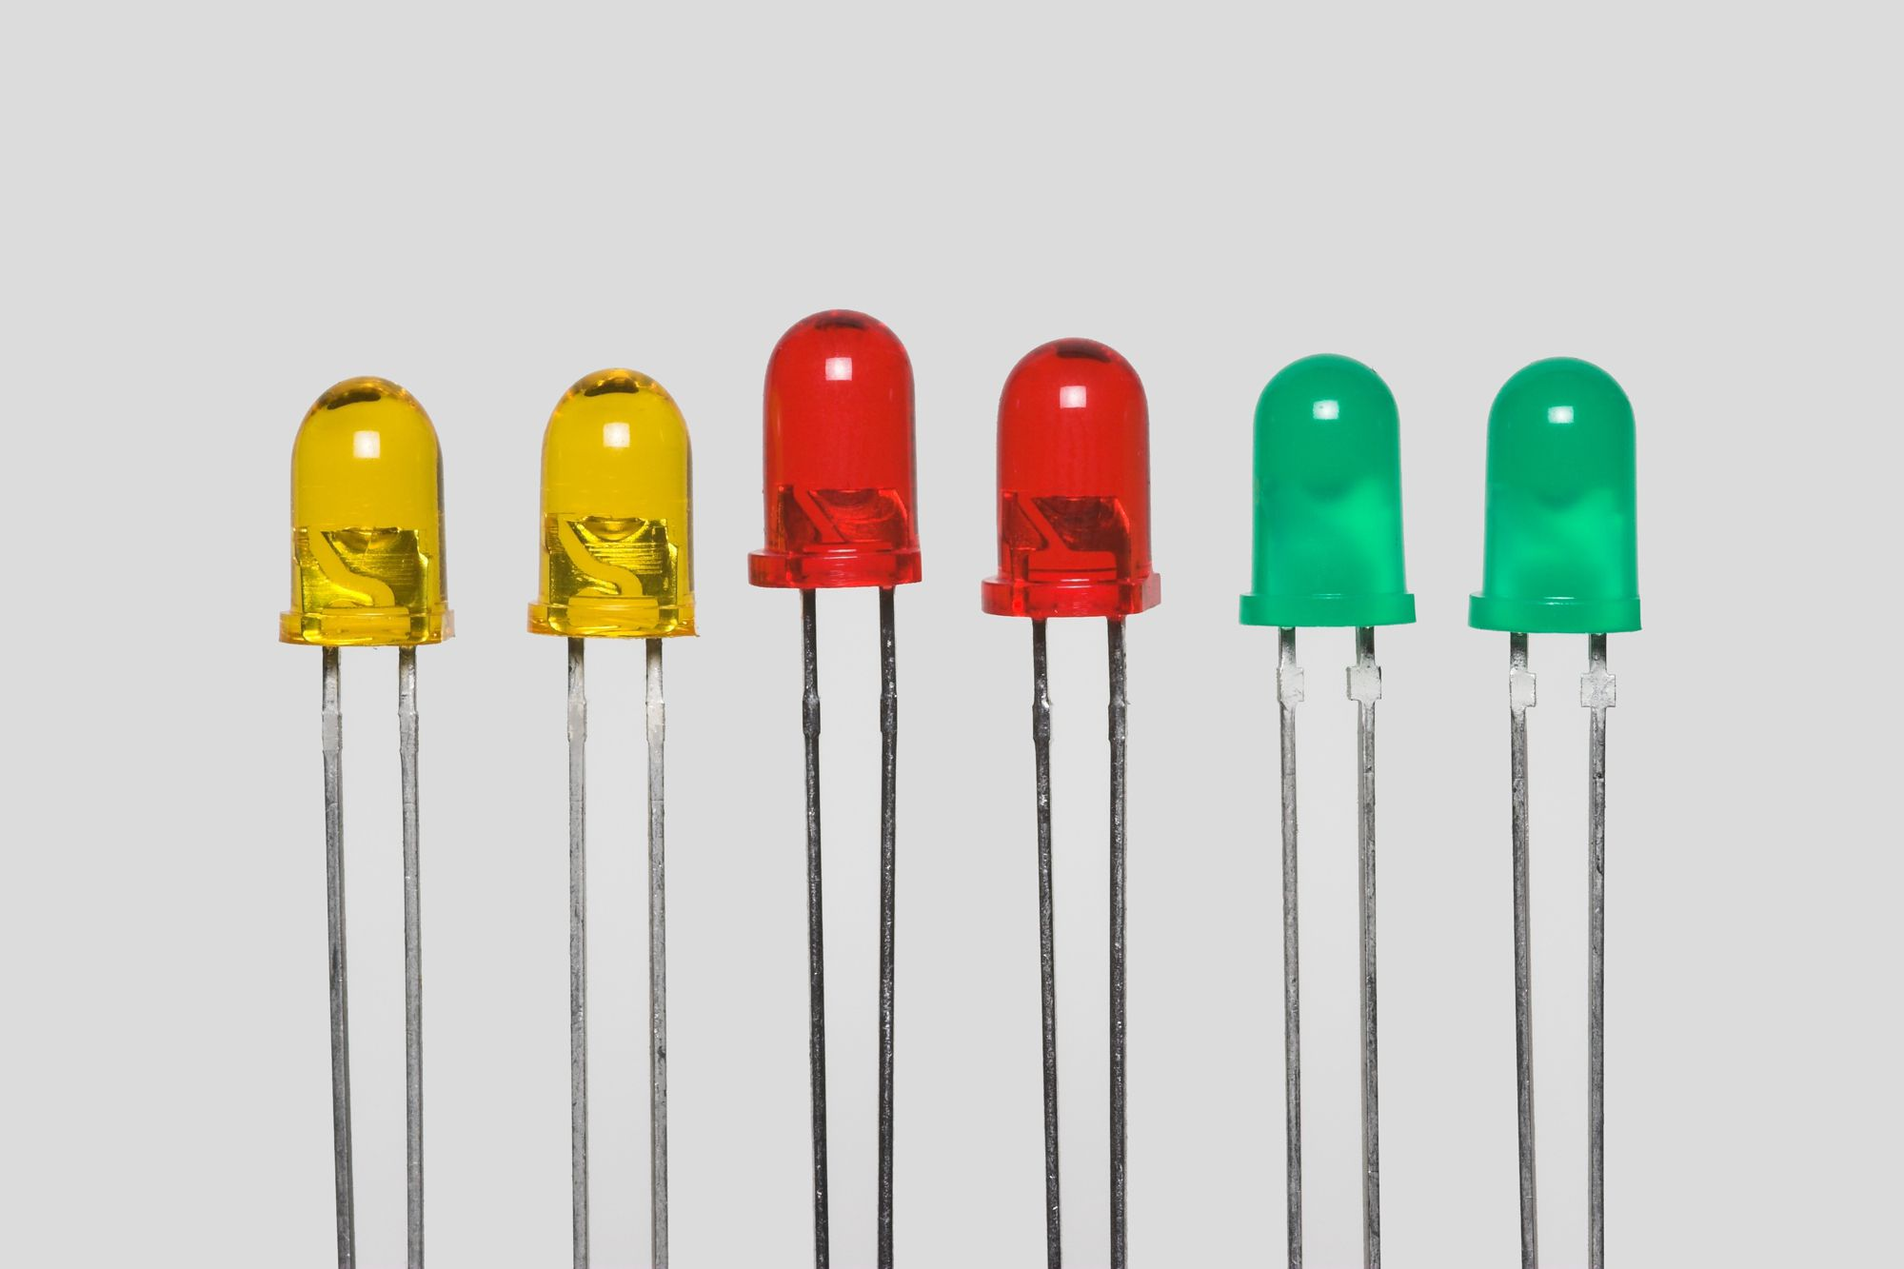
Components Used :
IR Sensor Module
LEDs

Slide 19
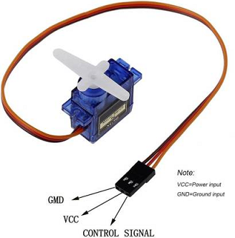
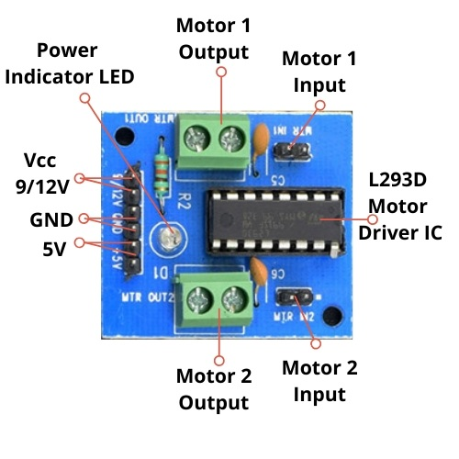
Components Used :
Servo Motors
L293D Bi-Channel Motor Driver Module

Slide 20
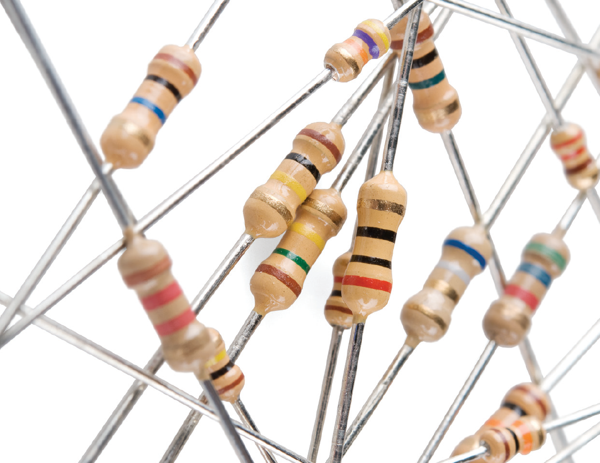
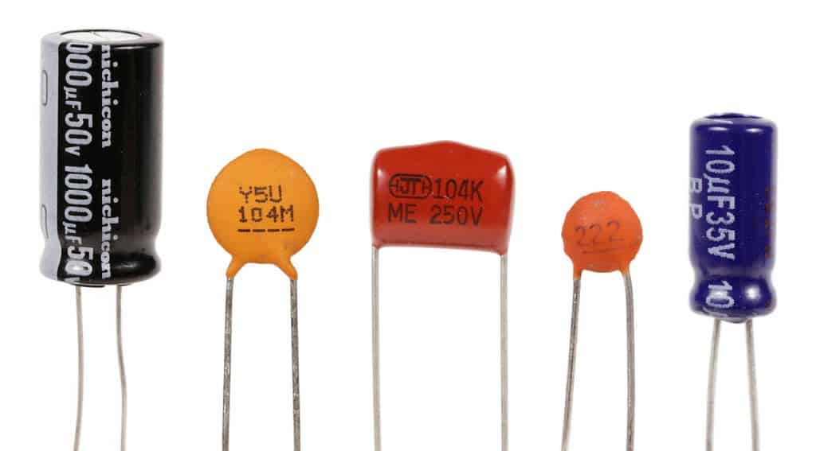
Components Used :
Resistors And Capacitors

Slide 21
Our Journey With the Project :
Realised that simulating on circuitverse was quite easy but implementing it on hardware is not a piece of cake as circuitverse has lot of assumptions blah blah...
What to do next?😕🤔

Slide 22
Proteus Simulation
Proteus file link:-
https://drive.google.com/file/d/1S8EL_bSuebc_5Vi0i3t5QfgAlovGAUSt/view?usp=sharing

Slide 23
Hardware Simulation

Slide 24
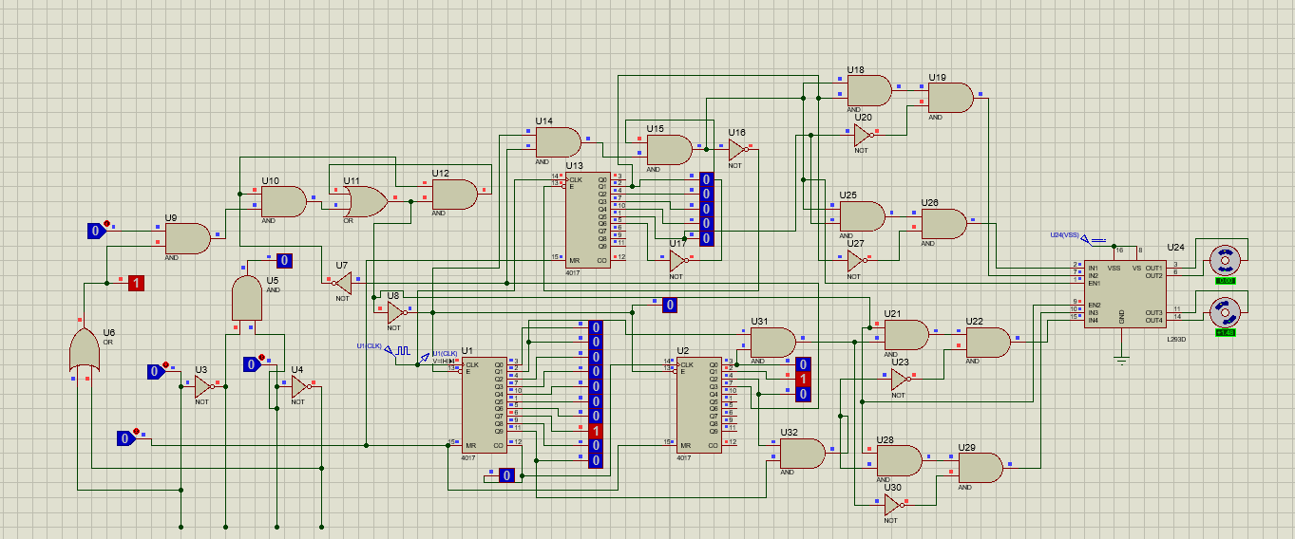
Circuit Diagram

Slide 25
Attachments
Block-level Diagram
Sensors
Logic Circuits
Counter 1
Motors
Motor Driver
Counter 2

Slide 26
Attachments
Sensor block
Camera Sensor
Temperature Sensor
Proximity Sensor
Logic Circuits
CD4017BE
IC1
Motor Drivers
Motors
Motor Driver Logic 1
Sanitizer Motor
Counter Block
CD4017BE
IC2
CD4017BE
IC3
Motor Driver Logic 2
Gate Motor
Component-level Diagram

Slide 27
CONCLUSION:
In this project,we have talked about smart home quarantine system which works on face recognition technology.
We have used camera sensors for face recognition.
Temperature sensors & US sensors also have been used.

Slide 28
THANK YOU !
😊

