Slide 1
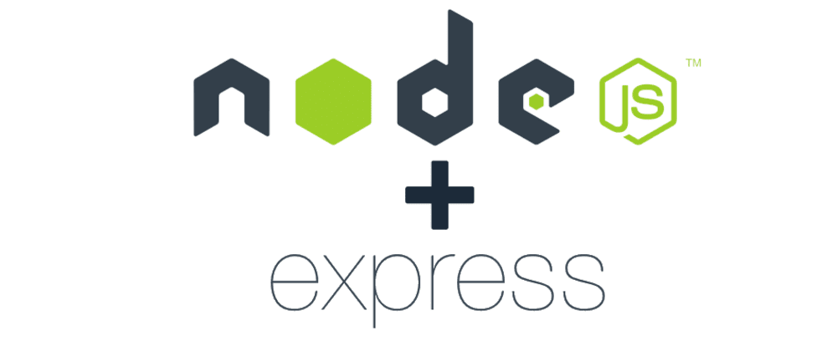

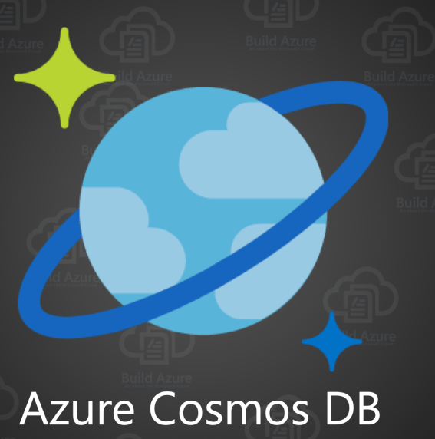
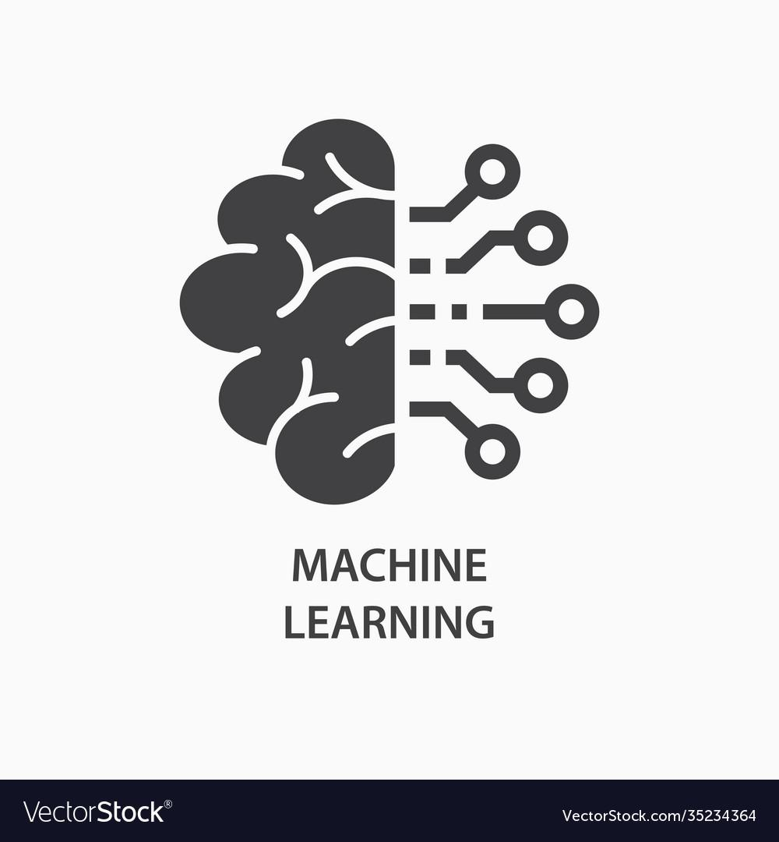
Future Ready Talent
Medical Assistant Cum Hospital Management Web App
Group Members:-
Faisal Rahman
Shubham Prakash

Slide 2
Good healthcare is a right of all !
Tagline

Slide 3
NodeJs
ExpressJs
MongoDb
Azure Bot Service
Azure Health Service
LUIS
Heroku
Tech-Stack To Be Used

Slide 4
It empowers small hospitals and healthcare Systems by providing them management tools and providing them better suggestions using modern technologies such as machine learning,ERN and chatbot interface
Its chatbot powered medical suggestion can be boon to people who generally neglect symptoms which can be a in long run disastrous .
Also a proper hospital management system can help to manage patient efficiently and hence a better health care facility
Problem it solves

Slide 5
An end to end integrated system to help patient and health care industry at the same time
Patient can book appointment.
Admin can login and only admin can delete patient from database.
Patient can enquiry about timings via chatbot
Patient can also take health advices from the chatbot
A fully responsive and attractive user interface.
Features

Slide 6
NodeJs
ExpressJs
MongoDb
Azure Bot Service
Azure Health Service
LUIS
Heroku
Problems We Faced

Slide 7
Webpages Snaps

Slide 8
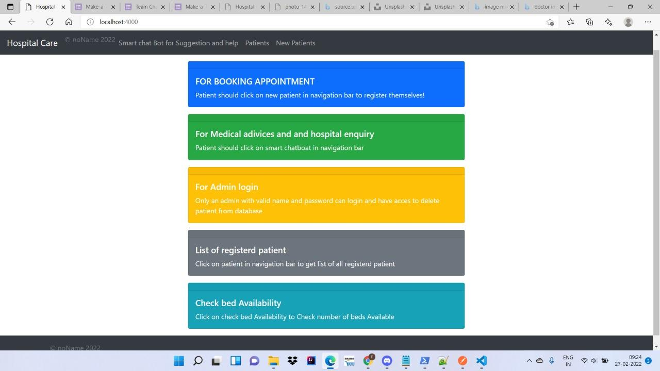

Slide 9
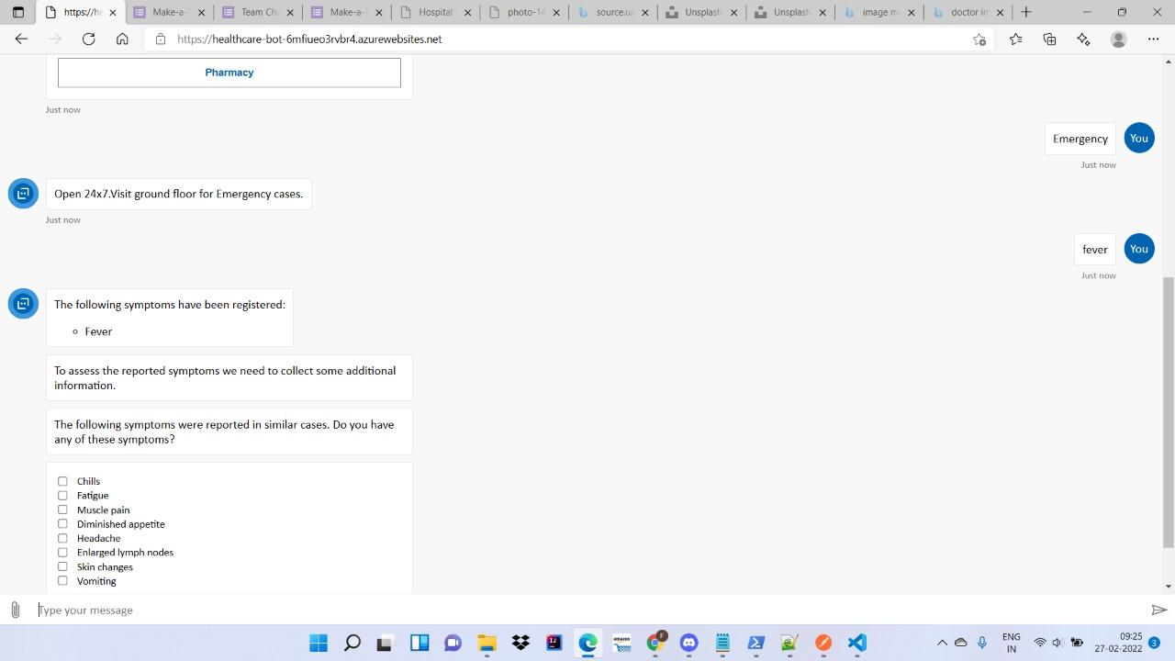

Slide 10
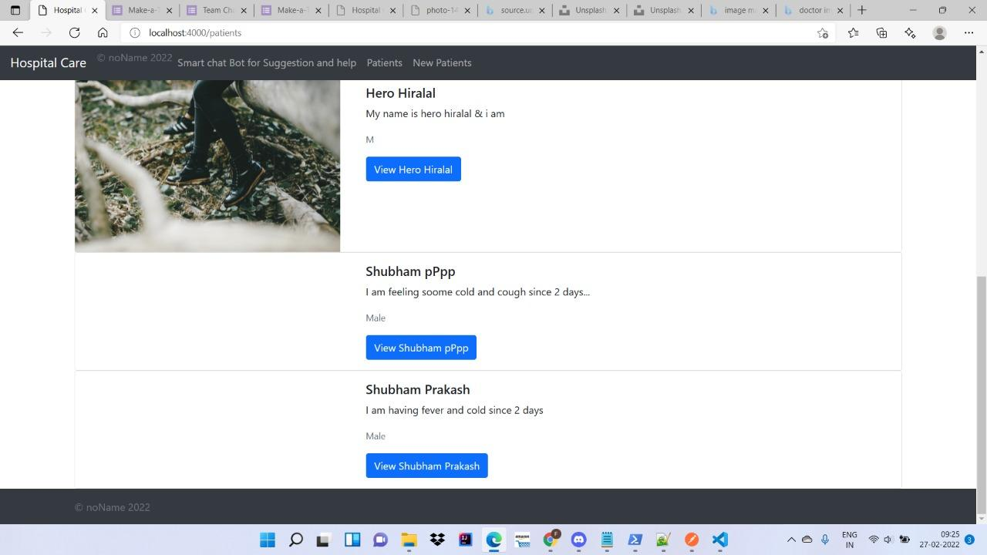

Slide 11
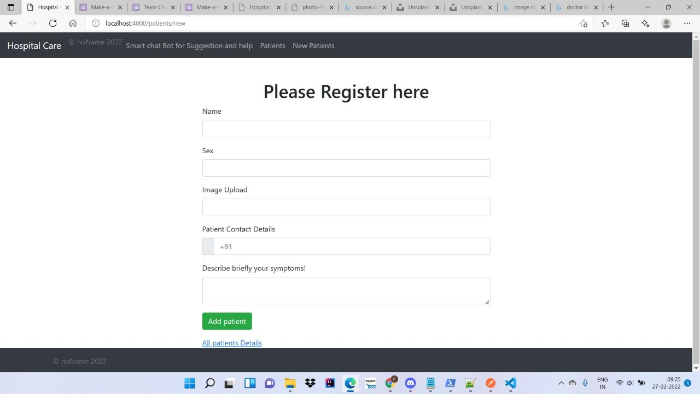

Slide 12
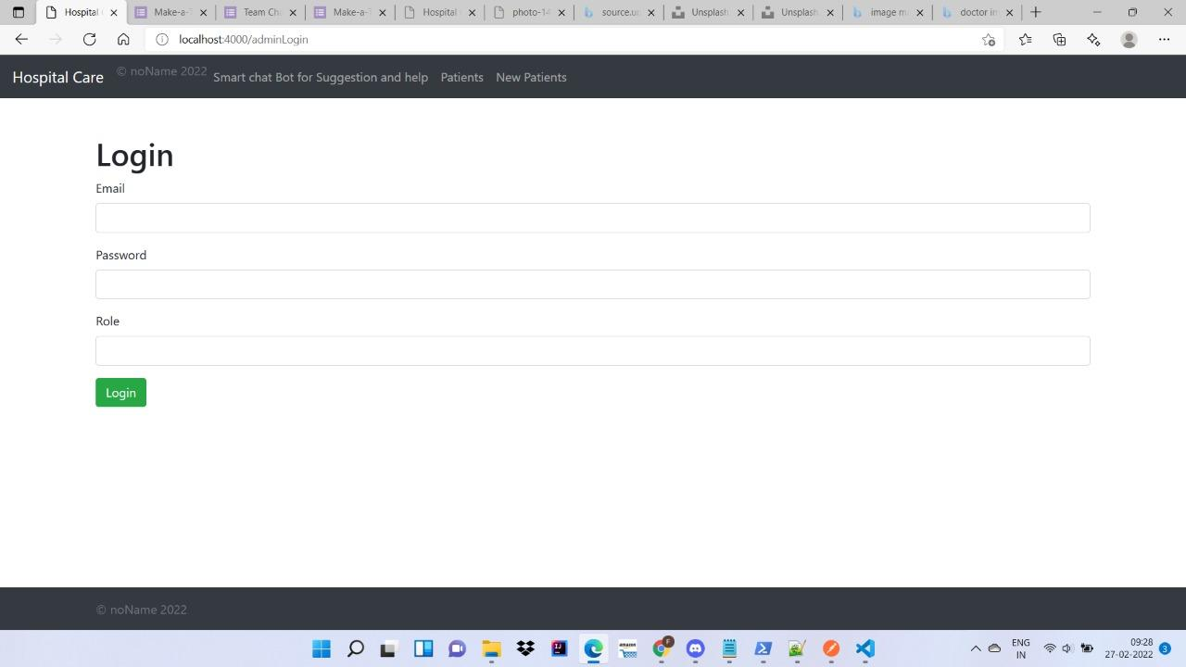

Slide 13
Thank You

