Slide 1

WELCOME

Slide 2


2
0
2
1
Digital Systems Design Project
SMART HOME SECURITY SYSTEM
Team Members
Shimaila Khan
Bikram Kumar Vivek
Faisal Rahman
Stanzin Dolkar
Shubham Prakash

Slide 3

Overview:
Project resembles a security system for home
Installed sensors in house ,controlled by an Arduino microcontroller board
Sensors keeps scanning everytime throughout the house
If any unusual activity takes place within the house,will notify you via sms

Slide 4
Importance and the scope of our project
Continuous Monitoring of home security through SMS .
Video Surveillance of suspected area
Keeps Track Of Room Temperature
Warning when fire in the house.
Activate cooling system when temperature in the house increases
Someone who take care of your house when u can’t

Slide 5
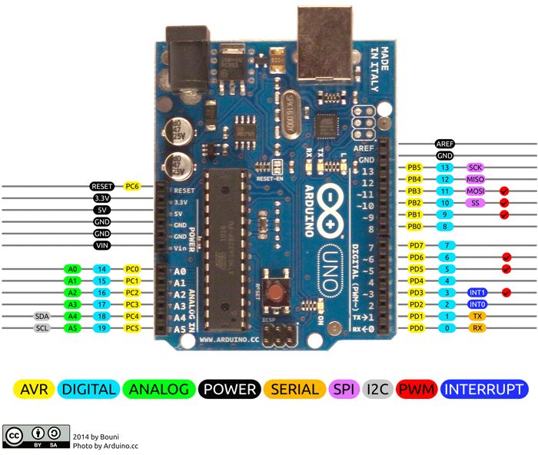
Arduino Uno- The Brain Of Our Project
Open Source Platform- Project Development
Based on - Atmega328P Microcontroller (8-bit)
Other Components:
1
Crystal Oscillator,
2
Voltage Regulator, etc.
PINs available:
1
14 Digital I/O (6 supports PWM)
2
6 Analog INPUT

Slide 6
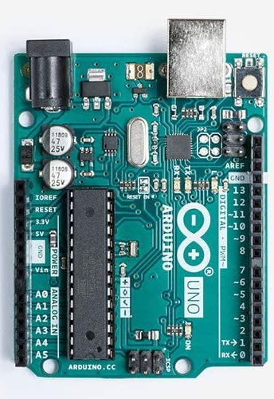
Why Arduino Is So Popular?😕🤔
1
Easy To Use
2
Open Source Microcontroller
3
Budget Friendly- Low Cost
4
Big Family Of Sensors
5
Libraries, Easy-to-Do Simple Things, Easy-to-Do Hard!!
6
Multi-Platform IDE
7
We Are Used To Use 😄

Slide 7
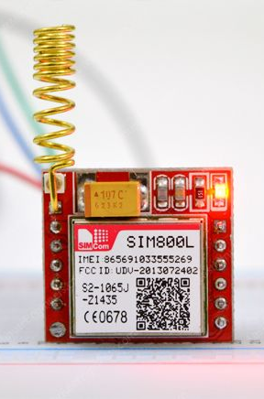
SIM800L- GSM module
Miniature Cellular Module
Uses:
1
GPRS Location Sharing
2
Send & Receive Calls
3
Send & Receive SMS
Supports QUAD band frequency
-Long Range Connectivity
Automatic Logging-in With Network

Slide 8
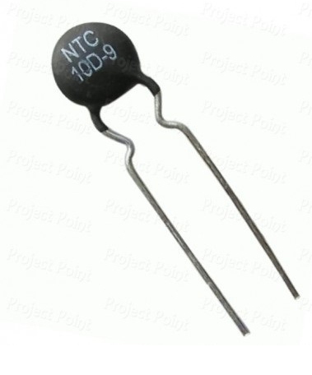
Sensors used & their Working Principles:
Changes resistance corresponding to the change in temperature
Two types on the basis of TCs:
1
NTC
2
PTC
Arduino will read value from the analog pin connected to thermistor.
Temperature will be measured corresponding to the change in value at the analog pin
Thermistor

Slide 9
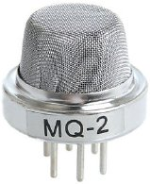
Sensors used & their Working Principles:
MOS-type sensor
Also known as Chemiresistor
Resistance varies accd. to amnt. of gas
LPG, Smoke, Alcohol, Propane, Hydrogen, Methane and Carbon Monoxide
200 to 10000 ppm.
Gas Sensor

Slide 10
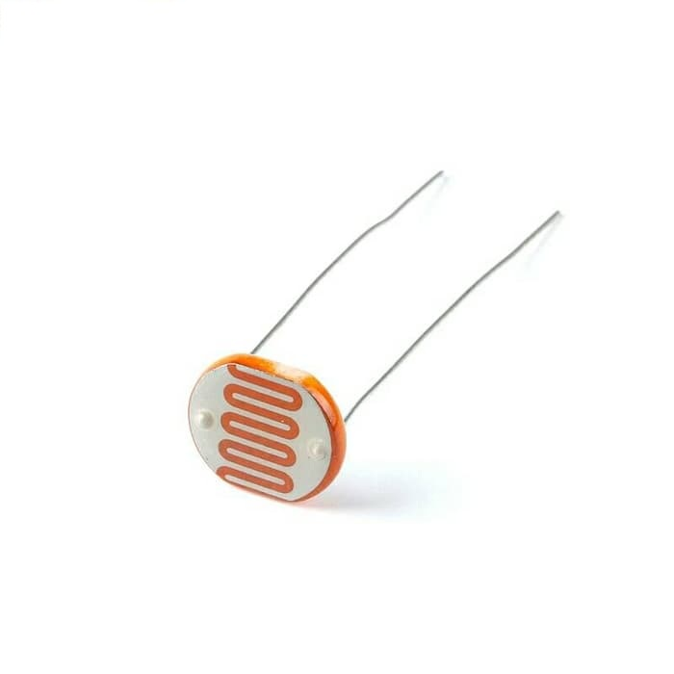
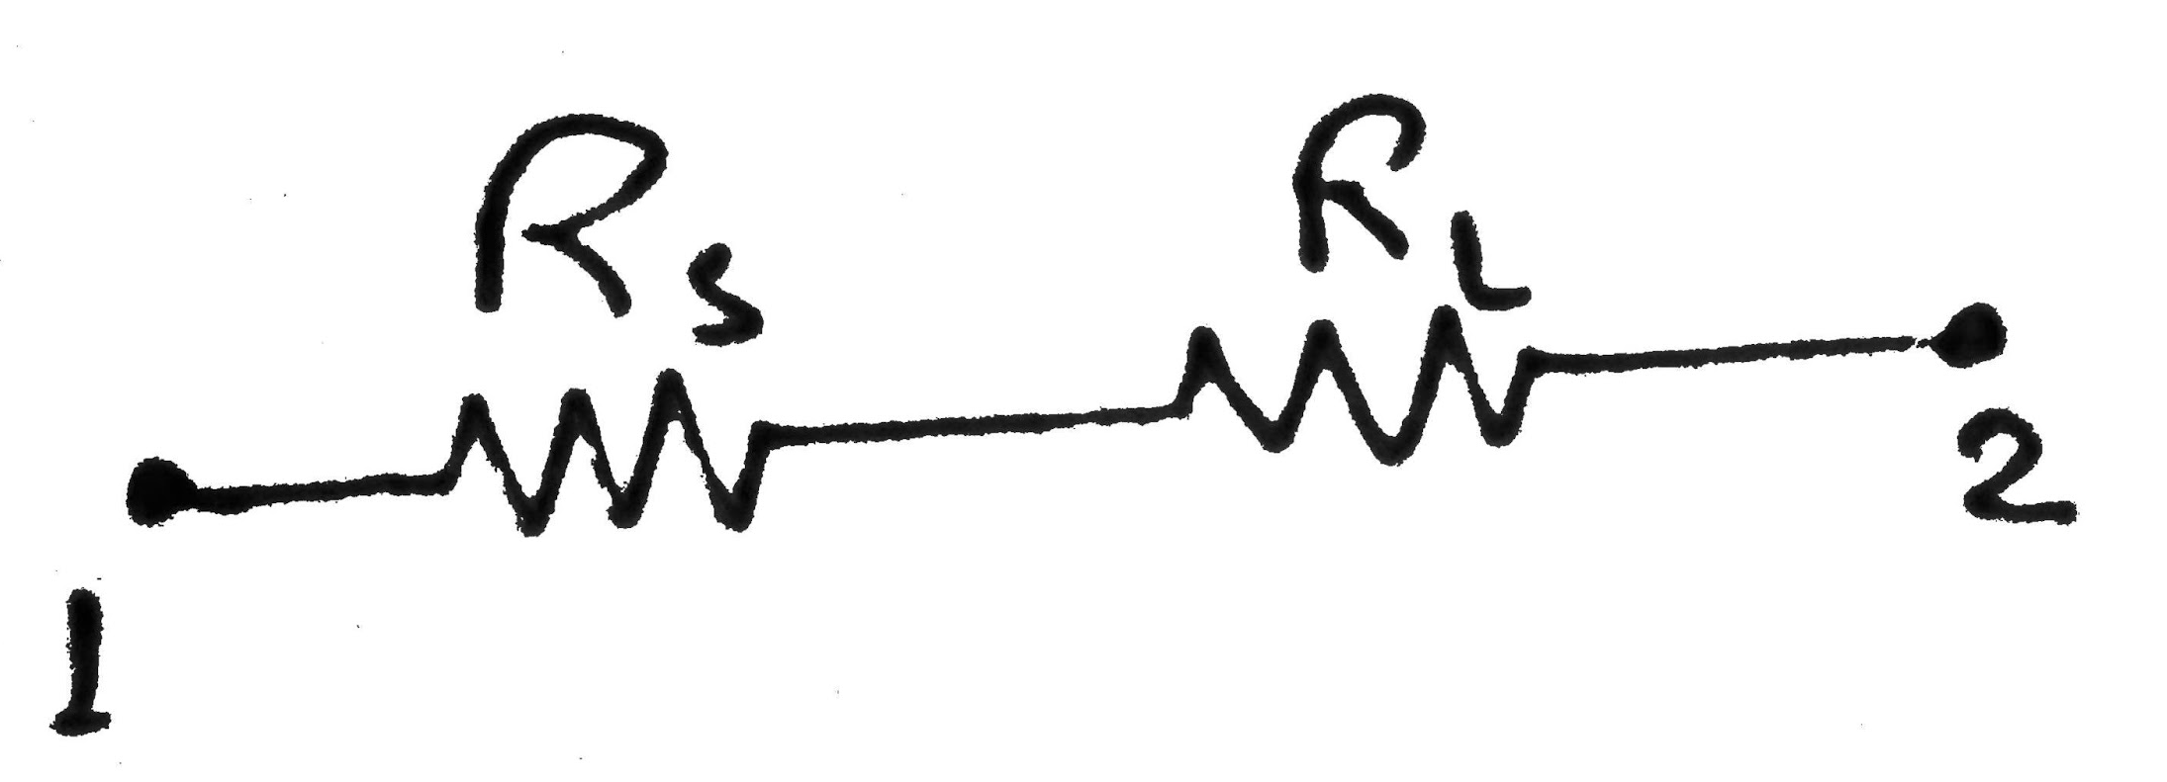
Sensors used & their Working Principles:
Changes resistance corresponding to change in intensity of light
A potential divider circuit is created with another resistor.
Arduino will read value from the analog pin connected to LDR
Value at analog pin decreases when light intensity decreases & vice-versa
Hence light can be controlled
LDR Sensor

Slide 11
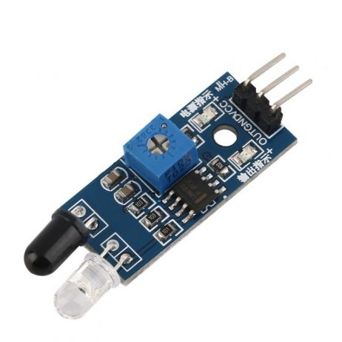
Sensors used & their Working Principles:
Commonly used to detect obstacles
Emitter emits IR rays.
Photodiode receives the reflected rays.
Resistance varies according to the amount of IR light received.
Can detect activity in around 1 m distance
IR Sensor

Slide 12
What the circuitry does:
If NO fault is present in the system:
LDR
Sensor
Arduino
Uno
(Acts as data collector)
Temperature
Sensor
Fire
Sensor
LCD
Gas
Sensor
Motion
Detector

Slide 13
What the circuitry does:
If Any Fault gets detected:
LDR
Sensor
Arduino
Uno
(Trigger)
Activates Corresponding System
Temperature
Sensor
Fire
Sensor
LCD
Gas
Sensor
SMS Alert
(via GSM Mod.)
Motion
Detector

Slide 14
How the circuitry works:
LDR
Sensor
Controls Room Light
Arduino
Uno
Temperature
Sensor
Controls Cooling System
Fire
Sensor
Controls Extinguisher System
Gas
Sensor
Room Evacuate
Message
Motion
Detector
Controls Camera Position

Slide 15
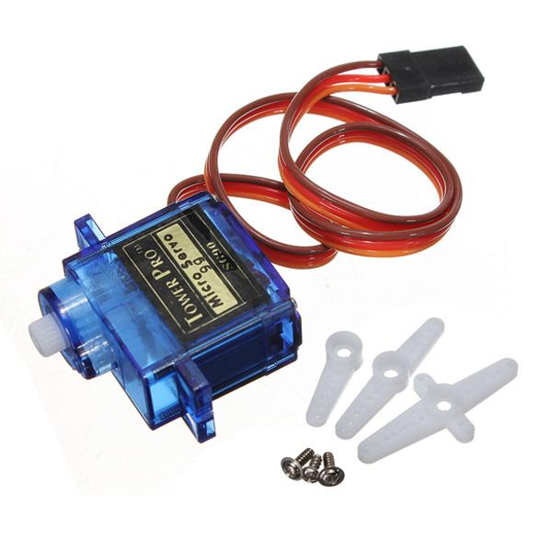
Actuators used :
Servos are extremely useful in robotics.
Servo works on the Pulse Coded Modulation.
It can rotate around in 210-degree range.
It can be very useful when rotation of only a particular angle is needed.
Servo takes command from microcontroller using signal pin.
Servo Motor

Slide 16
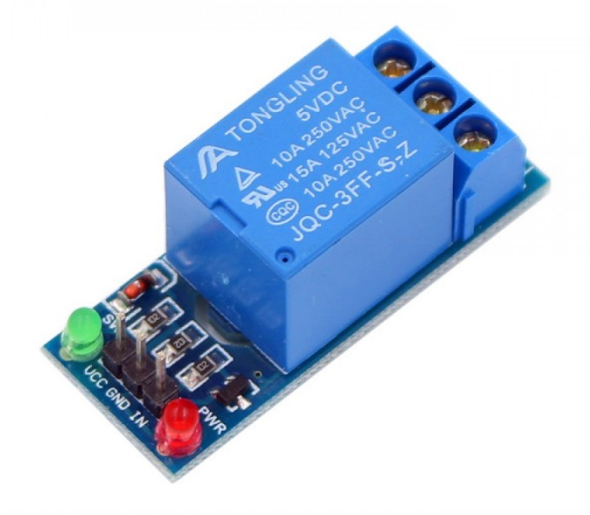
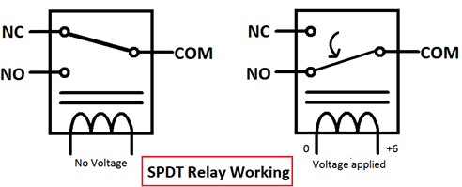
Actuators Used:
Electromechanical Device
Uses LOW Power Signals
-Controls HIGH Power Device
Input Current Activate Electromagnet
Two O/P Pins:
1
Normally Closed (NC)
2
Normally Open (NO)
Relay

Slide 17
Arduino Code:
To access the code:
https://drive.google.com/file/d/1443pNgJbXxsjBChSU_hMKzRzPAgXrlx8/view?usp=sharing

Slide 18
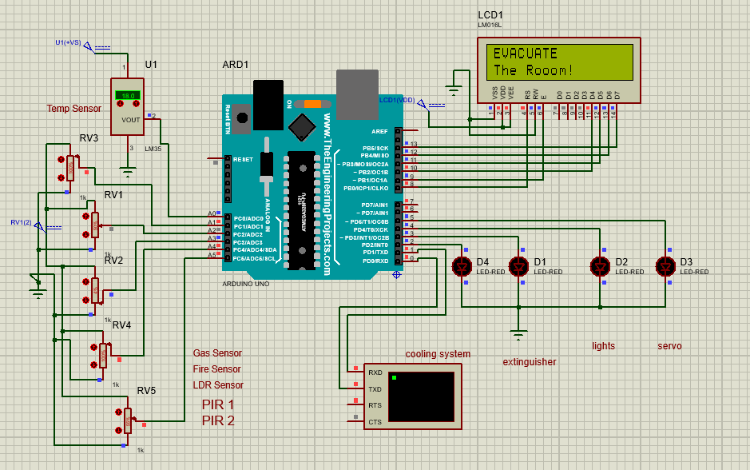
Circuit Diagram

Slide 19
Cost of the Project
Rs -570
1
Arduino Uno
2
Servo Motor
Rs - 282
3
Gas Sensor
Rs - 135
4
Sim800L GSM Module
Rs - 300
5
LDR,Thermistor,Capacitor,Resistor,diode
Rs - 50
6
Relay Module
Rs - 160
7
LCD Display
Rs - 290

Slide 20
FUTURE DEVELOPMENT & APPLICATIONS:
1
Most important application is domestic security
2
Can be enhanced to identify fingerprints
3
Main advantage is that it is fully automated
4
We can have a voice announcement system

Slide 21
2
0
2
1
THANK YOU😊

