Slide 1

Java presentation
Done by:
Denny Nalli
Sai Mohit
Sowjanya Yerra

Slide 2



Features of JAVA
Simple
OOPS concepts
Portable and Platform Independent
Robust
Secured
High-performance

Slide 3
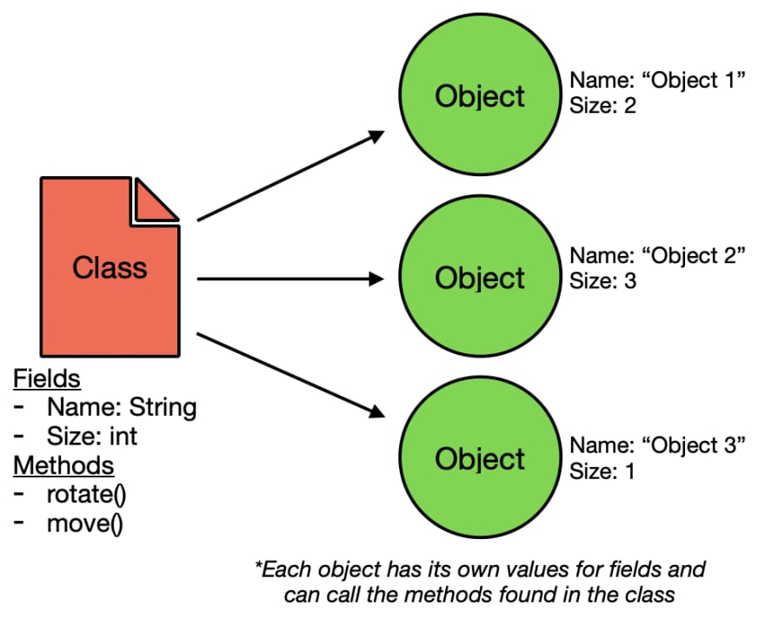
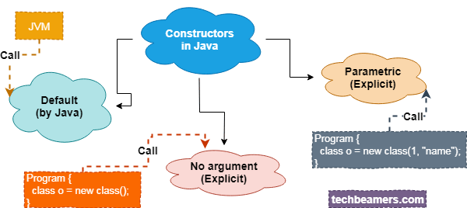
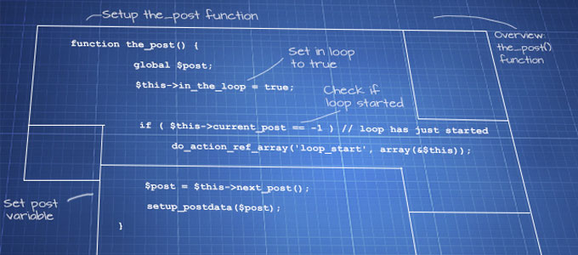
JAVA tools for OOPS
Classes
Objects
Methods
Constructors

Slide 4
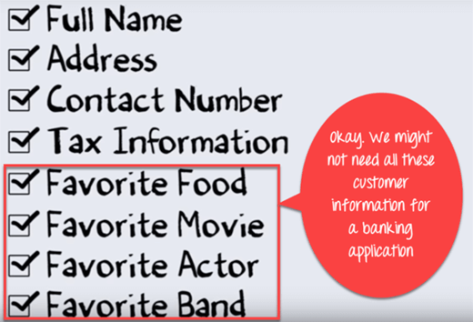
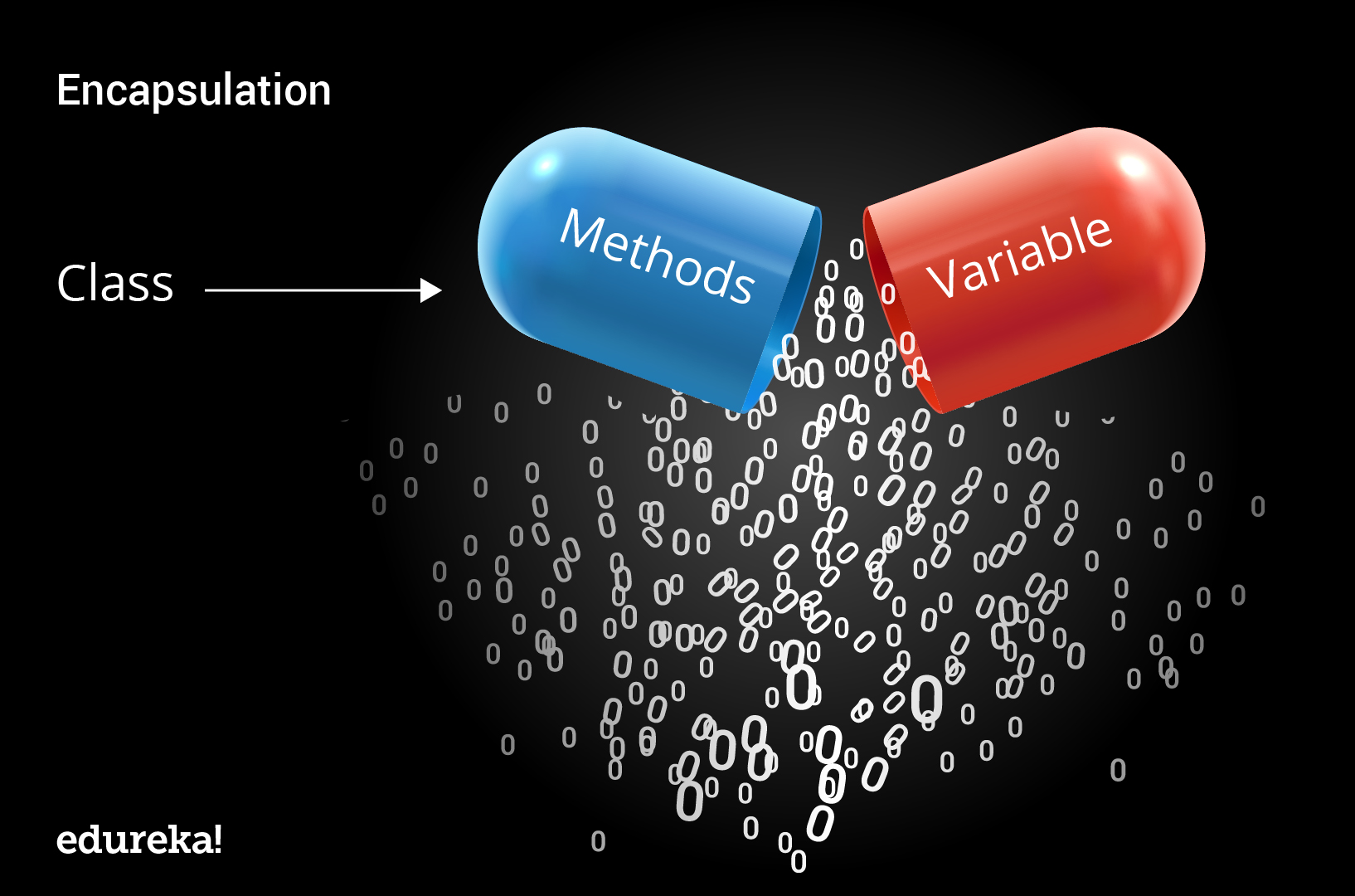
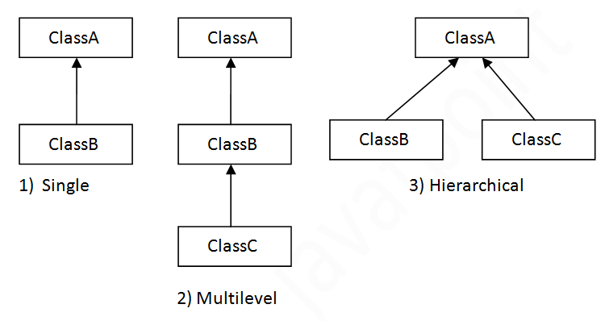
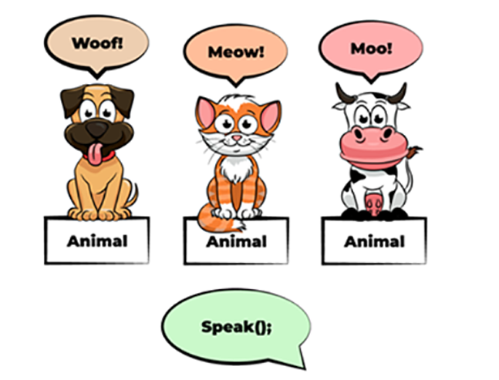
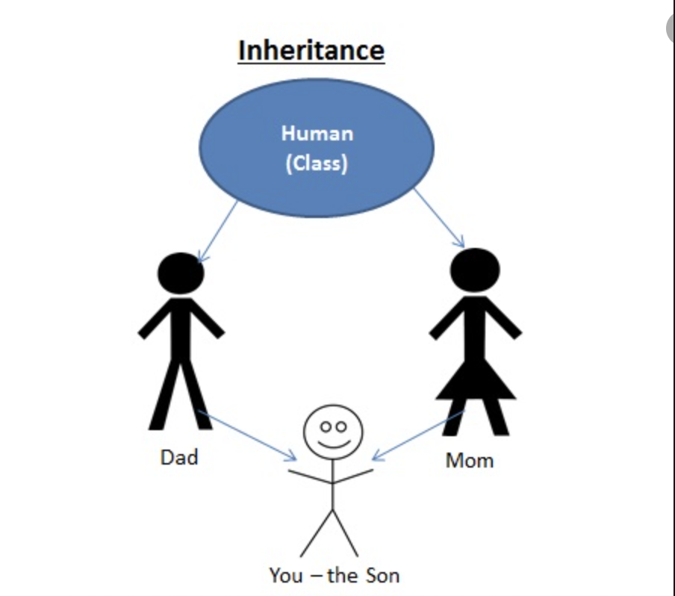
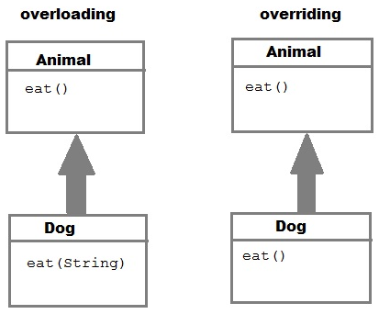
OOPS concepts
Inheritance
Polymorphism
Abstraction
Encapsulation

Slide 5
