Slide 1
Introduction
Graphical user interface (GUI)
  Presents a user-friendly mechanism for interacting with an application.
  Built from GUI components.
Command Line interface
  In a command Line interface the commands are entered from the keyboard.
  It is not user-friendly.
  Difficult to remember commands.

Slide 2
Most modern programs use a GUI (pronounced “gooey”):
Graphical: Not just text or characters but windows, menus, buttons, ..
User: Person using the program
Interface: Way to interact with the program

Slide 3
Graphical elements include:
Window: Portion of screen that looks as a window within the screen.
Menu: List of alternatives offered to user
Button: Looks like a button that can be pressed
Text fields: The user can write something in
etc.

Slide 4
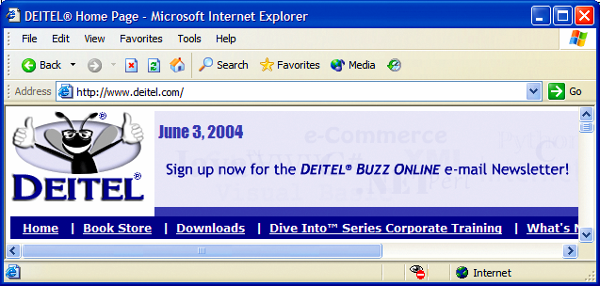
| Internet Explorer window with GUI components.
button
menus
title bar
menu bar
combo box
scroll
bars

Slide 5
Abstract Window Toolkit (AWT)
The AWT contains several classes and methods that allow you to create and manage windows/GUI (Graphical User Interface ).
The main purpose of the AWT is to support applet windows.
It can also be used to create stand-alone GUI applications.

Slide 6
AWT class hierarchy
Component
Label
Button
TextArea
TextComponent
TextField
Container
List
Choice
CheckBox
CheckBoxGroup
ScrollPane
Window
Panel
Scrollbar
Canvas
Applet
MenuComponent
Frame
Dialog
MenuItem
MenuBar
Menu

Slide 7
Component:
This is superclass of all user interface classes.
A component is something that can be displayed on a two-dimensional screen and with which the user can interact.
Attributes of a component include a size, a location, foreground and background colors, whether or not visible etc
Methods defined in class Component are:
  setLocation(int,int), getLocation() --- set and get component location
  setSize(int,int), getSize() ---- set and get component size
  setVisible() ---show or hide the component
  setForeground(Color), getForeground() – set and get foreground colors
  setBackground(Color), getBackground() -- set and get background colors.

Slide 8
Container
This is a type of component that can nest other components within it.
Ex:- Window, Frame, and panel are examples of containers.
Methods defined in a class Container are:
  setLayout(LayoutManager) -- sets layout manager for display.
  add( Component ) -- add component to the display
  remove( Component ) -- remove component from dispaly

Slide 9
Window :
  Window is a type of container, which has two-dimensional surface that can be displayed on an output device.
  It does not have title bar, menu , borders, and resizing corners.
Frame :
  It is a type of Window with a title bar, menu bar , borders, and resizing corners.
  Methods defined in a Frame class are
    setTitle(String), getTitle() --- set or get title
    setMenuBar(MenuBar) --- set menu bar for window
Layout Manager:
  A manager is used to position and place components in a Container.

Slide 10
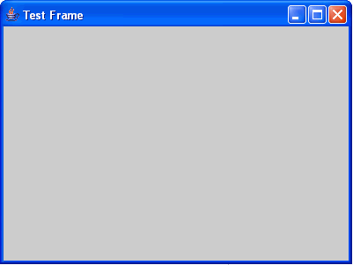
Frames
Frame is a window that is not contained inside another window.
Frame is the basis to contain other user interface components in Java graphical applications.
The Frame class can be used to create windows.
  Frame’s constructors:
  Frame( )
  Frame(String title)
After a frame window has been created, it will not be visible until you call setVisible( true).

Slide 11
Frame Location
By default, a frame is displayed in the upper- left corner of the screen.
To display a frame at a specified location, use the setLocation(x,y) method in the Frame class. This method places the upper- left corner of a frame at location (x,y).

Slide 12
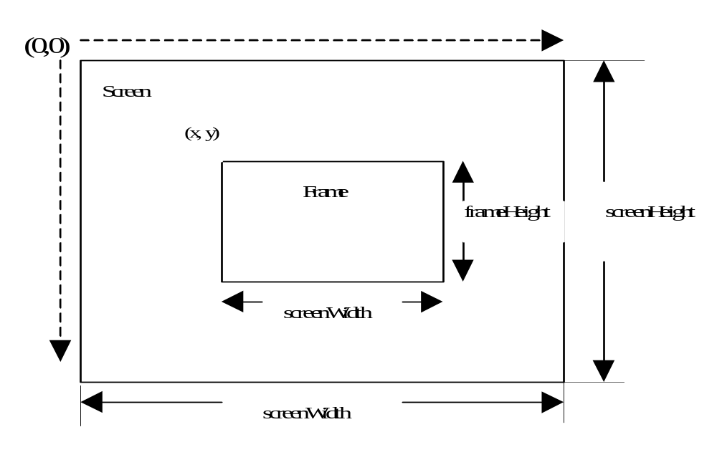
cont.

Slide 13
Frame - Method-I
import java.awt.*;
public class MyFrame
{
public static void main( String args[] )
{
Label l=new Label(“userId”);
Frame f = new Frame(“MyFrame");
f.add(l);
f.setSize(300,200);
f.setVisible(true);
}
}

Slide 14
Method-II
import java.awt.*;
public class MyFrame extends Frame
{
MyFrame()
{
super(“title of Frame”);
Label l=new Label(“userId”);
add(l);
setSize(300,200);
setVisible(true);
}
}
class ExFrame
{
public static void main( String args[] )
{
new MyFrame();
}
}

Slide 15
Method - III
import java.awt.*;
public class MyFrame extends Frame
{
MyFrame()
{ super(“title of Frame”);
Label l=new Label(“userId”);
add(l);
setSize(300,200);
setVisible(true);
}
public static void main( String args[] )
{
new MyFrame();
}
}

Slide 16
User-Interface Components
Label
  Label()
  Label( String text )
  Label( String text , int alignment )
Label.LEFT , Label.RIGHT , Label.CENTER - alignment
setText(String text)
getText()
Labels are passive controls that do not support any interaction
with the user.

Slide 17
Label
import java.awt.*;
public class ExLabel extends Frame
{
public ExLabel()
{
super("Label test");
Label label1 = new Label(“userId");
add( label1 );
setSize(300,200);
setVisible(true);
}
public static void main( String args[] )
{
new ExLabel();
}
}

Slide 18
Button
  Button()
  Button(String title )
getLabel()
setLabel()

Slide 19
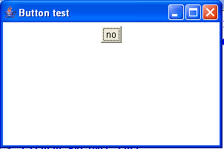
Button
import java.awt.*;
public class ExButton extends Frame
{
public ExButton()
{
super("Button test");
Button button1 = new Button(“no");
add( button1 );
setSize(300,200);
setVisible(true);
}
public static void main( String args[] )
{
new ExButton();
}
}

Slide 20
Checkbox
  Checkbox()
  Checkbox(String text)
  Checkbox(String text , boolean state)
  Checkbox(String text , CheckboxGroup group , boolean state)
getLabel() – Checkbox
setLabel() – Checkbox
getState() – Checkbox…on/off
setState() – Checkbox… on/off

Slide 21
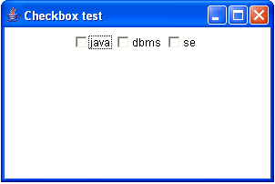
Checkbox
import java.awt.*;
public class ExCheckbox extends Frame
{
public ExCheckbox()
{
super("Checkbox test");
setLayout(new FlowLayout());
Checkbox check1 = new Checkbox(“java");
Checkbox check2 = new Checkbox(“dbms");
Checkbox check3 = new Checkbox(“se");
add( check1 );
add( check2 );
add( check3 );
setSize(300,200);
setVisible(true);
}
.............................

Slide 22
Checkbox Groups, Choices, and Lists
Three types of interface components are used to allow the user to select one item from a large number of possibilities.
  First is a group of connected check boxes with the property that only one can be selected at a time.( also called radio buttons ).
  Second is choice. A choice displays only one selection, but when the user clicks in the selection area, a pop-up menu appears that allows the choice to be changed to a different selection.
  A third is a List. A List is similar to a choice, but several items out of the range can be displayed at a time.
Use checkbox Group when the number of alternatives is small.

Slide 23
CheckboxGroup / Radio buttons
  CheckboxGroup()
  Checkbox(String text , CheckboxGroup group , boolean state)
Checkbox getSelectedCheckbox( )
void setSelectedCheckbox(Checkbox which)

Slide 24
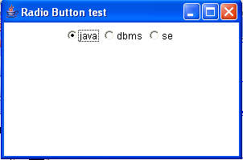
CheckboxGroup/Radio Buttons
import java.awt.*;
public class ExRadioButton extends Frame
{
public ExRadioButton()
{
super("Radio Button test");
setLayout(new FlowLayout());
CheckboxGroup cbg = new CheckboxGroup();
Checkbox check1 = new Checkbox(“java",cbg,true);
Checkbox check2 = new Checkbox(“dbms",cbg,false);
Checkbox check3 = new Checkbox(“se",cbg,false);
add( check1 );
add( check2 );
add( check3 );
.....................

Slide 25
Choice
  Choice()
add(String) – Items are added to the list in the order
in which calls to add( ) occur.
getItemCount() – int
getItem(int) – String
remove(int) –void
getSelectedItem() – String
select(int index) - void
select(String name) --void

Slide 26
Choice
import java.awt.*;
public class ExChoice extends Frame
{
public ExChoice()
{
super("Choice Button test");
setLayout(new FlowLayout());
Choice choice1 = new Choice();
choice1.add(“java");
choice1.add(“dbms");
choice1.add(“se");
add( choice1 );
setSize(300,200);
setVisible(true);
....................

Slide 27
List
  List()
  List(int rows)
  List(int rows, boolean multipleMode)
add(String) – adds item to the end of the list
add(String,int index) – adds item at index
getItemCount() –
getItem(int) –
remove(int) –
getSelectedItem() –
getSelectedItems() –

Slide 28
List
import java.awt.*;
public class ExList extends Frame
{
public ExList()
{
super("List test");
setLayout(new FlowLayout());
List List1 = new List(3,false);
List1.add(“java");
List1.add(“dbms");
List1.add(“se");
List1.add(“ppl");
List1.add(“co");
add( List1 );
...................

Slide 29
Text Components
TextField
  TextField()
  TextField(int columns)
  TextField(String text)
  TextField(String text, int columns)
setText(String) –
getText() –
setEchoChar(char) –
setEditable(bolean) –

Slide 30
TextField
import java.awt.*;
public class ExTextField extends Frame
{
public ExTextField()
{
super("TextField test");
setLayout(new FlowLayout());
TextField text1 = new TextField(“hello",30);
add( text1 );
...........................

Slide 31
TextArea
  TextArea()
  TextArea(String text)
  TextArea(int rows, int numChars)
  TextArea(String text , int rows, int numChars)
append(String) –
setText(String) –
getText() –
setEditable(bolean)

Slide 32
TextArea
import java.awt.*;
public class ExTextArea extends Frame
{
public ExTextArea()
{
super("TextArea test");
setLayout(new FlowLayout());
TextArea text1 = new TextArea(5,30);
add( text1 );
..........................

Slide 33
MenuBars , Menus, MenuItems
To create a menu bar, first create an instance of MenuBar.
  Consturctor - MenuBar( )
  This class only defines the default constructor.
  a menu bar contains one or more Menu objects.
Next, create instances of Menu ( menus)
  Constructors
    Menu( )
    Menu(String menuName)
Individual menu items are of type MenuItem.
  Constructors
    MenuItem( )
    MenuItem(String itemName)
    MenuItem(String itemName, MenuShortcut keyAccel)

Slide 34
Contd..
  You can disable or enable a menu item by using the setEnabled( ) method.
  You can determine an item’s status by calling isEnabled( ).
  You can change the name of a menu item by calling setLabel( ).
  You can retrieve the current name by using getLabel( ).

Slide 35
import java.awt.*;
public class ExMenubar extends Frame
{
public Exmenubar()
{
super(“Menubar test");
MenuBar mbar = new MenuBar();
setMenuBar(mbar);
Menu file = new Menu("File");
MenuItem item1, item2, item3, item4, item5;
file.add(item1 = new MenuItem("New..."));
file.add(item2 = new MenuItem("Open..."));
file.add(item3 = new MenuItem("Close"));
file.add(item4 = new MenuItem("-"));
file.add(item5 = new MenuItem("Quit..."));
mbar.add(file);
..........................

Slide 36
Dialog Boxes
A dialog box is a special window used to alert user or take input from user.
They are similar to frame windows, except that dialog boxes are always child windows of a top-level window.
Also, dialog boxes don’t have menu bars. In other respects, dialog boxes function like frame windows. (You can add controls to them, for example, in the same way that you add controls to a frame window.)
Dialog boxes may be modal or modeless.
When a modal dialog box is active, you cannot access other parts of your program until the dialog box is closed.
When a modeless dialog box is active, you can access other parts of your program.

Slide 37
Contd..
  Constructors
    Dialog(Frame parentWindow, boolean mode)
    Dialog(Frame parentWindow, String title, boolean mode)
  Here, parentWindow is the owner of the dialog box.
  If mode is true, the dialog box is modal.Otherwise, it is modeless.

Slide 38
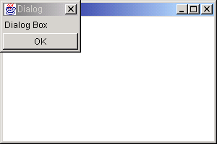
Dialog
import java.awt.*;
public class Ex022Dialog extends Frame
{
public Ex022Dialog()
{
super("Dialog test");
Dialog d = new Dialog(this,"Dialog",false);
d.add("Center",new Label("Dialog Box"));
d.add("South",new Button("OK"));
d.pack();
d.setVisible(true);
...........................

Slide 39
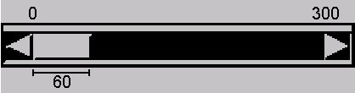
Scrollbar
Scroll bars are used to select continuous values between a specified minimum and maximum.
The maximum and minimum values can be specified
The line increment can be specified( the amount scroll bar will move when it is touched in the line ends)
The page increment can be specified ( the amount scroll bar will move when it is touched in the background area between the thumb and the end).

Slide 40
  Scrollbar()
  Scrollbar(int style)
  Scrollbar(int style, int initialValue, int thumbSize, int min, int max)
  Constants
    Scrollbar.VERTICAL
    Scrollbar.HORIZONTAL
getValue()
Scrollbar(Scrollbar.HORIZONTAL,0, 60, 0, 300);
getValue()
setValue(int newValue);
Minimum : default 0.
Maximum : default 100
Default line increment is 1
Default page increment is 10.

Slide 41
Scrollbar
import java.awt.*;
public class Ex010Scrollbar extends Frame
{
public Ex010Scrollbar()
{
super("Scrollbar test");
setLayout(new FlowLayout());
Scrollbar scroll1 = new Scrollbar(Scrollbar.HORIZONTAL);
Scrollbar scroll2 =
new Scrollbar(Scrollbar.HORIZONTAL,100, 60, 0, 300);
add( scroll1 );
add( scroll2 );
...........................

Slide 42
Canvas
A Canvas is a two-dimensional area used to draw some shapes on it using the
Graphics.
  Canvas()
setSize(int width,int height) –
setBackground(Color ) –

Slide 43
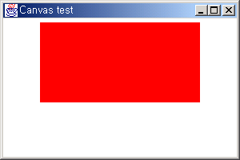
Canvas
import java.awt.*;
public class Ex011Canvas extends Frame
{
public Ex011Canvas()
{
super("Canvas test");
setLayout(new FlowLayout());
Canvas can1 = new Canvas();
can1.setSize(200,100);
can1.setBackground(Color.red);
add( can1 );
......................

Slide 44
Panel
This is simplest invisible container that holds GUI components.
It is recommended that you place the user interface components in panels and place the panels in a frame.
You can also place panels in a panel.
FlowLayout is the default layout for panel.
  Panel()
  Panel(LayoutManager layout)

Slide 45
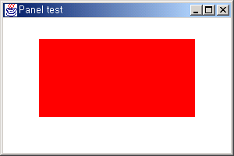
Panel
import java.awt.*;
public class Ex012Panel extends Frame
{
public Ex012Panel()
{
super("Panel test");
setLayout(null);
Panel pan1 = new Panel();
pan1.setSize(200,100);
pan1.setBackground(Color.red);
pan1.setLocation(50,50);
add( pan1 );
......................

Slide 46
Panel
import java.awt.*;
public class Ex013Panel extends Frame
{
public Ex013Panel()
{
super("Panel test");
setLayout(null);
Panel pan1 = new Panel();
pan1.setSize(200,100);
pan1.setBackground(Color.red);
pan1.setLocation(50,50);
add( pan1 );
Button button1 = new Button(“ok");
Button button2 = new Button(“cancel");
pan1.add( button1 );
pan1.add( button2 );
......................

Slide 47
ScrollPane
It is similar to a panel.
It can hold only one Component.
If size of the component held is larger than the size of the
ScrollPane,scroll bars will be automatically generated.
It does not have a LayoutManager
  ScrollPane()

Slide 48
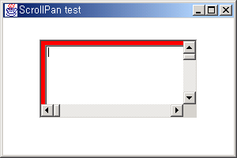
ScrollPane
import java.awt.*;
public class ExScrollPane extends Frame
{
public Ex014ScrollPane()
{
super("ScrollPan test");
setLayout(null);
ScrollPane sPane1 = new ScrollPane();
sPane1.setSize(200,100);
sPane1.setBackground(Color.red);
sPane1.setLocation(50,50);
Panel pan1 = new Panel();
TextArea text1 = new TextArea(300,500);
pan1.add( text1 );
sPane1.add( pan1 );
add( sPane1 );
......................

Slide 49
Graphics
Graphics object draws pixels on the screen that represent text and other graphical shapes such as lines, ovals, rectangles, polygons etc.
The graphics class is an abstract class( i.e Graphics objects can not be instantiated.
Drawing is performed differently on each platform, there cannot be one implementation of drawing capabilities on all systems.
When java is implemented on each platform, a subclass of Graphics is created that implements the drawing capabilities.

Slide 50
Contd..
Before you can do any drawing, you have to get a graphics context object ( subclass of Graphics ).
The best way to do that is to place all the code that does your drawing in the paint method of a component that’s added to a frame or panel.
The paint method receives an instance of the system-specific subclass that extends Graphics for the component as a parameter.

Slide 51
Graphics
subclass
subclass
subclass
Windows
Linux
Solaris
public void paint(Graphics g)
{
......
…..
}
Component (Frame / Panel / canvas / Applet)
Class myFrame extends Frame
{
……..
……..
public void paint(Graphics g)
{
g.drawOval(x1,y1,width,height);
……
}
}

Slide 52
public void paint(Graphics g)
The paint(Graphics g) method is common to all components and containers.
Needed if you do any drawing or painting other than just using standard GUI Components.
Any painting you want to do should be done here.
The paint(Graphics g) method does the actual painting/drawing on the Graphics object for the current component/container (Frame, canvas, panel, applet, button, etc.)
Never call paint(Graphics), call repaint( )
Notes:
7
7

Slide 53
How does the paint(Graphics g) method get called?
It is called automatically by Java whenever the component or container is loaded, resized, minimized, maximized.
You can cause the paint method to be called at any time by calling the component’s repaint() method.
Call repaint( ) when you have changed something and want your changes to show up on the screen.
  You do not need to call repaint() when something happens in Java’s own components (Buttons, TextFields, etc.)
  You do need to call repaint() after drawing commands (drawRect(...), fillRect(...), drawString(...), etc.)

Slide 54
The repaint() method will do two things:
1. It calls update(Graphics g), which writes over the old drawing in background color (thus erasing it).
2. It then calls paint(Graphics g) to do the drawing.
x
Java coordinate system
( 0,0)
(x,y)
y

Slide 55
Graphics methods for drawing shapes
  g.drawString (str, x, y);
    Puts string at x,y
  g.drawLine( x1, y1, x2, y2 )
    Line from x1, y1 to x2, y2
  g.drawRect( x1, y1, width, height)
    Draws rectangle with upper left corner x1, y1
  g.fillRect(x1, y1, width, height)
    Draws a solid rectangle.
  g.drawRoundRect( x, y, width, height,arcWidth, arcHeight )
    Draws rectangle with rounded corners.
  g.fillRoundRect( x, y, width, height,arcWidth, arcHeight )
    Draws a solid rectangle with rounded corners.

Slide 56
(x, y)
drawRoundRect parameters
arc height
arc width
height
width
(x, y)
drawOval parameters
height
width

Slide 57
  g.drawOval(x1, y1, width, height)
    Draws an oval with specified width and height.The bounding rectangle’s top left corner is at the coordinate (x,y).The oval touches all four sides all four sides of the bounding rectangle.
  g.fillOval(x1, y1, width, height)
    Draws a filled oval.
  g.setColor(Color.RED)
    Sets color, it is remain active until new color is set.

Slide 58
  g.drawArc(x1, y1, width, height, startAngle,arcAngle)
    Draws an arc relative to the bounding rectangle’s top-left coordinates with the specified width and height.The arc segment is drawn starting at startAngle and sweeps arcAngle degrees.
90
90
180
0
180
0
270
270
Positive angle
Negative angle

Slide 59
Drawing Polygons and Polylines
Polygon - multisided shape
Polyline - series of connected points
Methods of class Polygon
  drawPolygon( xPoints[], yPoints[],
  points )
    Draws a polygon, with x and y points specified in arrays. Last argument specifies number of points
    Closed polygon, even if last point different from first.
  drawPolyline ( xPoints[], yPoints[],
  points )
    As above, but draws a polyline
    Open polyline

Slide 60
Ex:-
int xValues[ ] = { 20, 40, 50, 30, 20, 15 };
int yValues[ ] = { 50, 50, 60, 80, 80, 60 };
g.drawPolygon( xValues,yValues,6 );
g.drawLolyline(xValues,yValues,6);
Exercise:
1. Write a java program to draw a polygon of eight edges.
2.Write a java program which creates human face.

Slide 61
Layout Managers
Arranges and lays out the GUI components on a container.
Every container has a default Layout Manager:
  Panels – FlowLayout
  Window (e.g. Frames, etc.) – BorderLayout
Usage:
  myContainer.setLayout( new LayoutManger() );

Slide 62
Layout Managers
  Flow Layout
  Grid Layout
  Border Layout
  Card Layout
  Gridbag Layout

Slide 63
Flow Layout
The Flow Layout manager arranges the components left-to-right, top-to-bottom in the order they were inserted into the container.
When the container is not wide enough to display all the components, the remaining components are placed in the next row, etc.
By default each row is centered.
The line alignment can be:
  FlowLayout.LEFT
  FlowLayout.CENTER
  FlowLayout.RIGHT

Slide 64
Flow Layout Example
English
French
Greek
Japanese
German
Spanish
Portuguese
Arabic
Chinese
Russian

Slide 65
Flow Layout Constructors
FlowLayout(align, hgap, vgap)
align – alignment used by the manager
hgap – horizontal gaps between components
vgap – vertical gaps between components
FlowLayout(align)
align – alignment used by the manager
A default 5-unit horizontal and vertical gap.
FlowLayout()
A centered alignment and a default 5-unit
horizontal and vertical gap.

Slide 66
Grid Layout
Container is divided into a grid where components are placed in rows and columns.
Every component has the same width and height.

Slide 67
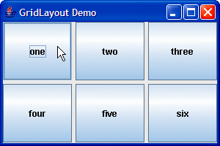
Grid Layout Examples

Slide 68
Grid Layout Constructors
GridLayout(r, c, hgap, vgap)
r – number of rows in the layout
c – number of columns in the layout
hgap – horizontal gaps between components
vgap – vertical gaps between components
GridLayout(r, c)
r – number of rows in the layout
c – number of columns in the layout
No vertical or horizontal gaps.
GridLayout()
A single row and no vertical or horizontal gaps.

Slide 69
Border Layout
The Border Layout manager arranges components into five regions: North, South, East, West, and Center.
Components in the North and South are set to their natural heights and horizontally stretched to fill the entire width of the container.
Components in the East and West are set to their natural widths and stretched vertically to fill the entire width of the container.
The Center component fills the space left in the center of the container.

Slide 70
Border Layout Arrangement
If one or more of the components, except the Center component, are missing then the rest of the existing components are stretched to fill the remaining space in the container.

Slide 71
BorderLayout Manager
North
West
Center
East
South
Usage:- add( new Button(“ok”), BorderLayout.NORTH);

Slide 72
Border Layout Constructors
BorderLayout(hgap, vgap)
hgap – horizontal gaps between components
vgap – vertical gaps between components
BorderLayout()
No vertical or horizontal gaps.

Slide 73
Border Layout Constraints
The positional constraints are:
  BorderLayout.NORTH
  BorderLayout.SOUTH
  BorderLayout.EAST
  BorderLayout.WEST
  BorderLayout.CENTER

Slide 74
CardLayouts
  CardLayout places components (usually panels) on top of each other in a stack like a deck of cards.
  You can see only one card at a time.
  By default, the first card is visible.
  We can put a cards on top using another control by using the methods next(), previous(), first(), last(), and show().

Slide 75
Cont'd
Constructor
-CardLayout()
Methods:-
public void first(Container parent);
public void next(Container parent);
public void previous(Container parent);
public void last(Container parent);
public void show(Container parent, String name);
New Card
add(component, name)
First Card

Slide 76
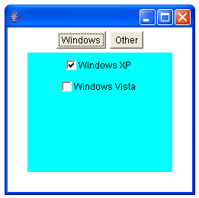
// CardLayout demo
import java.awt.*;
import java.awt.event.*;
public class CardLayoutDemo extends Frame
implements ActionListener, MouseListener {
Checkbox winXP, winVista, solaris, mac;
Panel osCards;
CardLayout cardLO;
Button Win, Other;
public CardLayoutDemo() {
setLayout(new BorderLayout());
Panel tabs=new Panel();
Win = new Button("Windows");
Other = new Button("Other");
tabs.add(Win);
tabs.add(Other);
add(tabs,BorderLayout.NORTH);
cardLO = new CardLayout();
osCards = new Panel();
osCards.setSize(100,100);
osCards.setLayout(cardLO); // set panel layout to card layout

Slide 77
winXP = new Checkbox("Windows XP", null, true);
winVista = new Checkbox("Windows Vista");
solaris = new Checkbox("Solaris");
mac = new Checkbox("Mac OS");
// add Windows check boxes to a panel
Panel winPan = new Panel();
winPan.setBackground(Color.CYAN);
winPan.add(winXP);
winPan.add(winVista);
// Add other OS check boxes to a panel
Panel otherPan = new Panel();
otherPan.setBackground(Color.RED);
otherPan.add(solaris);
otherPan.add(mac);
// add panels to card deck panel
osCards.add(winPan, "Windows");
osCards.add(otherPan, "Other");
// add cards to main applet panel
add(osCards,BorderLayout.CENTER);
// register to receive action events
Win.addActionListener(this);
Other.addActionListener(this);
// register mouse events
addMouseListener(this);
setSize(250,250);
setVisible(true);
}

Slide 78
public Insets getInsets(){ return new Insets(30,30,30,30);}
// Cycle through panels.
public void mousePressed(MouseEvent me) {
cardLO.next(osCards);
}
// Provide empty implementations for the other MouseListener methods.
public void mouseClicked(MouseEvent me) {
}
public void mouseEntered(MouseEvent me) {
}
public void mouseExited(MouseEvent me) {
}
public void mouseReleased(MouseEvent me) {
}
public void actionPerformed(ActionEvent ae) {
if(ae.getSource() == Win) {
cardLO.first(osCards);
//cardLO.show(osCards, "Windows");
}
else {
cardLO.last(osCards);
//cardLO.show(osCards, "Other");
}
}
public static void main(String arg[])
{
new CardLayoutDemo();
}
}

Slide 79
GridBagLayout Layout Manager
Flexible GridBagLayout
  Components can vary in size
  Components can occupy multiple rows and columns
  Components can be added in any order
  There are two classes that are used:
- GridBagLayout: provides the overall layout manager.
- GridBagConstraints: defines the properties of each component in the grid such as placement, dimension, and alignment

Slide 80
Specifying a GridBagLayout
To use a gridbag layout, you must declare the GridBagLayout and GridBagConstaraints object and attach the layout to your applet.
Example:
GridBagLayout gridbag = new GridBagLayout();
GridBagConstraints constraints = new GridBagConstraints();
SetLayout(gridbag);

Slide 81
Setting Constraints for Components
For each component that you add to the gridbag layout, you must first set an instance of the GridBagContraints class.
Let us look at an example:
constraints.gridx = 0 put component in first cell.
constraints.gridy = 0
gridbag.setConstraints(button1, constraints); set the constraints to button1.
add(button1); //add to the Frame

Slide 82
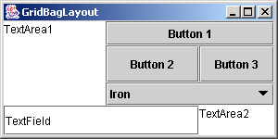
Precisely Placing Components
Use the gridx to set the column and gridy to set the row; both are zero based.
The gridlines do not appear on the interface, they are only to help visualize the layout.
Column
0
1
2
0
1
Row
2
3

Slide 83
Controlling Size
You can make a component use more than one cell by setting the gridwidth and gridheight data members.
Examples:
  constraints.gridwidth = 2; //Joins two cells horizontally
  constraints.gridheight = 2; //Joins two cells vertically

Slide 84
GridBagConstraint Data Members
Data Members (variables) | Value | Purpose
gridx | integer RELATIVE(default) | The grid column to place the component; first column is 0. Default RELATIVE specifies column to the right of last component placed.
 | constraints.gridx = GridBagConstraints.RELATIVE;//Next column constraints.gridx = 1;//Column two
gridy | integer RELATIVE(default) | The grid row to place the component; first row is 0. Default RELATIVE specifies row below last component placed.
 | constraints.gridy = GridBagConstraints.RELATIVE; constraints.gridy = 0;//Row one

Slide 85
GridBagConstraint Data Members Continued
gridwidth | integer Default value is 1. | Number of cells in the same row the component will use.
 | constraints.gridwidth = 2;//Component uses two cells
gridheight | integer Default value is 1. | integer Default value is 1.
Examples: | constraints.gridheigth = 2;//Component uses two cells in column
fill | NONE (default) HORIZONTAL VERTICAL BOTH | Resizing rules for a component smaller than its display area; HORIZONTAL makes component as wide as the display area; VERTICAL—as tall; BOTH expands it vertically and horizontally.
Examples: | constraints.fill = GridBagConstraints.BOTH;//Fill cell height & width constraints.fill = GridBagConstraints.HORIZONTAL;//Fill cell width

Slide 86
GridBagConstraint Data Members Continued
anchor | CENTER (default) NORTH SOUTH EAST WEST NORTHWEST NORTHEAST SOUTHWEST SOUTHEAST | Alignment of component within display area.
Examples: | constraints.anchor = GridBagConstraints.WEST;//Align component left constraints.anchor = GridBagConstraints.EAST;//Align component right
weightx | integer Default value is 0. | Determines horizontal spacing between cells.
weighty | integer Default value is 0. | Determines vertical spacing between cells.

Slide 87
GridBagConstraint Data Members Continued
ipadx | Integer Default is 0 | Specifies extra horizontal space that surrounds a component within a cell.
ipady | Integer Default is 0 | Specifies extra vertical space that surrounds a component within a cell.

Slide 88
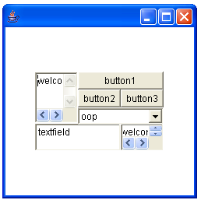
// GridBagLayout demo
import java.awt.*;
class GridBagDemo extends Frame
{
GridBagDemo()
{
GridBagLayout layout=new GridBagLayout();
setLayout(layout);
GridBagConstraints constraints=new GridBagConstraints();
TextArea ta=new TextArea("welcome",3,5);
constraints.gridx=0;
constraints.gridy=0;
constraints.gridwidth=1;
constraints.gridheight=3;
layout.setConstraints(ta,constraints);
add(ta);
Button b1=new Button("button1");
constraints.fill=GridBagConstraints.BOTH;
constraints.gridx=1;
constraints.gridy=0;
constraints.gridwidth=2;
constraints.gridheight=1;
layout.setConstraints(b1,constraints);
add(b1);

Slide 89
Button b2=new Button("button2");
constraints.gridx=1;
constraints.gridy=1;
constraints.gridwidth=1;
constraints.gridheight=1;
layout.setConstraints(b2,constraints);
add(b2);
Button b3=new Button("button3");
constraints.gridx=2;
constraints.gridy=1;
constraints.gridwidth=1;
constraints.gridheight=1;
layout.setConstraints(b3,constraints);
add(b3);
Choice c=new Choice();
c.add("oop");
c.add("oop");
constraints.gridx=1;
constraints.gridy=2;
constraints.gridwidth=2;
constraints.gridheight=1;
layout.setConstraints(c,constraints);
add(c);
TextField tf=new TextField("textfield");
constraints.fill=GridBagConstraints.BOTH;
constraints.gridx=0;
constraints.gridy=3;
constraints.gridwidth=2;
constraints.gridheight=1;

Slide 90
layout.setConstraints(tf,constraints);
add(tf);
TextArea ta1=new TextArea("welcome",1,2);
constraints.gridx=2;
constraints.gridy=3;
constraints.gridwidth=1;
constraints.gridheight=1;
layout.setConstraints(ta1,constraints);
add(ta1);
setSize(300,300);
setVisible(true);
}
public static void main(String arg[])
{
new GridBagDemo();
}
}

Slide 91
Events

Slide 92
The Delegation Event Model
Event object
Event handling
methods
Event source
Event listener

Slide 93
Action Events on Buttons
ActionEvent
actionPerformed(..)
Button
ActionListener

Slide 94
Events
All Events are objects of Event Classes.
Events can be generated as a consequence of a person interacting with elements in a graphical user interface.
Events may also occur that are not directly caused by interactions with a user interface
  For example, an event may be generated
    when a timer expires,
    a counter exceeds a value,
    a software or hardware failure occurs,

Slide 95
Event sources
Event source is a GUI component with which user interacts.
Event sources may generate more than one type of event.
A source must register listeners in order for the listeners to receive notifications about a specific type of event.
Each type of event has its own registration method.
Here is the general form:
public void addTypeListener(TypeListener el)
Here, Type is the name of the event and el is a reference to the event listener.

Slide 96
contd
For example,
the method that registers a keyboard event listener is called addKeyListener( ). The
method that registers a mouse motion listener is called addMouseMotionListener( ).
When an event occurs, all registered listeners are notified and receive a copy of the event
object. This is known as multicasting the event. In all cases, notifications are sent only to
listeners that register to receive them.

Slide 97
Event Classes
The classes that represent events .
All event classes are defined in java.awt.event package.
The following are the most important event classes.
Event Class Description
ActionEvent Generated when a button is pressed, a list item is double-clicked, or a menu item is selected.
MouseEvent Generated when the mouse is dragged, moved, clicked, pressed, or released; also generated when the mouse enters or exits a component.
KeyEvent Generated when the key is pressed , key is released, or key is typed.

Slide 98
TextEvent Generated when the value of a text area or text field is changed.
MouseWheelEvent Generated when the mouse wheel is moved.
WindowEvent Generated when a window is activated, deactivated, deiconified, iconified, opened, closing, closed.
ItemEvent Generated when a check box or list item is clicked; also occurs when a choice selection is made or a checkable menu item is selected or deselected.
FocusEvent Generated when a component gains or loses keyboard focus.
AdjustmentEvent Generated when a scroll bar is manipulated.
ContainerEvent Generated when a component is added to or removed from a container.

Slide 99
Event Listeners
A listener is a class that is notified when an event occurs.
It has two major requirements:
    It must have been registered with one or more sources to receive notifications about specific types of events
    It must implement methods to receive and process these notifications.
The methods that receive and process events are defined in a set of interfaces found in java.awt.event.
The listener class must implement listener interface to handle events.

Slide 100
Listener Interfaces
In addition to the Event classes, there are Listener interfaces corresponding to each Event class.
Some of them are listed here:
ActionEvent ActionListener
MouseEvent MouseListener
MouseMotionListener
KeyEvent KeyListener
TextEvent TextListener
AdjustmentEvent AdjustmentListener
ContainerEvent ContainerListener
FocusEvent FocusListener
ItemEvent ItemListener
TextEvent TextListener
WindowEvent WindowListener

Slide 101
Example
class MyActionListener implements ActionListener
{
public void actionPerformed(ActionEvent ae )
{
System.out.println(“button clicked”);
}
import java.awt.*;
import java.awt.event.*;
public class TestButtonAction extends Frame{
TestButtonAction()
{
Button b=new Button(“ok”);
add(b);
b.addActionListener(new MyActionListener( ) );
f.setSize(200,200);
f.setVisible(true);
public static void main(String[] args){
new TestButtonAction();
}
}

Slide 102
ActionEvent
ActionListener
public interface ActionListener
{
void actionPerformed(MouseEvent me)
}
class MyActionListener implements ActionListener
{
public void actionPerformed(ActionEvent ae)
{
// Handler_ code
}
}
Registration method:
C_ref.addActionListener(
Listener);

Slide 103
MouseEvent
MouseListener
public interface MousListener{
void mouseClicked(MouseEvent me)
void mouseEntered(MouseEvent me)
void mouseExited(MouseEvent me)
void mousePressed(MouseEvent me)
void mouseReleased(MouseEvent me)
}
class MyMouseListener implements MouseListener
{
public void mouseClicked(MouseEvent me)
{ // Handler_ code }
public void mouseEntered(MouseEvent me)
{ // Handler_ code }
public void mouseExited(MouseEvent me)
{ // Handler_ code }
public void mousePressed(MouseEvent me)
{ // Handler_ code }
public void mouseReleased(MouseEvent me)
{ // Handler_ code }
}
Registration methods:
C_ref.addMouseListener(
Listener);

Slide 104
MouseEvent
MouseMotionListener
public interface MousMotionListener{
void mouseDragged(MouseEvent me)
void mouseMoved(MouseEvent me)
}
class MyMouseMotionListener implements MouseMotionListener
{
public void mouseDragged(MouseEvent me)
{ // Handler_ code }
public void mouseMoved(MouseEvent me)
{ // Handler_ code }
}
Registration method:
C_ref.addMouseMotion
Listener( Listener);

Slide 105
KeyEvent
KeyListener
public interface KeyListener{
void keyPressed(KeyEvent ke)
void keyReleased(KeyEvent ke)
void keyTyped(KeyEvent ke)
}
class MyKeyListener implements KeyListener
{
public void keyPressed(KeyEvent me)
{ // Handler_ code }
public void keyReleased(KeyEvent me)
{ // Handler_ code }
public void keyTyped(KeyEvent me)
{ // Handler_ code }
}
Registration method:
C_ref.addKeyListener(
Listener);

Slide 106
Adapter classes
An adapter class provides an empty implementation of all methods in an event listener interface.
Adapter classes are useful when you want to receive and process only some of the events.
You can define a new class to act as an event listener by extending one of the adapter classes and overriding only those methods in which you are interested.

Slide 107
Cont..
Adapter Class Listener Interface
MouseAdapter MouseListener
KeyAdapter KeyListener
MouseMotionAdapter MouseMotionListener
WindowAdapter WindowListener
ContainerAdapter ContainerListener
FocusAdapter FocusListener

Slide 108
Inner Classes
A class defined within another class is known as inner class.
A nested class has access to the members, including private members, of the class in which it is nested.
However, the enclosing class does not have access to the members of the nested class.
The enclosing class access members of its nested class through nested class instance.

Slide 109
/* The following program illustrates how to define and use
an inner class. The class named Outer has one instance
variable named outer_x, one instance method named
test( ), and defines one inner class called Inner.
*/
// Demonstrate an inner class.
class Outer
{
int outer_x = 100;
void test()
{
Inner inner = new Inner();
inner.display();
}
// this is an inner class
class Inner
{
void display()
{
System.out.println("display: outer_x = " + outer_x);
}
}
}
class InnerClassDemo
{
public static void main(String args[])
{
Outer outer = new Outer();
outer.test();
}
}

