Slide 1
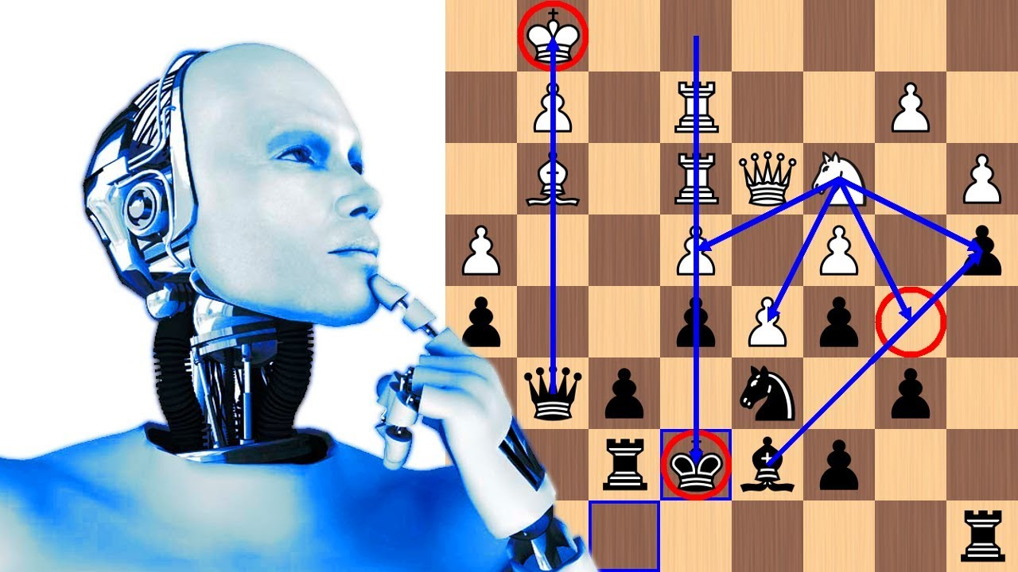
CHESS WITH ML BOT:
Under Guidance of: Presented by:
Dr. Sanjay Kumar Singh Shubham Rai
RSMT , Varanasi 2001080140039

Slide 2

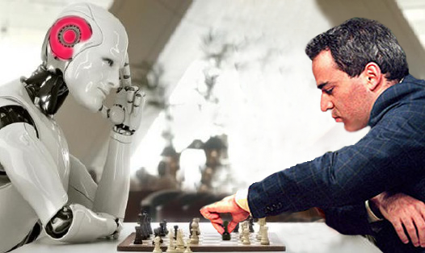
Introduction:
The purpose of project is to make a bot that can play the game of chess against human on standard size chess board.
The game of chess is a two player strategy board game played on a chessboard, a checkered game board with 64 squares arranged in an eight-by-eight grid.
The size of the chess board is 12‟12‟‟ and each square block has 1.5‟1.5‟‟ dimension.
Normally the game of chess is played between two human players involving an intensive exercise of mind on both sides.
The task of one move by robot can be classified into three parts i.e. identifying the current status on the chess board, checking for any incorrect move for human, calculating the best possible move for the robot.
This project tries to replace one of the human players to shape in a robot vs. human challenge.

Slide 3
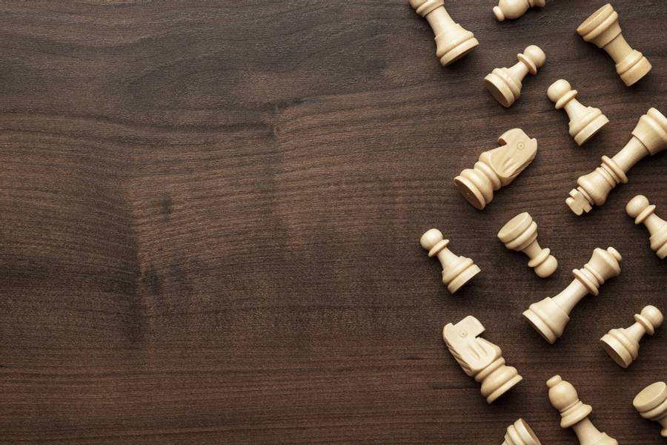
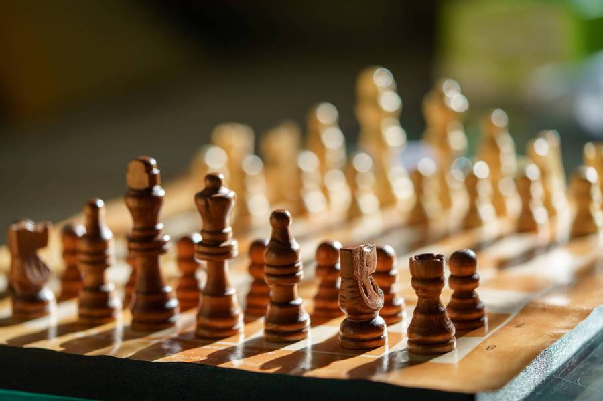
Overview of the Chess Project:
Create a HTML-5, CSS based user interface through which 2 players can play a chess game.
Provide an interactive user experience and validation using JavaScript.
Store the moves and transfer them to a MySQL database.
Use Python to train a ML bot using the saved data.
Launch the ML bot to play with human players.

Slide 4
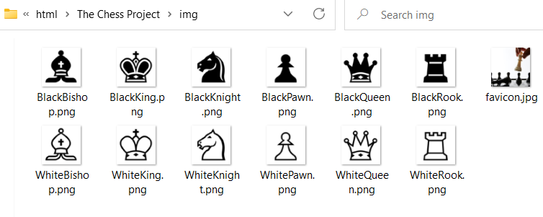
HTML & CSS:
Chess Board
Table 8 X 8 for the chess board
Placement is by div inside td.
<div class="chess-table">
Chess Pieces
Chess pieces are png files.
'white_pawn': './img/WhitePawn.png',
'white_rook': './img/WhiteRook.png',
Pieces Position
The positions are stored as JavaScript objects.
Initialgame.config.js
'a8': 'black_rook',
'b8': 'black_knight’,…..
CSS Classes:
Example:
files:
21 classes are created in style.css
.chess-table
.piece-box
.img.piece
.mychesstable
Only one file style.css

Slide 5
Java Script:
Files:
Directories:
Details:
3 directories are available to store JS files.
Config- it has 5 js files.
Config holds all the initial js files which identifies the positions of pieces and the link of the png files of pieces.
Services- it holds 2 folders and 5 js files.
Utils- it contains only one js files.
Services Directory manage the pieces determinations, pieces handling , and the players turns/movement.
app.js file helps to run the functions automatically.
Utils have only one js file which provides search queries and object cloning

Slide 6
Events:
'mouseenter':
This event Highlight the position in yellow is done by css
'mouseleave':
This event remove highlighting when mouse cursor will be removed from that place.
'click':
This event highlights the possible move positions

Slide 7
Chess & ML DFD [Level 0]:
Software
move
move
Player 1
Player 2
response
response
ML /
Module
Game State
Game State
Player
Admin
Suggested move
Ack
Notes:
Summarize your research in three to five points.

Slide 8
Chess DFD [Level 1]:
move
Chess
move
Player 1
Player 2
response
response
ACK
Player 2 turn
DataBase
Player 1 turn
move
response
response
move
Check Players turn
Determination
current state , move
ACK
move
Game state
response
ACK
Move Validation
Game State
Valid move
checkmate
Game Over
Ack
ACK
Notes:
Summarize your research in three to five points.

Slide 9
ML DFD [Level 1]:
Game State
ML /
Module
Game State
Player
Admin
Suggested move
Acknowledgement
Suggestion
Game State
Update
DataBase
Search for valid move
Move found
Not found
Generate Random move
ACK
ACK
Update
Notes:
Summarize your research in three to five points.

Slide 10
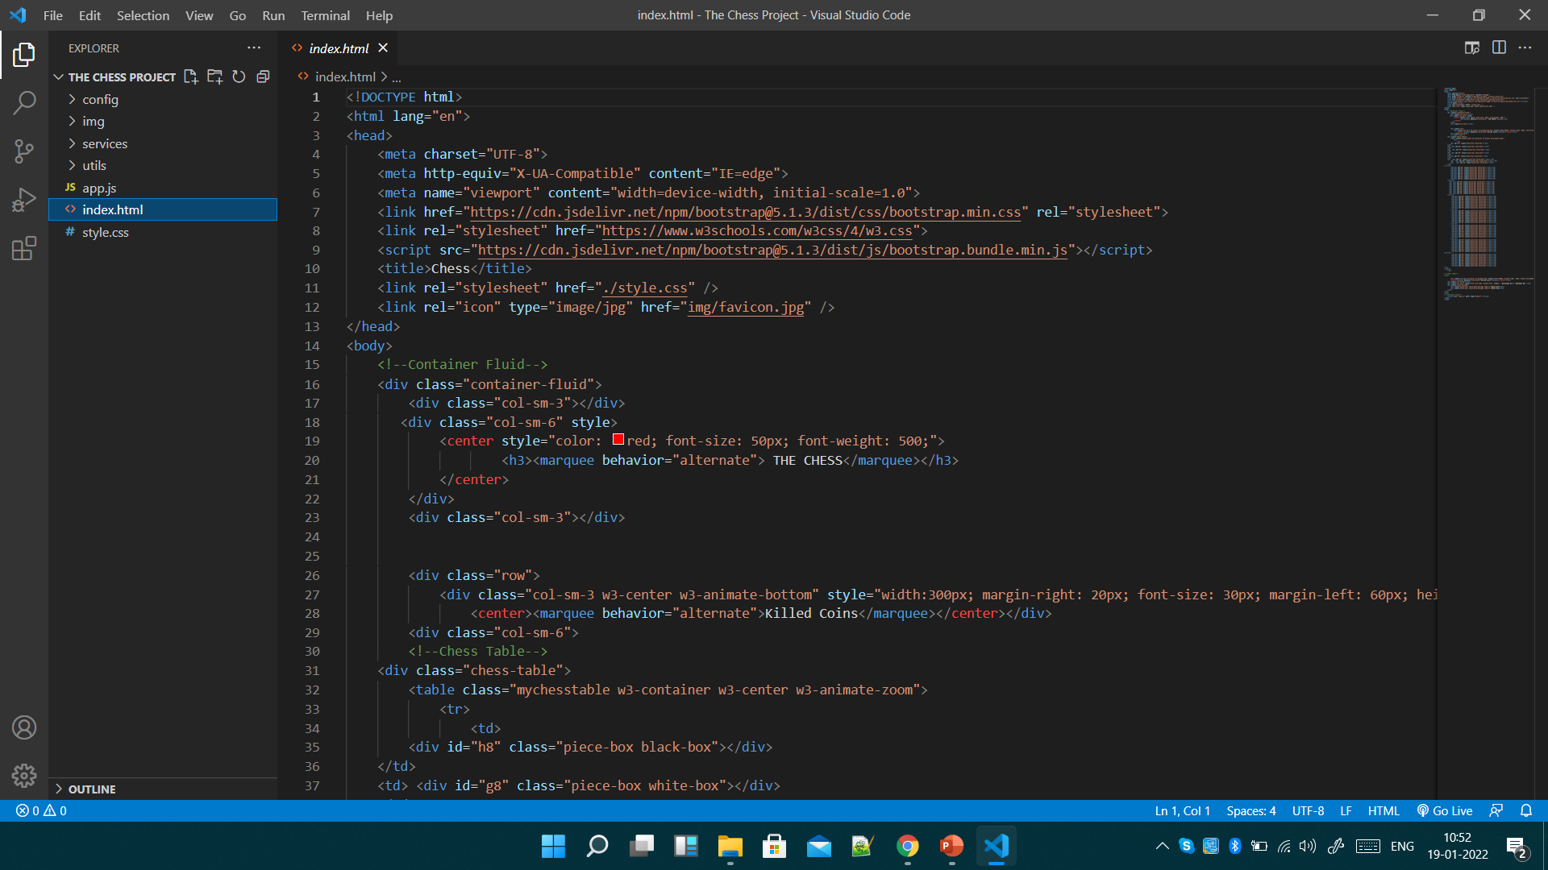
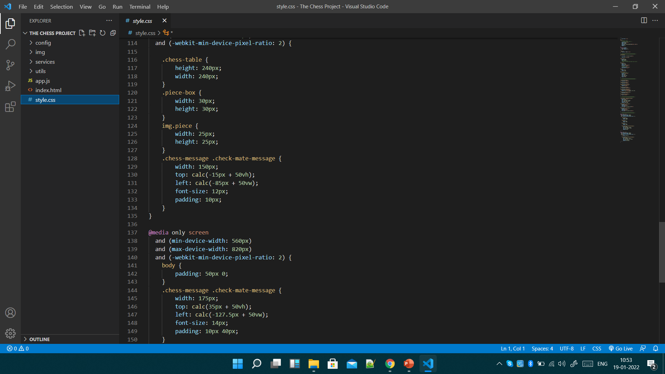
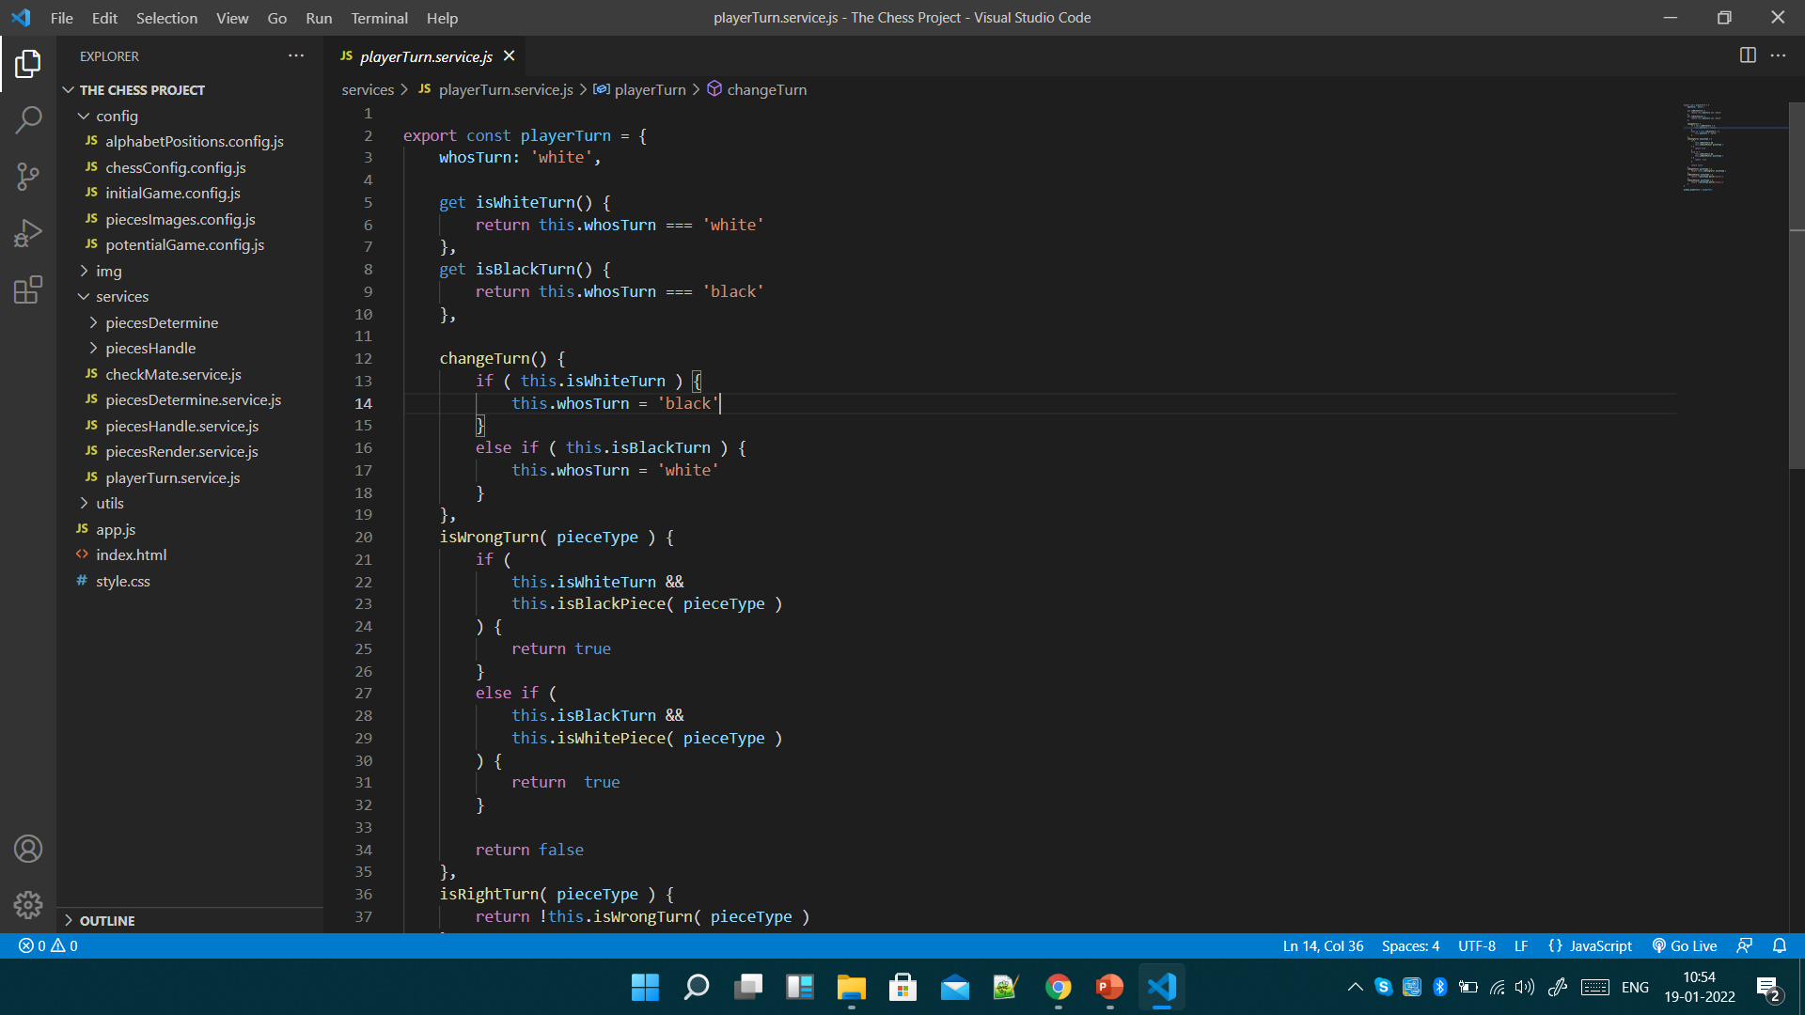
Index.html is the main home page which helps users to interact with the help of the css and js files.
style.css manage the styling of the html page.
JavaScript Manages the Positioning , Handling , Movements , Right / Wrong turns of the Pieces.
Notes:
Establish hypothesis before you begin the experiment. This should be your best educated guess based on your research.

Slide 11
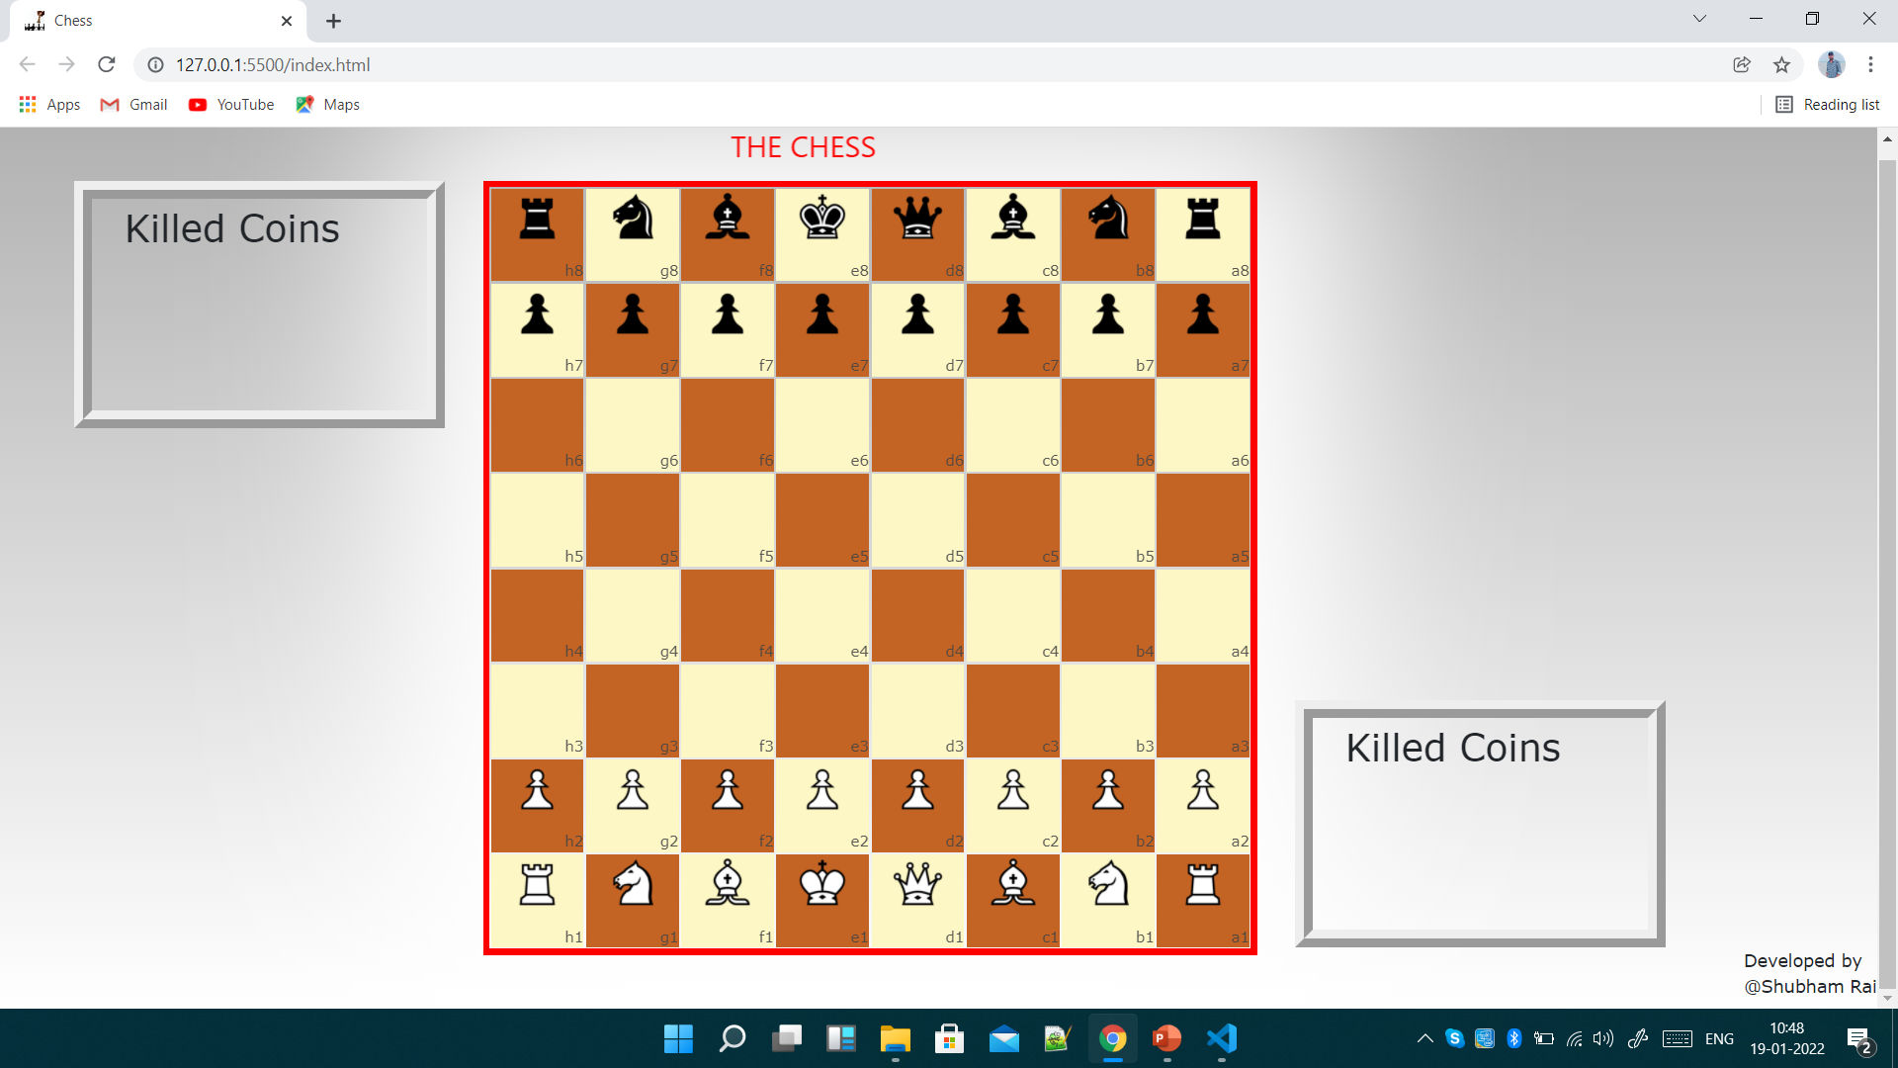
Result:
Notes:
Summarize your research in three to five points.

