Slide 1
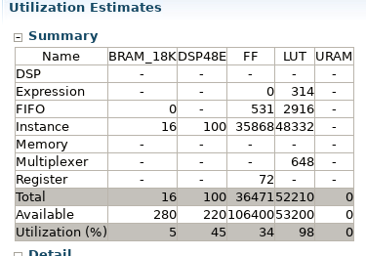
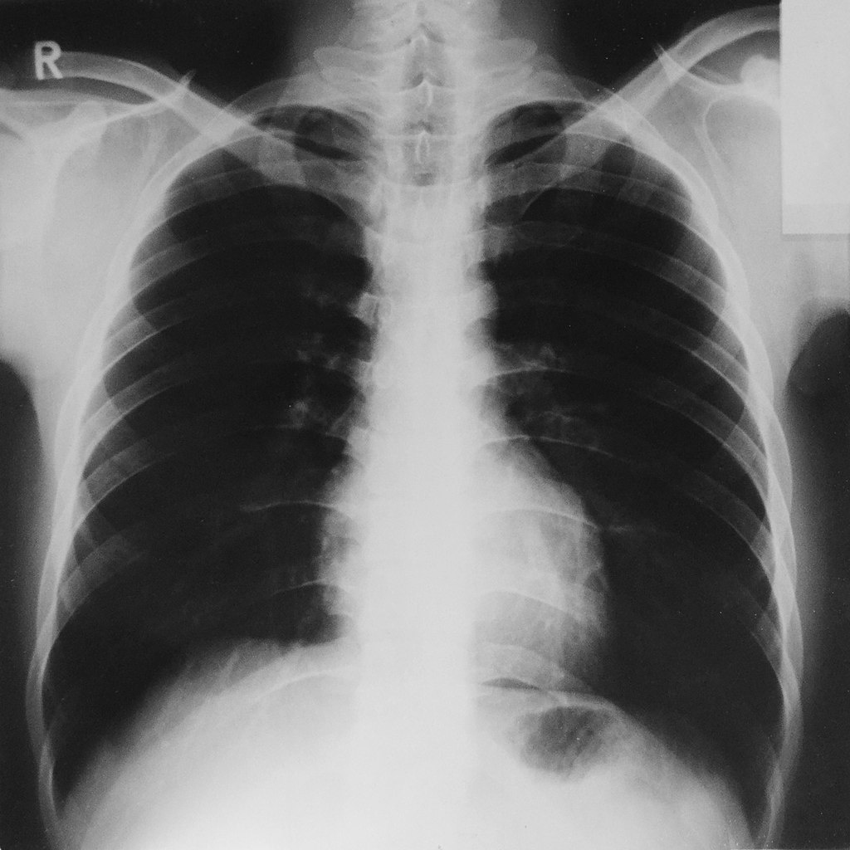
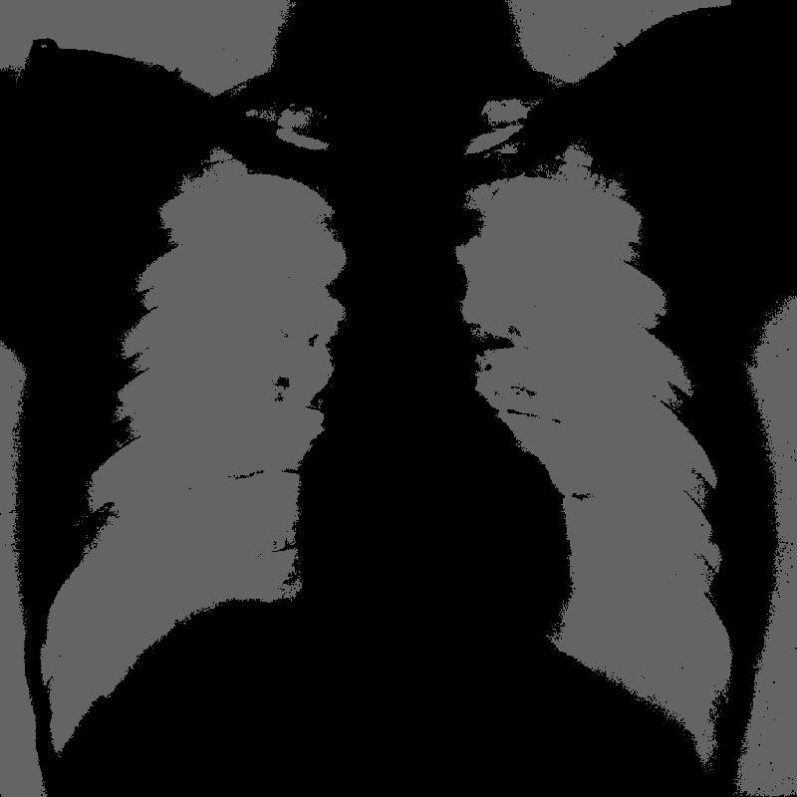
Image Segmentation for COVID-19 Chest X-RAY Shubham Rai and Salim Ullah, TU Dresden, Germany GitHub link
What did you learn, or what was interesting/difficult?
(learning) How acceleration works on VITIS
(difficult) Getting used to coding in this host-code (OpenCL APIs) and accelerated environment
(interesting) Easy to code and reproduce
Bottom-Up Approach
Started off with cvtColor filter to understand the flow
Integrated following filters– BGR2GRAY filter, threshold, resize, erode and dilate kernels
Executed Emu-SW, Emu-HW and Hardware builds
Block diagram?
Results, Image?
Original Image
Processed Image
Notes:
1

