Slide 1
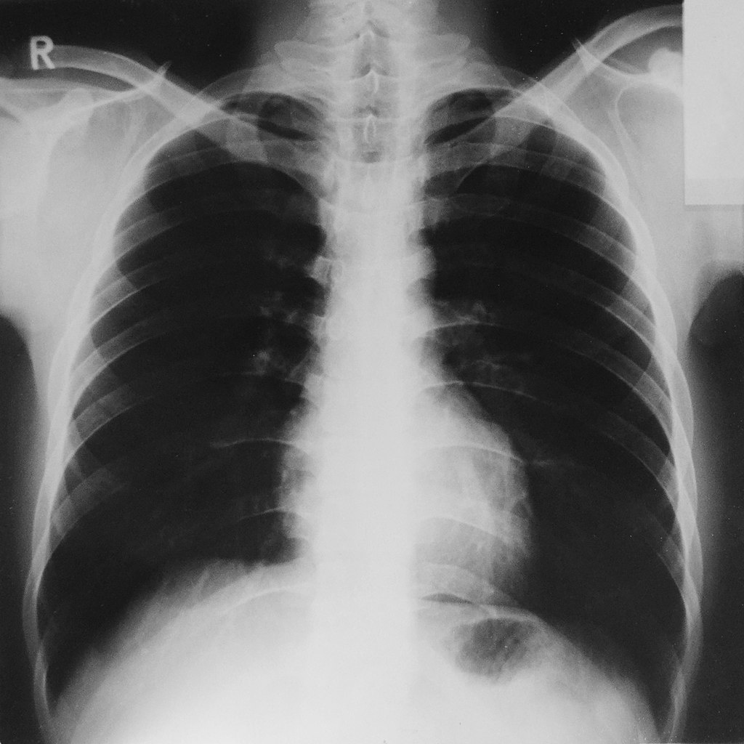
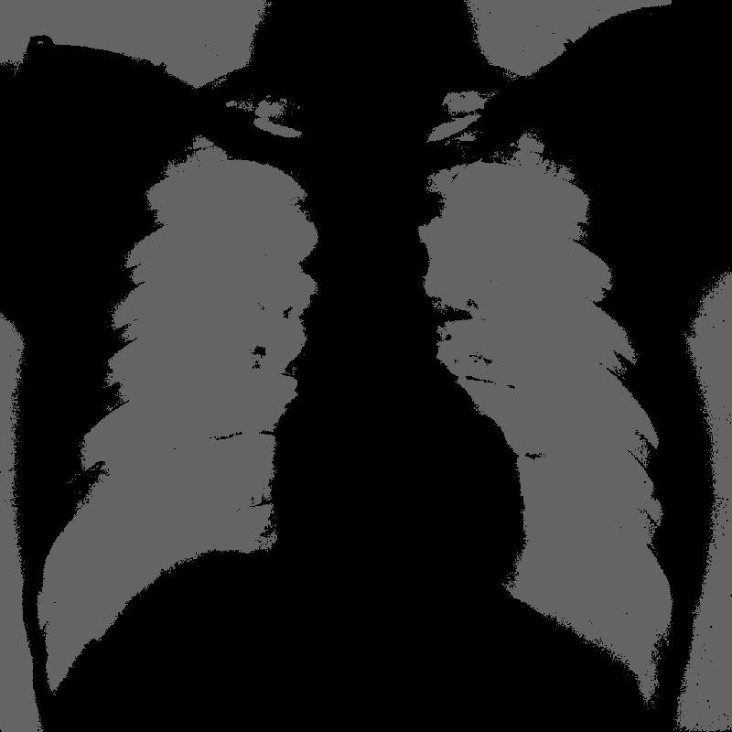
Image Segmentation for COVID-19 Chest X-RAY Shubham Rai and Salim Ullah, TU Dresden, Germany
https://github.com/shubhamrai26/xacc_project_img_segment
Bottom-Up Approach
Started off with cvtColor filter to understand the flow
Integrated following filters– BGR2GRAY filter, threshold, resize, erode and dilate kernels
Executed Emu-SW, Emu-HW and Hardware builds
Filters to be added: Canny, Histogram
Block diagram of achieved progress
What did you learn, or what was interesting/difficult?
(learning) How acceleration works on VITIS
(difficult) Getting used to coding in this host-code (OpenCL APIs) and accelerated environment
(interesting) Easy to code and reproduce
Input Image
CvtColor
BGR2
GRAY
Resize
Image
Original Image
Processed Image
Output
Image
Dilate
Erode
Notes:
1

