Slide 1

Report on
Business Analytics HealthCare Project
(Using R)
Domain – Data Science Batch
Project ID : CP1/ CP2
SHUBHAM RAJESH
Submitted on 13th January 2019
Mentor : Mr. Govinda Bobade

Slide 2
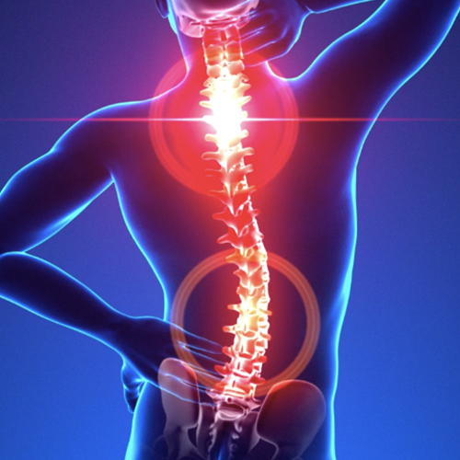
BUSINESS ANALYTICS HealthCare PROJECT REPORT
Health Care
On Lower Back Pain
1. AN INTRODUCTION

Slide 3
BUSINESS ANALYTICS on Healthcare- Spine PROJECT REPORT
1.1 Project Brief
The project is on Lower Back pain which is one of the most common reasons people go to the doctor or miss work, and it is a leading cause of disability worldwide. Most people have back pain at least once.
The lumbar spine, or low back, is a remarkably well-engineered structure of interconnecting bones, joints, nerves, ligaments, and muscles all working together to provide support, strength, and flexibility.

Slide 4
BUSINESS ANALYTICS on Healthcare- Spine PROJECT REPORT
1.2 Objective of the Study
To develop a model to the client, which can predict the new patients with their symptom of lower back pain, that do they have a normal or abnormal status of lower back.

Slide 5
BUSINESS ANALYTICS on Healthcare- Spine PROJECT REPORT
1.3 Approach of the Study
Load the dataset as csv in R
Check for Uni Variate Analysis
Check for Bi-variant Analysis
Split into train and test dataset
Apply the Algorithm.
Predict on the test dataset
Check for the accuracy
Plot the graphs.

Slide 6
BUSINESS ANALYTICS on Healthcare- Spine PROJECT REPORT
Loaded the Data set:
Loaded the dataset as read.csv.
Univariant Analysis Bivariant Analysis:
Detecting / Treating missing values: There were no missing values.
Detecting / Treating outliers: Using Boxplot, found the outliers and then the outliers were treated and capped.
Checking for the correlation between the variables with corrplot.
Splitting the dataset:
Splitting of Data into 70% train and 30% test data.
Apply the Algorithm:
Spine dataset is a classification problem as dependent variable is binominal/categorical in nature. The dependent variable is either Normal or Abnormal, so could be solved with different algorithms. Here I will be using Logistic Regression, Decision tree and Random Forest technique to build a model.

Slide 7
BUSINESS ANALYTICS on Healthcare- Spine PROJECT REPORT
Data Modelling- Logistic Regression Modelling
glm(formula = Status ~ pelvic_incidence + pelvic_tilt + pelvic_radius + degree_spondylolisthesis, family = binomial(), data = train)
Deviance Residuals:
Min 1Q Median 3Q Max
-1.8209 -0.3772 -0.0307 0.3066 2.7644
Coefficients:
Estimate Std. Error z value Pr(>|z|)
(Intercept) -18.14769 4.32440 -4.197 2.71e-05 ***
pelvic_incidence 0.12789 0.02807 4.556 5.21e-06 ***
pelvic_tilt -0.21755 0.04803 -4.530 5.91e-06 ***
pelvic_radius 0.13256 0.03132 4.232 2.31e-05 ***
degree_spondylolisthesis -0.17268 0.02820 -6.124 9.11e-10 ***
Signif. codes: 0 ‘***’ 0.001 ‘**’ 0.01 ‘*’ 0.05 ‘.’ 0.1 ‘ ’ 1
(Dispersion parameter for binomial family taken to be 1)
Null deviance: 267.57 on 213 degrees of freedom
Residual deviance: 116.12 on 209 degrees of freedom
AIC: 126.12
Number of Fisher Scoring iterations: 7

Slide 8
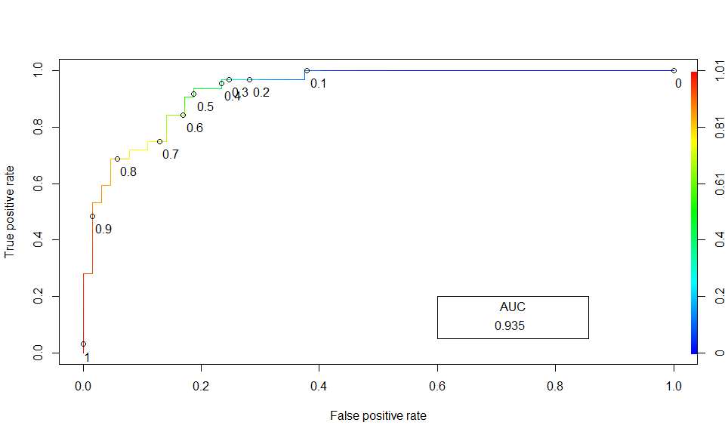
BUSINESS ANALYTICS CAPSTONE PROJECT REPORT
ROC Curve for Logistic Regression with Area Under Curve

Slide 9
BUSINESS ANALYTICS on Healthcare- Spine PROJECT REPORT
Data Modelling- Decision Tree Algorithm
Classification tree:
rpart(formula = Status ~ ., data = train, method = "class")
Variables actually used in tree construction:
[1] degree_spondylolisthesis pelvic_radius sacral_slope
Root node error: 68/214 = 0.31776
n= 214
CP nsplit rel error xerror xstd
1 0.323529 0 1.00000 1.00000 0.100165
2 0.220588 1 0.67647 0.73529 0.091031
3 0.073529 2 0.45588 0.52941 0.080472
4 0.010000 4 0.30882 0.63235 0.086202

Slide 10
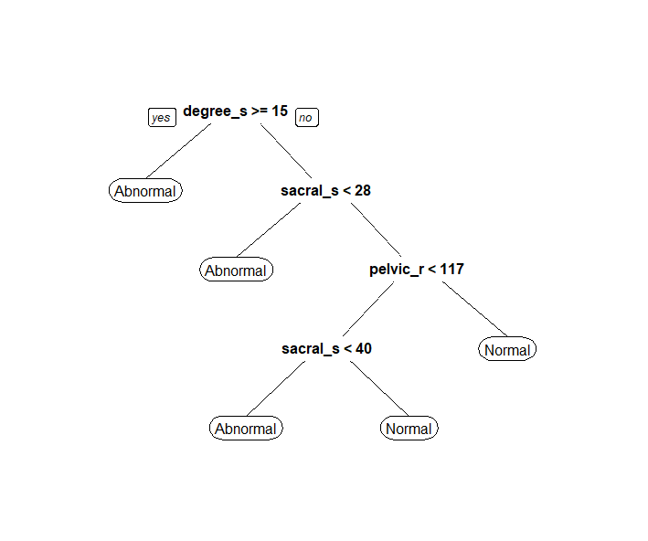
BUSINESS ANALYTICS CAPSTONE PROJECT REPORT
Decision Tree

Slide 11
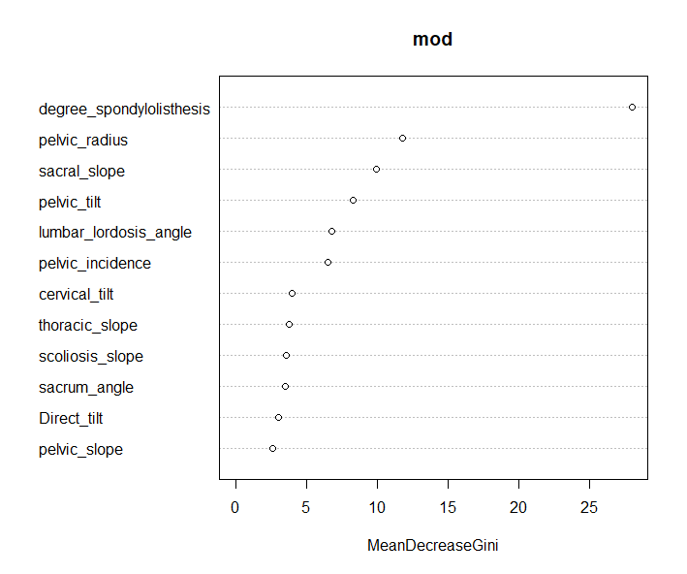
BUSINESS ANALYTICS on Healthcare- Spine PROJECT REPORT
Data Modelling- Random Forest
Classification tree:
Call: randomForest(formula = as.factor(Status) ~ ., data = train, mtry = 4)
Type of random forest: classification
Number of trees: 500
No. of variables tried at each split: 4
OOB estimate of error rate: 15.42%
Confusion matrix:
Abnormal Normal class.error
Abnormal 133 13 0.0890411
Normal 20 48 0.2941176
With Variable important plot
varImpPlot(mod)

Slide 12
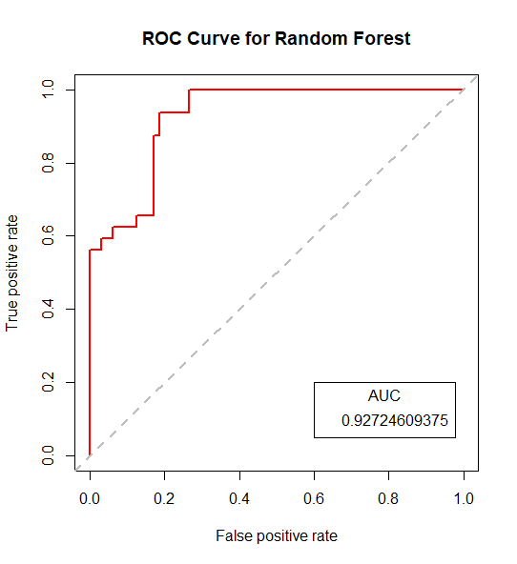
BUSINESS ANALYTICS CAPSTONE PROJECT REPORT
ROC Curve for Random Forest with Area Under Curve

Slide 13
BUSINESS ANALYTICS on Healthcare- Spine PROJECT REPORT
Data Validation – Prediction on test data, Accuracy, Confusion matrix
Confusion Matrix: Logistic
Prediction FALSE TRUE
Abnormal 52 12
Normal 3 29
Confusion Matrix: Decision Tree
Prediction Abnormal Normal
Abnormal 52 6
Normal 12 26
Confusion Matrix: Random Forest
Prediction Abnormal Normal
Abnormal 53 7
Normal 11 25
Model | Accuracy | Precision | Recall | F1 Score
Logistic Regression | 84.37 | 70.73 | 90.62 | 79.44
Decision Tree | 81.25 | 81.25 | 68.42 | 74.28
Random Forest | 81.25 | 78.12 | 69.44 | 73.52
Conclusion: Considering the above comparison, we can conclude that Logistic regression is the best model with the accuracy 84.37%.

Slide 14
I. COMPILATION OF R CODE
Put your R code here
Please follow the link
R_codes.rtf

Slide 15
Thank You

