Slide 1

LectureNotes Offline
Gujarati / Hindi lecture notes on Snapdragon, with no internet needed
Snapdragon® AI Lab Build & Present Challenge 2026
Rajput Shubham | B.E. Sem-I, Government Engineering College, Modasa (GTU)
Notes:
Introduce yourself and the project in one line: an offline tool that turns Gujarati/Hindi lecture recordings into notes and flashcards.

Slide 2



The problem
Students struggle to take notes in mixed-language lectures.
Mixed languages
Needs internet
Privacy and cost
Lectures mix Gujarati, Hindi and English technical terms. Writing notes while listening is hard.
Most AI note tools need a steady connection. Campus Wi-Fi and mobile data are often unreliable.
Recordings are uploaded to cloud servers, using data and raising privacy concerns.
LectureNotes Offline | Snapdragon AI Lab Build & Present Challenge 2026
2 / 8
Notes:
Three pain points: mixed languages, dependence on internet, and privacy/data cost of cloud tools.

Slide 3



The solution
Load a recording. Get study material. Everything stays on your laptop.
1 Transcribe
2 Summarize
3 Flashcards
4 Export
Whisper turns speech into text in Gujarati, Hindi or English.
A small on-device LLM (Llama 3.2 3B) writes short revision notes.
The same model creates question and answer cards.
Transcript, Markdown notes and a flashcards CSV.
LectureNotes Offline | Snapdragon AI Lab Build & Present Challenge 2026
3 / 8
Notes:
Walk through the four steps. Whisper for speech-to-text, Llama 3.2 3B for summary and flashcards.

Slide 4
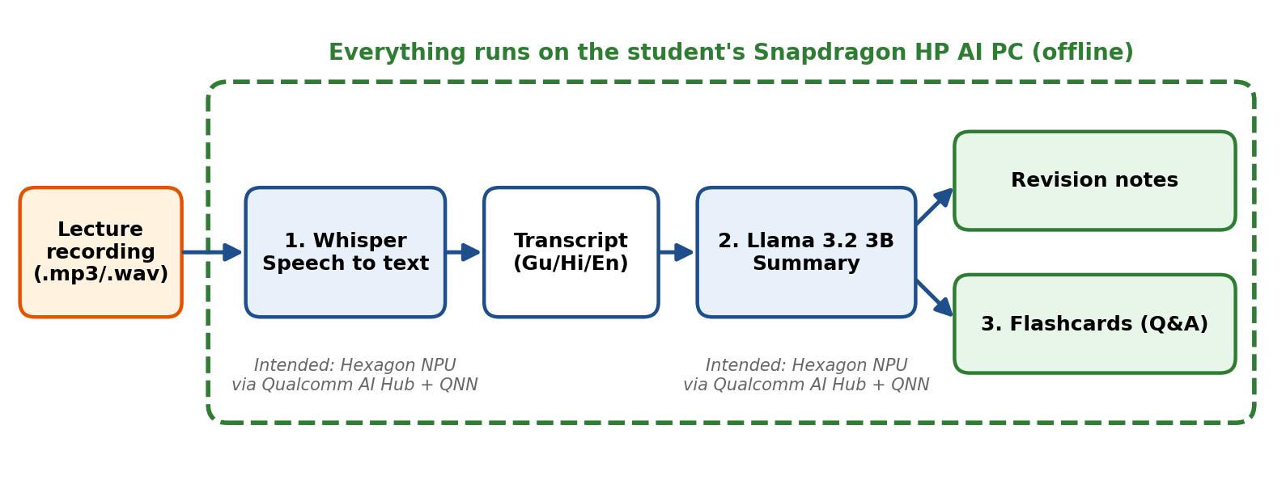
How it works
Whisper and Llama 3.2 3B are both available on Qualcomm AI Hub. The intended deployment compiles them for the Hexagon NPU and runs them through ONNX Runtime (QNN).
LectureNotes Offline | Snapdragon AI Lab Build & Present Challenge 2026
4 / 8
Notes:
Explain the pipeline. Be clear that the NPU path is the intended deployment unless you tested it on Snapdragon hardware.

Slide 5
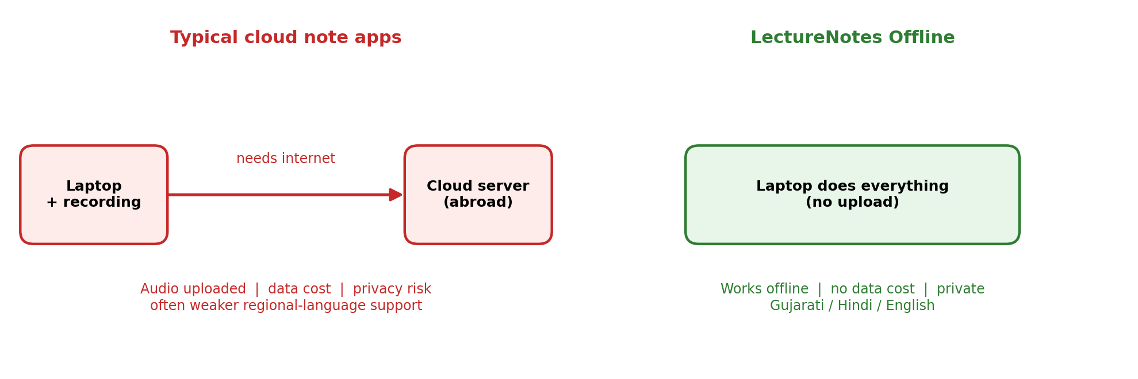



Why on-device on Snapdragon
Works offline
Private
Low power
No dependence on campus Wi-Fi or mobile data.
Audio, transcripts and notes never leave the device.
The Hexagon NPU is designed to run these models efficiently, helping battery life.
LectureNotes Offline | Snapdragon AI Lab Build & Present Challenge 2026
5 / 8
Notes:
Contrast cloud tools with an on-device approach: offline, private, low power.

Slide 6
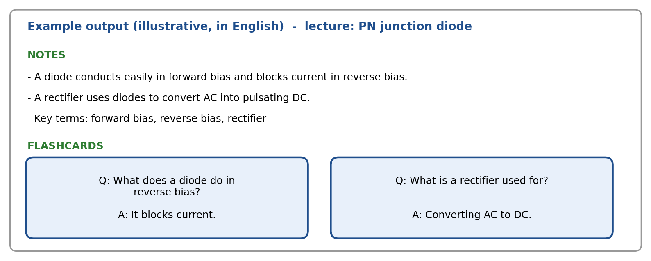
What you get
Illustrative example only. Not measured output.
LectureNotes Offline | Snapdragon AI Lab Build & Present Challenge 2026
6 / 8
Notes:
This is an illustrative mock-up, not real output. Replace it with a real output screenshot if you have one.

Slide 7


Status and honest limits
Current status
Known limitations
The prototype runs the full pipeline (transcribe, summarize, flashcards) on CPU. The NPU path is the intended deployment.
[EDIT: state whether you tested on a Snapdragon device and any measured results.]
Gujarati transcription is less accurate than Hindi or English.
A 3B model can write weaker Gujarati summaries.
Whisper can mistake names and formulas.
Review notes and cards before studying.
LectureNotes Offline | Snapdragon AI Lab Build & Present Challenge 2026
7 / 8
Notes:
Be honest about what was tested and what was not. Judges value clear limitations.

Slide 8
Next steps
Compile and benchmark on a real Snapdragon HP AI PC
Speaker separation for classroom questions
Formula sheet extraction
Export flashcards to Anki
GTU subject glossaries (e.g. Basic Electronics)
Thank you
Rajput Shubham
Government Engineering College, Modasa (GTU)
GitHub: [paste your repository link]
LectureNotes Offline | Snapdragon AI Lab Build & Present Challenge 2026
8 / 8
Notes:
Close with next steps and share your GitHub link.

