Slide 1


Portfolio Project-2: Zomato Data Analysis
This project analyzes a Zomato dataset to uncover insights on customer preferences, cost trends, and the impact of online versus offline orders. The goal is to understand patterns in ratings, votes, and restaurant types to help platforms like Zomato enhance customer experience and business strategy.
We explore data cleaning, preparation, and visualization techniques to reveal key trends and actionable insights.
by Shubham Raut

Slide 2

Restaurant Types Distribution
Most Common Types
Delivery and Casual Dining are the most common restaurant types in the dataset, followed by Cafes and Quick Bites.
Insight
This distribution reflects customer preferences and helps target marketing strategies effectively.

Slide 3
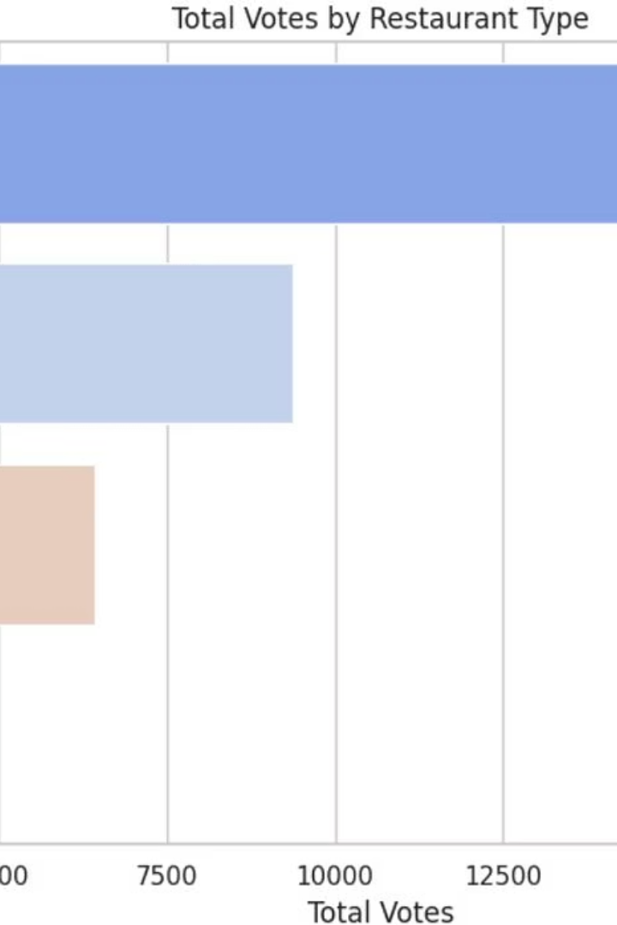
Votes by Restaurant Type
Dining
Buffet
Received the highest number of votes, exceeding 20,000, indicating strong customer engagement.
Received the lowest votes, between 2,500 and 5,000.
Cafes and Others
Cafes received 5,000-7,500 votes; other types ranged between 7,500 and 10,000 votes.

Slide 4
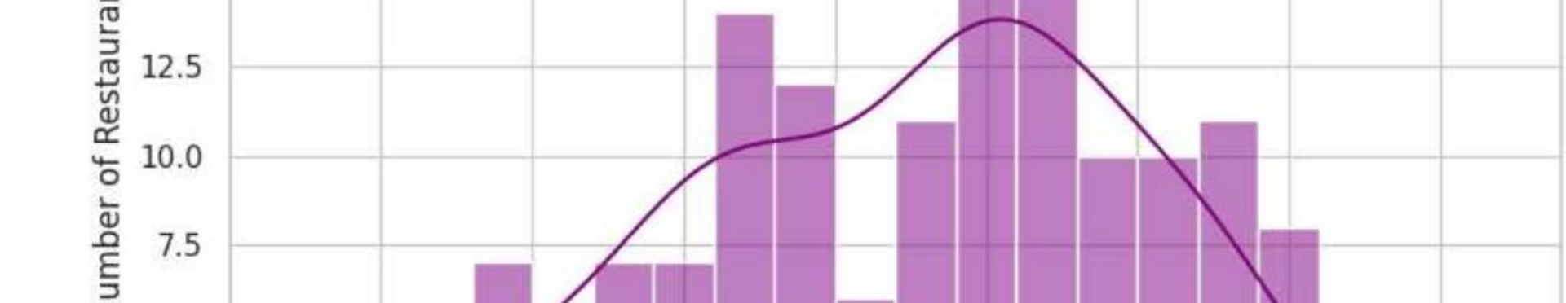
Ratings Distribution
Most restaurant ratings cluster between 3.5 and 4.5, with the highest concentration around 3.75 to 4.0. This suggests that the majority of restaurants provide a generally good customer experience.
However, the absence of consistently higher ratings indicates room for improvement in overall dining quality.

Slide 5
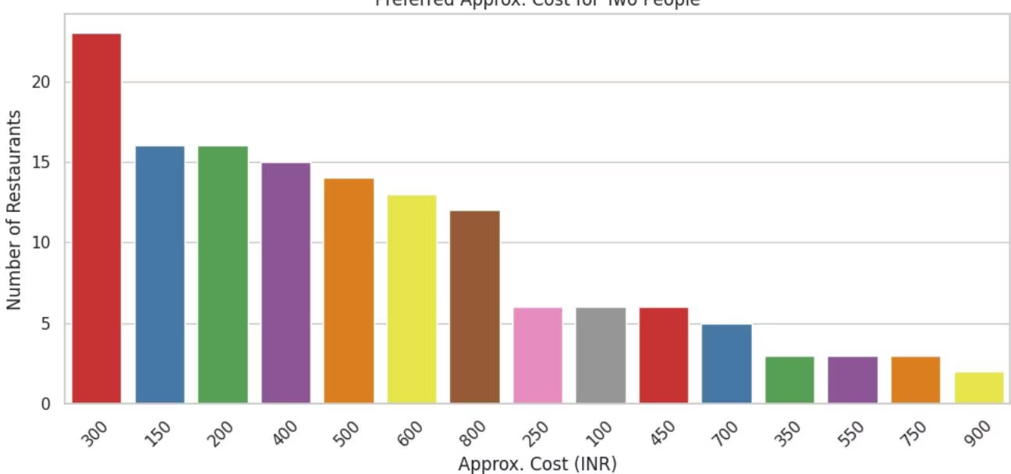
Spending Preferences for Couples
Average Spending
Cost Distribution
Couples spend on average around ₹418.24 for two people, providing a pricing benchmark for meal offers targeted at couples.
The preferred approximate cost for two people varies, with many restaurants clustered around mid-range price points.

Slide 6
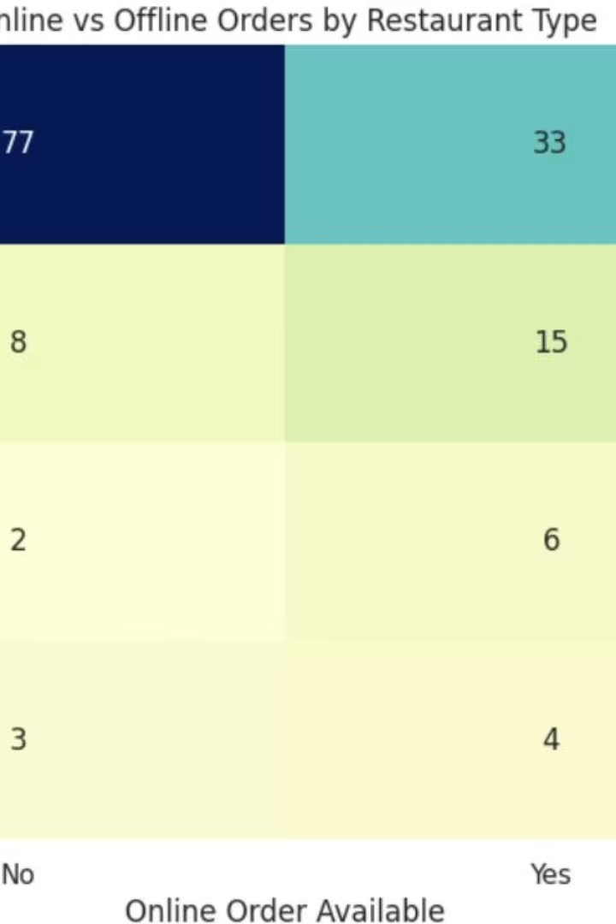



Online vs Offline Orders by Restaurant Type
Online Orders
Cafes, Quick Bites, and Dessert Parlors lead in accepting online orders.
Offline Orders
Casual Dining and Fine Dining show higher preference for offline ordering.
Strategic Insight
Zomato can target online promotions for cafes and offline deals for dining restaurants to optimize customer engagement.

Slide 7
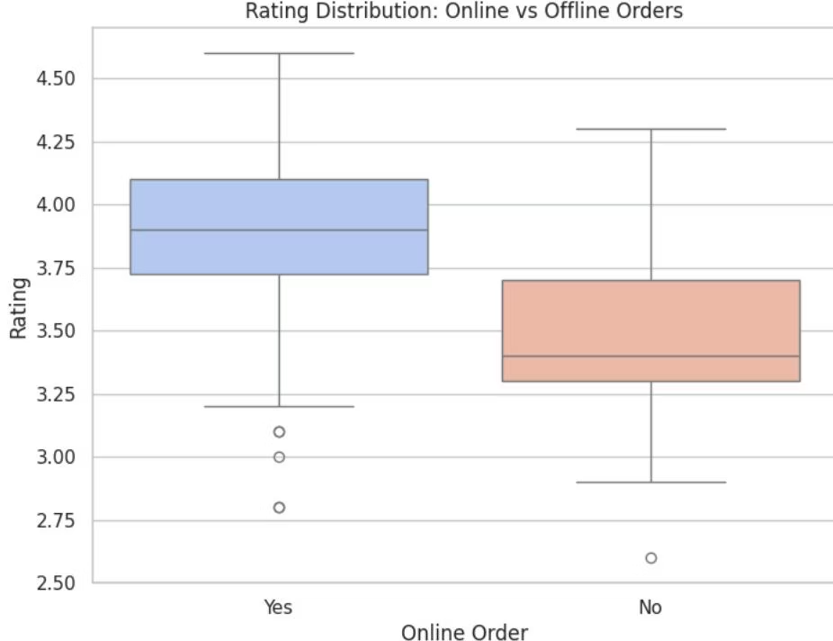
Ratings Comparison: Online vs Offline
Average Ratings
Implications
Online orders have a slightly higher average rating of 3.86 compared to 3.49 for offline orders, suggesting better customer experience or convenience with online ordering.
This insight can guide Zomato in enhancing online services and encouraging more customers to order online.

Slide 8
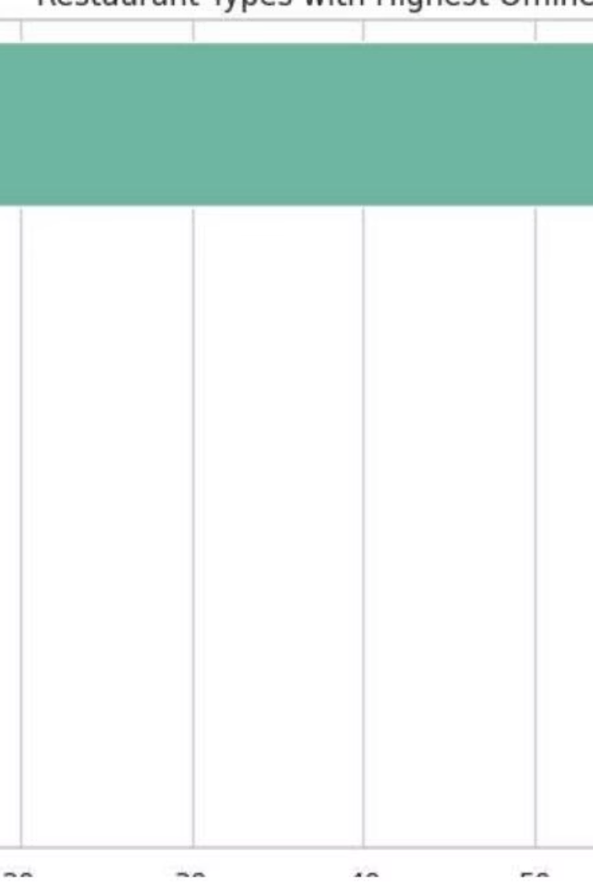
Restaurant Types with Highest Offline Orders
Offline Preference
Casual Dining and Fine Dining restaurants receive the highest number of offline orders.
Targeted Offers
Zomato can provide special offline offers to these customers to boost engagement and sales.

Slide 9
Final Summary: Zomato Data Insights Report
Restaurant Prevalence: Casual Dining is the most common restaurant type on Zomato’s platform.
Customer Engagement: Cafes and Casual Dining receive the highest votes, indicating popularity.
Rating Trends: Most ratings cluster between 3.5 and 4.5, showing steady quality.
Couples Spending: Average cost for two is ₹418.24, guiding budget-friendly offers.
Order Preferences: Online orders score higher ratings; Cafes lead online, Casual Dining leads offline.

Slide 10
Customer Persona Based on Findings
Dining Preference: Favors Casual Dining and Quick Bites for convenience and ambiance.
Ordering Behavior: Primarily orders online from cafes and fast food options.
Spending Pattern: Typical spend is ₹418.24 per couple, balancing quality and budget.
Ratings Habits: Leaves reviews mostly between 3.5 and 4.5 stars, showing moderate satisfaction.
Frequency: Often orders from highly voted, well-rated restaurants and values special offers.

