Slide 1
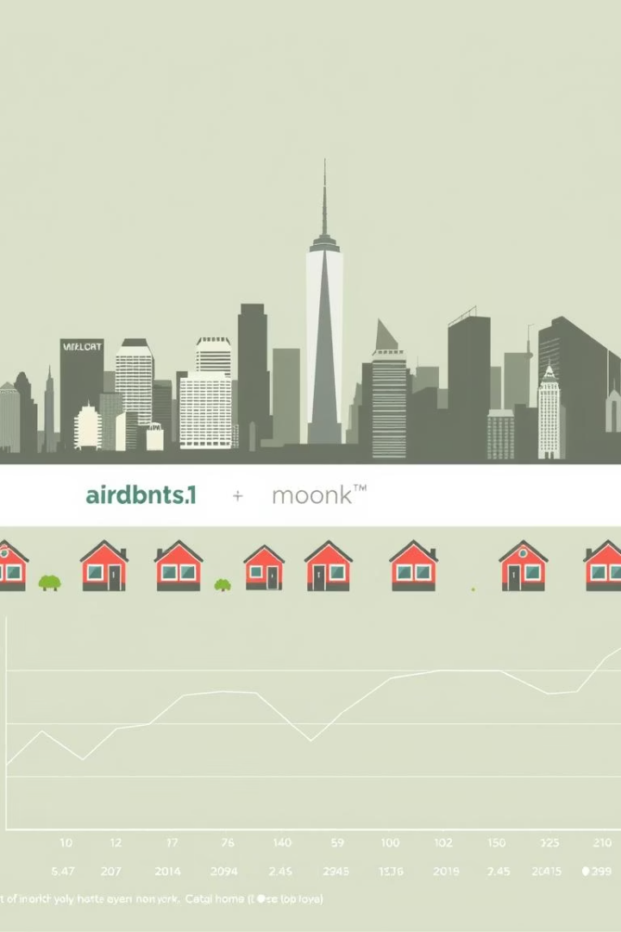

Airbnb Price Prediction Project
This project aims to predict Airbnb listing prices based on location, amenities, and host reputation. Using a dataset of New York City listings, we explore data preprocessing, analysis, and model training to understand pricing dynamics and build predictive models.
We leverage machine learning techniques including Linear Regression and XGBoost to estimate prices, focusing on key features such as neighborhood, room type, and host activity.
by Shubham Raut

Slide 2
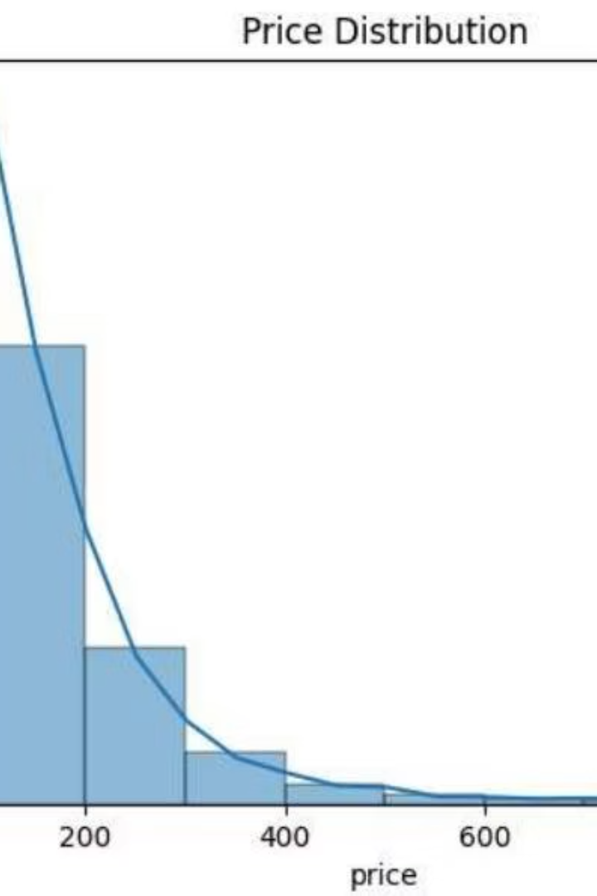
Data Overview and Preprocessing
Dataset Details
48,895 listings with 16 columns including location, room type, price, and reviews.
Outlier Removal
Filtered listings with prices above $500 to reduce extreme value impact.
Missing Data Handling
Filled missing reviews per month with zero and dropped remaining null rows.
Encoding
Converted categorical variables like neighborhood group and room type into dummy variables for modeling.

Slide 3
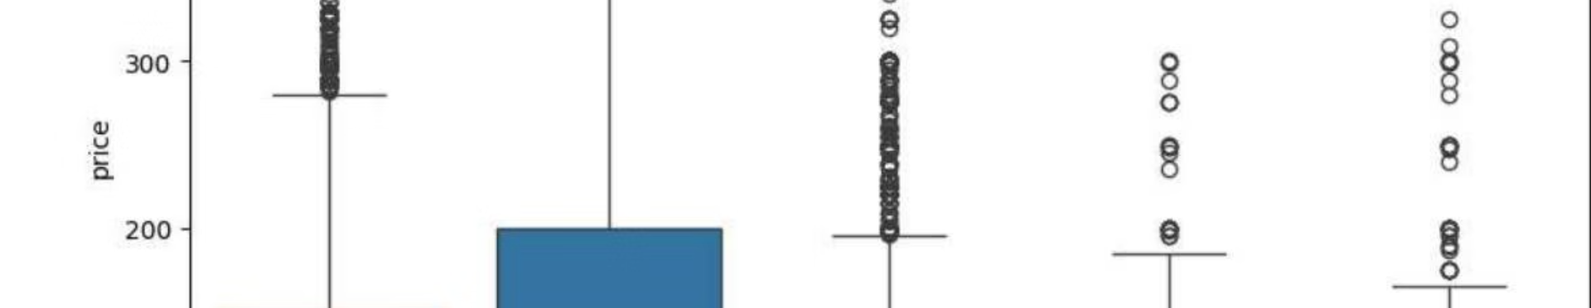
Price Variation by Neighborhood
Manhattan Premium
Brooklyn Prices
Highest median prices reflecting its premium market status.
Relatively high prices but below Manhattan.
Affordable Areas
Outliers
Queens and Staten Island offer more budget-friendly options.
High-priced outliers exist in all groups, requiring careful modeling.

Slide 4
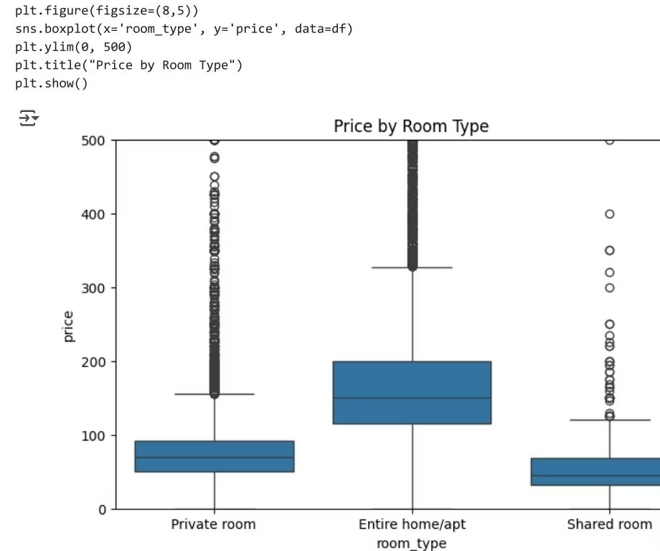
Impact of Room Type on Price
Entire Homes/Apartments
Private Rooms
Shared Rooms
Command the highest prices due to privacy and space.
Most budget-friendly option with lower pricing.
Generally priced lower but with some outliers.

Slide 5
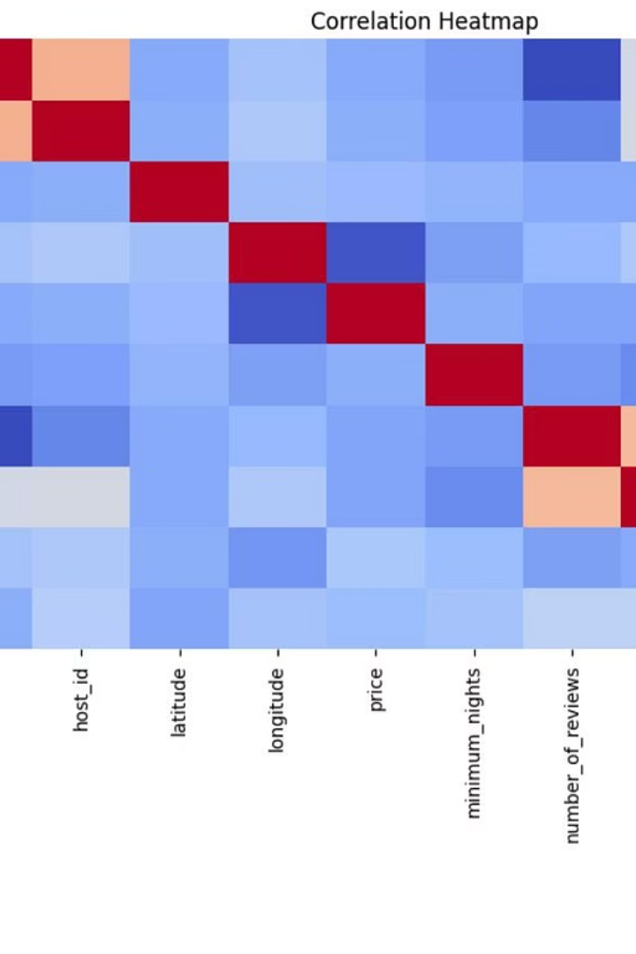



Correlation Analysis of Features
Weak Correlations
No single feature strongly correlates with price, indicating pricing depends on multiple factors.
Notable Features
Host listing count, availability, and longitude show weak associations with price.
Modeling Implication
Combining features in multivariate models is necessary for accurate price prediction.

Slide 6

Feature Selection and Data Splitting
Feature Selection
Selected numeric and encoded categorical features relevant to price prediction.
Data Splitting
Split dataset into training (80%) and testing (20%) sets for model evaluation.

Slide 7

Model Training and Performance
Linear Regression
Achieved R² score of 0.398, indicating moderate predictive power.
XGBoost Model
Improved performance with R² score of 0.458, capturing nonlinear relationships better.

Slide 8
Final Insights and Recommendations
Key Findings
Recommendations
Manhattan and Brooklyn have the highest number of listings and prices.
Focus on neighborhood and room type as primary predictors. Use advanced models like XGBoost for better accuracy.
Entire homes/apartments are priced higher than private rooms.

