Slide 1


Credit Card Fraud Detection Project
This presentation covers the development of a robust AI model to detect fraudulent credit card transactions. We address challenges like data imbalance and evaluate multiple machine learning models to ensure high precision and recall. The goal is to minimize false positives while effectively identifying fraud.
by Shubham Raut

Slide 2
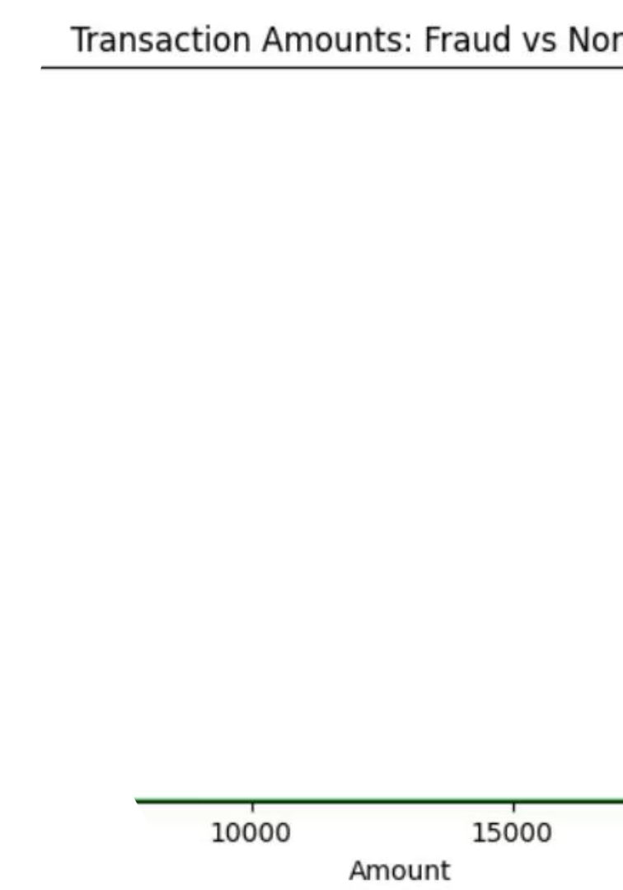
Dataset Overview and Class Imbalance
Dataset Size
Class Imbalance
284,807 transactions with 30 features including anonymized variables, Amount, and Class labels.
Only 0.17% of transactions are fraudulent, creating a significant imbalance challenge.
Visualization
Histogram shows transaction amounts for fraud (red) and non-fraud (green), highlighting distribution differences.

Slide 3
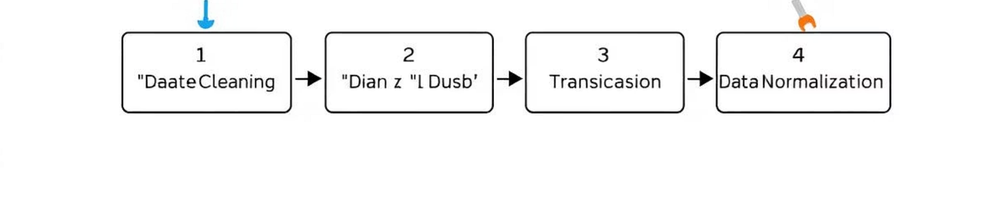
Data Preprocessing and Train-Test Split
1
Normalization
2
Feature Selection
3
Train-Test Split
StandardScaler applied to 'Amount' and 'Time' columns to normalize data.
Original 'Amount' and 'Time' columns dropped after scaling to avoid redundancy.
Dataset split into 80% training and 20% testing with stratification to preserve class distribution.

Slide 4
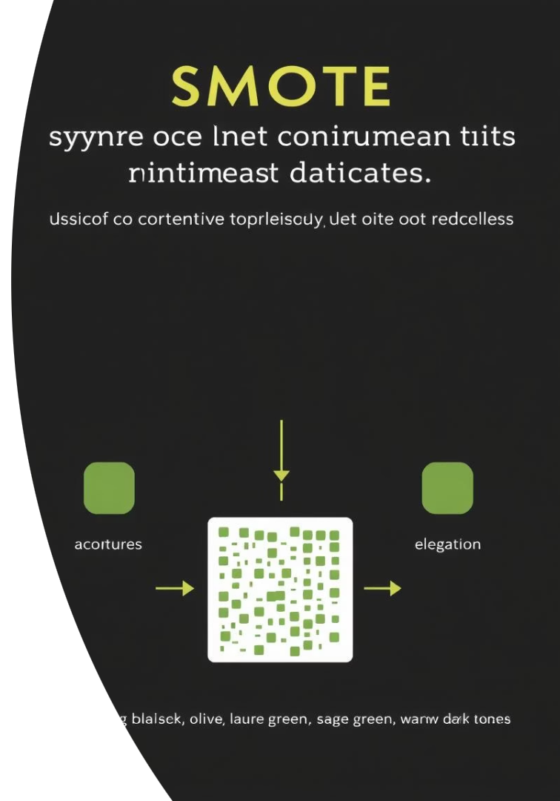
Handling Imbalanced Data with SMOTE
SMOTE (Synthetic Minority Over-sampling Technique) was used to balance the training data by generating synthetic samples of the minority class (fraudulent transactions). This approach helps models learn better decision boundaries and improves fraud detection performance.
Balancing the data is critical due to the extreme imbalance, with fraud cases representing only 0.17% of total transactions.

Slide 5
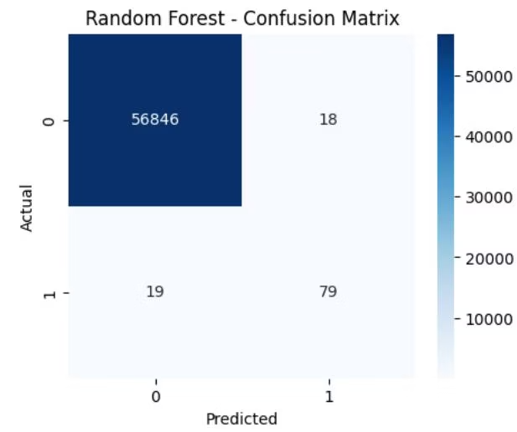
Model Training and Evaluation: Logistic Regression & Random Forest
Logistic Regression
Random Forest
ROC-AUC: 0.946
ROC-AUC: 0.903
High recall but low precision on fraud class
Better precision and recall balance
Accuracy around 95%
Accuracy near 99%

Slide 6
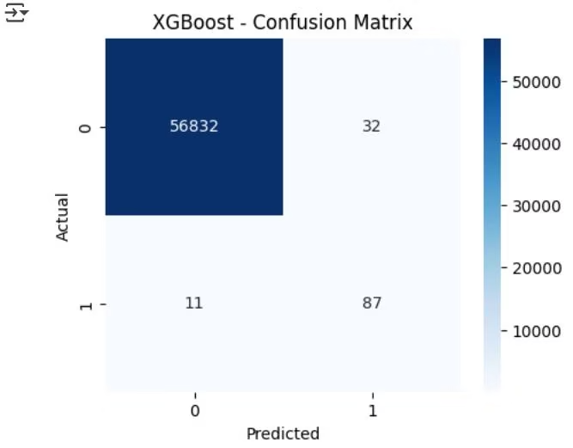
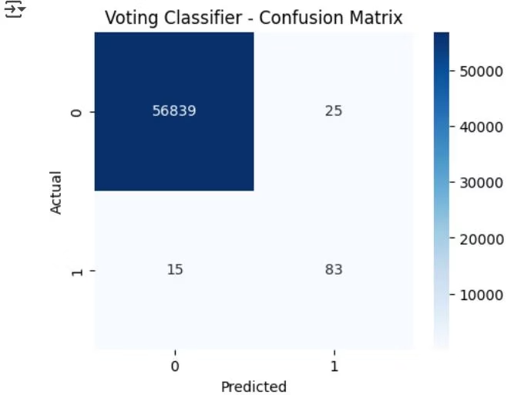
Model Training and Evaluation: XGBoost & Voting Classifier
XGBoost Classifier
Voting Classifier Ensemble
Achieved ROC-AUC of 0.944 with high precision (0.73) and recall (0.89) on fraud detection.
Combined Random Forest and XGBoost models, yielding best overall performance with ROC-AUC of 0.923 and improved fraud recall (0.85).

Slide 7
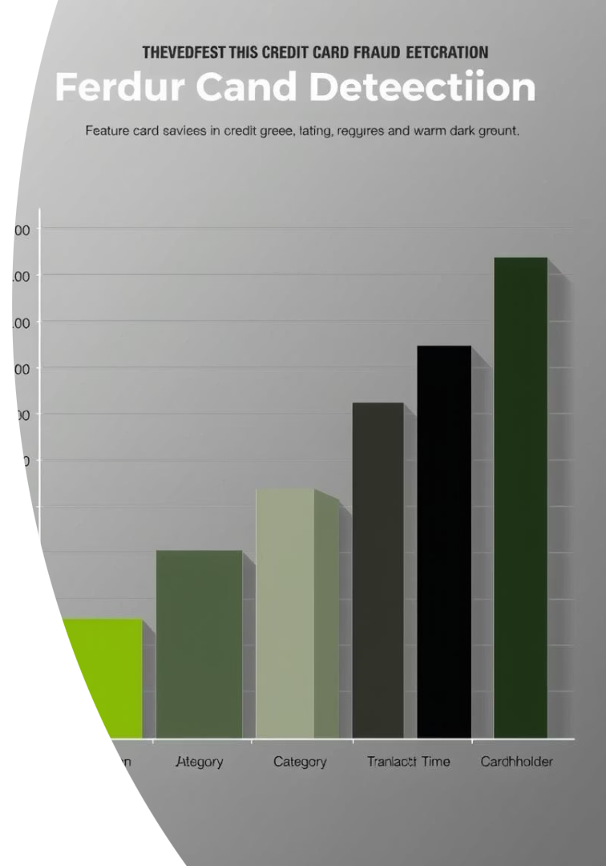
Feature Importance and Visualization Insights
Key Features
Normalized Amount
Some anonymized features like V14, V17, and V10 showed strong correlation with fraudulent activity.
Normalization of the Amount feature slightly improved model performance.
Confusion Matrices
Visualization confirmed significant improvement in fraud detection after balancing and ensemble modeling.

Slide 8

Conclusion and Next Steps
The developed model effectively detects credit card fraud with high accuracy and low false positives, making it suitable for real-time monitoring systems. It helps financial institutions reduce losses and enhances customer security.
Future work can focus on further tuning, deployment strategies, and expanding the model to adapt to evolving fraud patterns for continuous protection.

