Slide 1
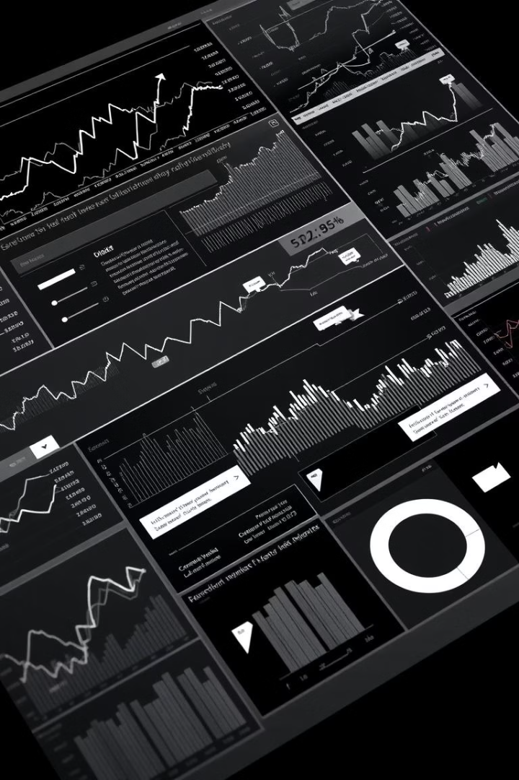

Stock Market Analysis Project
This project analyzes historical stock and cryptocurrency prices to uncover trends and calculate technical insights for informed investment decisions. We explore data preprocessing, exploratory data analysis, and feature selection using technical indicators. The goal is to provide actionable insights into market behavior and help identify optimal entry and exit points for trading.
by Sujata Raut

Slide 2
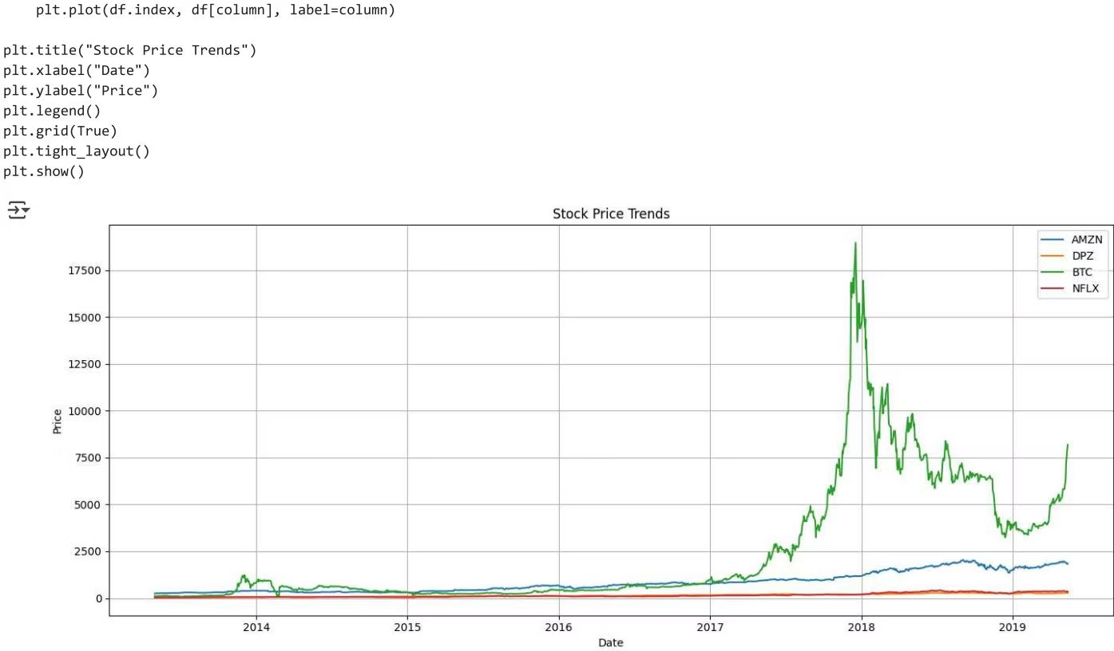
Data Preprocessing and Initial Overview
Data Cleaning
Initial Trends
The dataset was loaded and the 'Date' column converted to datetime format and set as the index. Missing values were checked and handled using linear interpolation, ensuring a clean time series for analysis.
Amazon (AMZN) and Domino's Pizza (DPZ) show steady growth, Netflix (NFLX) trends upward with fluctuations, and Bitcoin (BTC) exhibits high volatility with rapid growth and sharp declines, highlighting its speculative nature.

Slide 3
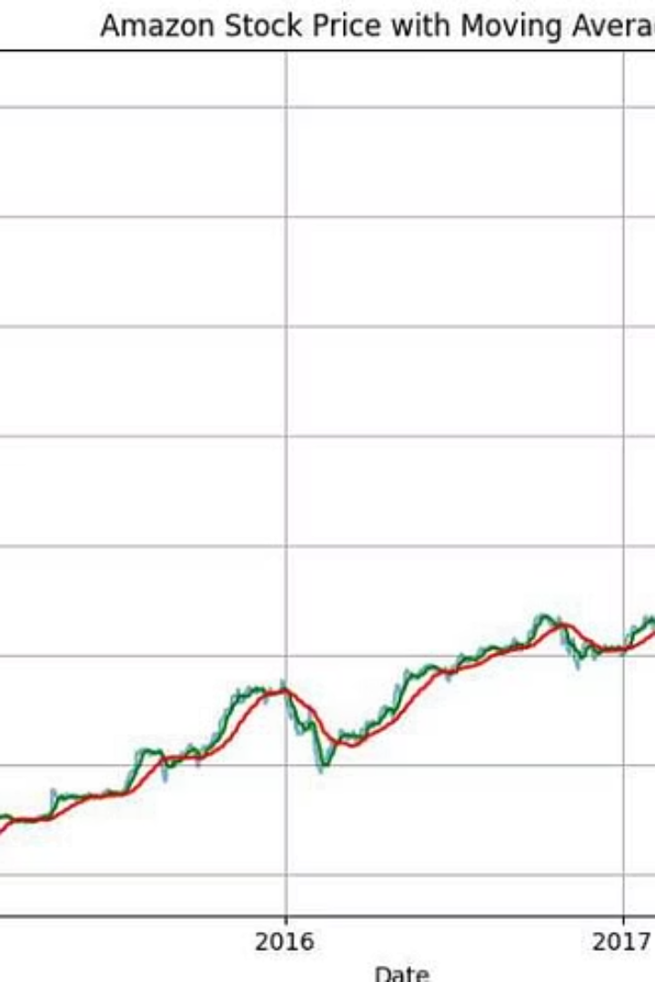
Moving Averages Reveal Trend Momentum
Short- and Long-Term Trends
Buy and Sell Signals
The 7-day and 30-day moving averages smooth price fluctuations, revealing consistent upward momentum for Amazon stock.
When the short-term average crosses above the long-term average, it signals potential buying opportunities; crossing below suggests possible trend reversals or dips.
Trend Clarity
Moving averages help filter noise, making it easier to identify sustained trends compared to raw price data.

Slide 4
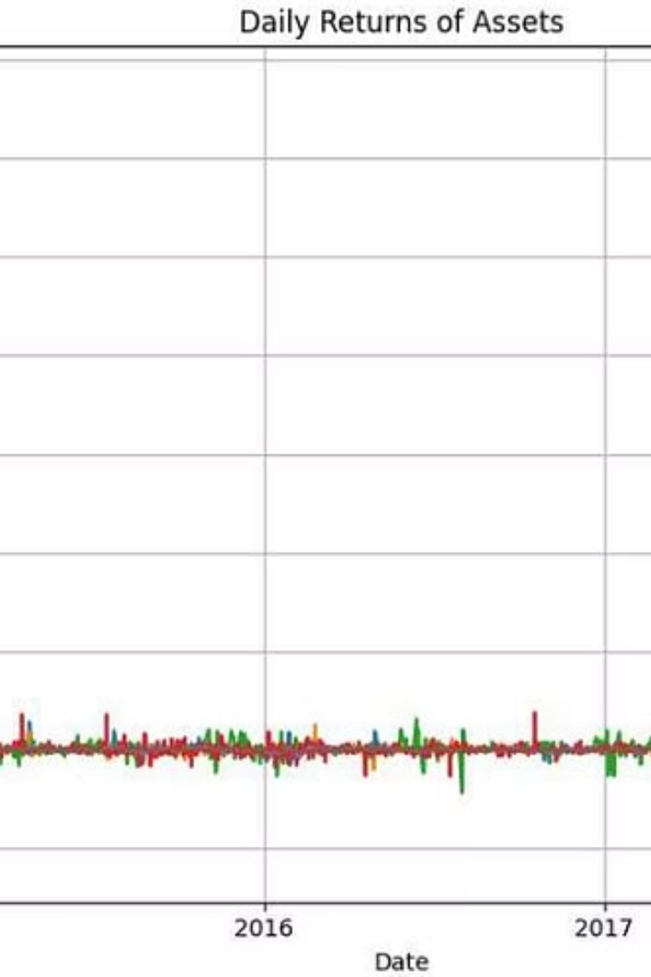
Daily Returns and Volatility Analysis
Volatility Differences
Stock Stability
Bitcoin shows the highest volatility with sharp spikes and dips, reflecting its high-risk, high-reward nature.
Stocks like Amazon, Domino's, and Netflix have smaller, steadier fluctuations, indicating more predictable behavior.
Market Influences
Extreme spikes, especially in Bitcoin, may be driven by market news, hype cycles, or regulatory events.

Slide 5
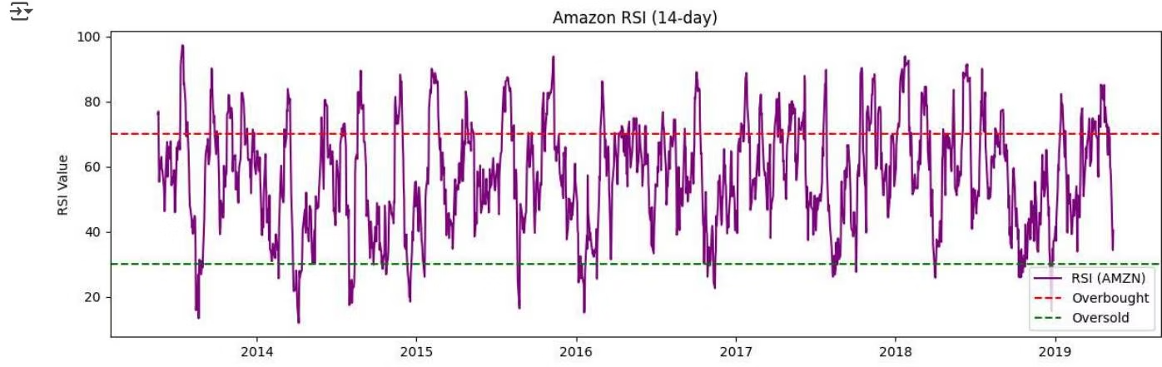
Relative Strength Index (RSI) for Amazon
Momentum Indicator
Market Behavior
RSI oscillates between 0 and 100, indicating momentum strength. Values above 70 suggest overbought conditions, while below 30 indicate oversold zones.
Amazon's RSI frequently enters both zones, reflecting active short-term price swings and healthy market dynamics without prolonged extremes.

Slide 6
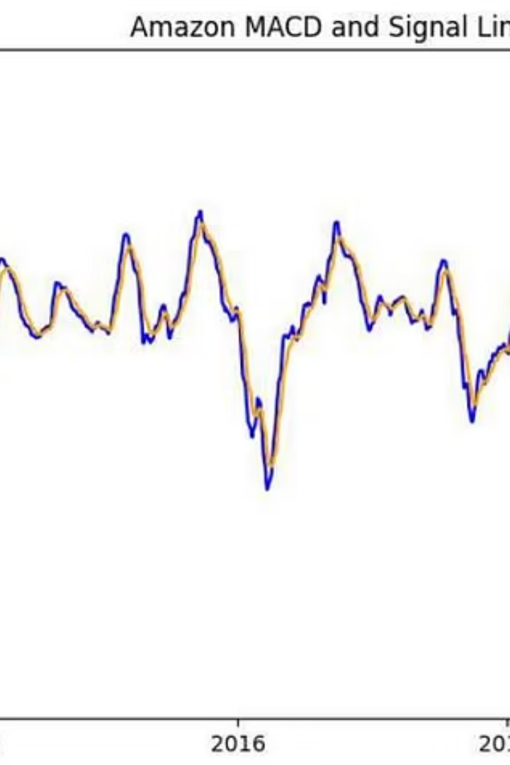



MACD Signals for Trend Reversals
Bullish Signals
MACD line crossing above the signal line indicates potential buy opportunities.
Bearish Signals
Crossing below the signal line suggests potential sell signals or trend reversals.
Momentum Strength
Larger gaps between MACD and signal lines reflect stronger momentum shifts, with frequent crossovers signaling active trading opportunities.

Slide 7
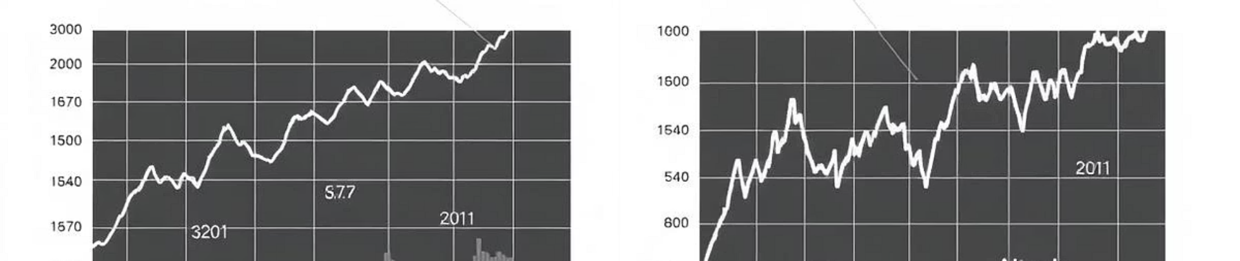
Summary of Key Insights
Trend Analysis
Volatility & Returns
Technical Indicators
Amazon, Domino's, Netflix, and Bitcoin show distinct long-term growth patterns, with Bitcoin being notably more volatile.
Daily returns highlight sharp fluctuations in Bitcoin, while stocks exhibit steadier trends and moderate volatility.
RSI identifies overbought and oversold zones; MACD reveals trend reversals and momentum shifts, aiding timing decisions.

Slide 8
Investment Implications and Next Steps
Moving Averages
RSI and MACD
Future Work
Help filter out market noise and clarify trend direction, supporting better investment timing.
Provide actionable signals for entry and exit points by highlighting momentum and trend changes.
Further analysis could include additional technical indicators and real-time data integration for dynamic decision-making.

