Slide 1
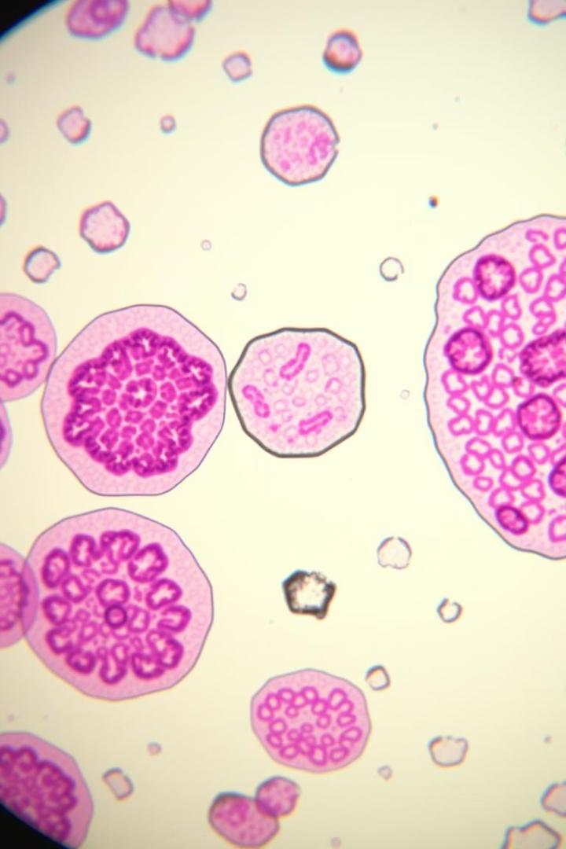

Lung Cancer Risk Analysis
This presentation analyzes a medical survey dataset to identify patterns and behavioral factors associated with lung cancer. We aim to build a predictive model based on lifestyle, age, smoking habits, and other variables.
by Sujata Raut

Slide 2

Project Overview and Data Loading
Project Objective
Analyze survey data to identify behavioral factors and patterns linked to lung cancer. Develop a model to predict lung cancer likelihood based on lifestyle, age, and smoking habits.
The dataset contains 309 entries across 16 columns, including demographic information, lifestyle choices, and various health indicators.
Initial Data Exploration
Dataset Shape: (309, 16)
No missing values detected across all columns.
Data types include integers for most features and objects for 'gender' and 'lung_cancer'.

Slide 3





Data Cleaning and Preprocessing
Review Column Names
Column names were standardized to lowercase and spaces replaced with underscores for consistency.
Check Unique Values
Verified unique entries in categorical columns like 'gender' ('M', 'F') and 'lung_cancer' ('YES', 'NO').
Clean Inconsistent Entries
Standardized categorical values (e.g., 'M' to 'MALE', 'YES' to 1) for uniform analysis.
Handle Duplicates
Identified and removed 33 duplicate rows to ensure data integrity and prevent bias in analysis.

Slide 4
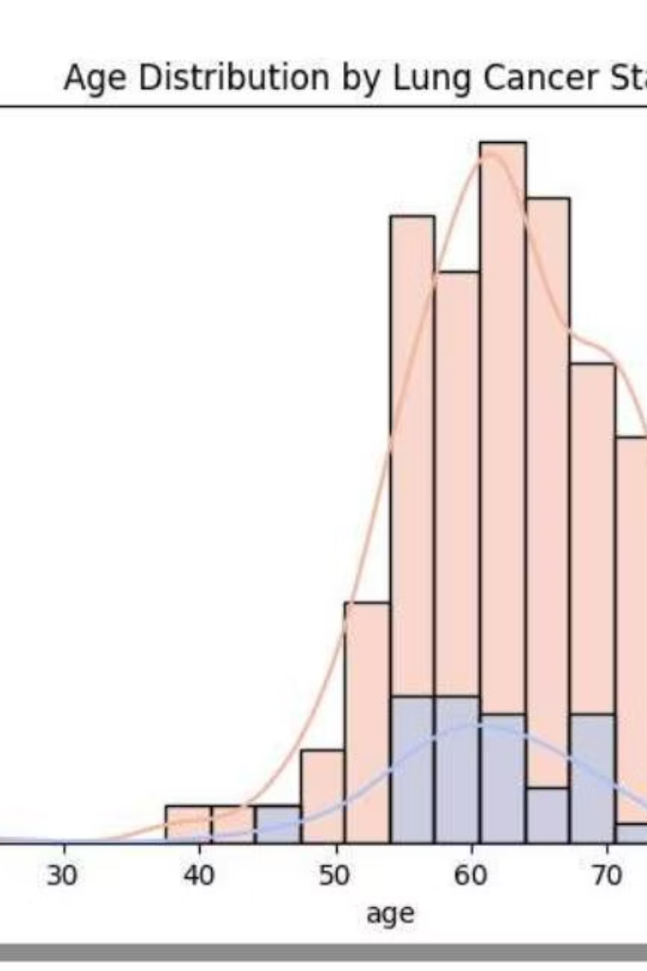



Exploratory Data Analysis (EDA)
Target Variable Distribution
Gender vs. Lung Cancer
The dataset shows a significant class imbalance, with more individuals not having lung cancer. This requires careful handling during model training.
Both males and females show high lung cancer cases, with males slightly outnumbering females, suggesting a potential gender-related pattern.
Age Distribution
Lung cancer cases are most common between ages 55 and 75, peaking around 65, indicating increased risk with age.

Slide 5
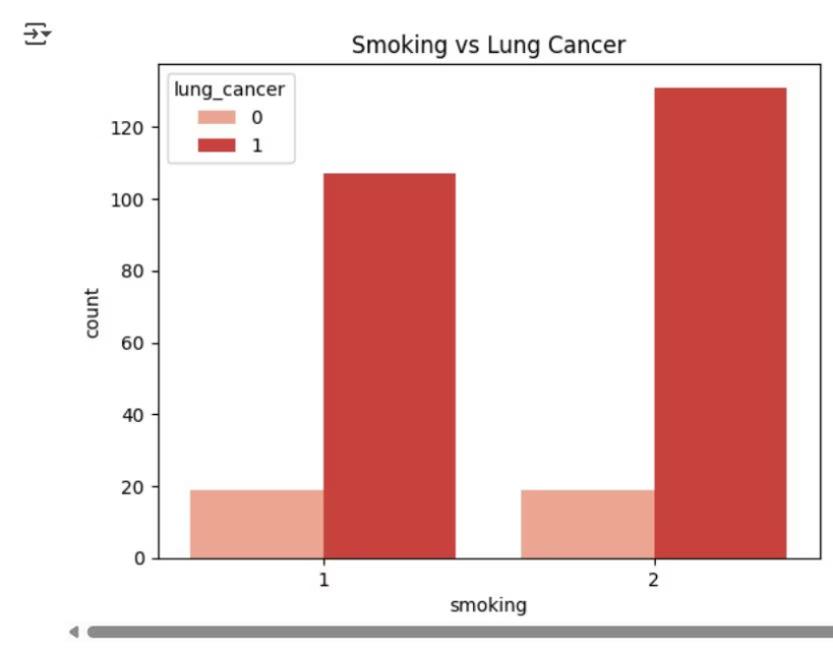
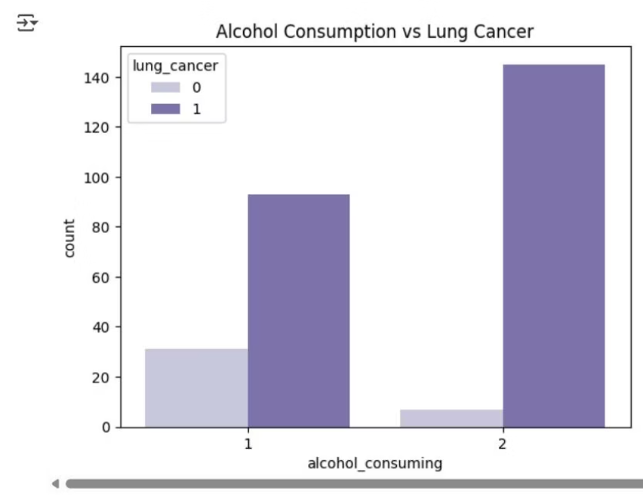
Lifestyle Factors and Lung Cancer
Smoking and Lung Cancer
Alcohol Consumption and Lung Cancer
Lung cancer cases are high among both smokers and non-smokers, but slightly more prevalent in smokers. This suggests smoking is a risk factor, though not the only one.
The distribution of lung cancer cases among alcohol consumers and non-consumers also shows a pattern, warranting further investigation into its role as a risk factor.

Slide 6
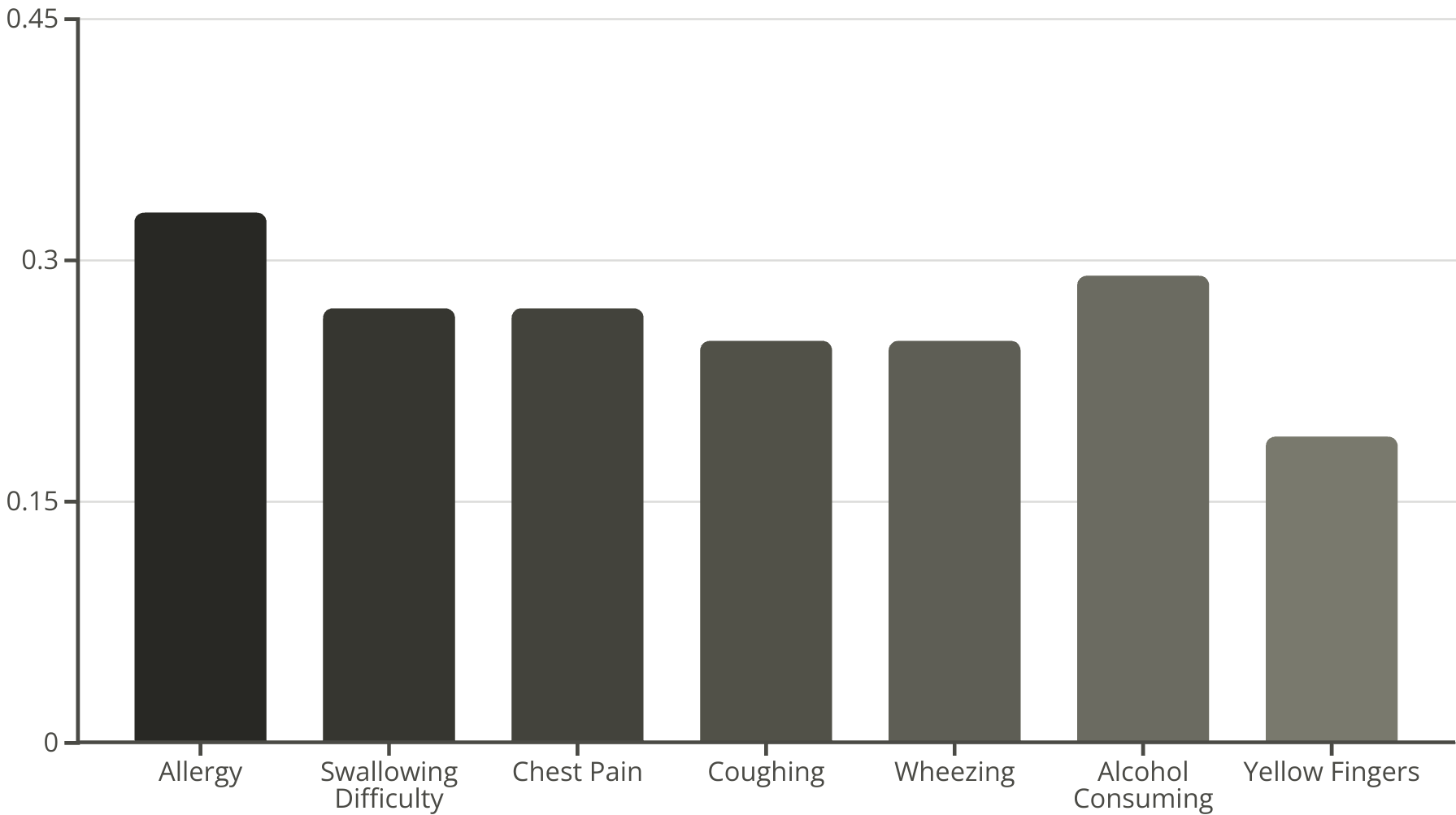
Feature Correlations and Key Indicators
A correlation heatmap reveals the relationships between various features and lung cancer. This helps identify the most influential factors.
Allergy, alcohol consumption, coughing, and swallowing difficulty show the strongest positive correlations with lung cancer. No strong negative correlations were observed.

Slide 7
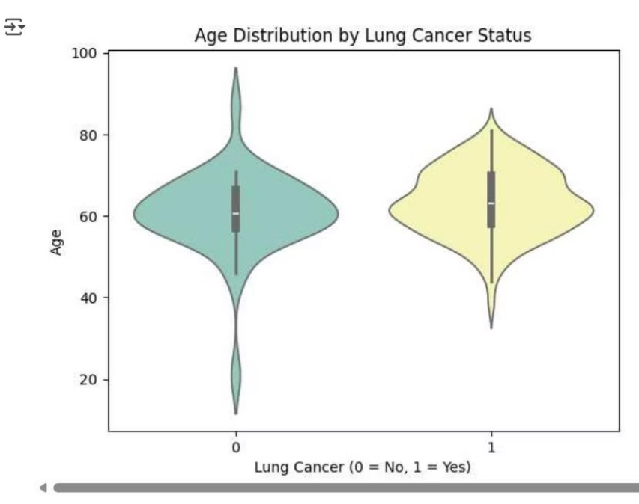
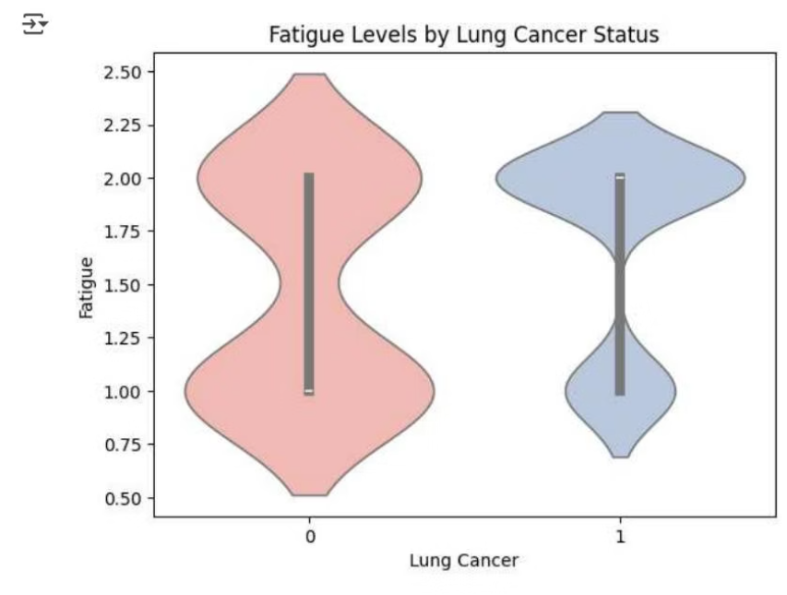
Feature Distributions by Cancer Status
Violin plots provide insights into how feature distributions vary between individuals with and without lung cancer.
Age Distribution
Fatigue Levels
Individuals with lung cancer are generally older, with most cases concentrated around ages 60 to 70.
Most individuals with lung cancer report higher fatigue levels, suggesting fatigue is more common among patients.

Slide 8
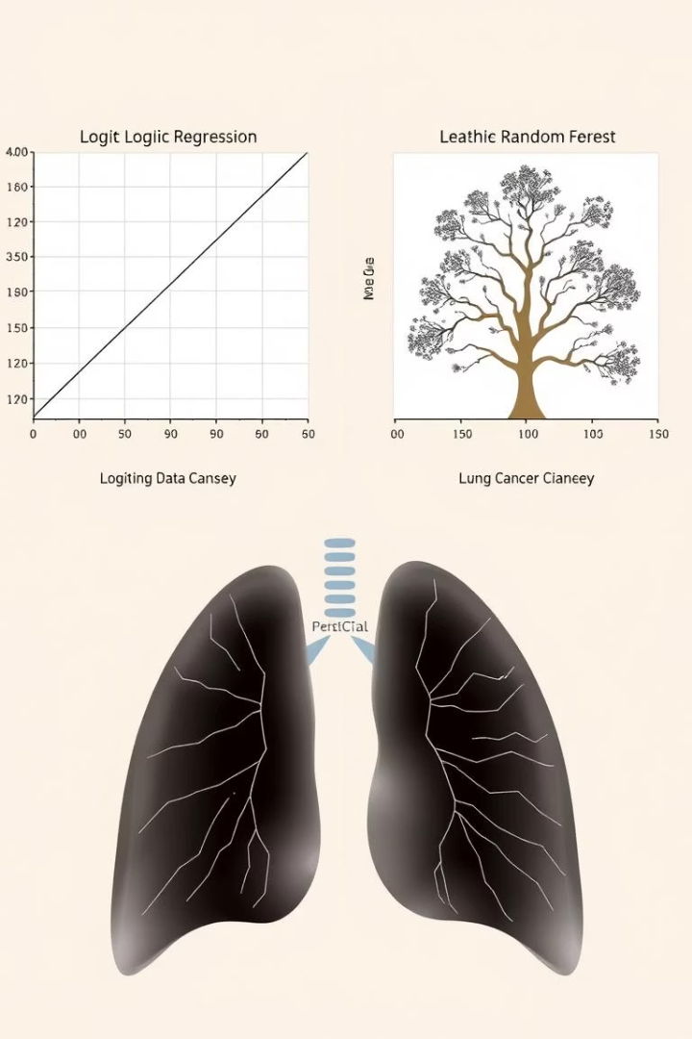
Model Building and Key Findings
Logistic Regression
Random Forest Classifier
Achieved an accuracy of 89.3%. This model provides a solid baseline for prediction, indicating its effectiveness in classifying lung cancer cases.
Performed slightly better with an accuracy of 91.1%. This ensemble method demonstrates robust predictive power for lung cancer risk.
Key Findings
Smoking, alcohol consumption, and chronic disease correlate strongly with lung cancer.
Age is a significant risk factor, with higher age groups showing more cases.
Fatigue, wheezing, and coughing are prominent behavioral indicators in lung cancer-positive individuals.

