Slide 1
METHOD TRACE Analyzer Team : Cloud Coders
Developed By:
Himanshu Tyagi
Shubham Ahirwar
Ishwar Kumar
Ravi Ranjan Gupta

Slide 2
Method TRACE
Method Trace has functionality to analyze the log file and generate the appropriate result
Trace from entry of Java Method to its exit in JVM
Keeps track of the stack trace in case it find
Filter the method in log file based on class name, method name, or both

Slide 3
Method Trace Analyzer
Helps developers to debug the code
Commonly used post-mortem diagnostic method to identify problem
Improves performance and detects errors
Capable of comparing different methods based on the their runtime in graphical form

Slide 4
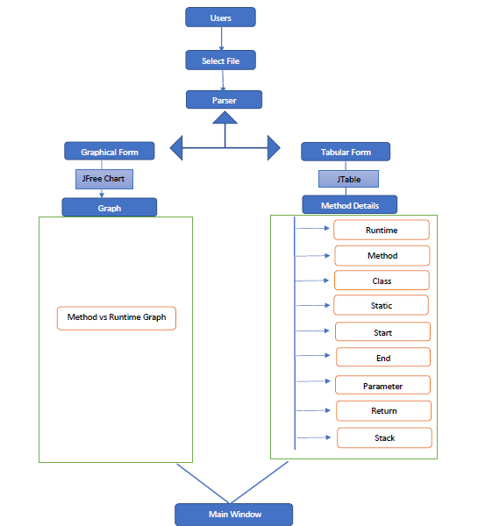
Trace Analyze Flow

Slide 5
Trace Analyze Flow
Method Trace Comparison Flow
File1
parser1
User
Parser
LogComparator
Critical Method
Log Table Creator
StartWindow
File2
parser2

Slide 6
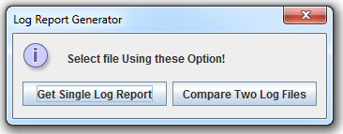
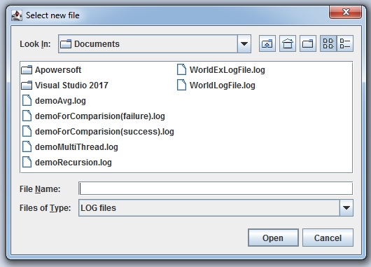
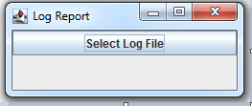
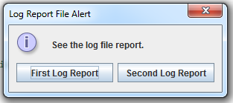
Screenshots

Slide 7
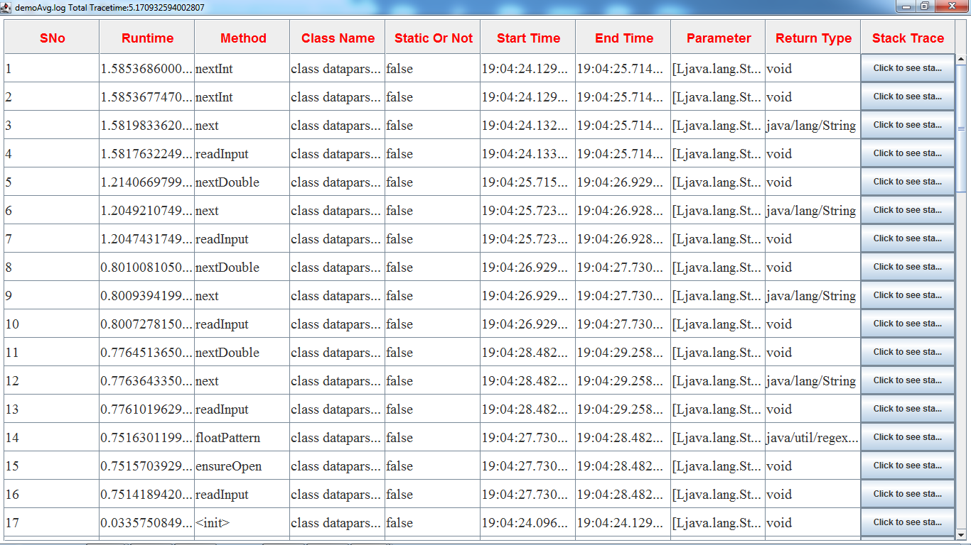
Method trace for single file

Slide 8
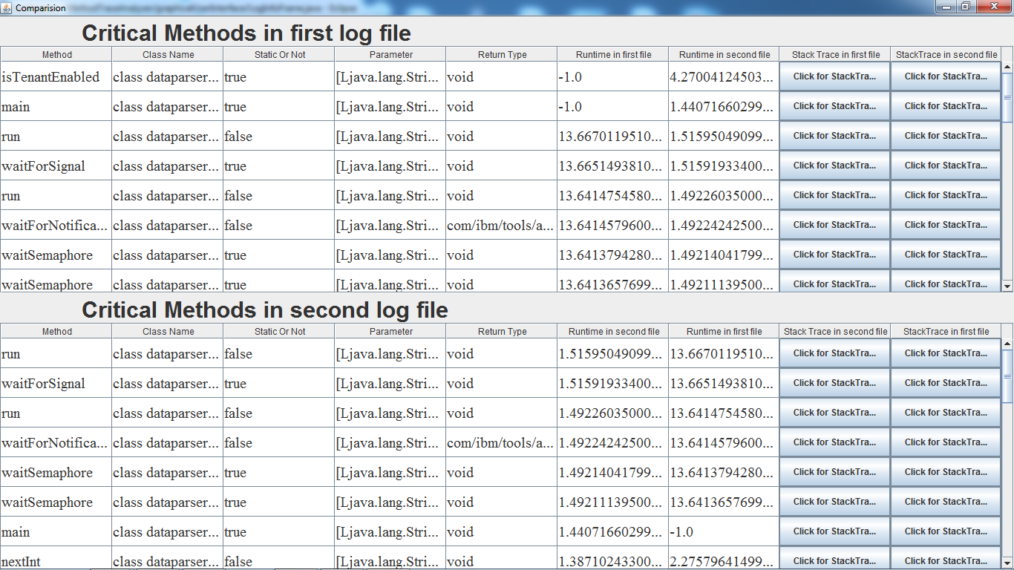
Log Comparison Screenshot

Slide 9
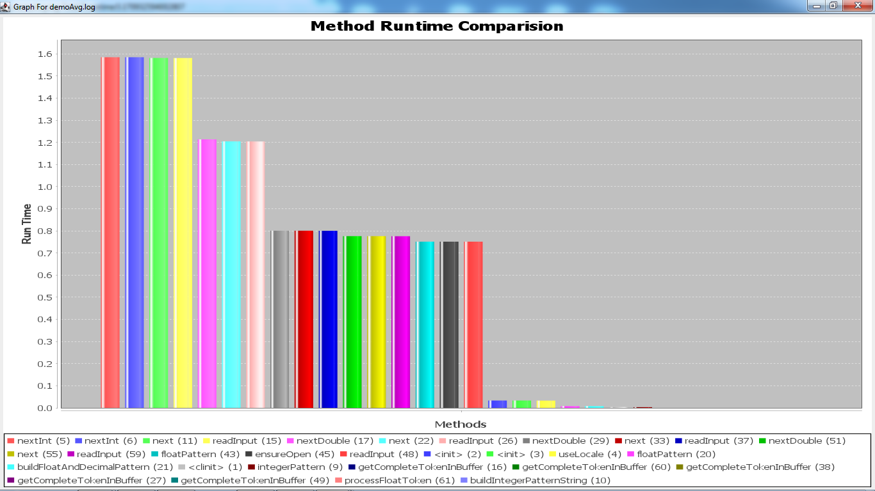
Graphical form of method runtime

Slide 10
Tools used for method trace analyzer
Eclipse Oxygen
Java JDK -8.0.222.10-openj 9
JFree Chart library

Slide 11
Thank You

